Slide 1
NPRR1230: Monitoring and Analysis Update
Congestion Management and Working Group (CMWG)
Matthew Schmidt
10/14/2024

Slide 2
Purpose of NPRR1230 Update
TAC requested periodic updates from ERCOT in terms of monitoring the impacts of NPRR1230
This presentation is the first such update, supplementing counterfactual studies performed for Summer 2023 with data analysis for South Texas Export Interconnection Reliability Operating Limits (IROLs) which were violated on 08/19/24
Note: Since NPRR1230 was implemented on 10/01/24, this presentation addresses a pre-implementation OD
We are seeking discussion and suggestions from CMWG for content focus and frequency of updates moving forward

Slide 3
Recap: NPRR1230
Addresses operating conditions observed in Summer 2023 for what are now the South Texas Export IROLs
ERCOT was previously dependent on using High Dispatch Limit (HDL) overrides to help mitigate the constraint
NPRR1230 increases the Shadow Price Cap for some IROLs
Establishes a transparent method for determining a new Shadow Price Cap for an individual IROL if needed
Security-Constrained Economic Dispatch (SCED) can further manage the IROLs, allowing for the use of market-based tools
Control Room Operators can focus on near-scarcity conditions
Updated Shadow Price Caps ($19,751/MWh) were implemented for the two South Texas Export IROLs (E_PASP, E_PATA) on 10/01/2024

Slide 4
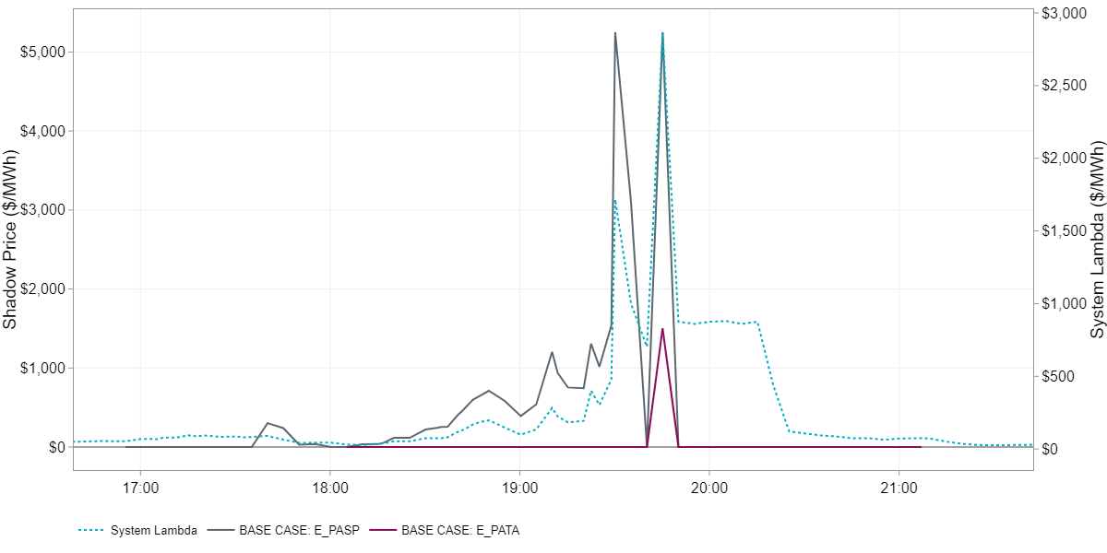
RTM Congestion on South Texas Export IROLs on August 19th, 2024
South Texas Export IROL E_PASP was violated for two SCED intervals (19:30 and 19:45)

Slide 5
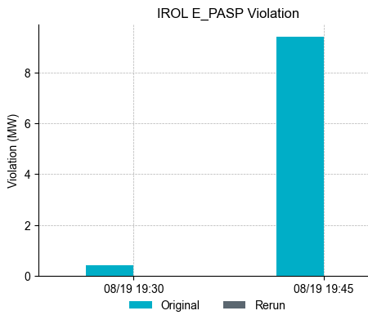
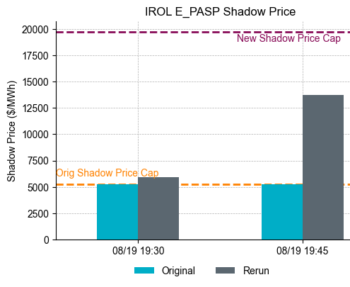
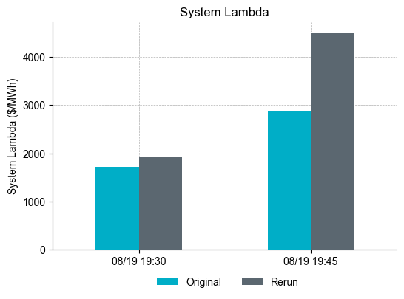
Counterfactual analysis w/ new SP Cap for South Texas Export IROL for violated intervals on 08/19/2024
Rerun analysis performed by increasing Shadow Price Cap on IROLs to $19,751/MWh for each interval in isolation
Differs to TAC analysis since the event occurred post IROL implementation and thus does not introduce model-specific assumptions (only perturbing Shadow Price Cap value)
Violation of IROL E_PASP mitigated with higher Maximum Shadow Price Cap ($19,751/MWh)
Shadow Price of $13,732/MWh necessary to resolve violation.
System Lambda increase of over 50% in the 19:45 SCED interval

Slide 6
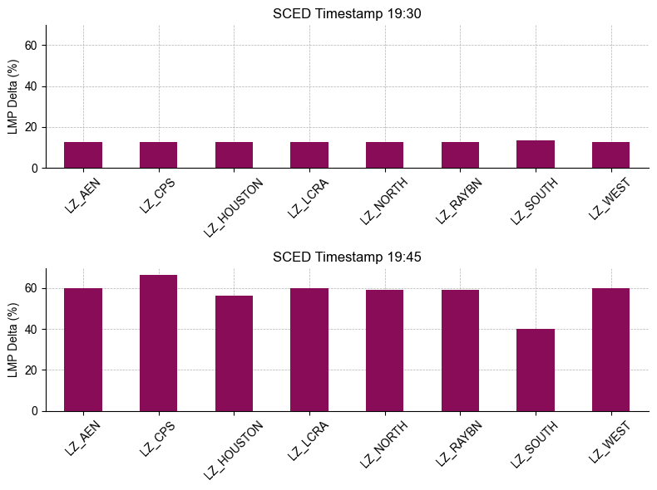
LMP Deltas (%) by SCED Interval and Load Zone
The largest percent LMP difference observed in Load Zone CPS during SCED interval 19:45
Positive LMP difference observed in Load Zone South
Suppressive impact of congestion component outweighed by increase in energy component of LMP

Slide 7
Analysis Questions
What kind of analysis/updates would CMWG like to see moving forward?
How frequent should analysis be provided at CMWG? Event-dependent?

