Slide 1
TEXAS SET UPDATE
RMS: October 15, 2024

Slide 2
UPDATE
Flight 0924: TEXAS SET 5.0
Test Beds: 9/16
Reviewed TEST Scripts and Day 1 Activities

Slide 3
TEXAS SET 5.0 Conversion
Plan
TEXAS SET Conversion will occur the week of 11/4 and will require a market outage over the course of Friday 11/8, Saturday 11/9, and Sunday 11/10
*FINAL Transition Plan TX SET V5.0 chart details all activities during the week of the conversion.
Customer Impacts
Customers will not be permitted to schedule MVIs on 11/8 and 11/9
For lights out emergencies CRs and TDSPs will utilize market approved Safety Net work arounds to assist customers. These workarounds are not intended to replace all orders, but would only be used for emergency requests to energize a premise for the customer

Slide 4
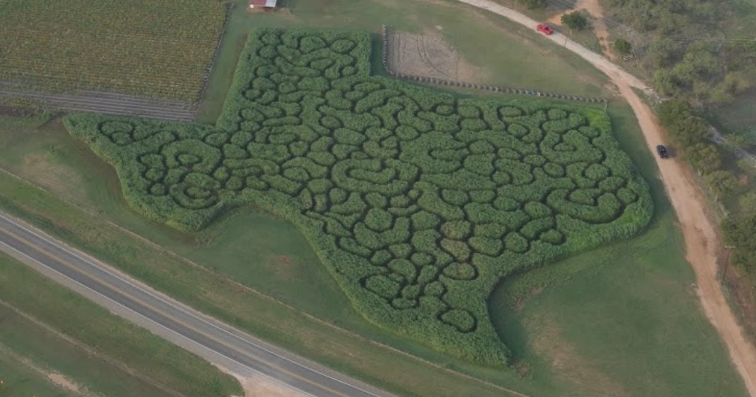
UPDATE
NEXT MEETING
Flight 0924: TEXAS SET 5.0
Test Beds: 9/16
Reviewed TEST Scripts and Day 1 Activities
October 23rd
Joint Meeting
WEBEX Only

