Slide 1
ERCOT IBRTF: Other Industry Updates
Julia Matevosyan
Chief Engineer
ESIG
10/11/2024

Slide 2


UNIFI, Fall Seminar Series, 2024
Register Here
https://unificonsortium.org/

Slide 3





Forum for the Implementation of Reliability Standards for Transmission (i2X FIRST)| 7/30/24
An initiative spearheaded by the Solar Energy Technologies Office and the Wind Energy Technologies Office

Slide 4
Upcoming i2X FIRST Meetings
May 28th, 2024, 11 a.m.- 1 p.m. ET: Introduction of Evolving Standards Landscape
June 25th, 2024, 11 a.m.- 1 p.m. ET: IEEE2800 Ride Through Requirements
July 30th, 2024, 11 a.m.- 1 p.m. ET: IEEE2800 Ride Through Requirements, OEM Readiness
August 20th, 2024, 11 a.m.- 1 p.m. ET: IEEE2800 Ride Through Requirements, OEM Readiness, cont.
September 24th, 2024, 11 a.m.- 1 p.m. ET: Measurement Data for Performance Monitoring and Model Validation
October 24th, 2024 hybrid (in person and online), full day workshop, during ESIG Fall Workshop, Providence, RI: Focusing on Conformity Assessment with applicable interconnection requirements, e.g. IEEE2800
November 26th, 2024, 11 a.m.- 1 p.m. ET:
December 17th, 2024, 11 a.m.- 1 p.m. ET:
January 28th 2025, 11 a.m.- 1 p.m. ET:
February 25th 2025
March 20th, 2025 hybrid full day event during ESIG Spring Workshop, Austin, Texas
Sign up for all future i2X FIRST Meetings here: https://www.zoomgov.com/meeting/register/vJItceuorTsiErIC-HInpPbWuTUtrYQAuoM#/registration
Follow DOE i2X FIRST website: https://www.energy.gov/eere/i2x/i2x-forum-implementation-reliability-standards-transmission-first for meeting materials & recordings and for future meeting details & agendas

Slide 5
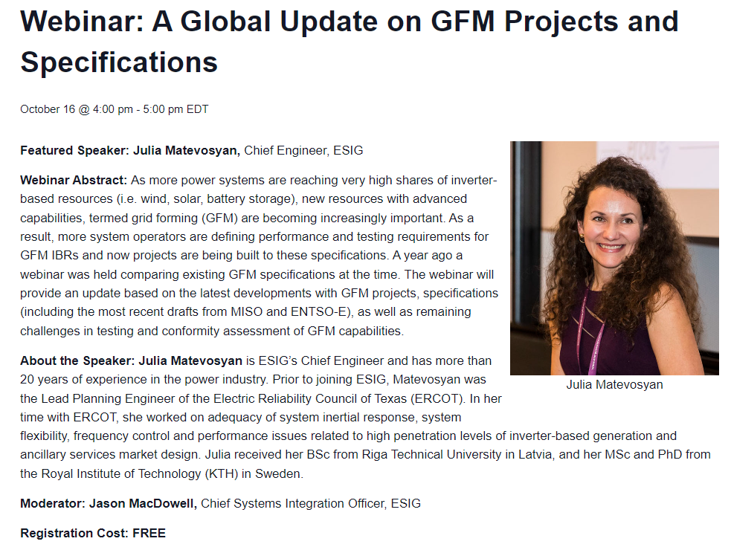
ESIG Webinar: A Global Update on GFM Projects and Specifications
Register Here

Slide 6
Julia Matevosyan
julia@esig.energy

