Slide 1
Lubbock Retail Integration Task Force – LRITF October 15th, 2024
Chris Rowley Michael Winegeart Sheri Wiegand

Slide 2
LRITF meeting 9/10/24 & weekly market call update
The Task Force reviewed the following:
Decimals –Further discussions will be held on the absence of decimal language in the TXSET guides for certain QTY and MEA segments. LP&L is sending up to six decimal places for the reads and values on the 867s, yet only two places on the 810s.
LSE files – LP&L indicated gap retrieval is in place, however, automated process to send reversioned files is still being tested. In the meantime, LP&L to manually send all LSE files prior to true-up settlement. LP&L working to develop a process utilizing ERCOT Missing Settlement Data reports and target resending of data.
LP&L’s Proposed Tariff – LP&L reviewed at a high level the proposed revisions to their tariff effective November 1, 2025:
Separating the Franchise Fee from the Delivery Service Fee. SAC04 will be ADJ006 Franchise Fee Adjustment
Two new discretionary fees are planned:
PMVI for AMSM and non-standard meters – a fee of $75 will be assessed under SAC04 SER019 Service Connection
Clearance requests received within 3 days of requested date – a fee of $150 will be assessed under SER021 Requested Clearance Request
“Demand charges for off cycle switches will be adjusted as necessary” is not automatically programmed in their systems

Slide 3
Daily Market Calls Stabilization issues
The weekly market calls will be held on Thursdays @ 10:00 AM to discuss any on-going issues:
https://us06web.zoom.us/j/89361889543?pwd=olviNzrBXvZJHnEHKgOUZprYTpSDDV.1
Meeting ID: 893 6188 9543
Passcode: 112233
DNP 650_01 RCNs processing – Fix to not push DNPs out two days with an ROL indicator is in production; RCN fix is still being tested; customers charged incorrect premium fee will be cancel/rebilled for standard $30 fee; LP&L working on appropriate cancel/rebilling fix to credit customers
867 IDR–Originally ESG systems were translating dates incorrectly thus causing issues, fix should be in place; next issue, LP&L was missing information in EDI and working to correct; also, an interval summary issue is closer to a solution
Siebel Changes for Out of Sync conditions– ERCOT working with LP&L to ensure RORs are aligned in systems. LP&L had submitted ~19 MarkeTraks to correct the appropriate ROR and close out open enrollment requests; however, ERCOT provided a list of ~250 MVIs/MVOs requiring review
BDMVIs submitted from transition until mid to late May – LP&L is unable to cancel an 810 for a BDMVI thus they are working to “credit note” the account ensure the REP receives the appropriate refund/credit; still working with Oracle to correct – some notes are placed on MTs indicating issue with cancelling

Slide 4
Daily Market Calls Stabilization issues- continued
810s received, Missing dates on 867s – start/end reads on 867s were missing for some unmetered and metered situations. LP&L is still working with Oracle to send out missing 867s.
867 cancels received, 810 cancel TRAN IDs not aligning – Oracle is working on 810 cancels to accurately tie back to the original 867/810.
Separate 810s for Discretionary Service Charges – the issue was to be corrected in late July and DSCs for DNPs are now being placed on appropriate monthly 810s.
LOA Historical Usage Requests – REP should see reformatted LOA requests to align with RMG.
814_20 ESI Maintenance- LP&L systems are unable to send an 814_20 to update the following: a premise to be reclassified from res vs non-res, address change without GIS approval, and meter type changes (e.g. AMSR to AMSM). Thus, REPs will need to send an MVI on a newly created ESI and an MVO on “old” ESI.
Updated DLFs – LP&L will consider updating DLFs to reflect new data; waiting for data from ERCOT and should submit to ERCOT by October 30th

Slide 5
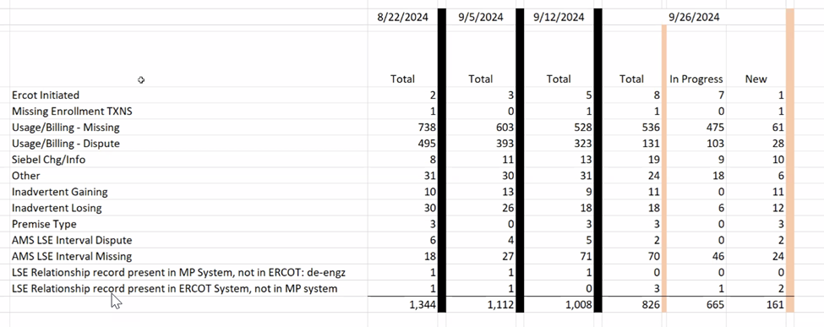
OPEN MARKETRAK STATS as of 9/26/24

Slide 6
Lessons learned
Customers with Multiple ESIs and DREP Process
Find a way to compare before defaulting – possibly provide customers with ESIs on their bundle bill prior to competition; create ESIs earlier in the process
TXSET Guides need updating
We need to take some time and ensure we’ve captured the areas that need to be changed – ‘combo’ 814_05 kH vs KMON; Decimals; generalized practices - perhaps a ‘utility orientation’
Need Regulatory/Legal decisions at beginning of project
Full awareness of any impacting legislation
Early conversations
LP&L has paved the way for additional MOU/ECs
Impact of Cycle Dates locked down and true MVI situations
Impacts stacking logic at go-live
Clear determination so REPs may design systems accordingly

Slide 7
Lessons learned - continued
Phone Number formats & Country Code issue
Update TXSET Guide
Clean data for ESI creation
Avoid creation of ‘bad’ ESIs only to have to retire
Eliminates downstream confusion – customers, REPs
Understanding for Munis, other utilities may be associated
Addresses without descriptions
Systems should be able to use secondary address fields to help avoid inadvertent gain situations
Decimals in meter reads
With AMI being the standard meter type, this is an opportunity to allow decimals in meter reads. We are already using them in IDR situations

Slide 8
Lessons learned - continued
Priority Codes for MVIs &Reconnects
Should be included in the RMG along with other priority codes (service orders)
TDSP Matrices in one location
One place for: AMS Data Practices, Emergency Operating Plans, Solar Practices, Transaction Timelines
Including list in ERCOT opt-in checklist
Online enrollments – what options for multiple ESIs?
Better customer experience if more than one ESI is to be enrolled
Providing a postcard to each customer with ESI information prior to sales window
Cancel/rebill timing and LSE files
This information is not captured in any protocols or guides at ERCOT… it is more of an ERCOT business process that impacts utilities processes. How can we capture for the next entrant? Opportunity to include in operating guide for settlements

Slide 9
Lessons learned - continued
Full testing
Robust end to end testing with ‘real’ data including billing
Awareness of all files and extracts on ERCOT MIS
Understanding of extracts available and purpose of data, Missing Usage Report
WIN! Having a media market in a condensed geographical area resulted in effective communications to the residents
Providing questions for consideration – shopping guide and partnership with PUCT
Knowing the audience and conducting business/enrollments how the community wants to conduct business
Shopping Fairs
Market Participants
Market participants were disengaged until the last minute
Requiring participation in the task force meeting if REP wants to become active in the territory

Slide 10
Lessons learned - continued
EPS Meters
Understanding if territory has EPS meters, Muni will need to accept 867s from ERCOT
Understanding market processes
DCN/RCN processes and billing
ESI Maintenance and updating attributes
ERCOT Settlement Process
Understanding of the settlement differences of BUSIDRRQ, significance of LSE files and reversions, and impacts of cancel/rebills
Smart Meter Texas Onboarding
Expectations and requirements for integration
Updating Distribution Loss Factors
Calculation methodology, expectations and revisions

Slide 11
TIMELINE of Actions
Pro Forma Tariff
Access Agreement
POLR Process
Safety Net Process
Q4 2022
ERCOT Activities: SAC04s, Load Profiles
TSDP Activities: Critical Care, DLFs, Solar/DG, Switch Hold Files, BUSIDDRQ, Call Center, OGFLT, Weather Moratoriums, Proration
LP&L Rates
Customer Enrollment Process – Detailed Timeline
PUCT Complaint Process / Application of PUCT Rules
Transaction Timelines / TXSET Timelines
CSA Process
Q1 2023
Q2 2023
ESI IDs in TDSP Extract
RMG Chapter 8 Revisions
Historical Usage Requests
TDSP AMS Data Practices
Mass Customer Lists
Power to Choose website
Customer Forums/Town Halls
Flight Testing / Bank Testing
Q3 2023
CBCI files
Default REP Selection Process
DNP Blackout Period
Market Operations Group Established
Tampering Information Process
Smart Meter Texas
Q4 2023
March 2024
GO LIVE – Transition to Competition
Completed
Q3 2023
Q4 2023
Q1 2024
Q4 2024 Q1 2025

Slide 12
Lritf meeting 10/15/2024 @ 1:00PM following RMS –via Webex
AGENDA ITEMS:
Decimals -867 vs 810 # of decimal places
AMS Data Practices – Reversioned LSE files
Stabilization
650_01 RCN Processing
DNP Discretionary Service Charges on 810s
867_03 IDRs
Seibel Changes with ERCOT
BDMVIs and 810s
810s not referencing correct 867s
810s received, missing 867s
Missing start/end Reads
Tariff Rate & Discretionary Charge Changes
814_20 ESI ID Maintenance
Open MarkeTraks
LP&L Weekly Market Calls
DLF Updates
TX SET v5.0 Readiness
Lessons Learned
Open Discussion
Meter Read & Holiday calendars

