Slide 1
PDCWG Report to ROS
Chair: Kevin Bunch, EDF Trading North America
Vice Chair: Chad Mulholland, NRG
ROS
October 3rd, 2024

Slide 2
Report Overview & Notes
Report Overview
  Meeting Minutes
    ERCOT Frequency Control Metrics and Regulation Reports
    TRE Report
    Analysis of Disturbances
  BAL-001-TRE-2 FMEs and IMFR
    1 FME in the month of August
  Frequency Control Report

Slide 3
Frequency Measurable Events Performance

Slide 4
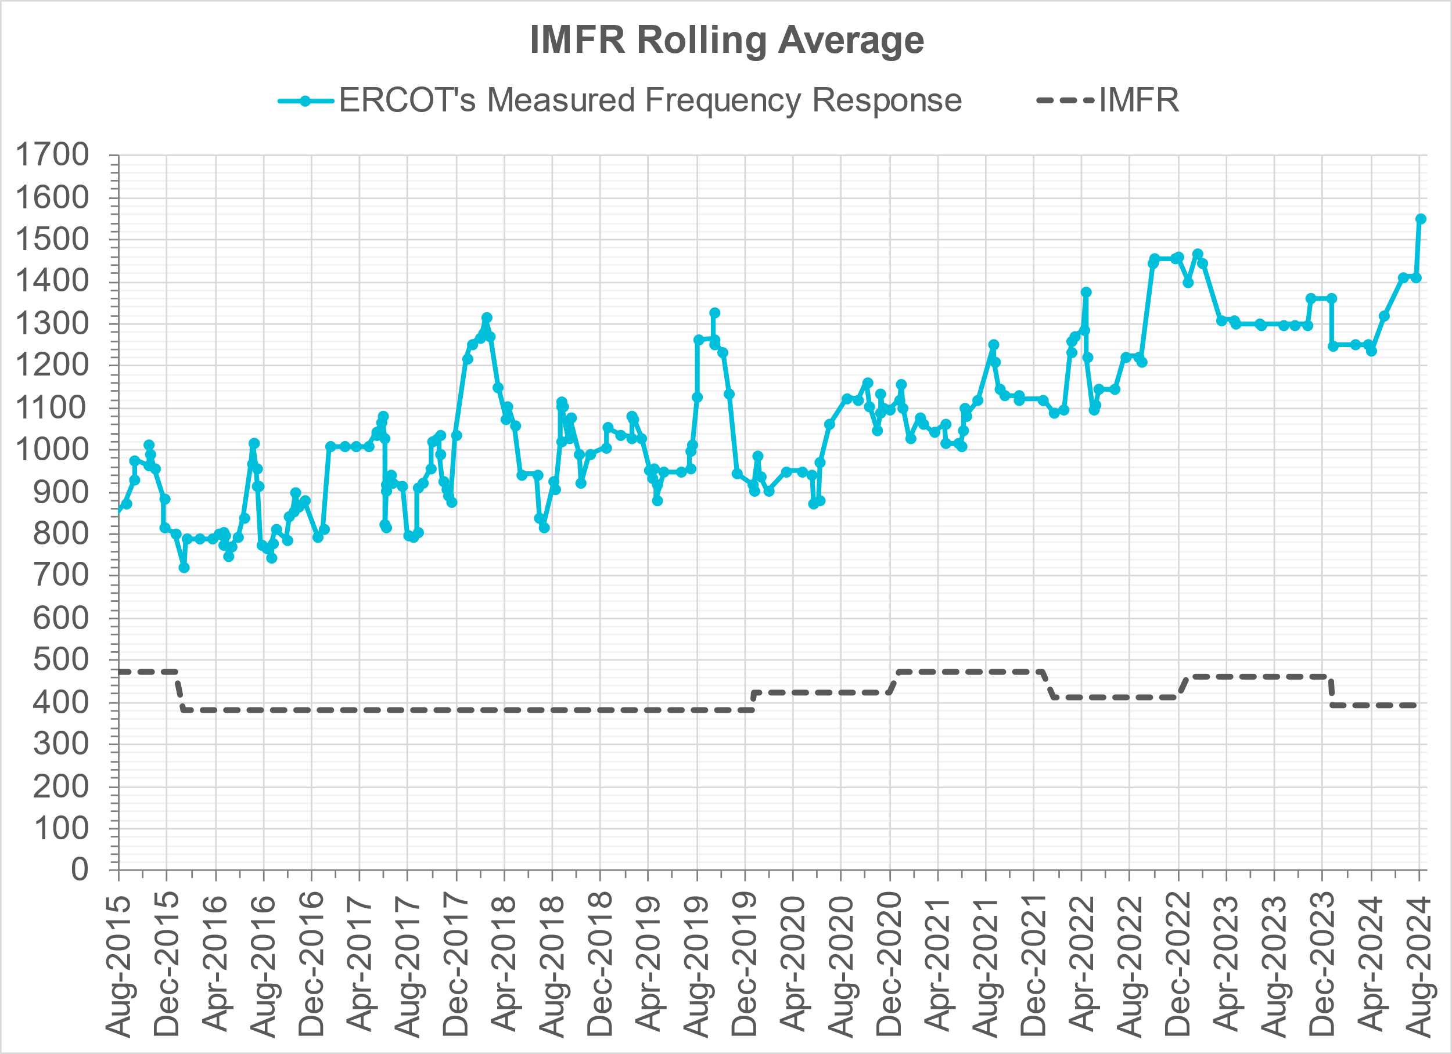
Interconnection Minimum Frequency Response (IMFR) Performance
IMFR Performance currently
1552.00 MW/0.1HZ
Frequency Response Obligation (FRO): 395 MW/0.1 Hz

Slide 5
Questions?

Slide 6
Frequency Control Report
February 2024

Slide 7
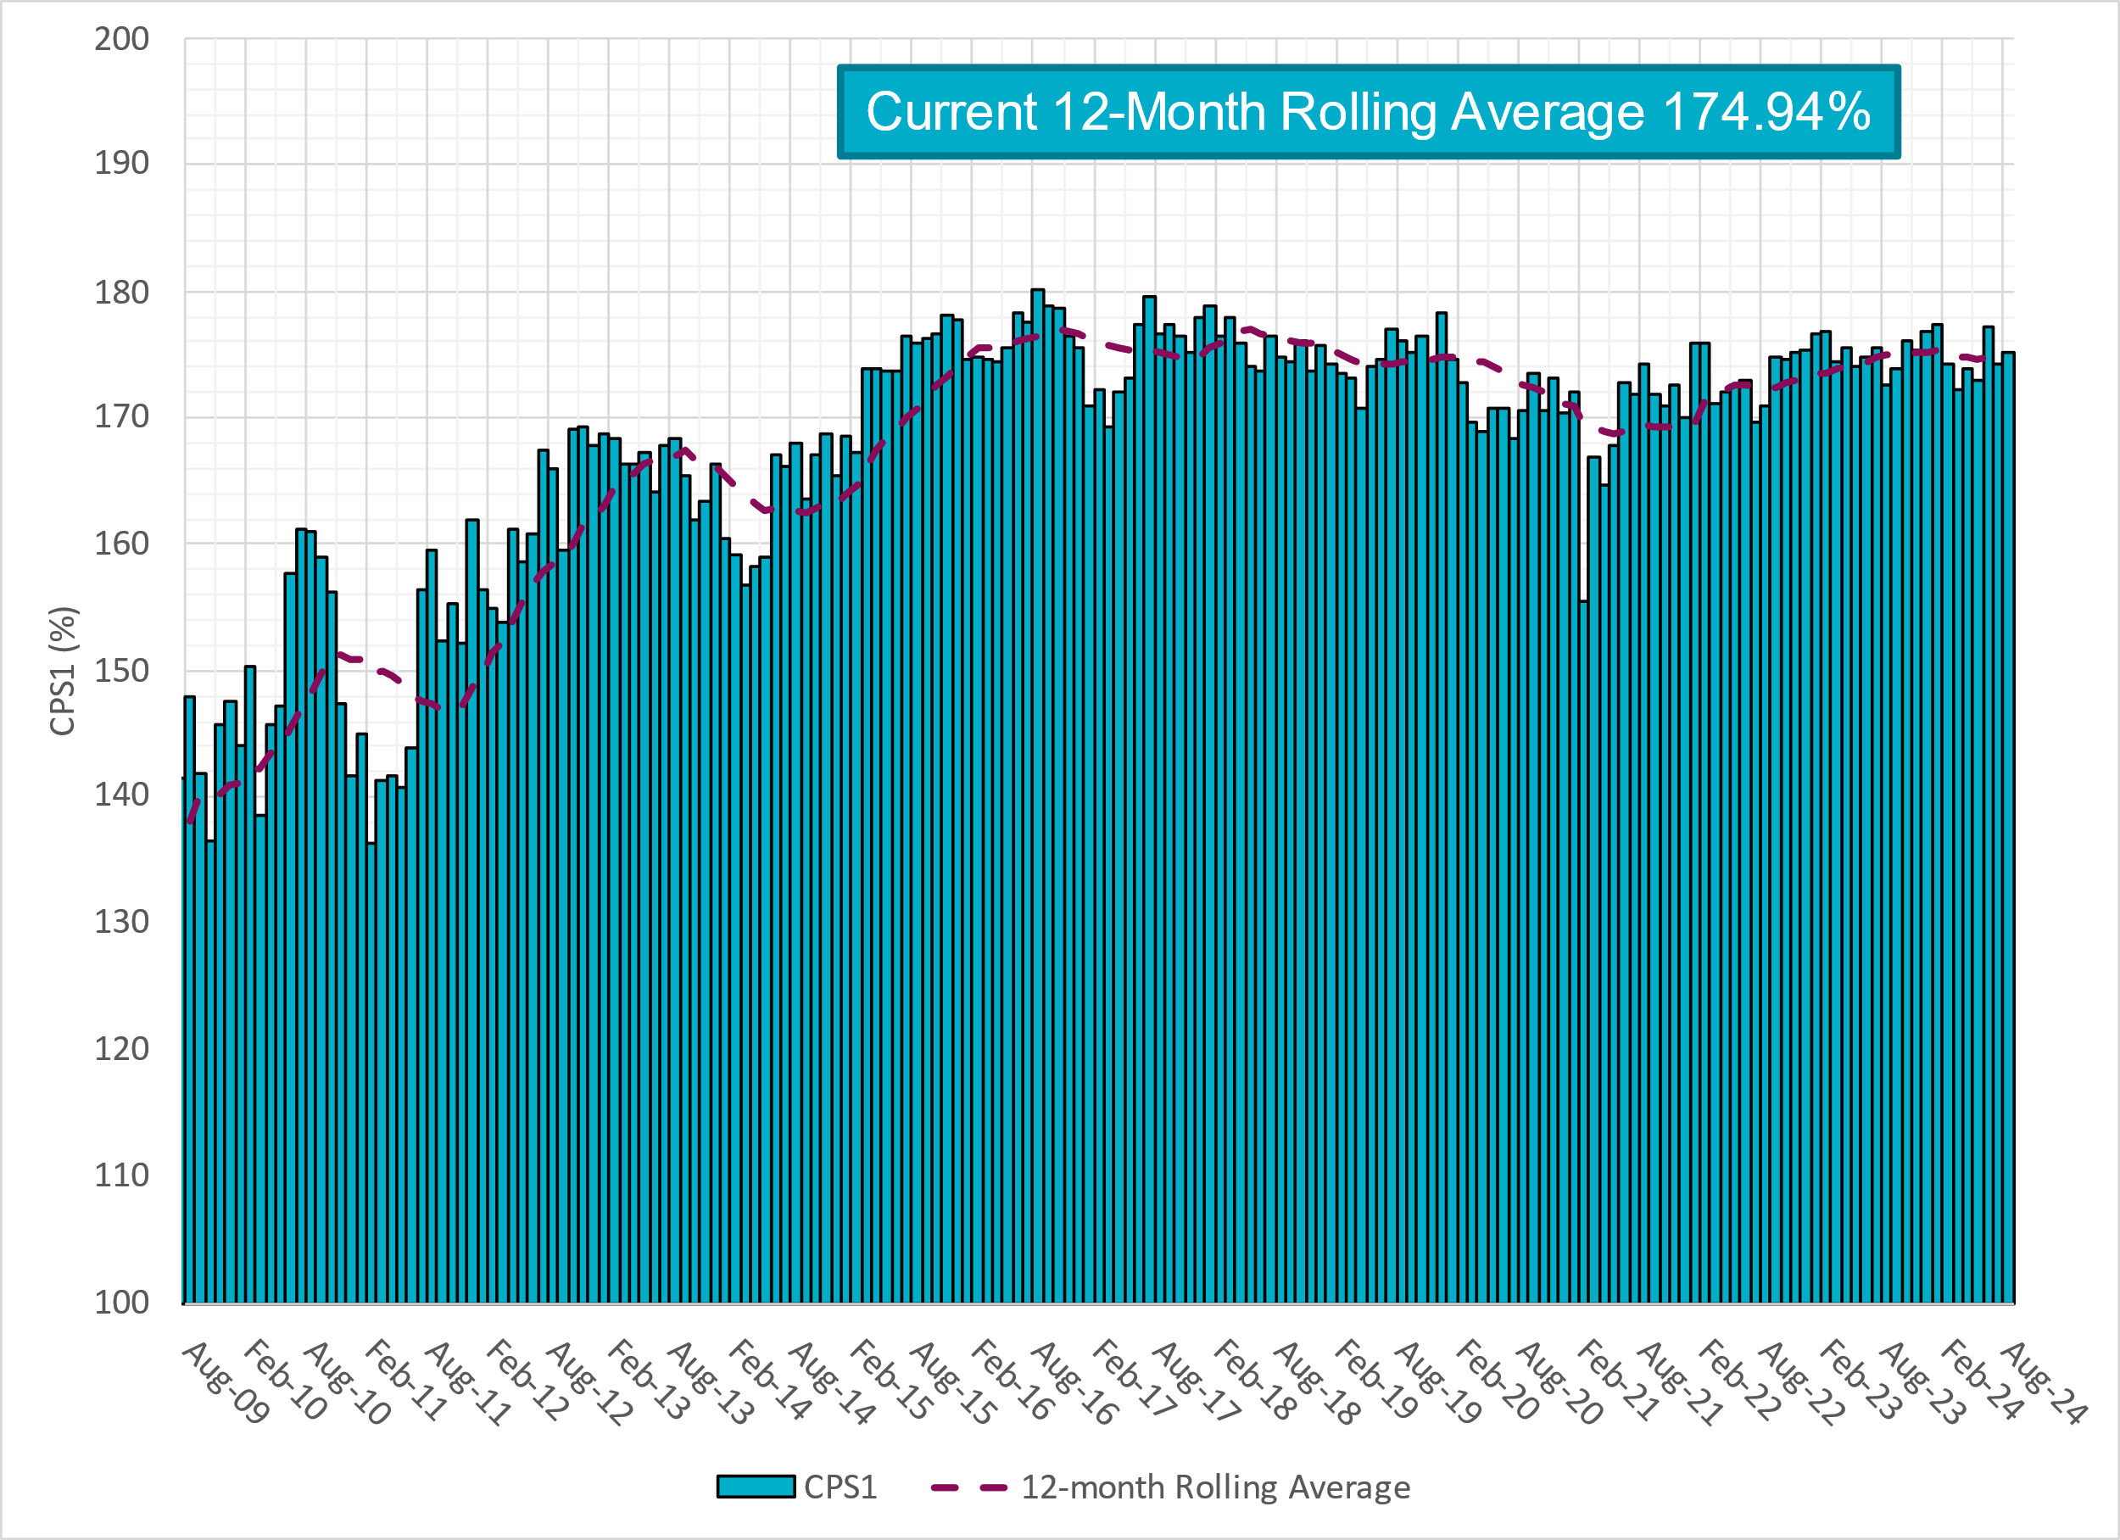
CPS1 Performance

Slide 8
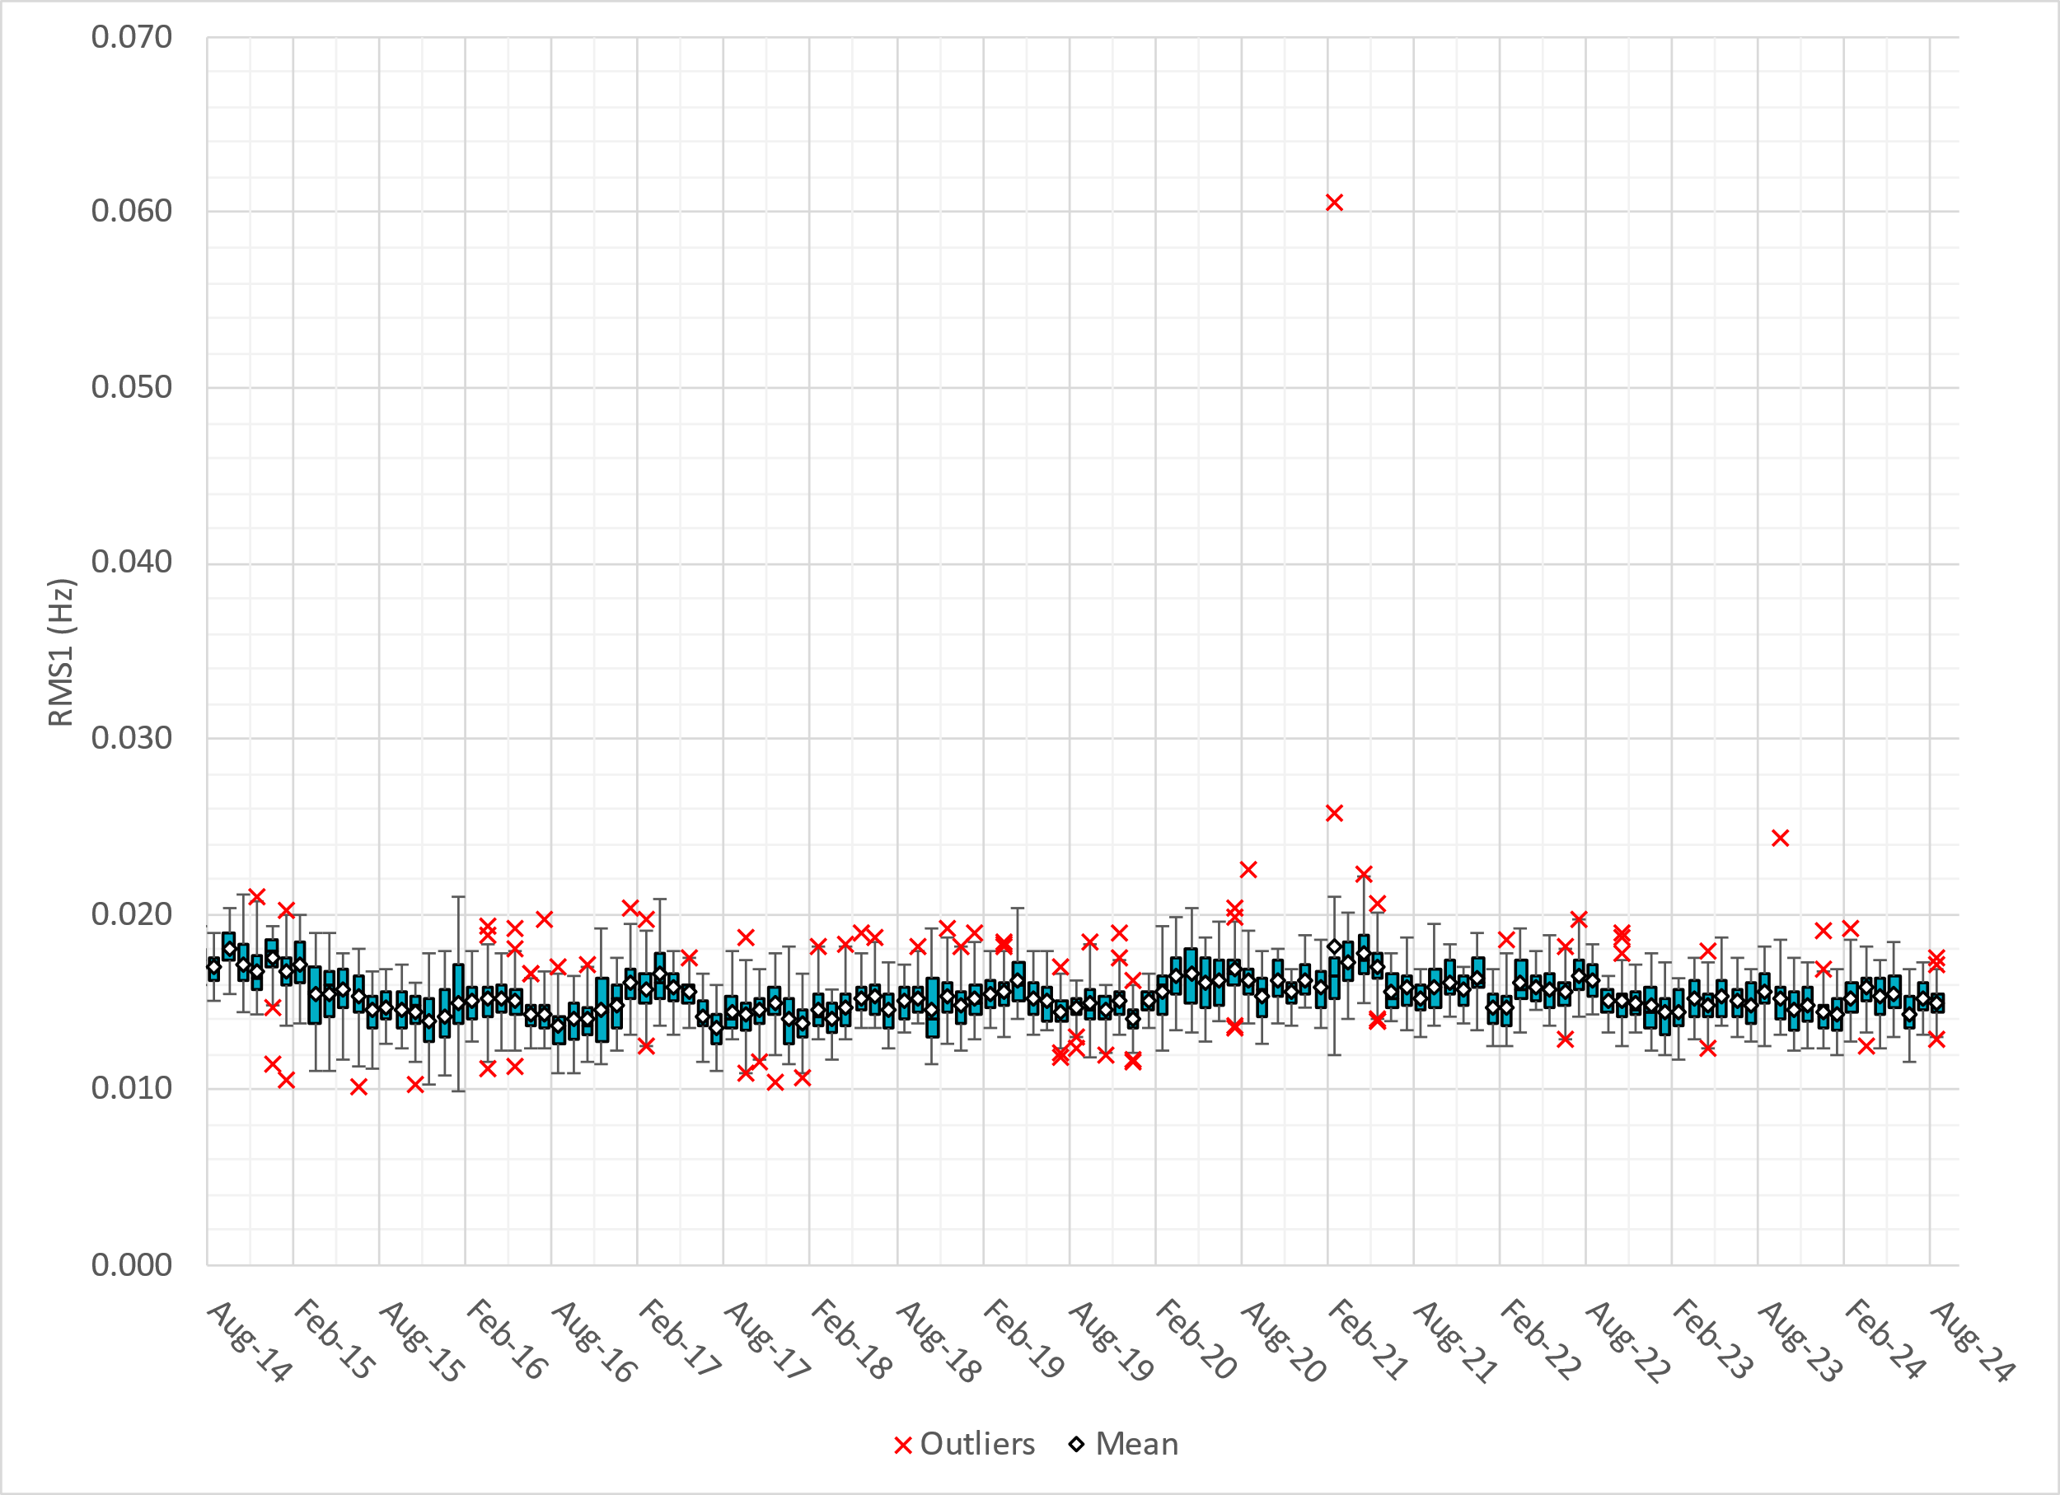
RMS1 Performance of ERCOT Frequency
Notes:
14.94 mHz on avg for August 2024

Slide 9
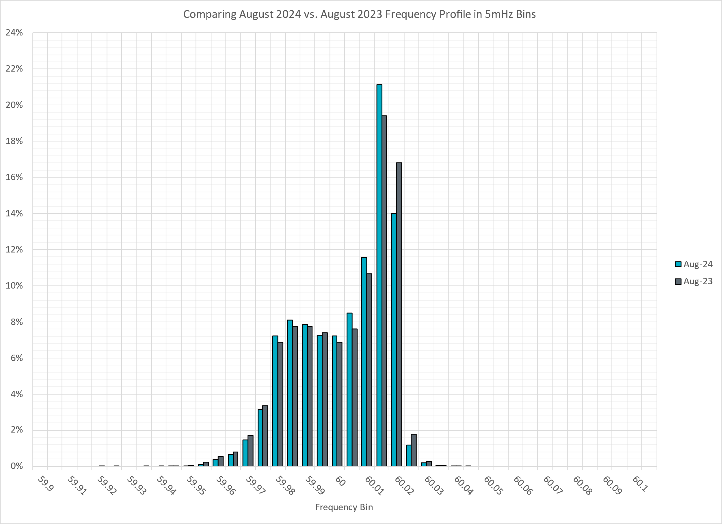
Frequency Profile Analysis

Slide 10
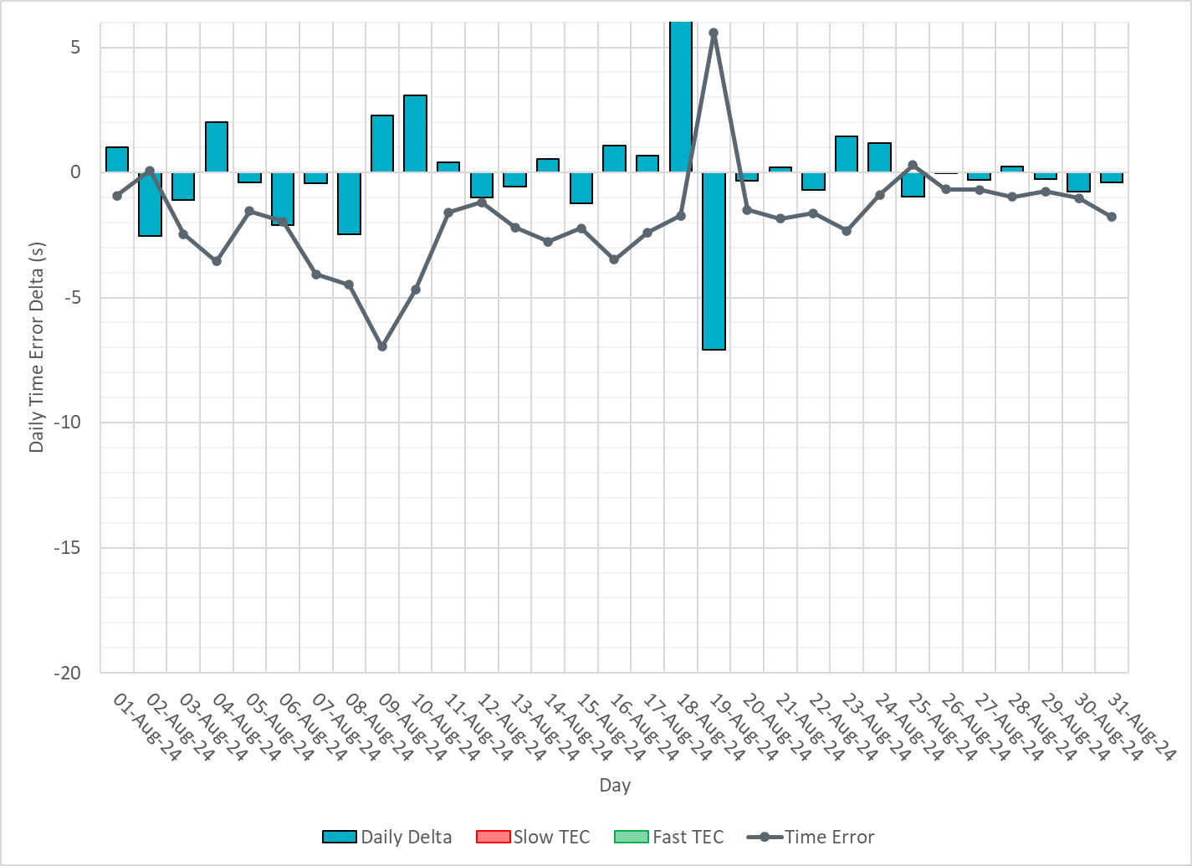
Time Error Corrections

Slide 11
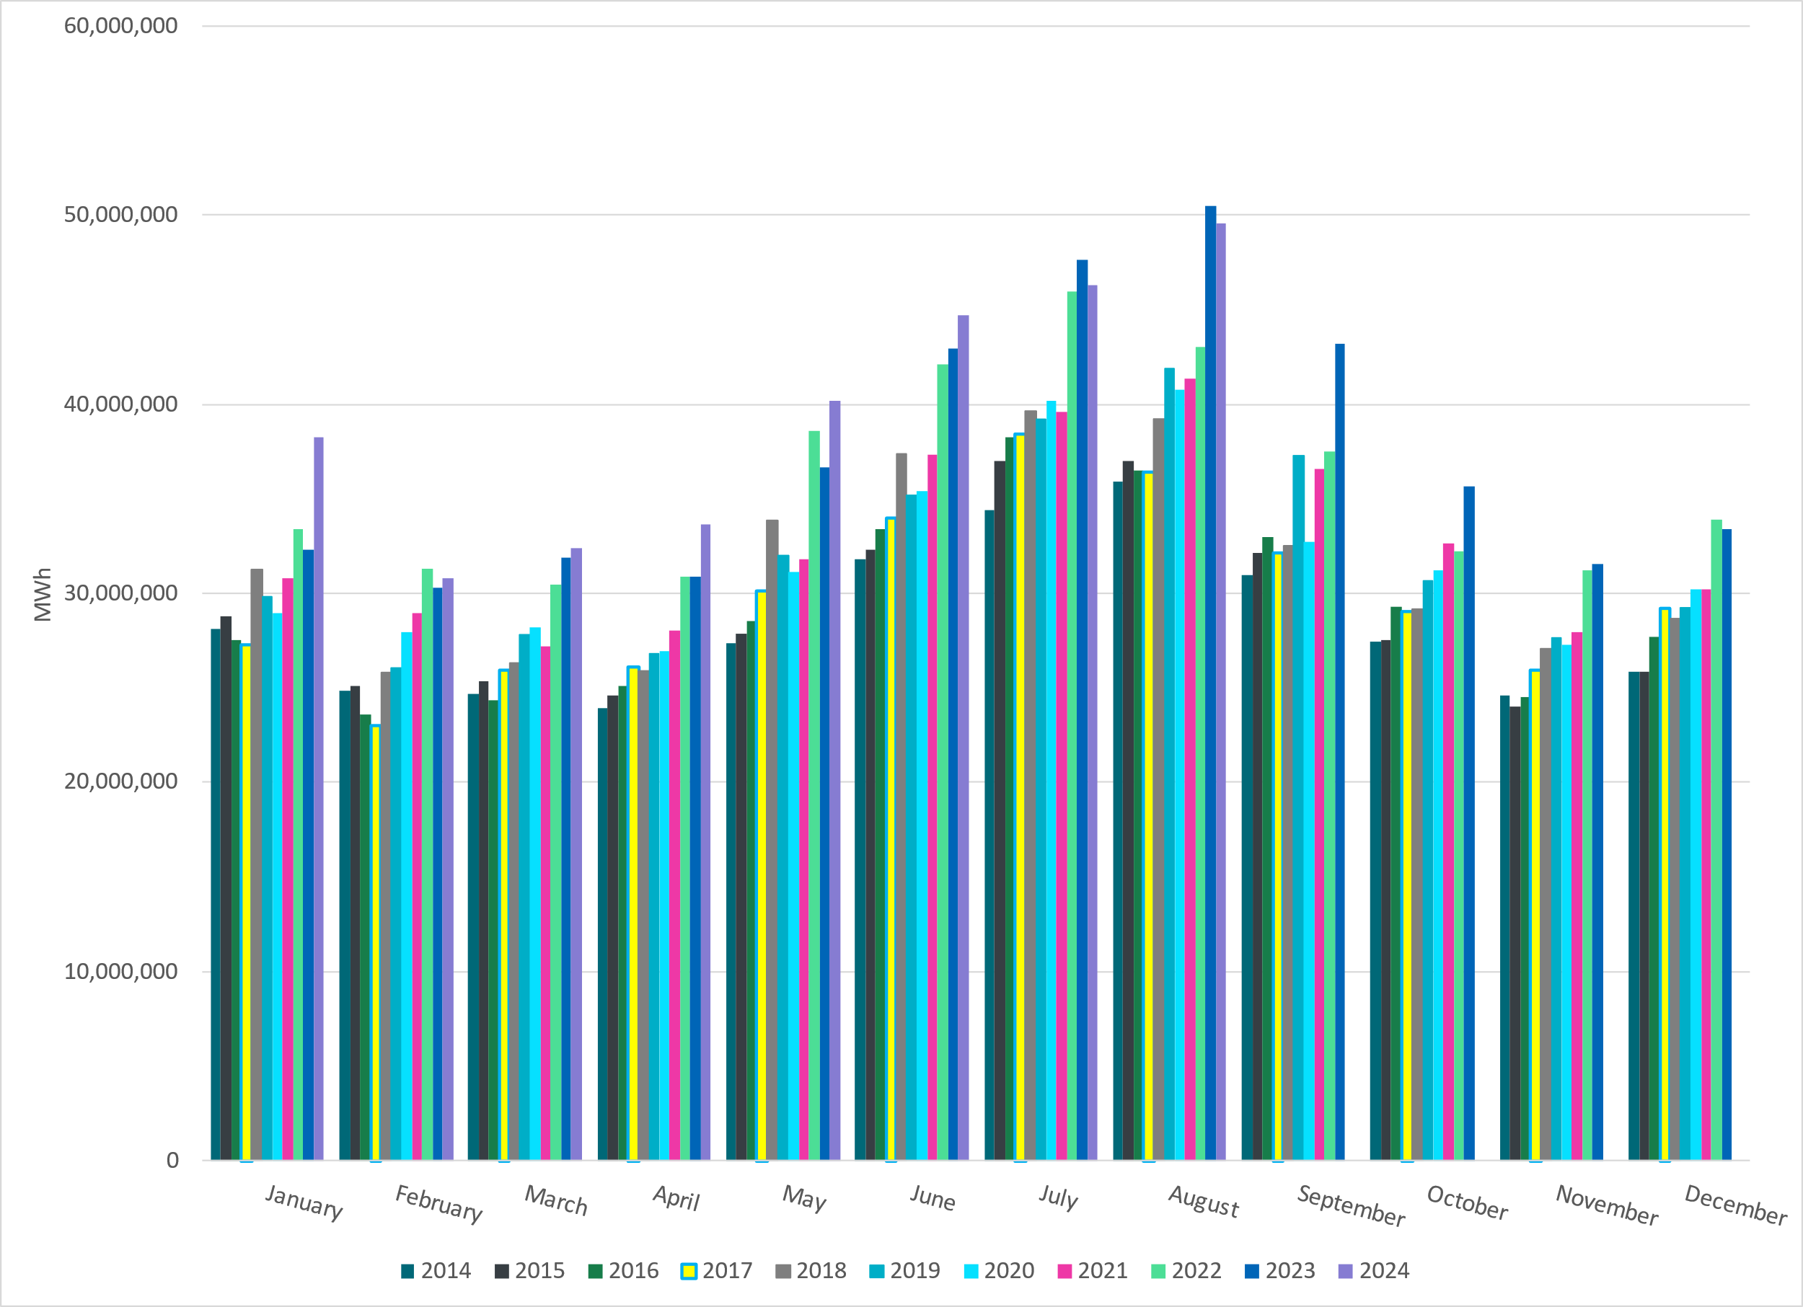
ERCOT Total Energy
Notes:
49,524,061 MWh

Slide 12
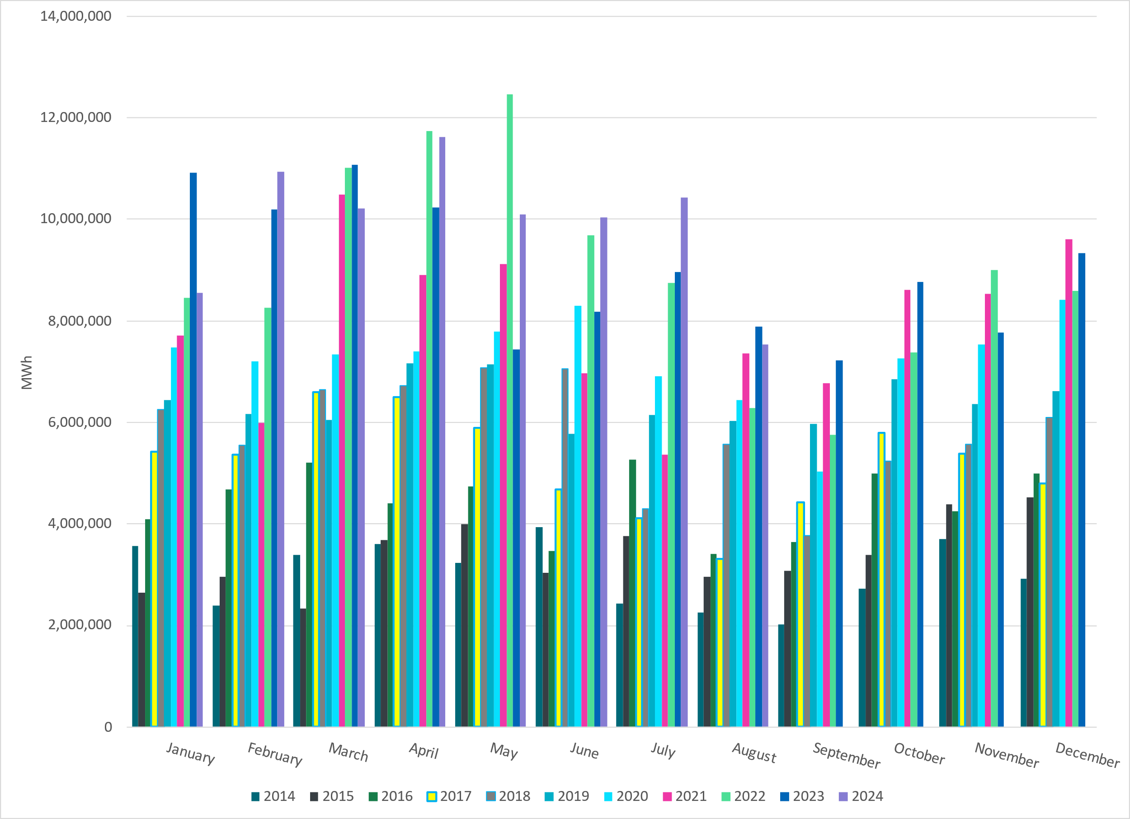
ERCOT Total Energy from Wind Generation
Notes:
7,540,015 MWH

Slide 13
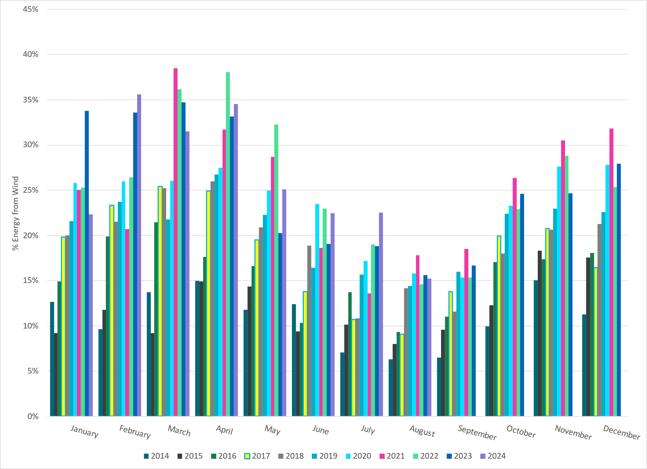
ERCOT % Energy from Wind Generation
Notes:
15.22% of total energy was provided by wind generation

Slide 14
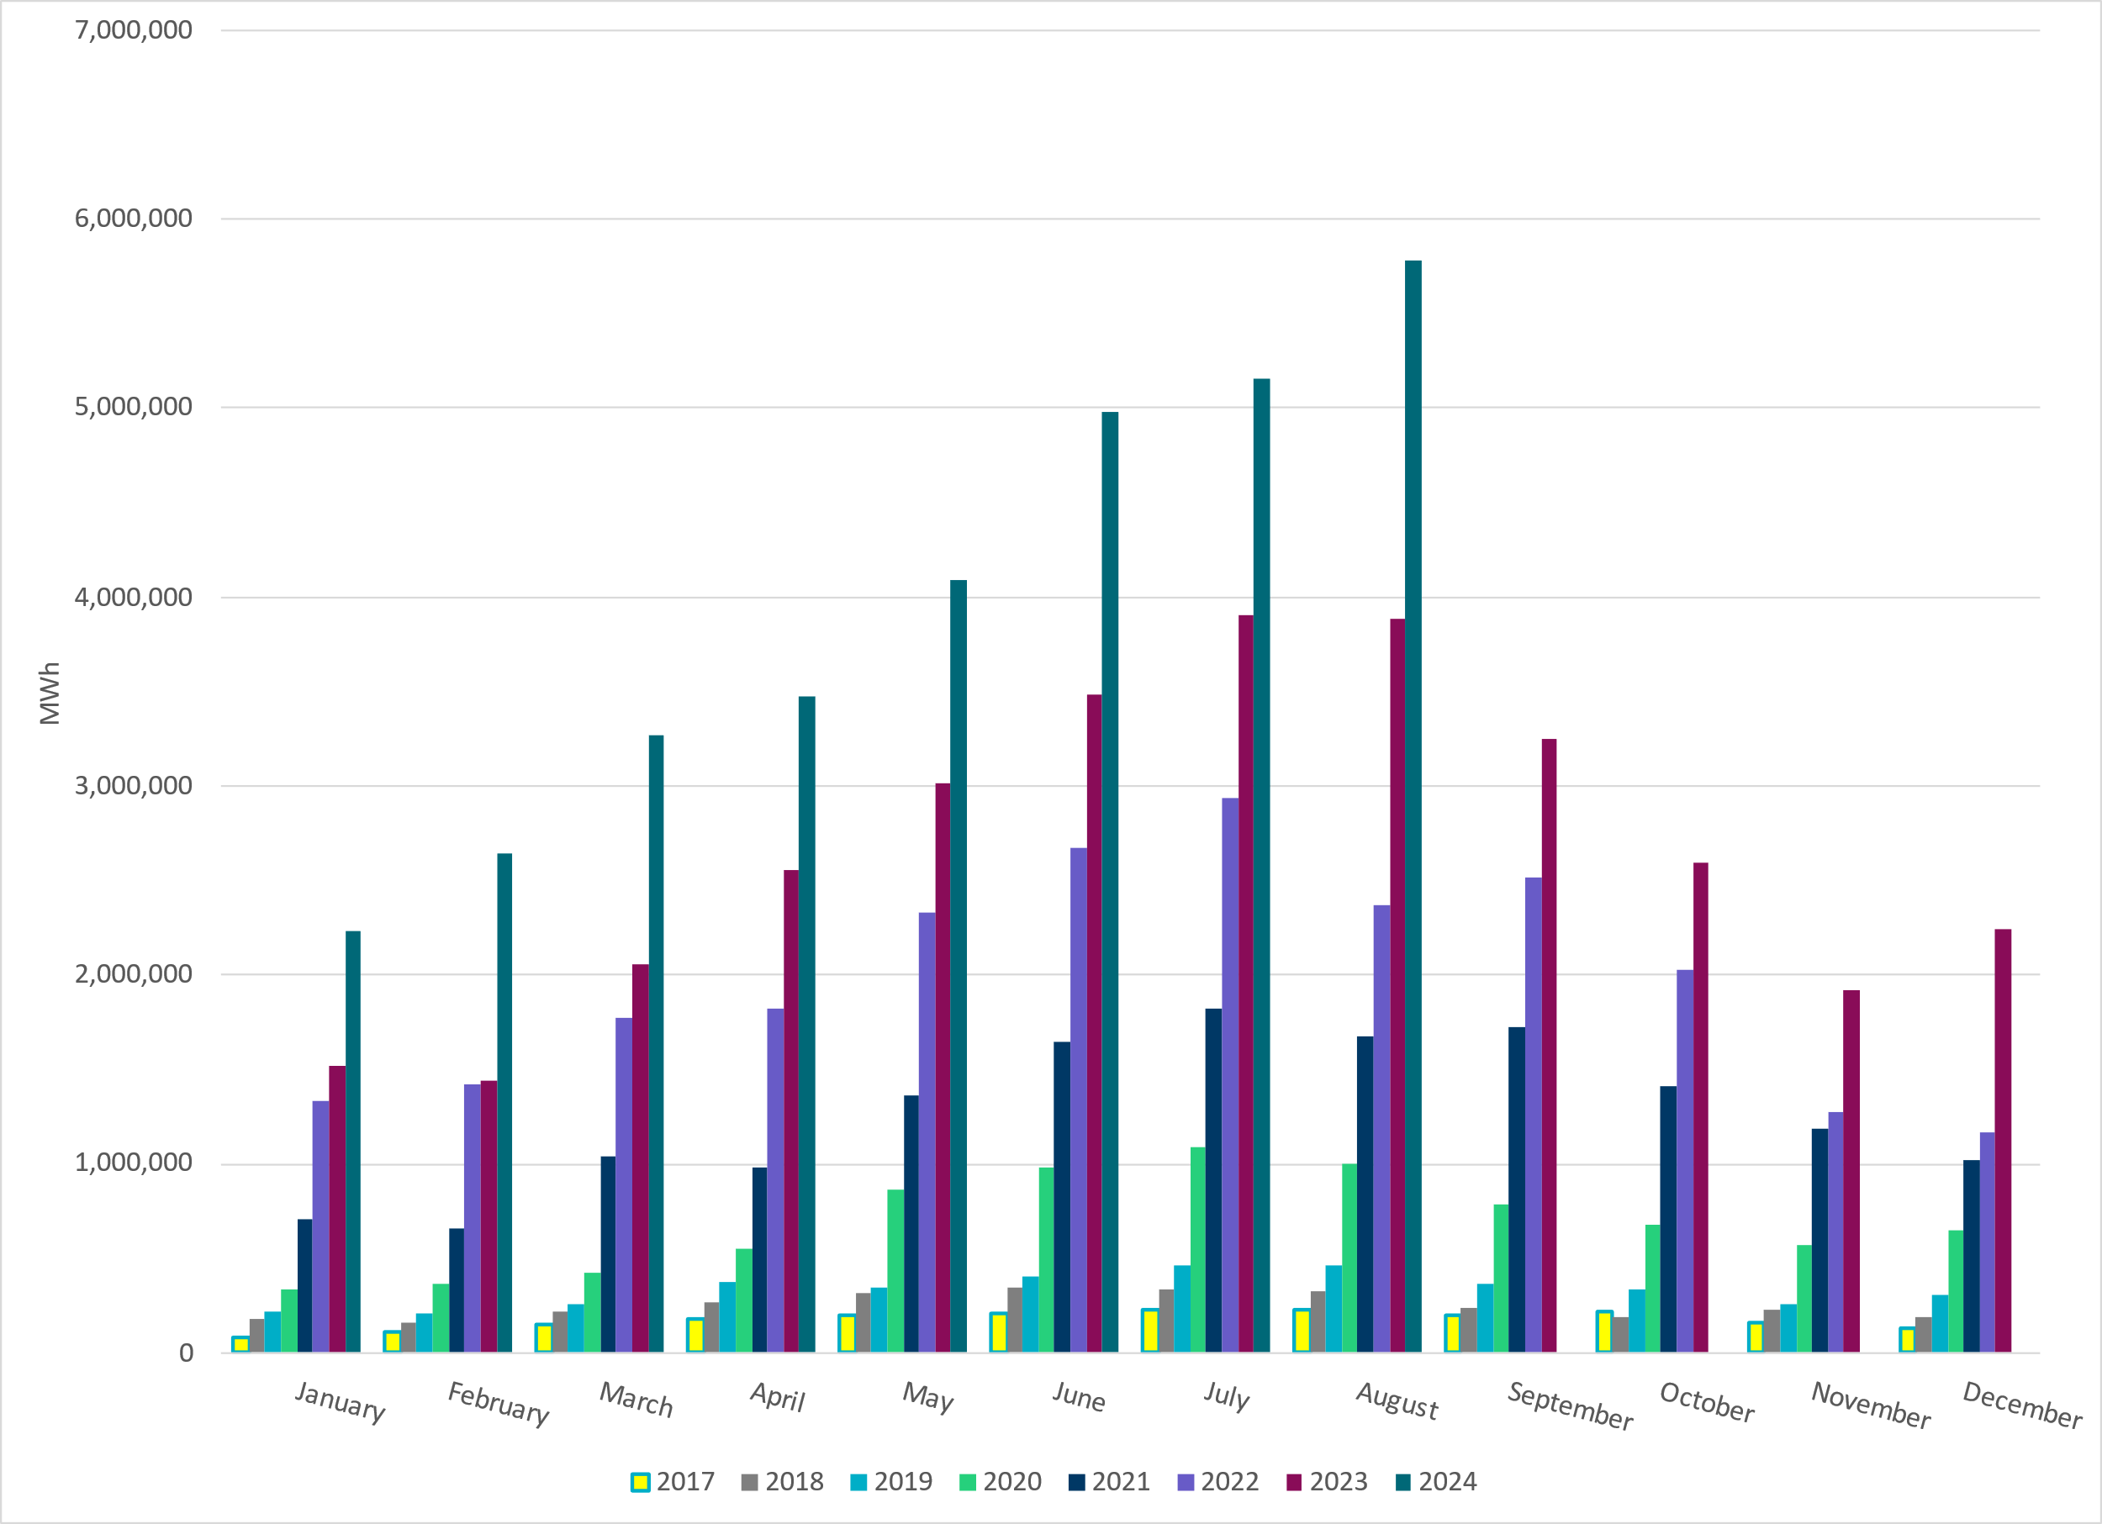
ERCOT Total Energy from Solar Generation
Notes:
5,782,018 MWh

Slide 15
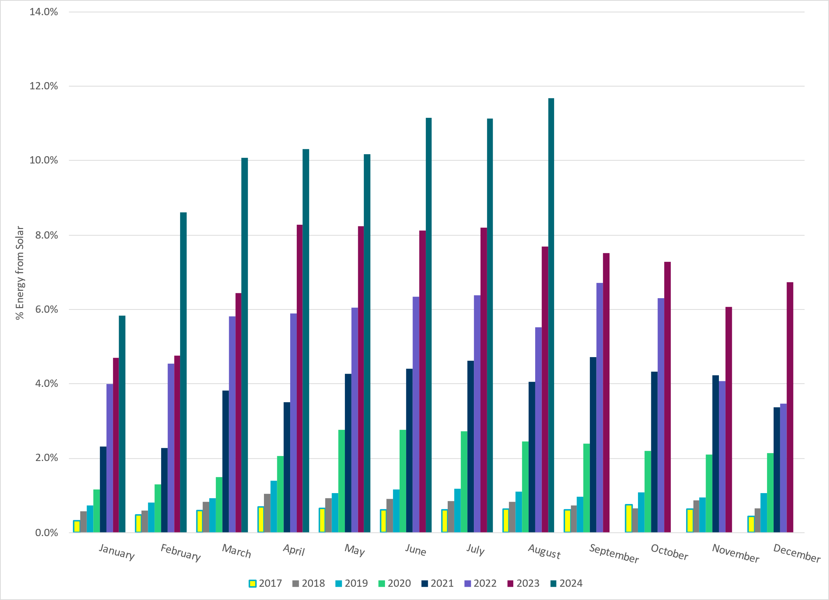
ERCOT % Energy from Solar Generation
Notes:
11.68% of total energy was provided by solar generation

Slide 16
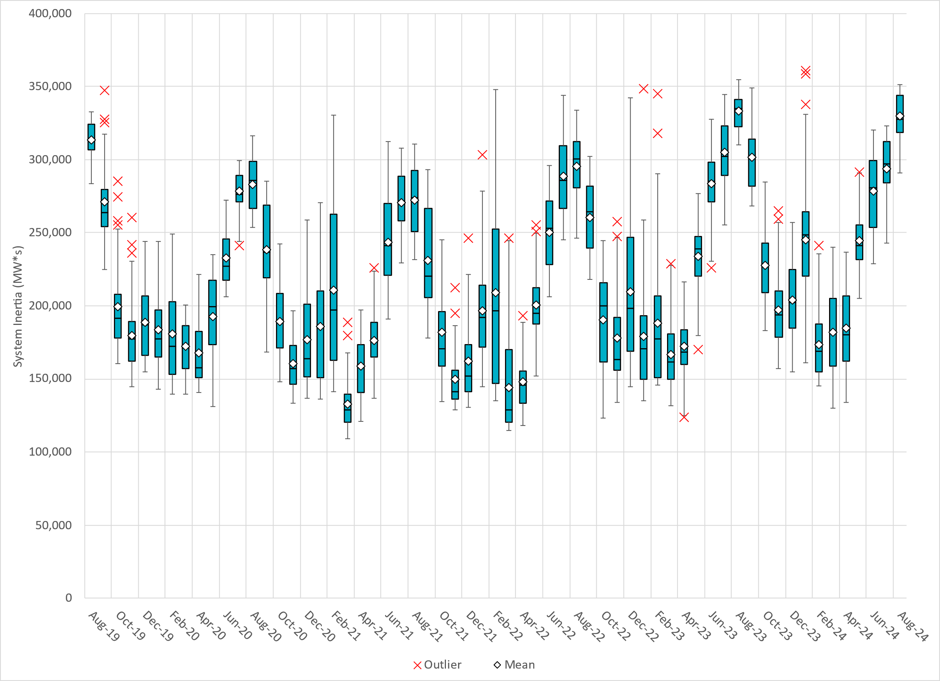
ERCOT Daily Minimum System Inertia
Notes:
Minimum Inertia in August 2024 = 290,891 MW*s on August 1st
Historical Overall Minimum was 109,029 MW*s on 3/22/2021
August Data:
Mean: 329,746 MW*s
Max: 351,463 MW*s on August 6th
Min: 290,891 MW*s on August 1st

Slide 17
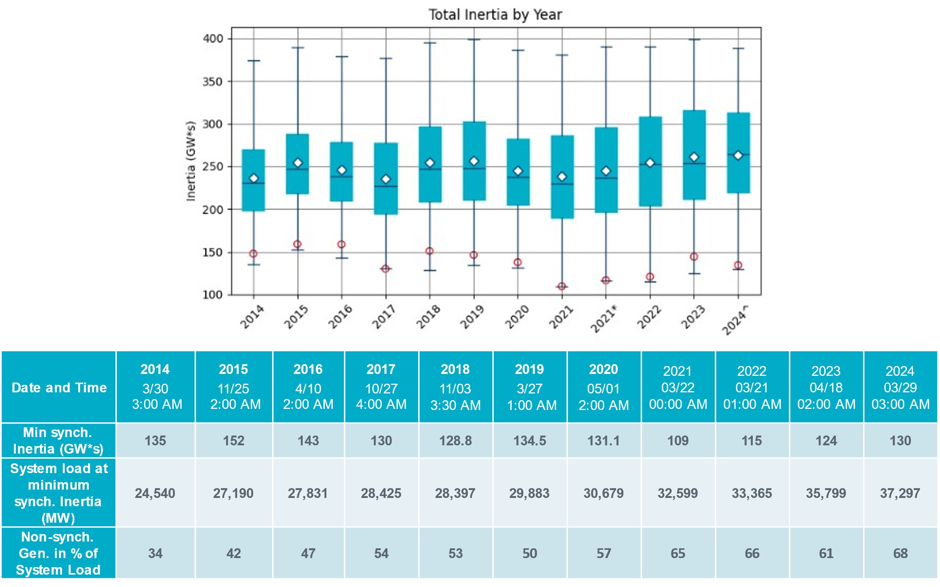
ERCOT Inertia Trend
Notes:
Summary of ERCOT intertia for the previous 10 years. Lowest inertia this year was on March 29th.
For each box, the central mark (red line) is the median, the edges of the box (in blue) are the 25th and 75th percentiles, the whiskers correspond to +/- 2.7 sigma (i.e., represent 99.3% coverage, assuming the data are normally distributed. The corresponding lowest inertia in each year is given in the table.
The circle on each boxplot is showing inertia during time when highest portion of load was served by wind/solar generation in that year.

