Slide 1
ERCOT Mobile App Enhancements
Leo Angele
IT Digital Services Support
09/26/2024

Slide 2
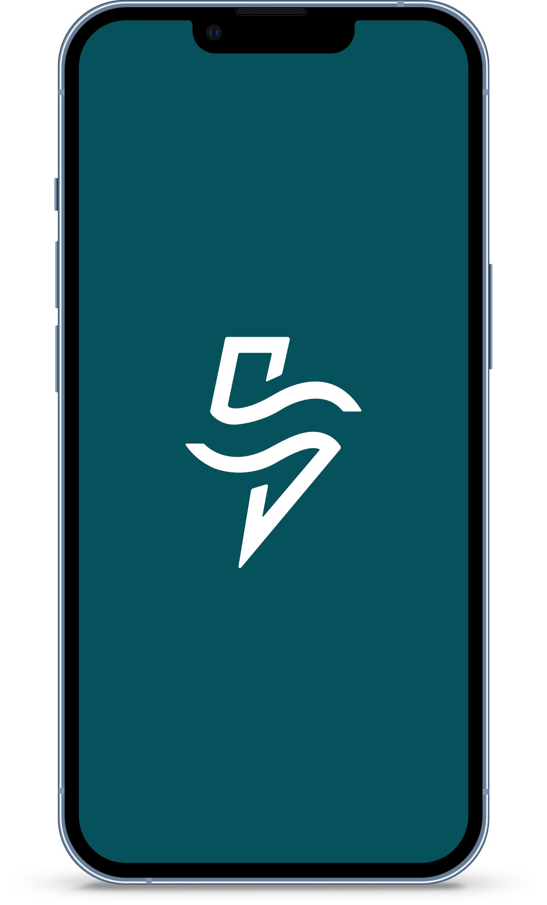
ERCOT Mobile App
ERCOT has made enhancements to the ERCOT mobile app based upon Market Participant and public feedback.
On Monday, September 30, 2024, we will launch the updated app.

Slide 3
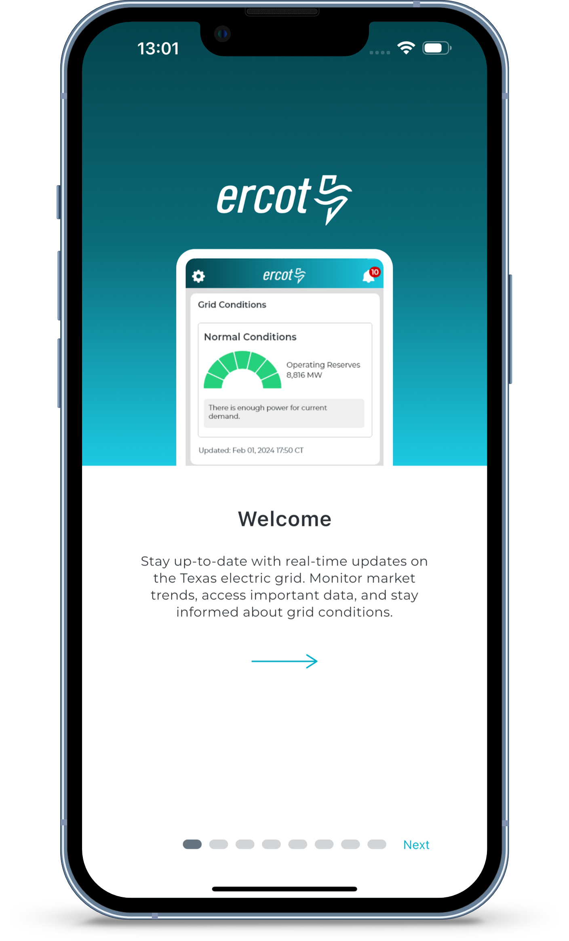
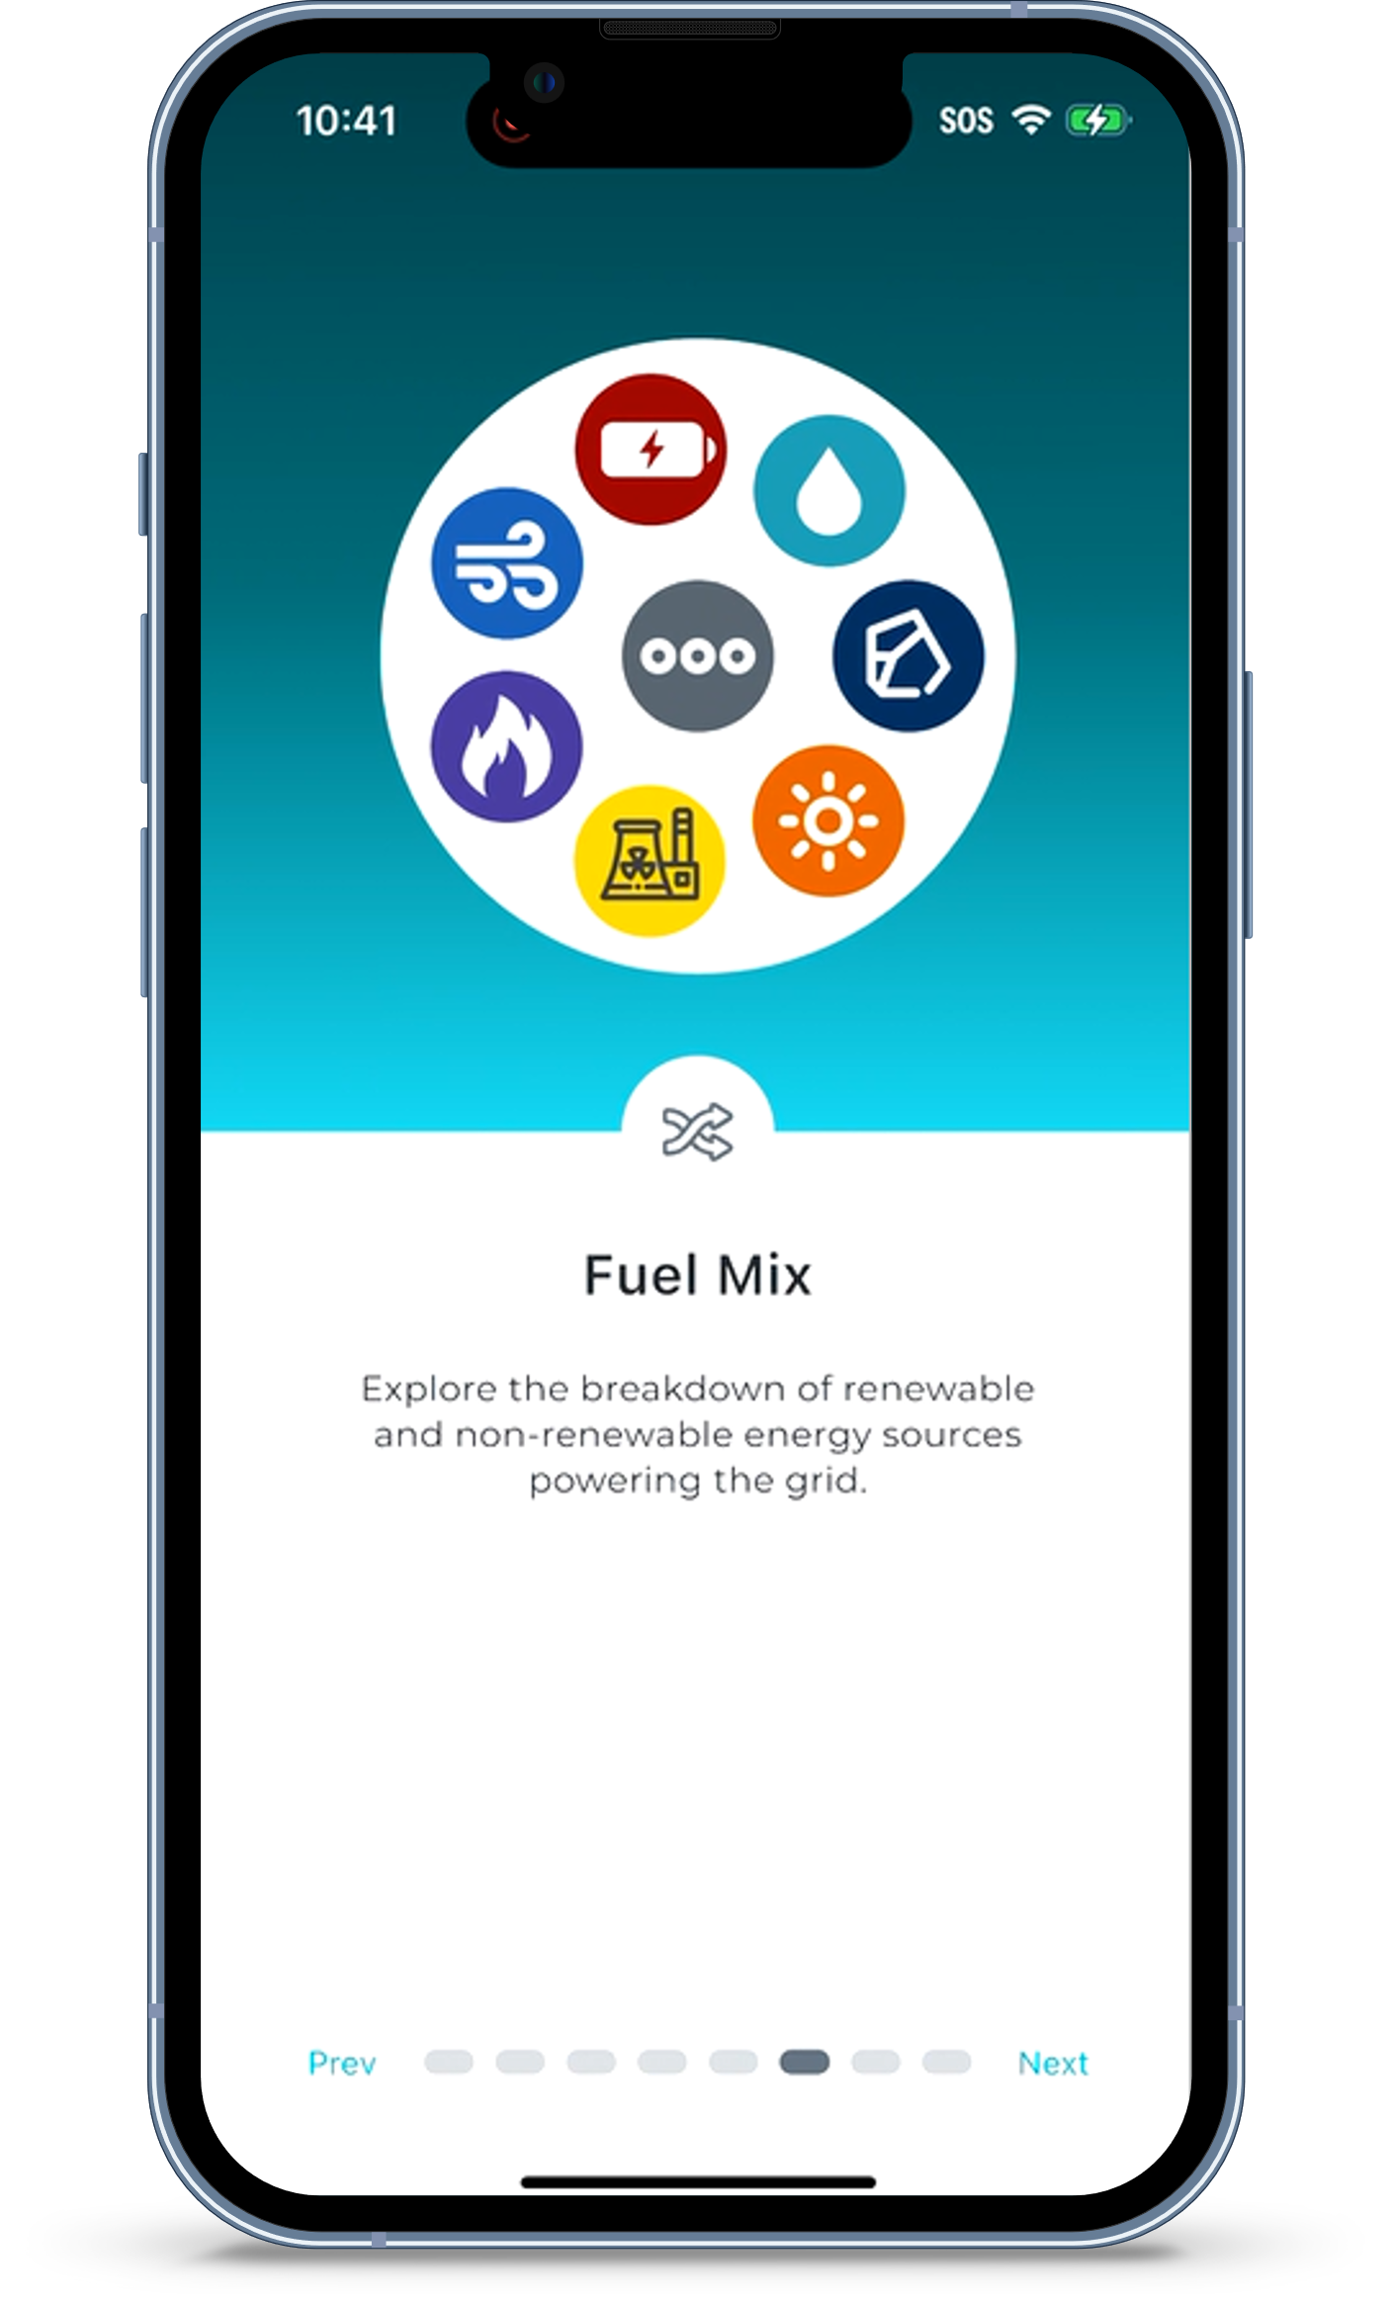
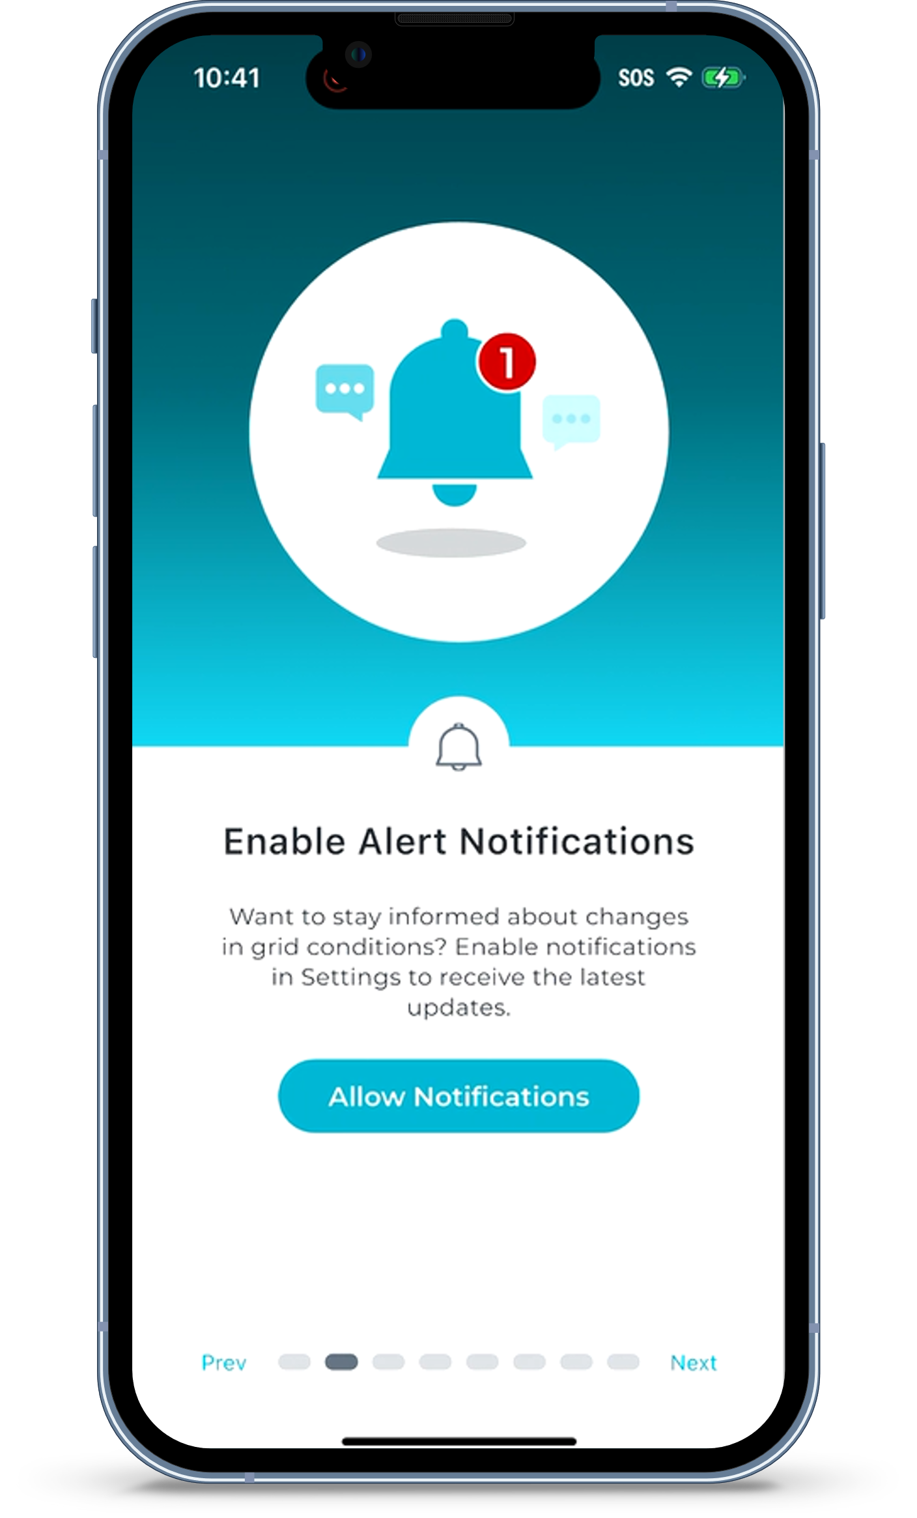
Informative Welcome Screens Walk Users Through the New Features

Slide 4
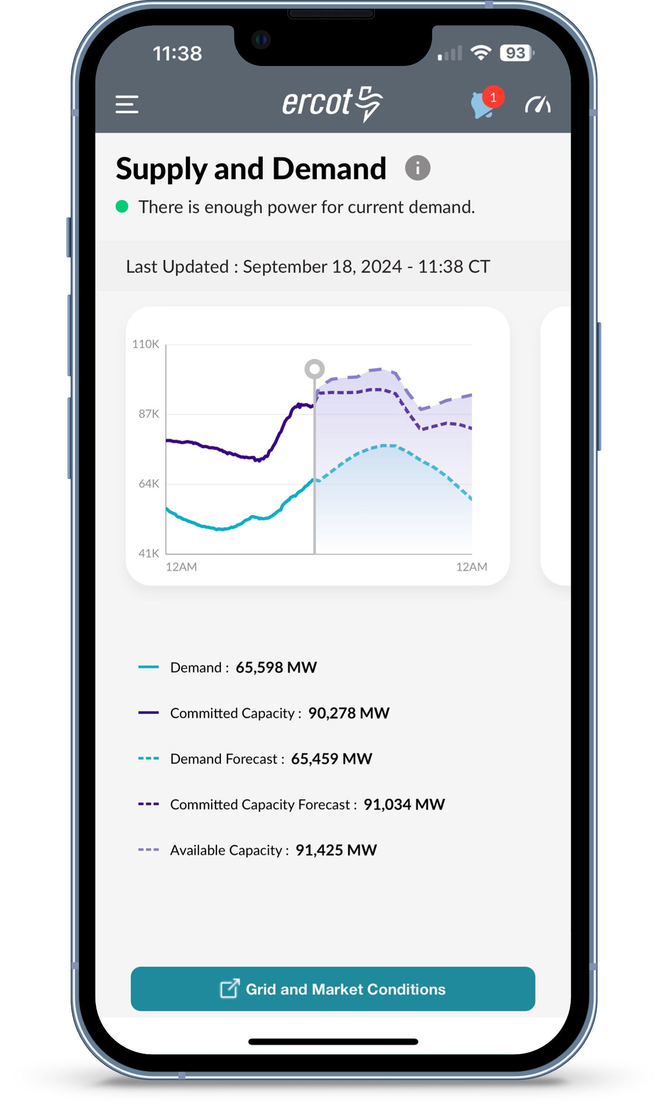
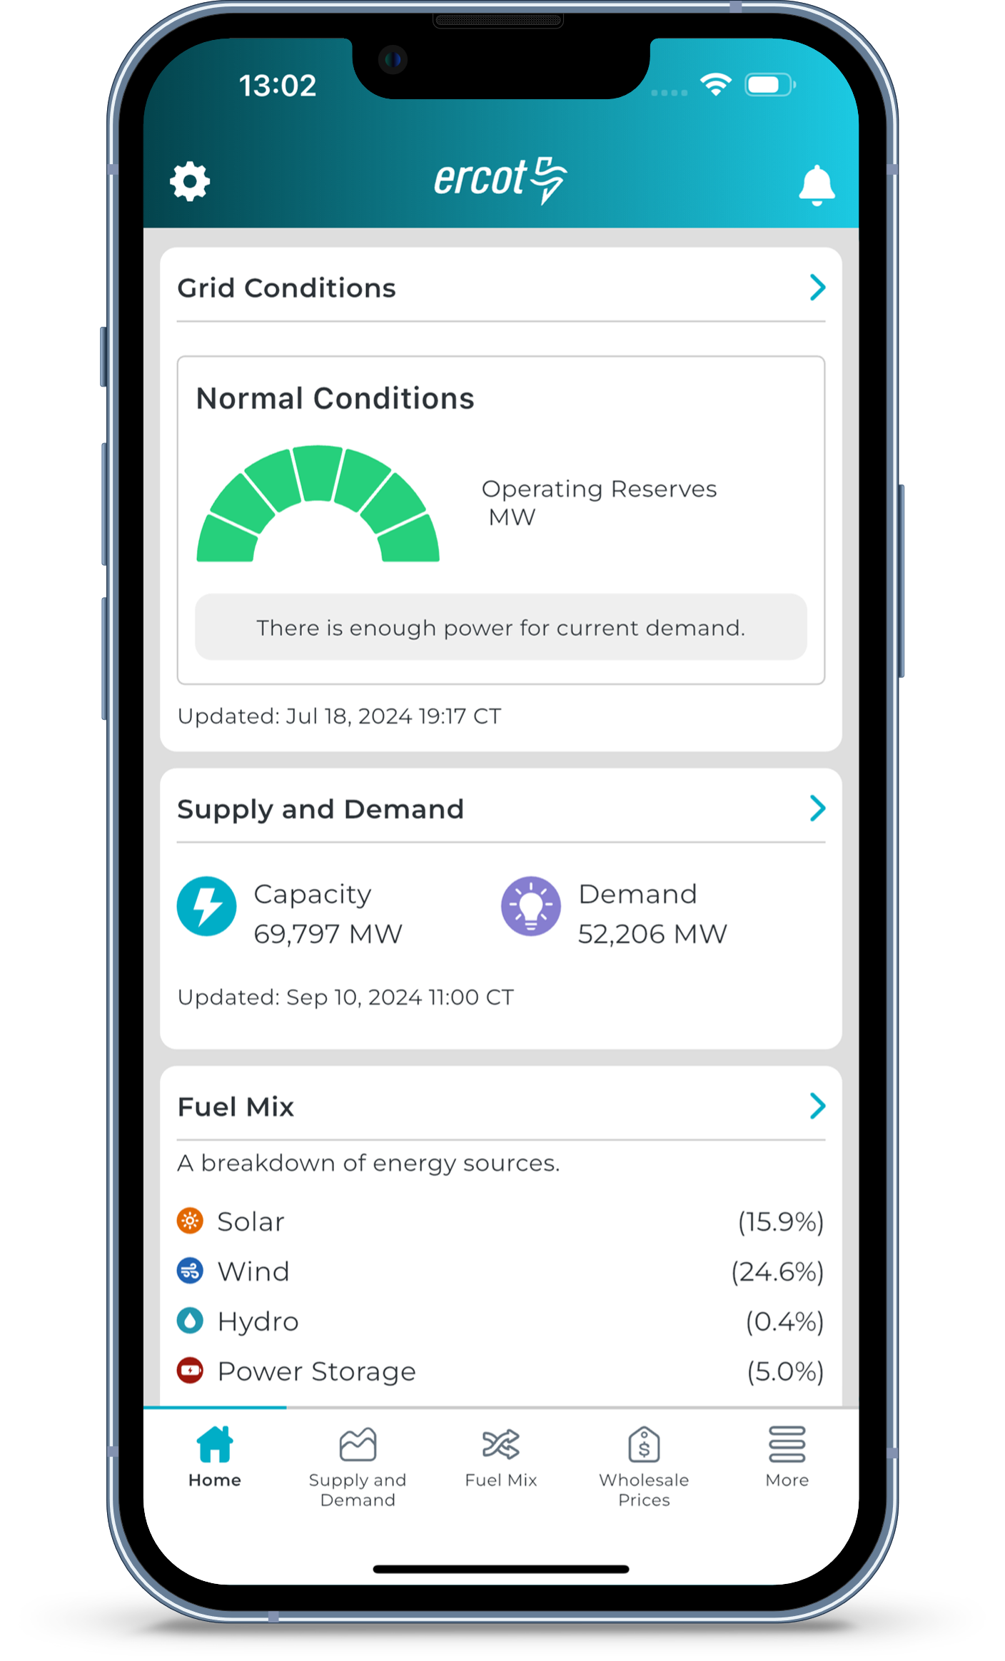
Redesigned Look
New
Current
Improved navigation

Slide 5
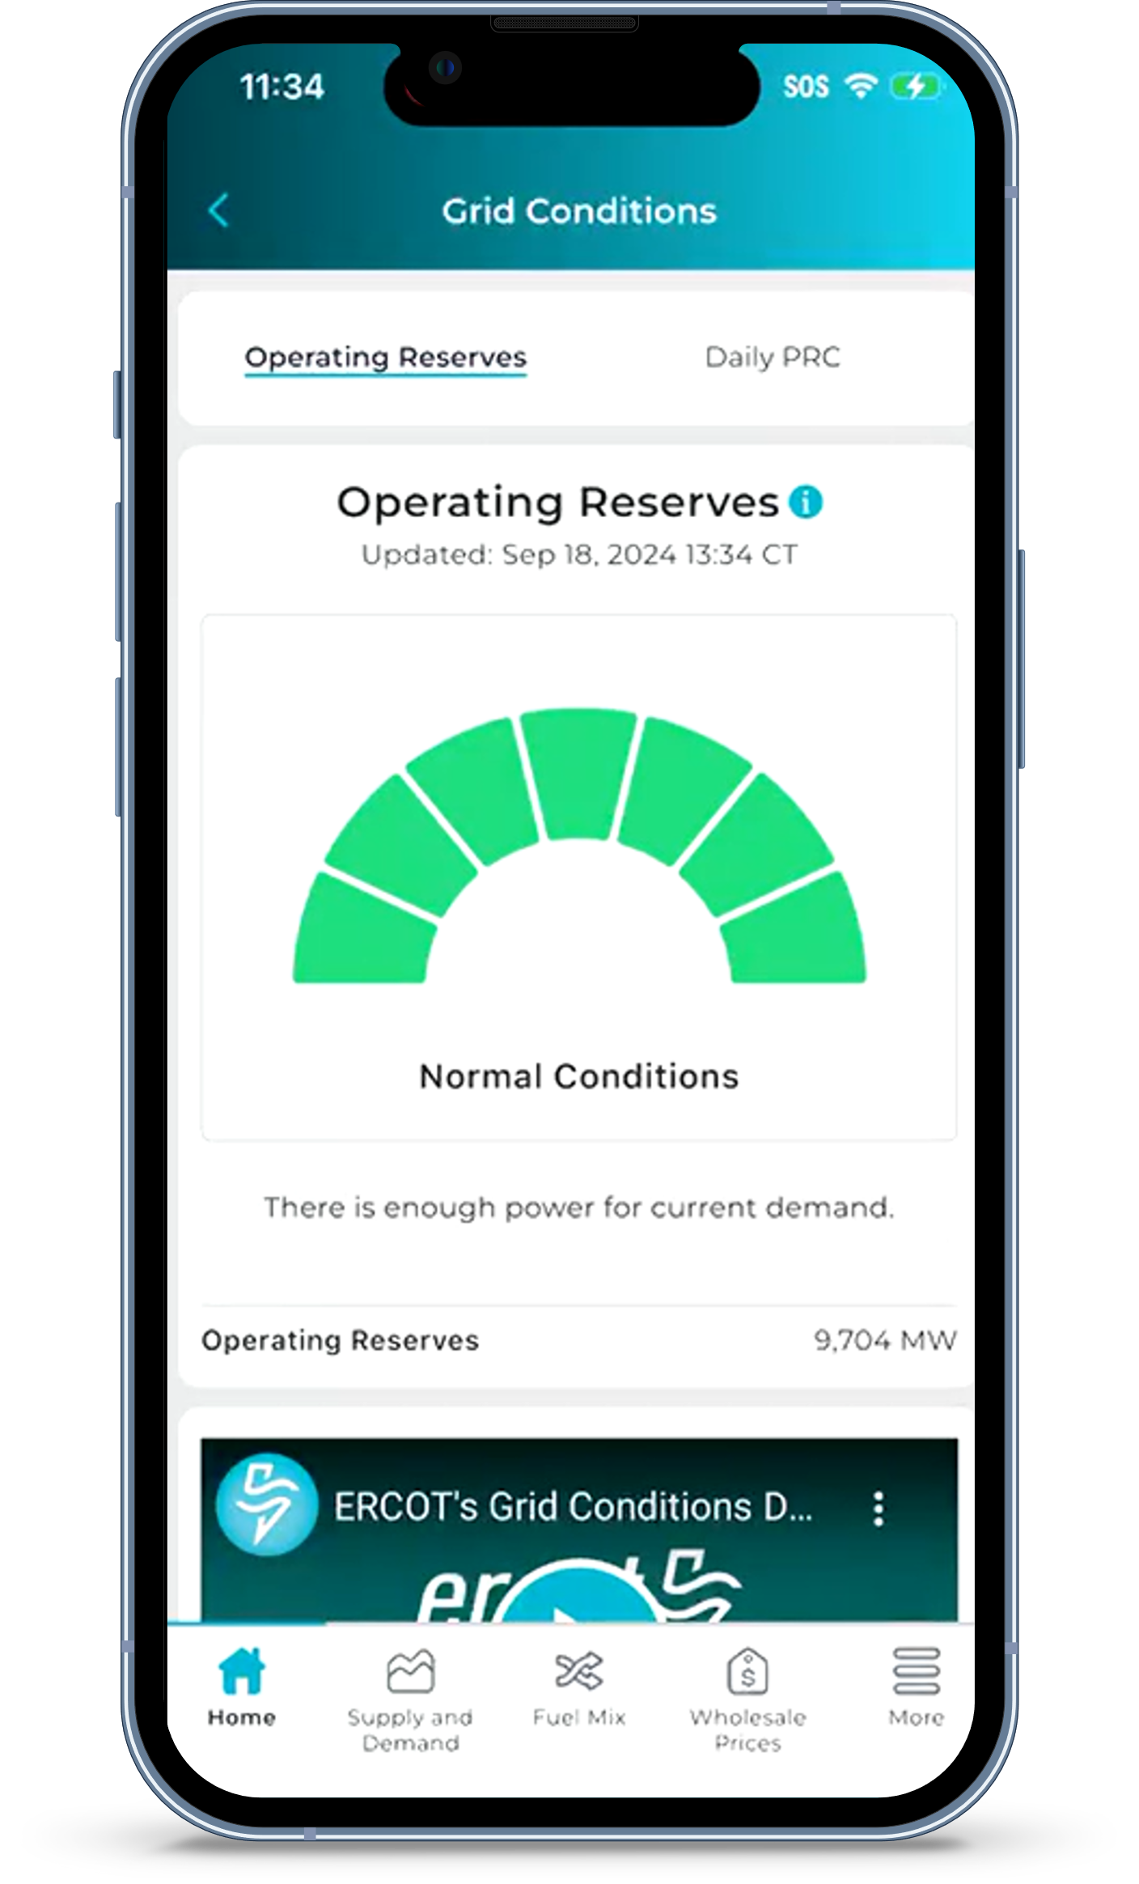
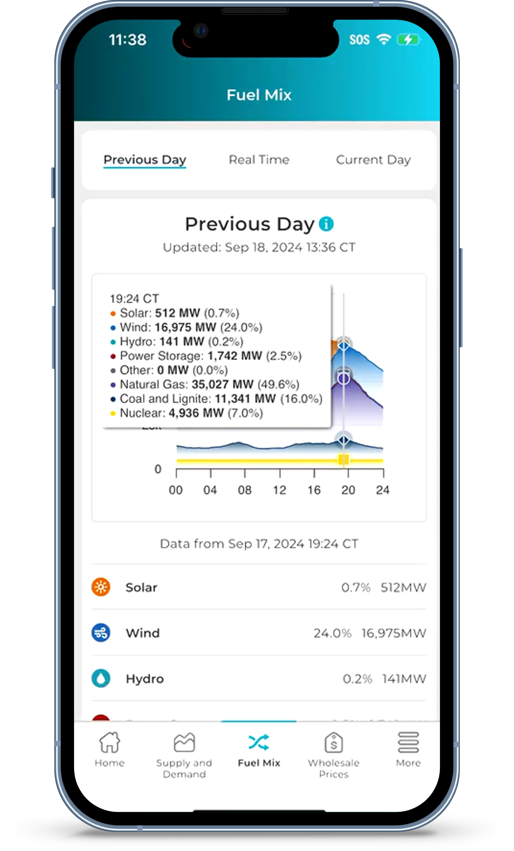
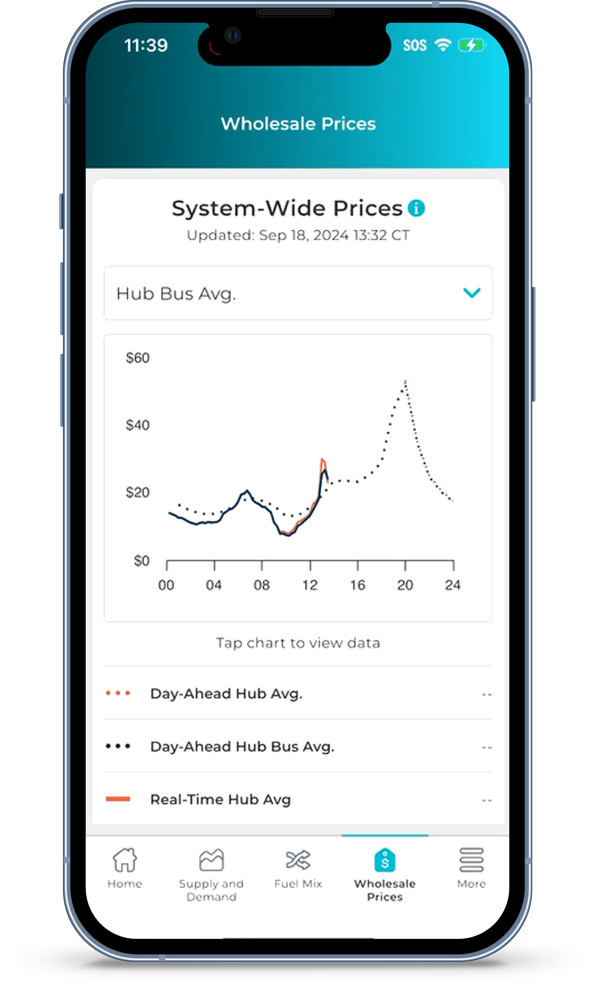
ERCOT Interactive Dashboards
ERCOT’s most popular dashboards have been added, expanded, and made interactive:
Grid Conditions
Supply and Demand
Fuel Mix
System-Wide (Wholesale) Prices
Quick videos explain dashboard features

Slide 6
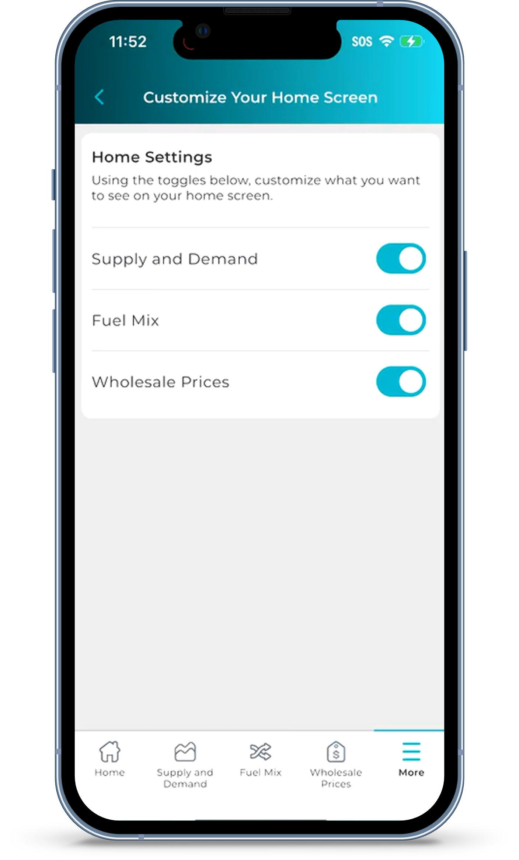
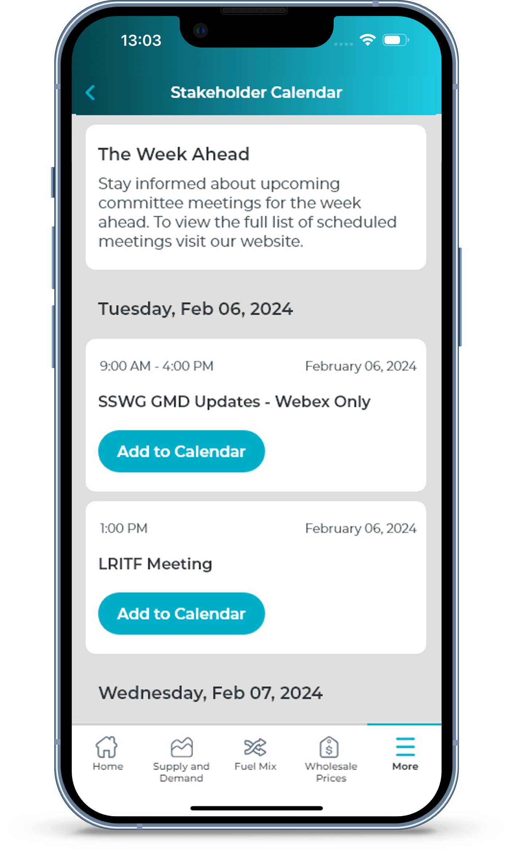
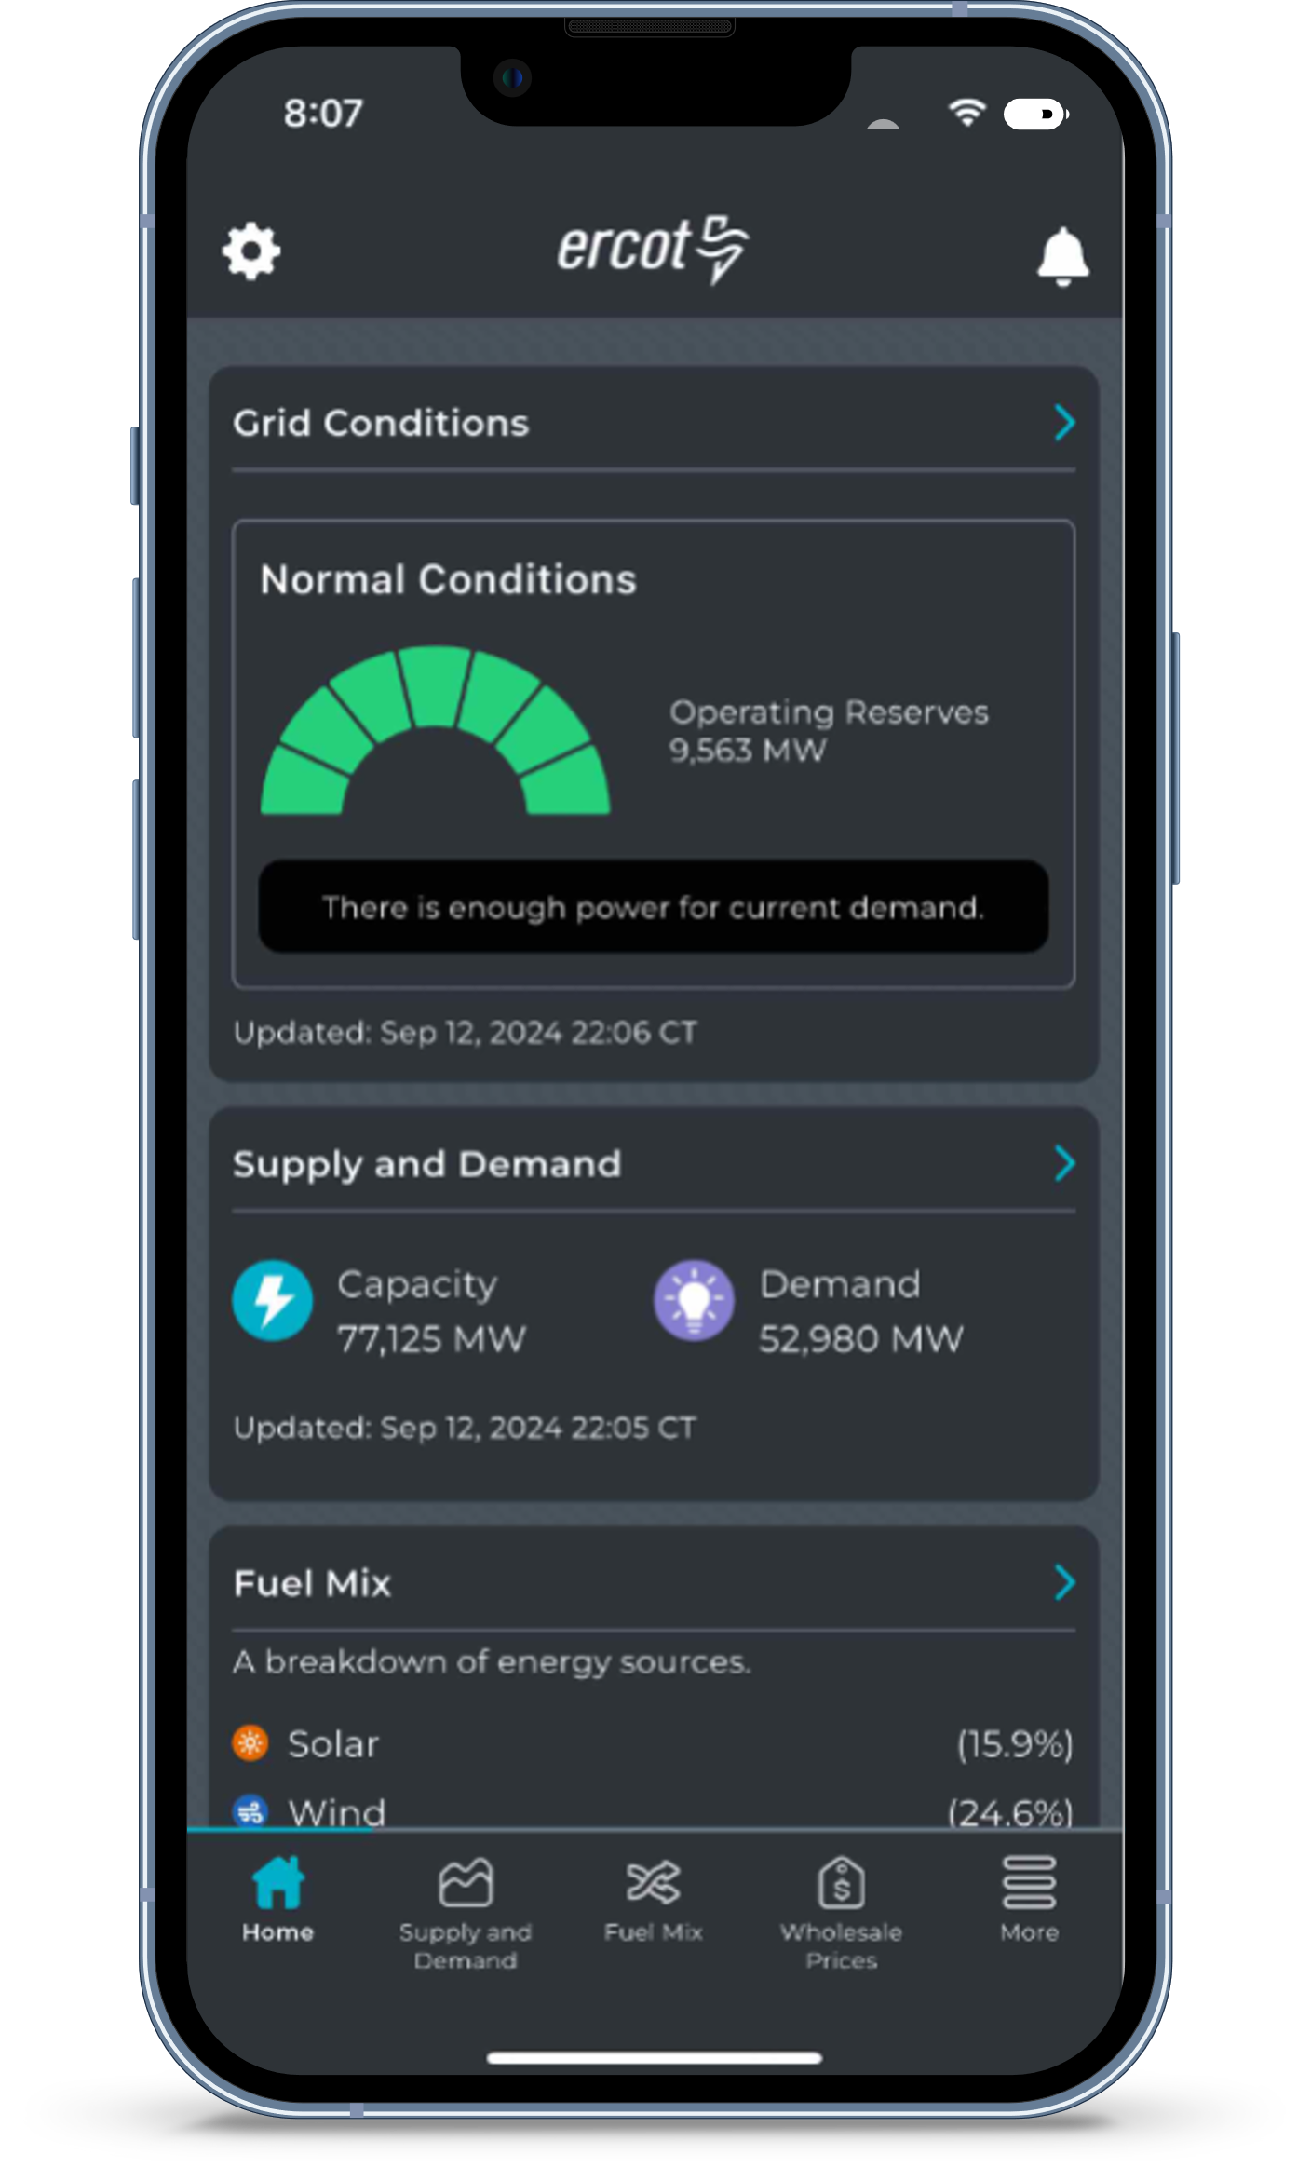
Additional Enhancements
See the meeting calendar for the week ahead
Customize which dashboards appear on home screen
Change to Dark mode
Submit feedback
Better performance on the latest operating systems

Slide 7
Additional Information
ERCOT published Market Notices announcing new app on August 30, 2024 and September 20, 2024
ERCOT released promotional video announcing new app
https://youtu.be/qPycHRnKra0
Existing app users will be notified of new version via pop-up notification
ERCOT will promote new app via news release and social media platforms on October 2, 2024

