Slide 1
Down Stream Production Changes (DPC) – Process Automation
Sreenivas Badri
September 26, 2024

Slide 2
Down Stream Production Changes (DPC) – Process Automation
Objectives of Today’s Discussion
Present current DPC Process
Introduce DPC Automation effort concept and high-level implementation approach
This effort provides new tool to Market Participants to facilitate DPC submission process.
Plan to seek feedback from Market Participants through future NDSWG/TWG meetings on implementation approach.

Slide 3
Down Stream Production Changes (DPC)
Downstream Production Change (DPC) is a standard process that makes changes to the Network Model in production in between the weekly model loads without having to load a new model (database load).
This process is managed by the multiple teams at ERCOT (Network Modeling, GMS, Shift Engineers, Operations etc.).
DPC process helps update the network model in both Energy and Market Management systems (EMS and MMS) incorporating the changes submitted by the transmission operators that are critical to maintaining the reliability of the system.
The DPC process allows ERCOT to make specific data modifications in real-time including:
Static Line / Transformers Ratings
Dynamic Line Ratings
Line / Transformer Impedance
Contingency Definition updates
Enabling and Disabling of Contingencies
GTC updates
RAP and RAS changes
GTC and RAP/RAS definition updates related DPCs are submitted by ERCOT Operations team.

Slide 4
Down Stream Production Changes (DPC)
DPC process is intended to make model changes in production between weekly model loads as necessary, not for model changes that can follow normal NOCMR timelines.
Current High level DPC Process
MP
(Submits Model changes for DPC)
NMMS
Review Model and Create DPC
Jira Process
1. Review and Approve by Operations team
2. Track DPC implementation in EMS/MMS systems across multiple models
EMS/MMS
DPC process demands significant collaboration efforts between several departments within ERCOT and market participants. It requires significant amount of manual effort to create, validate, track and implement DPCs in multiple environments across multiple weekly model loads.
The manual nature of DPC tasks often leads to inefficiencies, delays, and increased resource loading across several departments within ERCOT. This multifaceted process demands extensive time and resources to ensure accuracy and efficiency.

Slide 5
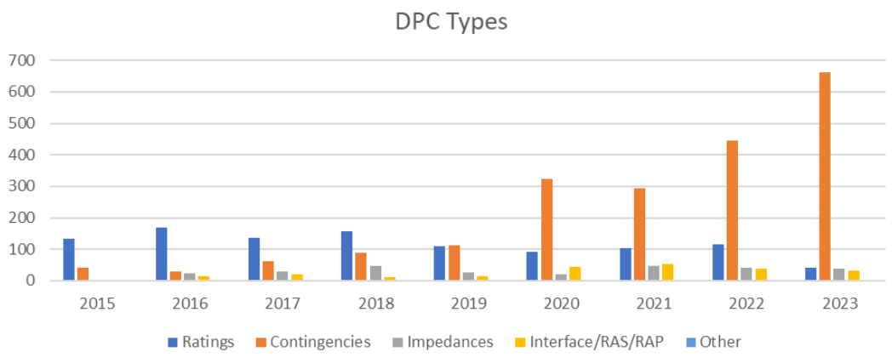
Down Stream Production Changes (DPC)
The need for automation has become increasingly evident as the volume of DPC changes processed by ERCOT continues to rise each year, driven by the substantial growth in the ERCOT system.

Slide 6
New Automated DPC Process – High level details
Develop a new DPC tool to allow Market Participants submit DPCs with start and end times.
ERCOT Operations will review and approve DPCs.
Upon approval, DPCs get implemented in ERCOT real-time systems (EMS/MMS) automatically.
Thereafter, DPCs get implemented automatically in EMS/MMS systems during every week model load until end time of DPCs.
This new DPC tool will provide visibility to Market Participants on DPC implementation status in ERCOT EMS/MMS systems.
Market Participants Operations team can submit DPCs with start and end times based on operational needs using this new DPC Tool without depending on their modeling team. It reduces the coordination efforts across multiple departments within Market Participants as well.
MP
(Submits DPC changes)
New DPC Tool
ERCOT Review & Approval
EMS/MMS

Slide 7
DPC Automation – Implementation Approach
Allow Market Participants submit only following DPCs using this new DPC tool if emergency data changes are required in ERCOT real-time systems (EMS/MMS) with immediate start time to mitigate reliability risks.
Contingency Enable and Disable
Static Line / Transformers Ratings
Dynamic Line Ratings
Line / Transformer Impedance
If DPC is a permanent model change, DPC end time should reflect when this change will be available in production models. This type of DPC model change can be submitted to NMMS following normal NOMCR timelines.
This creates clear demarcation between operational data changes and model changes of current DPC submission process.
Market Participants operations team can submit above DPC types if emergency data changes are required in ERCOT real-time systems.
Market Participants modeling team can continue to use current DPC process (using NMMS) to submit DPCs which are permanent model changes.

Slide 8
Next Steps
Seek feedback from Market Participants on implementation approach through future NDSWG/TWG meetings.
Finalize the implementation approach based on Market Participants feed back.
Perform Impact Analysis (IA) of this effort and determine implementation timelines.

