Slide 1
RTC+B Task Force
Update
Matt Mereness
TWG
September 26, 2024

Slide 2
Outline
Program Go-Live Announcement
Realignment of Current Issues for RTCBTF
Discuss Market Trials Plan

Slide 3
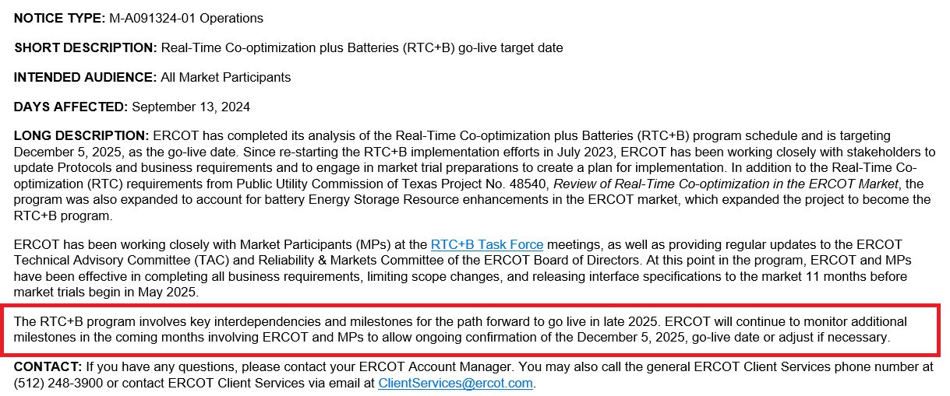
RTC+B Program Go-Live Announcement
Links to:
Market Notice
Press Release
Trending Topic Paper

Slide 4
Sequence and Dates for Market Trials to Go-Live
30-day Market Notice
11/5/25
Start
5/5/25
Start
7/7/25
Start
9/2/25
Go-Live
12/5/25*
May 2025
June 2025
July 2025
Aug 2025
Sep 2025
Oct 2025
Nov 2025
Dec 2025
QSE Scorecards & Exit Criteria for each Trial Phase
RTC QSE Submission Testing
(Submit COP, RT AS Offers,
DAM Virtual AS, Outages for ESRs)
Open-loop RTC SCED
(QSE offers, SCED non-binding award/dispatch)
Ongoing Open-Loop
& Periodic Closed-loop SCED/LFC
(QSE RTC offers and telemetry to support closed-loop frequency control test 2-3 tests of 2-4 hour durations)
Transition to Go-Live
Upon completion of testing, confirmation of ERCOT and market readiness for Go-Live.
RTC QSE Telemetry Check-out (QSEs add/verify new telemetry points for UDSP, New ramp rates, ESR telemetry)
QSE Telemetry Tests
(Individual QSE to follow UDSP and support new ramp rate and ESR telemetry)
Day-Ahead Market
(Non-binding DAM using QSE offers for at least 2 tests)
* Go-Live date reflects 12/5/2025 as first Operating Day
where 12/4/2025 is planned software migration.

Slide 5
New streamlined RTCBTF Issues List going forward
Parameter and Policy dates defined
Ramp-up of RTC Simulator Analysis and priorities of what to study
More details coming for Market Readiness progression

Slide 6
Reviewed at September RTCBTF
Issue 1- Initial Review of Parameters for AS Proxy Offer Curves
  Likely to become a hot-topic (proxy offer at $0, the $OfferCap, or in between)
  Will discuss at Oct and Nov RTCBTF meetings and then November TAC
Review RTC and ESR Clarifying Revision Requests if market questions
  RTC- NPRR1245 (any updates from ERCOT)
  ESR- NPRR1246, NOGRR268, PGRR118, OBDRR52 (any updates from ERCOT)
Issue 3- RTC Simulator update
  ERCOT committed to studying 3 Operating Days and providing analysis at Oct RTCBTF
Issue 10- Market Trials Plan Review
  Final review planned at next RTCBTF meeting and coming to October TAC for endorsement.
Discuss Approach to Training/Readiness
  ERCOT authored initial outline of Market Readiness “training components”
Issue 18 – Placeholder for MPs Discussion of AS Demand Curves
  ERCOT posted explanation of ASDC discussion and posted with TAC materials
  Also note Shams has expressed concerns with AS Indifference requirement being needed (link)
Next meeting in-person/WebEx on Tuesday, October 22, 2024

Slide 7
Next Steps
Today prove 10 minute walk-through of current blackline version of the Market Trials Plan
  Open posted file to walk through objectives and high-level approach
RTCBTF agreeable to combining with technical discussion at monthly meetings
  Similar to recent “Settlement Deep-Dive” at RTCBTF, allow for any technical deep dives on topics or general discussion.
Questions?

