Slide 1
ERCOT Technology Working Group (TWG)
September 26, 2024

Slide 2
ERCOT TWG
WELCOME

Slide 3
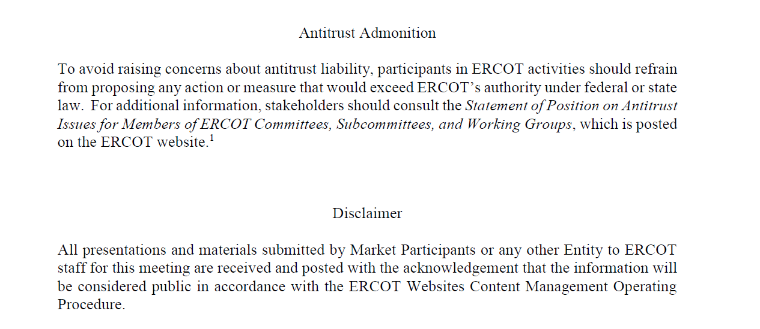
ERCOT TWG

Slide 4
ERCOT TWG Agenda
Item # | Item Description | Presenter | Start Time
1 | Antitrust admonition | Sreenivas Badri | 2:00 PM
2 | RTC+B Updates | Matt Mereness | 2:05 PM
3 | TxSET Market Testing and Retail SLA Updates | Mick Hanna | 2:30 PM
4 | Redesigned Mobile App Release | Leo Angele | 2:40 PM
5 | Down Stream Production Change (DPC) Process Automation | Sreenivas Badri | 2:50 PM
6 | Other Projects/Initiatives updates |  | 3:10 PM
 | RIOO ESR Project – Data Migration status updates | Andy Adams
 | SCR799 - ERCOT Outage Study Cases in the System Operations Test Environment (SOTE) – status update | Yugendher Karedla
7 | NDCRC - Generating Unit Tests and Automatic Tracing Project Go-Live updates | Nick Barbas | 3:20 PM
8 | Project Updates | Troy Anderson | 3:40 PM
9 | Round Table Discussion | Blake Holt (LCRA) | 3:50 PM
10 | Adjourn | Blake Holt (LCRA) | 4:00 PM

Slide 5
RTC+B Updates
RTC+B Updates – Matt Mereness

Slide 6
TxSET Market Testing and Retail SLA Updates
TxSET Market Testing and Retail SLA Updates – Mick Hanna

Slide 7
Redesigned Mobile App Release
Redesigned Mobile App Release – Leo Angele

Slide 8
Down Stream Production Change (DPC) Process Automation
Down Stream Production Change (DPC) Process Automation – Sreenivas Badri

Slide 9
Other Projects/Initiatives Status Updates
RIOO ESR Project – Data Migration status updates – Andy Adams
SCR799 - ERCOT Outage Study Cases in the System Operations Test Environment (SOTE) – status update – Yugendher Karedla

Slide 10
NDCRC - Generating Unit Tests and Automatic Tracing Project
NDCRC - Generating Unit Tests and Automatic Tracing Project Go-Live updates – Nick Barbas

Slide 11
Project Updates
Project Updates – Troy Anderson

Slide 12
ERCOT TWG – Round Table Discussion
ERCOT TWG – Round Table Discussion – Blake Holt (LCRA)
  Future Topics of Interest
  Topics and presentations from TWG members

Slide 13
ERCOT TWG
Thank You
You can reach Sreenivas at
Sreenivas.Badri@ercot.com and Blake at Blake.Holt@LCRA.ORG

