Slide 1
NPRR1214 Changes: Indifference Payment required under RTC to avoid Incentive Incompatibility
Shams Siddiqi, Ph.D.
Rainbow Energy Marketing Corp. (REMC)
(512) 619-3532
shams@crescentpower.net
CMWG Meeting
September 23, 2024

Slide 2
Lack of Indifference Payment creates Perverse Incentives
Reliability Deployment Price Adder (RDPA) creates Settlement Point Prices (SPPs) at Resource Nodes that are inconsistent with (and higher than) SCED Dispatch LMPs – this is true for every instance of positive RDPA
Current RTC has no Indifference Payment to correct for Incentive Incompatibility of SCED energy dispatch
Current RTC send inefficient and inappropriate price signals throughout the grid – very problematic with price responsive resources and Loads
For example: 4/22/22 at 15:00:
  System Lambda=$63.85/MWh
  RDPA=$230.45/MWh
  RTOLCAP (Operating Reserves) = 16,302 MW
  ORDC Adder = 0
  Non-Spin RT MCPC = $0 under RTC (since all RTOLCAP eligible to provide Non-Spin)
  LZ West LMP = $9.97/MWh; LZ North LMP = $84.07/MWh
  LZ West SPP = $240.42/MWh; LZ North SPP = $314.52

Slide 3
Lack of Indifference Payment creates Perverse Incentives
Ex 1a: Turkey Track Wind (TTW) in West under RTC and system-wide RDPA
  SCED LMP = -$1.93/MWh
  RT SPP = -1.93 + 230.45 = $228.52/MWh
  SCED Dispatch BP = 0 MW, SCED Non-Spin Award = 164 MW
  Current pre-RTC payment to keep TTW from chasing RT SPP = RTRDAIAMT = $230.45/MWh * 164 MWh/12 = $3,149 (Total revenue in RTM)
  TTW has no incentive to over-generate since it would make less money from over-generation
  Current post-RTC payment (no indifference payment) = ($228.52*0 MW + 0*164MW)/12 =$0
  TTW has strong incentive to over-generate since it makes $228.52 for each MWh until Base Point Deviation Charges kick in
Ex 1b: Turkey Track Wind (TTW) under RTC with NPRR1214
  SCED LMP = -1.93 $/MWh
  SCED Pricing Run LMP (=RT SPP) = $14.95/MWh (NPRR1214)
  SCED Dispatch BP = 0MW, SCED Dispatch Run Non-Spin Award = 164 MW
  SCED Pricing Run BP = 164MW, SCED Pricing Run Non-Spin Award = 0MW
  NPRR1214 Indifference Payment = Max[0, (164-0)*(14.95-(-1.93)) = $230.70 [Note: 0.5 multiplier is deleted in comments to ensure no incentive to over-generate]
  TTW has no incentive to over-generate [Note: AS payment not reduced due to over-generation]
Current RTC LZ West SPP = $240.42/MWh; NPRR1214 LZ West SPP ~ $20/MWh: current RTC sends wrong price signal to resources and LFLs in LZ West – LFLs curtailing in LZ West will result in additional IRRs being curtailed.

Slide 4
Lack of Indifference Payment creates Perverse Incentives
Ex 2a: Wolf Hollow 2 CC (WH2) under RTC and system-wide RDPA
  SCED LMP = $73.22/MWh
  RT SPP = 73.22 + 230.45 = $303.67/MWh
  SCED Dispatch BP = 1009MW, SCED Non-Spin Award = 80MW
  Current pre-RTC payment to keep WH2 from chasing RT SPP = RTRDAIAMT = $230.45/MWh * 80 MWh/12 = $1,536
  WH2 has no incentive to over-generate
  Current post-RTC payment (no indifference payment) = ($303.67*1009MW + 0*164MW)/12 =$25,5333
  WH2 has strong incentive to over-generate since it makes $303.67/MWh less marginal operating cost for each MWh until Base Point Deviation Charges kick in
Ex 2b: Wolf Hollow 2 CC (WH2) under RTC with NPRR1214
  SCED LMP = $73.22/MWh
  SCED Pricing Run LMP (=RT SPP) = $994.65/MWh (NPRR1214)
  SCED Dispatch BP = 1009MW, SCED Dispatch Run Non-Spin Award = 80MW
  SCED Pricing Run BP = 1089MW, SCED Pricing Run Non-Spin Award = 0MW
  NPRR1214 post-RTC payment (excluding Indiff) = (1009*994.65+80*0)/12 = $83,633
  NPRR1214 Indifference Payment = Max[0, (1089-1009)*(994.65-73.22)]/12 = = $6,142.87
  WH2 has no incentive to over-generate (likely loses money if WH2 over-generates)

Slide 5
Lack of Indifference Payment creates Perverse Incentives
Without an Indifference Payment, there is a very strong incentive to not follow Resource Base Point (BP) based on being paid Resource Node LMP+RDPA by overproducing
To avoid this incentive incompatibility, currently all Resource available capacity is paid the RTRDAIAMT (RDPA-related Ancillary Service Imbalance Amount) of $230.45/MWh – which is magnitudes greater than needed to keep Resource’s indifferent and eliminate incentive to not follow their respective BPs
However, RTC eliminates RTRDAIAMT and thus creates an incentive incompatibility in following BP (the market is currently overpaying just to ensure this issue is addressed)
The following graph compares what is paid today as RTRDAIAMT and the proposed Indifference Payment based on ΔLMP*ΔMW between pricing run and dispatch run deltas

Slide 6
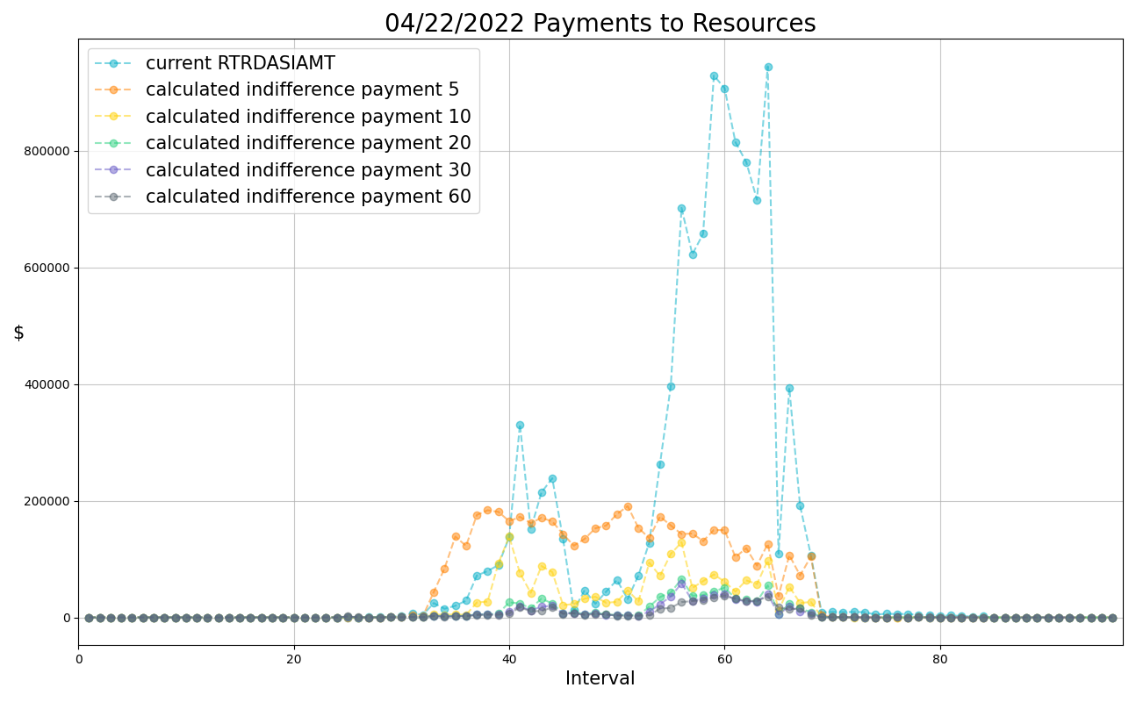
Current RDRDASIAMT v. Proposed Indifference Payment related to RDPA

Slide 7
NPRR1214 Draft Comment Changes
Draft NPRR1214 Joint Sponsors comments address all the issues raised by ERCOT:
  These comments remove all the changes related to implementation of this NPRR prior to RTC+B – thus significantly reducing the NPRR changes
  Specify indifference payments for Energy Storage Resources
  Specify details on how DC Tie related RDPA calculations are to be performed
If a severe scarcity event were to occur after RTC implementation but prior to fixing this lack of Indifference Payment, RDPA could be $4,000/MWh whereas System Lambda $1,000/MWh creating a huge reliability concern with Resources not following their BPs – hundreds of Resources over-generating by greater of 5MW or 5% can cause serious reliability concerns.
Current RDPA uses 60-minute ramp relaxation which results in 0 RDPA adder (actually negative RDPA adders which is set to 0) for a significant portion of RDPA intervals – should we change RDPA to use actual 5-minute ramp pre-RTC?
This NPRR is now very simple and there is no reason to delay approval of this NPRR since results of ERCOT’s extensive analysis provides the data needed to answer Market Participant questions.
Joint Sponsors would like to work with ERCOT to finalize draft comments before submitting.

