Slide 1
NPRR 1235, DRRS
SAWG Discussion
September 27, 2024

Slide 2
Executive Summary
History of DRRS shows intent to support investment in reliable dispatchable generation and was framed as an alternative to the PCM
The design and definition must recognize this intentional dual function as both an operational and reliability tool
The statutory requirements help buttress this position, especially when PURA §39.159 is read holistically
The current system may already violate the reliability standard so the DRRS design should be considered now to help ensure reliability
Some have commented that DRRS should not cover resource adequacy issues, but no alternative mechanism has been proposed to meet the reliability needs

Slide 3
DRRS Pre-history
As early as 2021, the IMM began voicing support for a new “Uncertainty” Ancillary Service, which included a two- to four-hour product that could be deployed when uncertainty resulted in tight real-time conditions (associated with intermittent generation output, load, and other factors).
Some of the components should sound familiar to what’s included in NPRR 1235:
  Procured and co-optimized with energy and other AS in DAM
  Accompanied by a modestly-priced reserve demand curve
  Deployed to start up longer lead-time units when ERCOT detects unexpected operating conditions
  Reduce reliance on out-of-market actions, such as RUC

Slide 4
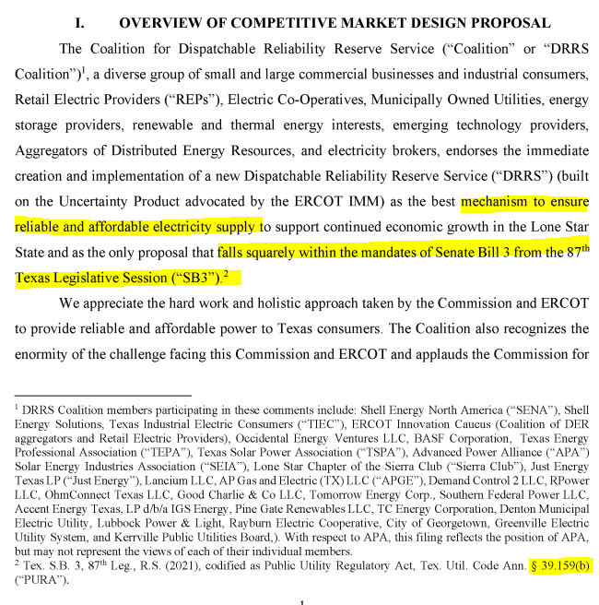
Origins of DRRS
Comments filed by the DRRS Coalition (December 2022) “built on the Uncertainty Product advocated by the IMM … as the best mechanism to ensure reliable and affordable electricity supply … that falls squarely within the mandates of [SB3’s codification of PURA 39.159(b)],” also adding:
  “Development of [DRRS] will best resolve ERCOT's reliability concern by both guaranteeing real-time availability and sending market signals to attract new investment in flexible dispatchable resources that best meet system needs.”
  “Together with a policy commitment to the approach, this process would provide market certainty, a revenue stream, and new investment incentive for the types of flexible dispatchable resources capable of efficiently resolving system reliability issues, as the investment in more variable resources and new sources of demand grow and change.”
Notes:
Arguably the link to the reliability standard in PURA 39.159(b) is this “policy commitment to the approach.”

Slide 5
Origins of DRRS
Importantly, the DRRS Coalition presented DRRS explicitly as an alternative to the PCM (as well as the LSEO and FRM proposals, which were characterized by the DRRS Coalition as “capacity market” proposals), stating:
“This proposed approach [DRRS] is superior to any of the administrative capacity procurement models presented in the E3 Report, (i.e., the [PCM], the [FRM], and the [LSEO]…). These proposed Capacity Market Constructs will not effectively value and incentivize new steel in the ground…”
“Compared with the proposed Capacity Market constructs, a targeted Ancillary Service product [DRRS] and potential modification of existing Ancillary Services is better suited for resolving the current reliability concerns and would better provide pricing signals for additional flexible, dispatchable resource investment.”
“Compared to an Ancillary Service [DRRS], PCM … creates too much risk and hence shifts additional cost burden onto consumers through an added risk premium in consumer rates. The hedging risk for an Ancillary Service product [DRRS], on the other hand, is much smaller and thus more cost effective for customers”

Slide 6
Origins of DRRS
Similarly, the Bates White Report (May 2023) advocated for DRRS in contrast to the PCM and estimated a necessary DRRS procurement quantity ~9.5 GW:
“By enhancing the revenues available to dispatchable resources, DRRS will further incentivize the continued investment in dispatchable generation to meet ERCOT’s reliability needs.”
“PCM would be a novel and untested alteration to the ERCOT market that would be significantly more complex to implement than the DRRS uncertainty product … In contrast [to PCM], DRRS would be much simpler to implement, as it would fit easily into the existing structure of co-optimized energy and ancillary services procurement.”
“We estimate that DRRS would provide annual revenue of approximately $1.7 billion directed to the dispatchable resources that help address forecast uncertainty. Incremental net revenue from DRRS would support the addition or retention of about 9,900 MW of incremental capacity on the ERCOT system”
  “Estimated annual DRRS revenue for 2024 is: 9,491 MW x 8,760 hours x $20.24/MWh /1,000,000 = $1,683 million”

Slide 7
Statutory Requirements
The DRRS program must support the objectives of PURA§39.159(b)-(c):
(b) The commission shall ensure that the independent organization certified under Section 39.151 (Essential Organizations) for the ERCOT power region:
  (1) establishes requirements to meet the reliability needs of the power region;
  (2) periodically, but at least annually, determines the quantity and characteristics of ancillary or reliability services necessary to ensure appropriate reliability during extreme heat and extreme cold weather conditions and during times of low non-dispatchable power production in the power region;
(c) The commission shall ensure that:
  resources that provide services under Subsection (b) are dispatchable and able to meet continuous operating requirements for the season in which the service is procured;
  winter resource capability qualifications for a service described by Subsection (b) include on-site fuel storage, dual fuel capability, or fuel supply arrangements to ensure winter performance for several days; and
  summer resource capability qualifications for a service described by Subsection (b) include facilities or procedures to ensure operation under drought conditions.
Notes:
Note that (2) also specifies “ensure winter performance for several days”

Slide 8
Statutory Requirements
The DRRS must adhere to the following requirements in PURA §39.159(d):
(1) The quantity of DRRS “for dispatchable generation facilities” is “based on historical variations in generation availability for each season based on a targeted reliability standard or goal, including intermittency of non-dispatchable generation facilities and forced outage rates”;
(2) A resource is required to “be capable of running at least four hours at the resource’s high sustainable limit” (though ERCOT “may require a resource to be capable of running for more than four hours as the organization determines is needed”), “be online and dispatchable not more than two hours after being called on for deployment”, and “have the dispatchable flexibility to address inter-hour operational challenges” [note that several of these also tie back to requirements in PURA §39.159(b)-(c)]; and
(3) “Reduce the amount of reliability unit commitment by the amount of [DRRS] procured.”

Slide 9
Statutory Requirements
When considering PURA §39.159 holistically and in its origin context:
DRRS is intended to help meet the requirements of PURA §39.159(b)
DRRS is therefore also intended to help meet the ERCOT reliability standard recently adopted in 16 TAC § 25.508, which “implements [PURA] §39.159(b)(1) as revised by Section 18 of [SB 3] during the Texas 87th Regular Legislative Session”¹
DRRS design and definition must therefore recognize its dual function as both an operational tool and a tool for meeting the reliability standard for the ERCOT region

Slide 10
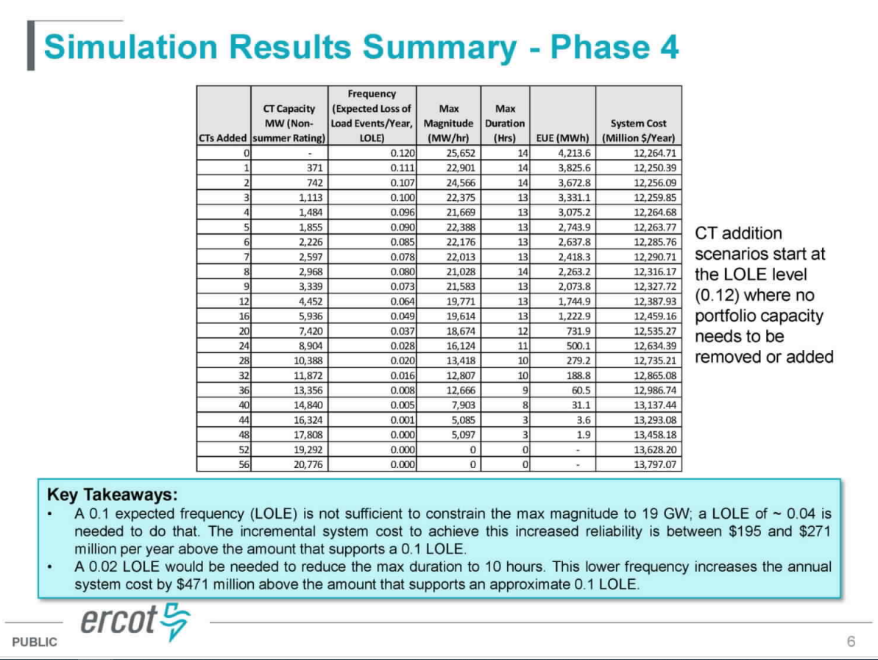
Reliability Standard
ERCOT’s simulation results show that the current system may already violate the reliability standard (0.12 LOLE frequency, 25.6 GW max magnitude, 14 hours max duration)
Shows that conservative approach to DRRS design should be considered now to ensure reliability

Slide 11
Reliability Standard Rule
Adopted 16 TAC §25.508 includes three criteria:
Frequency – equal to or less than one event in 10 years on average
Duration – maximum expected length must be less than 12 hours, with a 1.00% exceedance tolerance
Magnitude – average lost load for a given hour, which must be less than the maximum number of MWs of load shed can be safely rotated during a loss of load event (with a 1.00% exceedance tolerance)

Slide 12
Reliability Assessment
16 TAC §25.508 also requires a three-year reliability assessment:
If there are identified deficiencies, ERCOT must provide the Commission with a menu of proposed market design changes
Market design changes could include revisions to quantities of AS procured, including DRRS
Assessment by rule is required to begin January 1, 2026 – but sooner may be warranted

Slide 13
Comments Regarding Resource Adequacy
IMM’s most recent comments stated that DRRS is more of a spot market product for forecast uncertainty and using the product to cover resource adequacy issues more long-term doesn’t seem appropriate
Is there another product or mechanism that would help the market ensure the reliability standard is met?

Slide 14
Changes to PCM
The Commission endorsed a firm $1 billion gross cost cap based on Commission staff’s recommendation at the August 29, 2024 open meeting
Staff noted in its August 22, 2024 memo:
  This approach would limit the ability of the PCM to achieve a reliability standard by itself, meaning that other market enhancements will be needed in the long-term.
A natural consequence is that DRRS and other market design parameters must play a larger role in meeting the reliability standard

Slide 15
Need for DRRS
DRRS has a very clear and well-documented link to being a tool for meeting the reliability standard and its origins show it was proposed as an alternative to the PCM.
This policy objective should be explicitly considered. To that end, we have developed modifications to the NPRR language to align the program with the stated purpose of the program.

Slide 16
Other DRRS Considerations
The IMM commented that a sloped demand curve would better reflect the marginal reliability value of procuring additional DRRS
  Vistra agrees; the value of DRRS does not vanish at a single price point
  Revisions to the DRRS ASDC should take into account the dual nature of DRRS and ERCOT’s assessment of the current market relative to the reliability standard

Slide 17
Questions/Feedback

