Slide 1
CARD Allocation Proposal
September 24, 2024
WMWG

Slide 2
Description of Proposal
Based on the feedback we received on our previous proposal last month, we have revised our methodology to include more load hours and more variability in when peak hours occur
Under the new approach, we are proposing to:
Take the Top 60 Hours for each month (based hourly load data from ERCOT) = Set A
Take the Top 4 Hours of the Top 15 Days each month = Set B
Determine the set of hours resulting from combining Set A and B = Set C
This revised two-factor approach is conceptually straightforward but difficult to predict, resulting in added “cost” to loads that adjust behavior to maximize CARD revenue (i.e., a load would need to respond 3-4x the actual number of hours in Set C in order to maximize CARD revenue)
Notes:
Just a note on the data – We have vendors who collect data from ERCOT so there may be some small differences between the values in this presentation and the actual settled values.

Slide 3
January 2024
Example 1

Slide 4
Set A – Top 60 Hours

Slide 5
Set B – Top 4 Hours of Top 15 Days

Slide 6
Set C – Combination of Set A and B

Slide 7
May 2024
Example 2

Slide 8
Set A

Slide 9
Set B

Slide 10
Set C

Slide 11
Results

Slide 12
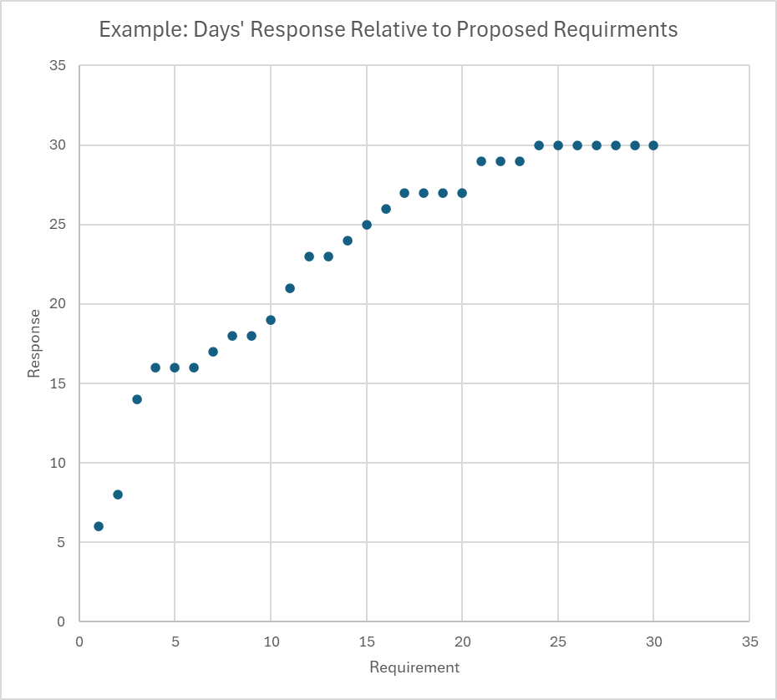
Results
January and May seemed to be indicative of the distribution we would see through the winter and summer months, respectively
To follow the variability in peak hours when combining Set A and B, loads would have to change their behavior even more often than the total unique hours shown in Set C (i.e., 102 hours for January and 76 hours for May) to make sure they are maximizing their load during the top hours that would go into the average each month
This demonstrates that we do not need to create a methodology that includes as many as eight hours a day for each day of the month to get the desired result
Diminishing “multiplier effect” at larger requirements

Slide 13
2021 to 2024
Summary of Set C Hours

Slide 14
Total Set C Hours

Slide 15
Benefits of Proposed Approach

Slide 16
Benefits of Proposal
Disincentivize behavior ERCOT and the IMM are concerned about by increasing the number of hours used in the calculation
Less risk of unintended consequences for other market participants/loads (compared to monthly or top eight hours of each the day)
Two-factor approach to calculation of average of values in Set C (which would then be used to determine LRS) is conceptually straightforward but difficult to predict (supporting first bullet above)
While proposal measures ~70 to ~100 hours/month, the 3-4x behavioral “multiplier effect” means actual behavioral adjustment would require closer to 300 hours

Slide 17
Feedback/Questions

