Slide 1
CRR Auction Discussion Items
Samantha Findley
CRR Market Operations
CMWG
September 23, 2024

Slide 2
Agenda
Share more analysis about submitted transactions/bidding behaviors
Discussion of potential CRR changes
ERCOT’s path forward

Slide 3
Avg Transactions submitted by CRRAH over the last 11 LTAS auctions

Slide 4
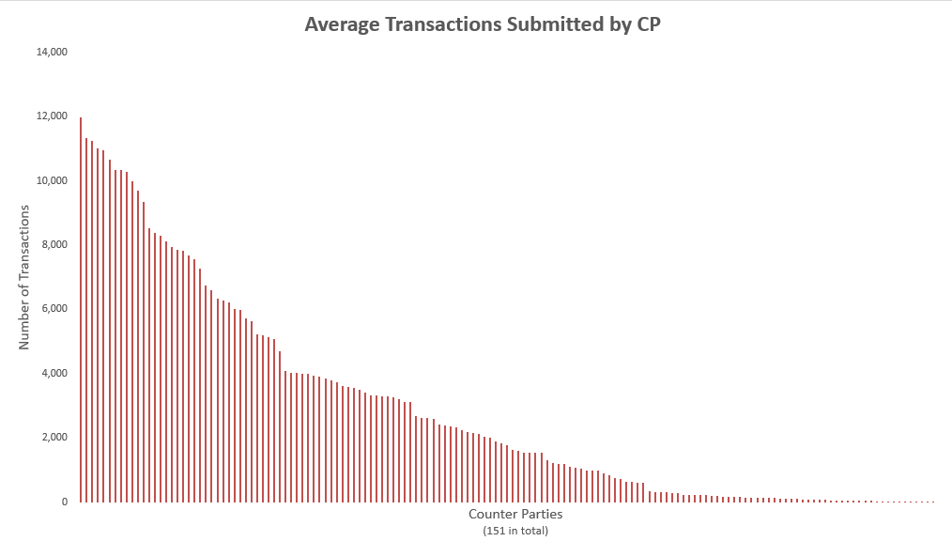
Avg Transactions submitted by Counter-Party over the last 11 LTAS auctions

Slide 5
ERCOT’s 3 types of paths forward
Problem statement:
ERCOT CRR Auctions have increasing performance issues and risks due to increasing population of bids.
Resolution path #1- Administrative guardrails (priority to reduce risk of a TAP and risk of long-running solution times)
Resolution path #2- Market Incentives to scale back participation to within administrative guardrails
Resolution path #3- Market redesign to increase performance

Slide 6
Resolution path #1- Administrative guardrails (priority to reduce risk of TAP and long-running solution times)
Administrative TOU limits- Mitigation has already been introduced (new per-TOU limit for current SEQ6)
Administrative lowering of bids per CRRAH- reducing per-CRRAH limit by xx % will reduce risk of Transaction Adjustment Period
Update TAC-approved CRR transaction limits, both at total auction level and for per-CRRAH limits
In parallel, ERCOT will explore appropriate limits for each LTAS auction in a “TAC approved document” like CRR Activity Calendar
Examples: SEQ 1 450kOverall/150kTOU/4000CRRAH and SEQ6 300k/100kTOU/2500CRRAH

Slide 7
Resolution path #2- Market Incentives to scale back participation to within administrative guardrails
Minimum Option Bid Price - Increasing existing min bid price from $0.01 to TAC approved value (example, $0.25) would create downward pressure on volume of CRR Option bids – ERCOT-sponsored NPRR
Unawarded Bid fee for Options - Introduce bid fee for unawarded Options to create downward pressure on bid levels- NPRR and system change

Slide 8
Resolution path #3- Market redesign to increase performance
Discontinue multi-month bids in LTAS - ERCOT to begin a study to convert multi-month bids into single-month bids and assess expected gain in performance (although would create more bids, reduces strain on optimization solving over multiple models/months).
Different levels of Network Model Percentages - smaller scale network models <30% have performance issues (SEQ4 – SEQ6 auctions). May reconsider current scaling percentages in protocols.
Other ideas?

Slide 9
Next steps
ERCOT will be working to file an NPRR that conceptually provides for the following discussed items:
Administrative TOU limits
Administrative lowering of bids per CRRAH
Minimum Option Bid Price
ERCOT to begin study for removal of multi-month bids

