Slide 1
ERCOT Frequency Events
August 2024
ERCOT
Operations Planning
PDCWG | September 18, 2024

Slide 2
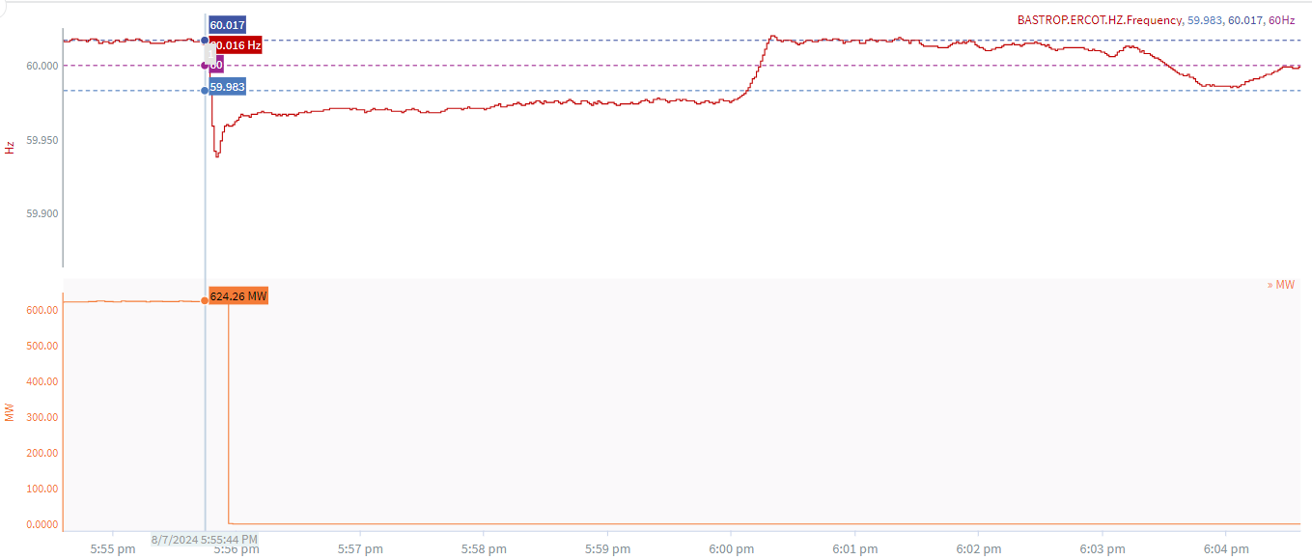
8/7/2024 17:55:44(Non-FME)
Notes:
The unit tripped offline while carrying approximately 624 MW
Starting Frequency: 60.017 Hz
Minimum Frequency: 59.938 Hz
A-C Time : 6 seconds
Recovery Time(back to deadband): 4 minutes 23 seconds
ECRS Released: 0 MW
Nonspin Released: 153.95 MW
Trip Reason: Circulating Water Pump
Contextual Information: A total of 411 MW of regulation Up was deployed during the event
No Selection Reason: C point is too small

Slide 3
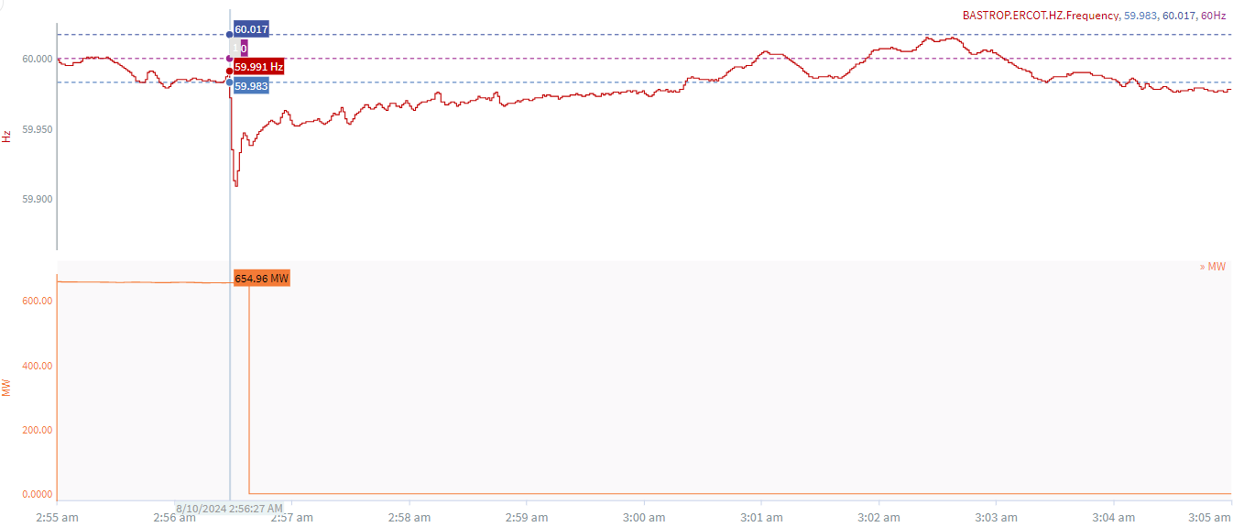
8/10/2024 2:56:27(FME)
Notes:
The unit tripped offline while carrying approximately 655 MW
Starting Frequency: 59.984 Hz
Minimum Frequency: 59.909 Hz
A-C Time : 4 seconds
Recovery Time(back to deadband): 3 minutes 54 seconds
ECRS Released: 0 MW
Trip Reason: Unknown at this time.
Contextual Information: A total of 142 MW of regulation up was deployed during the event.
.

Slide 4
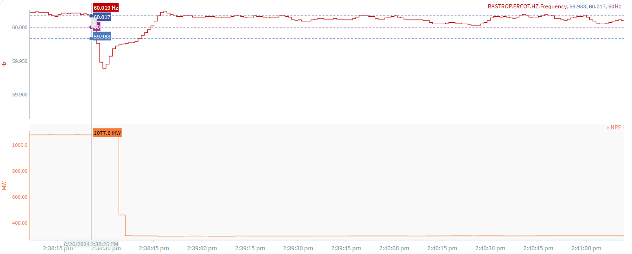
8/26/2024 14:38:25(Non-FME)
Notes:
The unit experienced runback and partially tripped offline while carrying approximately 1078 MW
Starting Frequency: 60.019 Hz
Minimum Frequency: 59.939 Hz
A-C Time : 4 seconds
Recovery Time(back to deadband): 0 minutes 15 seconds
ECRS Released: 0 MW
Trip Reason: Unknown at this time.
Contextual Information:
Wind generation ramped 213 MW from 14:38:25-14:38:55.
Solar generation ramped 273 MW from 14:38:25-14:38:55.
No Selection Reason: C point is too small

Slide 5
Questions?
Thank you!

