Slide 1
EAL Change Proposals
Scenario #5C & D, #5E & F
Sanchir Dashnyam
ERCOT Market Credit Manager
ERCOT Public
September 18, 2024

Slide 2
Invoice Exposures – Definitions
Invoice exposures – New
M1 days forward invoices + 7 days look back actual invoices
M1 days could range from 10 to 21 days depending on weekends/holidays, MP activity
Invoices exclude M&N securitization invoices, CRR auction invoices, miscellaneous invoices relating to $2B distributed to market for Sec N on 6/21/22
Data is for a period covering 11/21/2021 through 4/30/2024
Excluded CARD invoices
TPEA excludes Uri invoices, PUL uplift
Excluded CARD credits from OUT
TPEA – Invoice exposures = Gap
Negative gap is when invoice exposures exceed TPEA (less than -$10,000)
Positive gap is when TPEA exceeds invoice exposures (more than $10,000)
Independent amounts posted as a result of NPRR1165 are not included in these calculations. IA’s are part of TPES.

Slide 3
Current EAL Formula vs. Scenarios #1, #1a and 1b
Current: EAL _{q} = Max [IEL during the first 40-day period only beginning on the date that the Counter-Party commences activity in ERCOT markets, RFAF * Max {RTLE during the previous lrq days}, RTLF] + DFAF * DALE + Max [RTLCNS, Max {URTA during the previous lrq days}] + OUT _{q} + ILE _{q}
OUT _{q} = OIA _{q} + UDAA _{q} + UFA _{q} + UTA _{q} + CARD*
Scenario #1: EAL t = Max [RFAF * Max { RTNLE during the previous lrt days}, FAF*RTNLF] + DFAF * DALE + Max [RTLCNS NLCD, Max {ULERTA during the previous lrq days}] + OUT (included UDAA)
NLE = Total net liability extrapolated (Last 14 days RTM Initial Statement Average + Last 14 days DAM Initial Statement Average based on RTM Initial OD)*M1. Use same RTM ODs for DAM as well
NLF = net liability forward = 1.5 * NLCD
NLCD = (7 most recent Operating days Real time estimates + 7 most recent DAM ODs day-ahead) if settled data is available use settled else estimates – no price cap
FAF = 21 future / most recent days 7 RTM Prices
ULE = unbilled liability extrapolated (Last 14 days RTM Initial Statement Average + Last 14 days DAM Initial Statement Average based on RTM Initial OD)*M2 - use same RTM ODs for DAM as well
Scenario #1a: EAL = Max [RFAF * Max { RTNLE during the previous lrt days}, FAF*RTNLF] + DFAF * DALE + Max [RTLCNS (RTLCNS + UDAA), Max {ULERTA during the previous lrq days}] + OUT
Scenario #1b EAL t = Max [RFAF * Max { RTNLE during the previous lrt days}, FAF*RTNLF] + DFAF * DALE + Max [RTLCNS NLCD, Max {ULERTA during the previous lrq days}] + OUT
OUT t = OIA + UFA + UTA + CARD* (S1a and S1b excludes UDAA)

Slide 4
Scenarios #2, #3 and #4
Scenario #2*: EAL q = Max [IEL during the first 40-day period only beginning on the date that the Counter-Party commences activity in ERCOT markets, Max{(RFAF * Max {RTLE) during the previous lrq days}, RTLF] + DFAF * DALE + Max [RTLCNS, Max {URTA during the previous lrq days}] + OUT q + ILE q
Scenario #3*: EAL q = Max [IEL during the first 40-day period only beginning on the date that the Counter-Party commences activity in ERCOT markets, RFAF * Max {RTLE during the previous lrq days}, RTLF] + DFAF * DALE + Max [RTLCNS, Max {URTA during the previous lrq days}] + OUT q + ILE q
  Two RFAF’s: CP specific RFAF and Global RFAF
  CP specific RFAF = Projected Real-Time ICE Forward Average Price / Max RTLE date Historic Real-Time Settled Average Price
  Global RFAF is calculated based on existing methodology. Global RFAF is used in MCE calculations.
Scenario #4*: Take Scenario #1a as a basis: EAL = Max [RFAF * Max { RTNLE*FAF during the previous lrt days}, FAF*RTNLF] + DFAF * DALE + Max [RTLCNS (RTLCNS + UDAA), Max {ULERTA during the previous lrq days}] + OUT
  Apply FAF against NLE, then take the Max and compare against FAF*NLF. Essentially combine Scenario #2 and Scenario #1
  Establish a floor for FAF at 1
  Increase MCE for load entities (2 days from 1 day) - FAF Revised

Slide 5
Scenarios #5C and #5D
Scenario #5A: Take Scenario #4 as a basis: EAL = Max [RFAF * Max { RTNLE*RFAF during the previous lrq days}, FAF*RTNLF] + DFAF * DALE + Max [RTLCNS (RTLCNS + UDAA), Max {ULERTA during the previous lrq days}] + OUT*
  RFAF_{i} = 21-day future prices / 14 days RTM Prices corresponding to the 14 days in NLE_{i.} Cap RFAF at 1.5. RFAF is applied against NLE. There is a floor for RFAF at 1.00. For each RFAF, we are using the corresponding Operating Day (and not Invoice Business Day) RTM settled prices, which match the respective operating Days in the NLE.
  Apply FAF against NLF. FAF = 21-day future prices / 7 most recent days RTM Prices corresponding to the 7 days in NLF. Set a floor of 1 for FAF.
  Strip out impact of CARD invoices from both invoice exposures and TPEA
  For MCE use RFAF (No floor Or Cap) for a minimum of 2 days for load.
Scenario #5B: The same as #5 above, except the look back period for NLE and ULE changes depending on a season (except for traders):
summer months: 40 days from May 16 through Sep 15,
non summer months: 20 day lookback from Sep 16 through May 15.
Scenario #5C and #5D: The same as #5B above, except there is a lower floor for RFAF as it is applied against NLE (vs. S5B with a floor of 1 )
(1) Scenario 5C – floor is set at 0.75.
(2) Scenario 5D – floor is set at 0.5
Scenario #5E and #5F: The same as #5B above, except for RFAF as it is applied in MCE
Scenario 5E – floor is set at 1
Scenario 5F – ceiling is set at 1.5

Slide 6
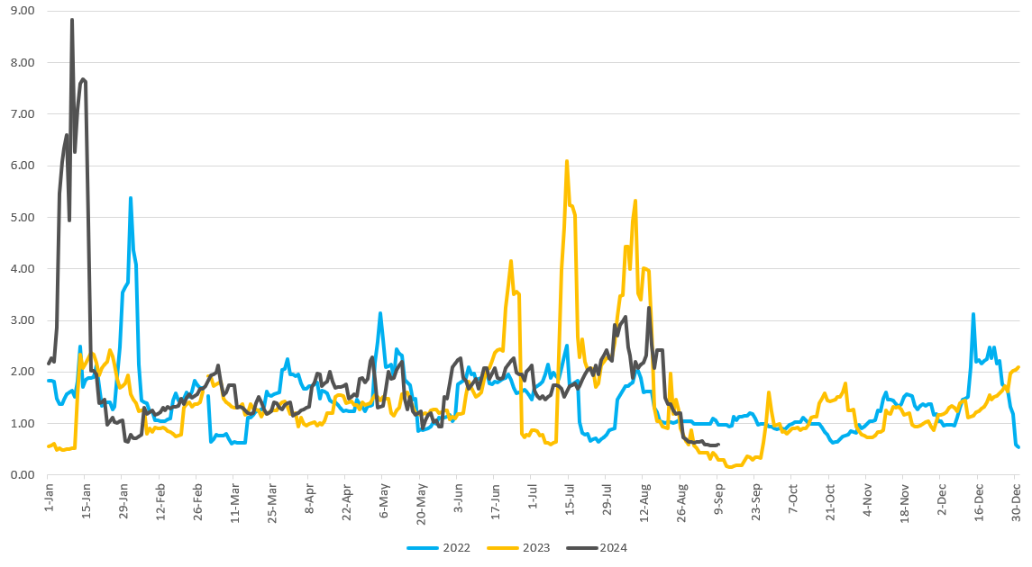
RFAF behavior
RFAF tends to go below 1.00 after the event happens

Slide 7
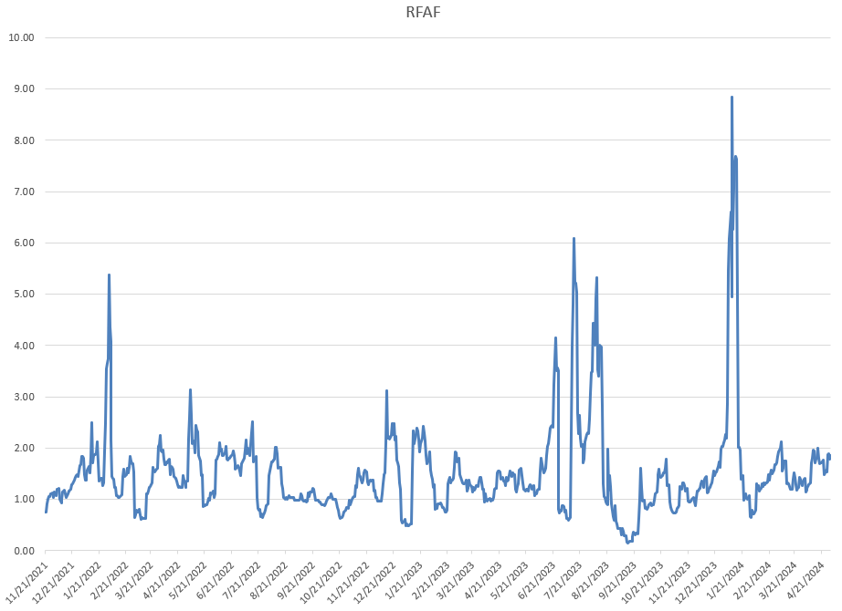
RFAF behavior

Slide 8
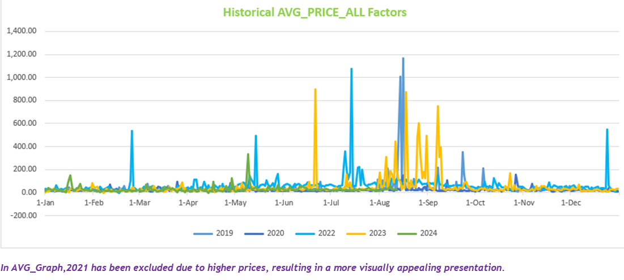
Historical average price comparison

Slide 9
Negative and Positive Gaps: S5C & D compared against S5B

Slide 10
Negative and Positive Gaps: S5C & D compared against S5B
Lowering the floor for RFAF (as it is applied against NLE) to 0.75 results in a significant reduction in the rate of increase of positive gaps. Overall positive gaps increase about 4% compared to 7% for S5B.
Lowering the floor further to 0.50 could result in the increase negative gaps.
ERCOT supports Scenario 5C with a lower RFAF floor of 0.75 for NLE.

Slide 11
Negative and Positive Gaps: S5E & F compared against S5B

Slide 12
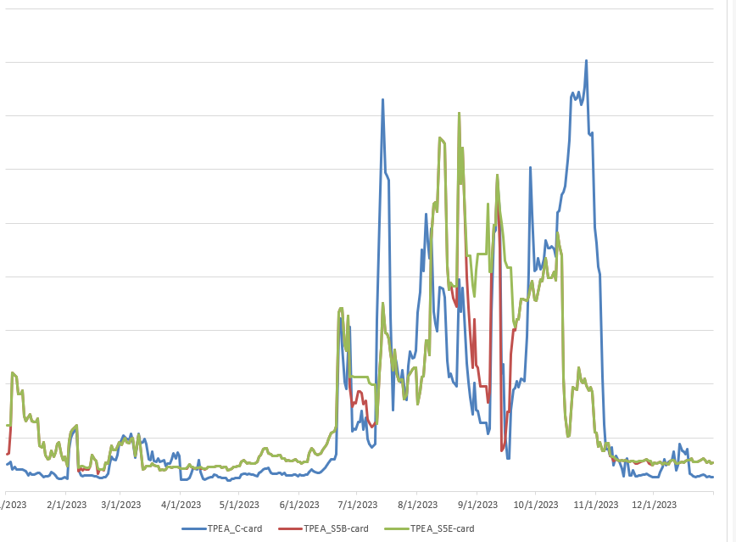
Sample CP – floor of 1 for RFAF for MCE vs. no floor
In situations when MCE is driving the TPEA, i.e., EAL is negative or minimal, putting a floor of 1.00 provides a smoother TPEA, as can been above. This will also lead to low(er) negative gaps.
The floor of 1.00 corrects the discounting of exposures when RFAF drops below 1.00 due to formulaic (high prices roll off from the denominator) reasons. Discounting of exposures below 1.00 would unduly expose the market to potential losses.
The same observation is true during the transition from mild to high volatility period: when MCE is driving the exposures it provides a cushion for volatility and discounting it below 100% goes against the principle of conservatism.

Slide 13
Conclusion:
ERCOT recommends Scenario 5C as outlined above: lowering the floor for RFAF as it is applied against NLE to 0.75 instead of 1 will reduce positive gaps without major changes in negative gaps. However, it is noted that negative gaps will not be reduced as much as under Scenario 5B, especially during the high volatility periods.
As for RFAF for MCE, ERCOT recommends having a floor 1. This is to avoid discounting exposures when TPEA is driven by MCE.
ERCOT does not recommend putting a cap for RFAF as it is applied in MCE. Keeping MCE sensitive to upcoming price volatility, especially during the periods of transition, could make critical difference. Also, there is no material impact on overall negative/positive gaps during the period analyzed.

