Slide 1
RTC+B Task Force
Update
Matt Mereness
RTCBTF
September 13, 2024

Slide 2
Outline
Brief Program update: RTC+B Program Update from Board T&S
Reminder of RTCBTF Review Cycle
Review Improved/Streamlined Issues List
Reminder of Scope of RTC+B Program
Proceed with rest of RTCBTF Agenda

Slide 3
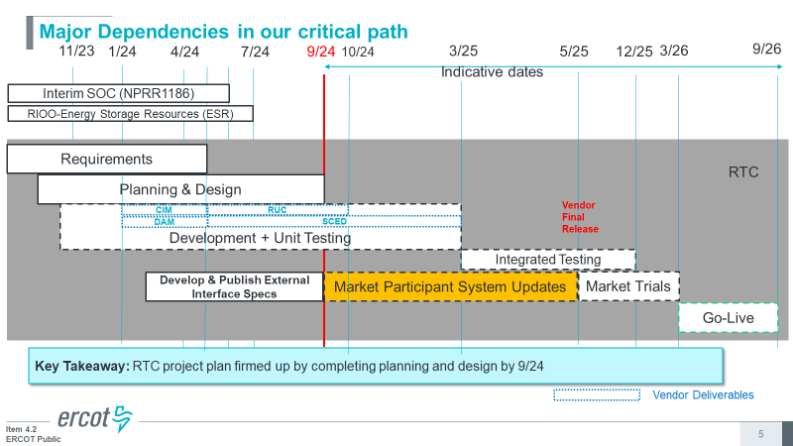
RTC+B Program Update
(excerpt from June Board T&S RTC Update)
ERCOT to publish go-live date before or during September

Slide 4
Sequence and Potential Dates for Market Trials
(dates subject to change while in Planning phase)
May 2025
June 2025
July 2025
Aug 2025
Sep 2025
Oct 2025
Nov 2025
Dec 2025
QSE Attestation
9 months before Trials
Each activity will have a public-facing Scorecard and exit Criteria
3-4 months
2 months
1 month
DRAFT
RTC QSE Submission Testing
(Submit COP, RT AS Offers,
DAM Virtual AS, Outages for ESRs)
Open-loop RTC SCED
(QSE offers, SCED non-binding award/dispatch)
Closed-loop SCED/LFC
(QSE RTC offers and telemetry to support closed-loop frequency control test 2-3 tests of 2-4 hour durations)
Transition to Go-Live
Upon completion of testing, confirmation of ERCOT and market readiness for Go-Live.
RTC QSE Telemetry Check-out (QSEs add/verify new telemetry points for UDSP, New ramp rates, ESR telemetry)
QSE Telemetry Tests
(Individual QSE to follow UDSP and support new ramp rate and ESR telemetry)
Day-Ahead Market
(Non-binding DAM using QSE offers for at least 2 tests)
Current draft of the earliest possible dates for Market Trials and Go-Live that have been shared through TWG and the RTC+B Workshops, in support of Market Participants readiness at RTCBTF.
Actual Market Trials and Go-Live milestones are to be determined and will be communicated no later than 9/30/24.
1-2 months
Updated 2024-05-22

Slide 5
Plans for Meetings and Review Cycles
Reminder of RTC+B Program Scope
  RTC Key Principles were approved to lay foundation of NPRR1007-1013
    Consolidated Key Principles: https://www.ercot.com/files/docs/2020/04/01/RTC_Key_Principle_Quick_Reference.docx
    Library of Key Principles: https://www.ercot.com/mktrules/puctDirectives/rtCoOptimization
  Battery Key Topic Concepts approved to lay foundation of NPRR1014
    https://www.ercot.com/mktrules/keypriorities/bes
  RTC State-of-Charge accounting in NPRR1204
Objective is to present concepts or issues that need to be resolved for an effective implementation.
  Coordinating timelines for interface requirements and testing,
  Providing the forum for any analysis or policy decisions (such as parameter values)
  Coordinating market readiness and cutover activities,
  Review draft Revision Requests or other artifacts necessary to successfully implement the program within the identified timeframes, and discussing other details as needed.
Lessons learned from RTCTF to avoid being delayed in decisions:
  Meeting #1: Initial concept presented by ERCOT staff
  Meeting #2: Comments and alternatives presented by MPs
  Meeting #3: RTCTF consensus achieved or escalated to TAC for a vote to decide the matter.

Slide 6
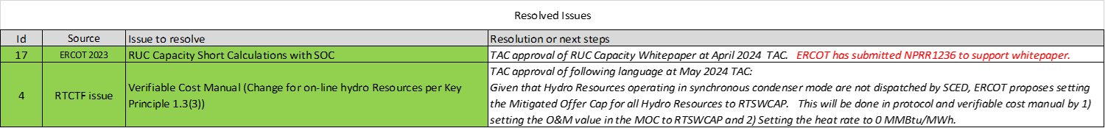
Change to RTCBTF Issues List
Prior to Sept meeting, ERCOT will streamline and align to key risks with program schedule.
OLD LIST

Slide 7
Change to RTCBTF Issues List
New streamlined version posted with meeting for brief discussion

Slide 8
Change to RTCBTF Issues List
How mapped and transitioned into streamlined list

Slide 9
Reminder of Details Scope of RTC+B Program
(Excel version posted with meeting)

Slide 10
Proceed with rest of meeting
Issue 1- Initial Review of Parameters for AS Proxy Offer Curves
Review RTC and ESR Clarifying Revision Requests if market questions
  RTC- NPRR1245 (any updates from ERCOT)
  ESR- NPRR1246, NOGRR268, PGRR118, OBDRR52 (any updates from ERCOT)
Issue 3- RTC Simulator update
Issue 10- Market Trials Plan Review
Discuss Approach to Training/Readiness
Issue 18 – Placeholder for MPs Discussion of AS Demand Curves
  ERCOT posted explanation of ASDC discussion
Heads-up on topics for October RTCBTF meeting
Next meeting in-person/WebEx on Tuesday, October 22, 2024

