Slide 1
Project Update
September 12, 2024
Troy Anderson
ERCOT Portfolio Management

Slide 2
Project Update Agenda
Recent / Upcoming Project Highlights
2024 Release Targets
Priority/Rank Recommendations for Revision Requests with Impacts
NPRR1188 – Implement Nodal Dispatch and Energy Settlement for Controllable Load Resources
NPRR1244 – Clarification of Controllable Load Resource Primary Frequency Response Responsibilities
Technology Working Group (TWG)
Next meeting is 9/26/2024
Impact Analysis Accuracy Report
Location of Revision Request Project Information: http://www.ercot.com/services/projects

Slide 3
Recent / Upcoming Project Highlights
2024 August Release – R8 – 8/22/2024 Complete
NPRR1058 – Resource Offer Modernization
NPRR1131 – Controllable Load Resource Participation in Non-Spin
OBDRR040 – ORDC Changes Related to NPRR1131
NPRR1186(b) – Implement consideration of ESR SOC in ERCOT tools and studies
60 Day Reports
SCR821 – Voltage Set Point Target Information for DGR or DESR
2024 September Release – R9 – 9/26/2024 In Flight
NPRR1002 – BESTF-5 ESR Single Model Registration and Charging Restrictions in Emergency Conditions
RRGRR023 – Related to NPRR1002
NOGRR208 – Related to NPRR1002
Forecast Presentation Platform – CDR Reports
Note: Projected Go-Live dates are subject to change. Please watch for market notices as the effective dates approach.

Slide 4
2024 Release Targets – Approved NPRRs / SCRs / xGRRs
R1
R3
R5
January 1/25 | February 2/22 | March 3/28 | April 4/25 | May 5/30 | June 6/27
NPRR1092(b) PGRR098(a) ESR Telemetry Public API Enhancements | NPRR1132(a) RRGRR032 NOGRR249(b) NPRR1184(a) NPRR1026(b) NPRR1172(a) | NPRR1040 NOGRR247(a) NPRR1165 NPRR989(a) NPRR1038 NOGRR204(a) |  | SCR819 NPRR1111 Securitization Default Charge Supporting Data | NPRR1149 NPRR1186 NPRR1196 NPRR1121 NPRR1090 NPRR962 NPRR1139 NPRR1205(a)
R2
R4
R6
ü
ü
ü
ü
ü
ü
ü
ü
ü
ü
ü
ü
ü
ü
ü
ü
ü
ü
ü
ü
ü
ü
ü
ü
ü
ü
ü
ü
ü
ü
1/1
3/11
Various effective dates
2/1
2/26
4/1
6/1
2/16
3/1
ü
7/1
ü
R7
R9
July 7/25 | August 8/22 | September 9/26 | October 10/24 | TX SET 5.0 11/10 | December 12/11-12/12
 | NPRR1058 NPRR1131 NPRR1186(b) OBDRR040 SCR821 | Forecast Presentation Platform (CDR rpts) NPRR1002 RRGRR023 NOGRR208 | NPRR1205(b) | NPRR1095 SCR817 SCR823 RMGRR172 RMGRR168 RMGRR179 | NPRR1183 PGRR088 PGRR094 SCR799
R8
R10
R11
E
E
E
E
E
E
E
E
E
E
P
E
E
P
11/1
Q4
E
Go-live dates can differ from Protocol effective dates – Please refer to market notices for more details
APPENDIX
Red Text: New additions and target release changes
Strike-Through Text: Previous target release
(a), (b), etc.: Multiple phase release
Project Status Codes
NS = Not Started
I = Initiation
P = Planning
E = Execution
H = On Hold
NPRR989(a) – ESR tech. req.
NPRR1026(b) – SLF – Reporting
NPRR1092(b) – Limit RUC Opt-Out
NPRR1132(a) – RIOO portion
NPRR1172(a) – RUC Process/Clawback
NPRR1184(a) – Interest calcs
NPRR1186(b) – 60 Day Reports
NPRR1205(a) – Credit Limit %
NPRR1205(b) – Credit Rating
NOGRR204(a) – ESR tech req
NOGRR247(a) – UFLS changes
NOGRR249(b) – MIS posting
PGRR098(a) – Section 4.1.1.8
Release targets are subject to change

Slide 5
Priority / Rank Recommendations for Revision Requests with Impacts
Recommendations for…
Revision Request | Description | Priority | Rank | Comments
NPRR1188 | Implement Nodal Dispatch and Energy Settlement for Controllable Load Resources | 2026 | 390 | $1.8M-$2.5M, 18-24 months Impacted System(s): MMS, S&B, Credit, EMS, Reporting, Integration, Registration, ERCOT.com, EPS Metering REGULATORY ERCOT recommends post-RTC+B project
NPRR1244 | Clarification of Controllable Load Resource Primary Frequency Response Responsibilities | TBD | TBD | $70k-$100k, 5-7 months Impacted System(s): NDCRC, EMS Market input requested: Is this critical enough to try to implement in parallel with RTC+B or can it wait until 2026?
PPL Rank Information
Next available 2024 Rank in Business Strategy = 4110
Next available 2025 Rank in Business Strategy = 4530
Next available 2026 Rank in Business Strategy = 4710
Next available Rank in Regulatory = 390

Slide 6
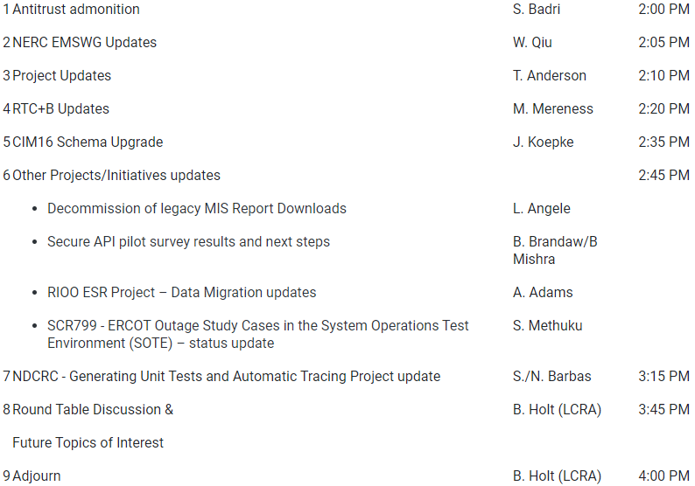
Technology Working Group (TWG)
Agenda for TWG meeting held on 8/29/2024:
Next TWG scheduled for 9/26/2024

Slide 7
Variance from IA Cost Range – Revision Request Projects
26
10
Exceeds IA Range
9 Projects
3
12
4
7
Actual $ Variance from IA Range
5
21
23
Within IA Range
14 Projects
6
8
9
11
13
14
16
17
18
19
20
22
24
25
Below IA Range
3 Projects
15
2021
10 Projects
15 Revision Requests
2022
11 Projects
23 Revision Requests
2023
5 Projects
9 Revision Requests
If actual spend falls within the IA range the variance is 0
Note: Graph compares the posted IA cost range with the actual project spend

Slide 8
Variance from IA Duration Range – Revision Request Projects
7
4
Exceeds IA Range
7 Projects
Duration Variance from IA Range
9
21
6
12
Within IA Range
10 Projects
10
3
8
13
14
15
17
22
23
24
26
5
11
19
20
1
16
18
Below IA Range
9 Projects
2
2021
10 Projects
15 Revision Requests
2022
11 Projects
23 Revision Requests
2023
5 Projects
9 Revision Requests
If actual duration falls within the IA range the variance is 0.
Note: Graph compares the posted IA duration range with the actual project duration

Slide 9
Revision Request Project Legend
NPRR1081, Revisions to Real-Time Reliability Deployment Price Adder to Consider Firm Load Shed
NOGRR195, Generator Voltage Control Tolerance Band
NPRR998, ERS Deployment and Recall Messages
NPRR905, CRR Balancing Account Resettlement
SCR811, Integrate Solar Forecasts and SCR811 Implementation
SCR789, Update NMMS Topology Processor to PSS_E 34 (35) Capability - Phase 1 Only
NPRR902, ERCOT Critical Energy Infrastructure Information
NPRR974, NPRR978, NPRR1048, SCR806, Alignment with Amndmnt PUCT SubsRule 25_505_Schedule
SCR804, ERCOT GridGeo Access for Transmission Operators
NPRR986, NPRR971, NPRR1043, Implementation of NPRR986 BESTF-2 and NPRR971
SCR812, Create Intermittent Renewable Generation Integration Report
NPRR1097, Create Resource Forced Outage Report
NPRR939, Modification to Load Resources Providing RRS to Maintain Minimum PRC on Generators During Scarcity Conditions
SCR800, SCR809, Implementation
NPRR1108, ERCOT Shall Approve or Deny All Resource Outage Requests
NPRR1120, Create Firm Fuel Supply Service
SCR815, MarkeTrak Upgrade & Enhancements
NPRR1093, NPRR1101, Load Resource Participation in Non-Spinning Reserve
NPRR917, NPRR1016, NPRR1052, NPRR1065, NOGRR212, PGRR082, RRGRR026, DGR DESR Implementation Strategy
NPRR1103, NPRR1114, Securitization - Subchapter N
NPRR863, NPRR1015, NPRR1079, NOGRR187, FFR Advancement
NPRR1154, Include Alternate Resource in the Availability Plan for the Firm Fuel Supply Service
NPRR1020, EPS Metering - Allow Some Integrated Energy Storage Designs to Calculate Internal Loads
NPRR1103, NPRR1114, Securitization Phase 2A - Maine Invoice and Credit Exposure
SCR789, Update NMMS Topology Processor to PSS_E 34 (35) Capability – Phase 2
NPRR863, NPRR1085, NPRR1096, NPRR1148, Creation of ERCOT Contingency Reserve Service (ECRS)

