Slide 1
Proxy AS Offer Price Floor: Analysis and Recommendations
Weifeng Li
Zhengguo Chu
RTCBTF
September 13, 2024

Slide 2
Outline
To facilitate a better understanding of what an appropriate proxy AS Offer floor should be in RTC and how, in today’s Real-Time Market, proxies are being created for energy offers, ERCOT has conducted two studies:
Study 1: Quantify how many proxy energy offers are created and the total proxied MW in Real-Time Market per SCED run.
  We looked into both the “fully proxied EOC” as well as “partially proxied EOC”
    Fully proxied EOC: For Resources without submitted Three-Part Offers
    Partially proxied EOC: For Resources with submitted Three-Part Offers but not covering the full range.
Study 2: Analyze historical AS Offers and identify offering patterns and behaviors.

Slide 3
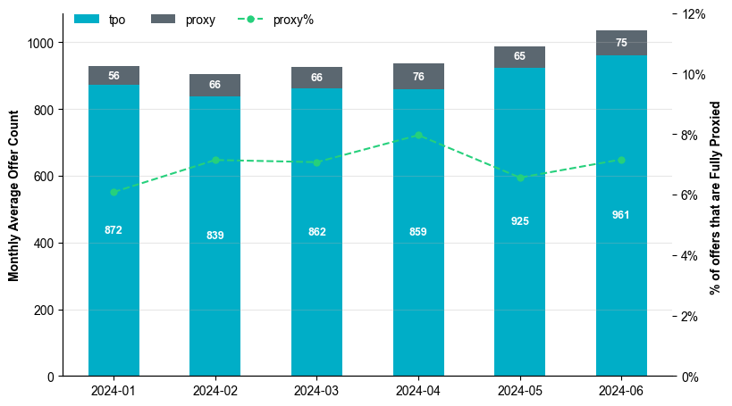
Energy Proxy Offer Count Per SCED Run
Proxy offer count for each SCED run is defined as the total number of Resources without a Three-Part Supply Offer (TPO) that have a proxied Energy Offer Curve (EOC) in the Real-Time Market.
  The 1st SCED interval of every hour in 2024 are analyzed.
  Resources that are on 'ONOS', 'OFF', 'OUT', 'OUTL', 'OFFNS’, 'EMR', 'EMRSWGR' status are excluded from the analysis.

Slide 4
Energy Proxy Offer Count by Resource Type

Slide 5
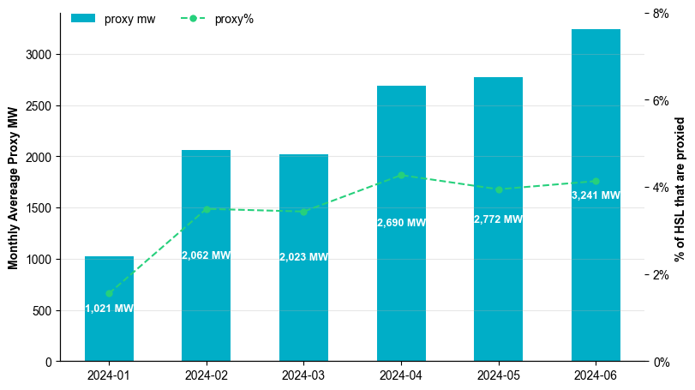
Proxied MW Per SCED Run
Proxied MW Per SCED Run is the Sum of proxied MW of all resources that are not on 'ONOS', 'OFF', 'OUT', 'OUTL', 'OFFNS’, 'EMR', 'EMRSWGR' status.
Proxied MW for each SCED run includes both the partially proxied MW and the fully proxied MW.
For a given resource that has a proxy EOC created,
  If a TPO exists, Proxied MW = Highest Breakpoint on SCED step2 EOC – Max Quantity of Submitted TPO
  If a TPO does not exist, Proxied MW = Highest Breakpoint on SCED step2 EOC

Slide 6
Observations
From Jan 2024 to Jun 2024, on average:
  Approximately 67 Resources’ Real-Time energy offers are fully proxied and they make up ~7% of Real-Time offer curves per SCED run.
    Batteries generally have the most proxied offers.
  Approximately 2,301 MW of energy is proxied and they make up ~3.5% of Real-Time total HSL per SCED run.

Slide 7
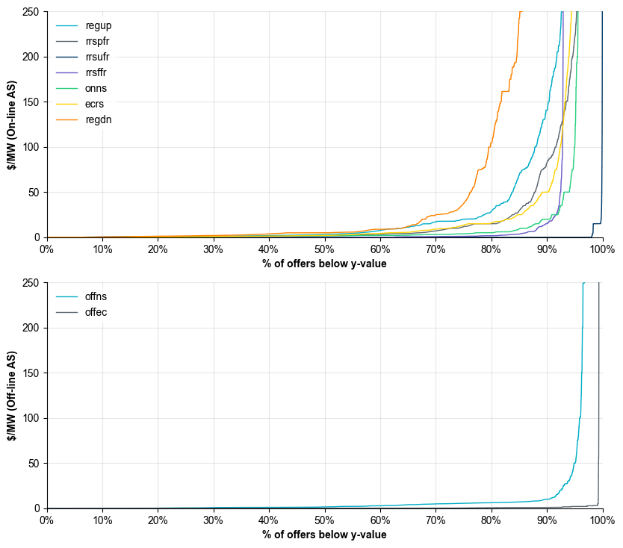
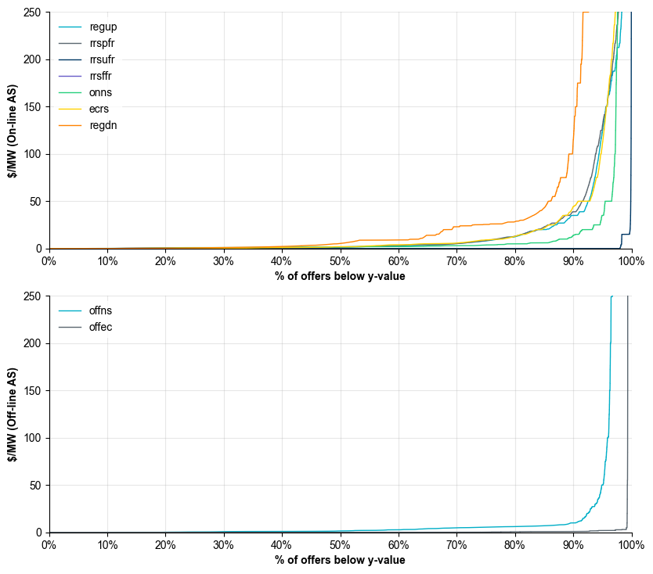
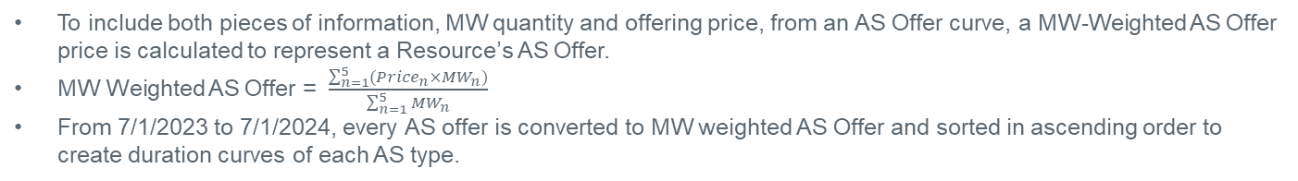
MW Weighted AS Offer
To include both pieces of information, MW quantity and offering price, from an AS Offer curve, a MW-Weighted AS Offer price is calculated to represent a Resource’s AS Offer.
MW Weighted AS Offer = $\frac{\sum_{n=1}^{5}{{(Price}_{n}×{MW}_{n})}}{\sum_{n=1}^{5}{{MW}_{n}}}$
From 7/1/2023 to 7/1/2024, every AS offer is converted to MW weighted AS Offer and sorted in ascending order to create duration curves of each AS type.
All resource type included
ESR and CLR excluded

Slide 8
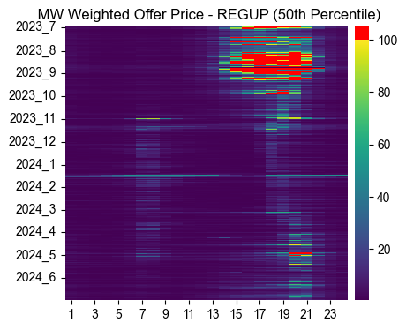
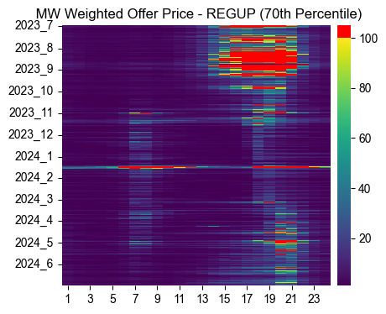
MW Weighted AS Offer- Reg Up
From 7/1/2023 to 7/1/2024, for every hour, each resource’s Reg Up offer is converted to the MW weighted offer.
For every hour, the 50th percentile and 70th percentile of the MW weighted offers are extracted to represent the Reg Up offer price of that hour.
Two hourly heatmaps of MW weighted Reg Up Offer price (50th and 70th percentile) to show seasonal offer patterns
*CLR’s and ESR’s excluded

Slide 9
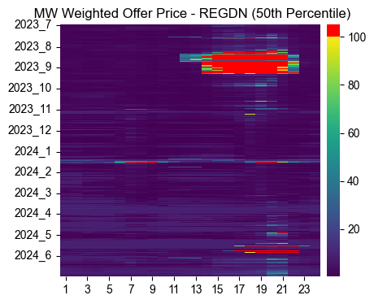
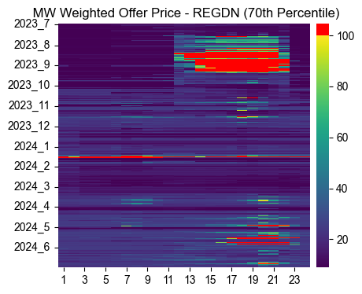
MW Weighted AS Offer- Reg Down
From 7/1/2023 to 7/1/2024, for every hour, each resource’s Reg Down offer is converted to the MW weighted offer.
For every hour, the 50th percentile and 70th percentile of the MW weighted offers are extracted to represent the Reg Up offer price of that hour.
Two hourly heatmaps of MW weighted Reg Down Offer price (50th and 70th percentile) to show seasonal offer patterns
*CLR’s and ESR’s excluded

Slide 10
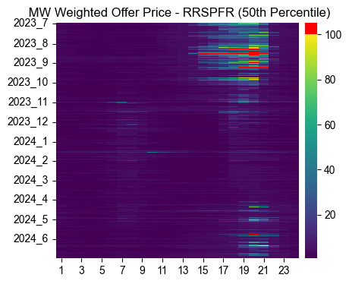
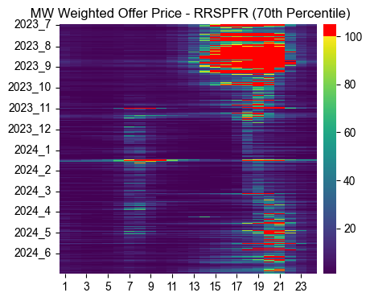
MW Weighted AS Offer- RRS PFR
From 7/1/2023 to 7/1/2024, for every hour, each resource’s RRS PFR offer is converted to the MW weighted offer.
For every hour, the 50th percentile and 70th percentile of the MW weighted offers are extracted to represent the RRS PFR offer price of that hour.
Two hourly heatmaps of MW weighted RRS PFR Offer price (50th and 70th percentile) to show seasonal offer patterns
*CLR’s and ESR’s excluded

Slide 11
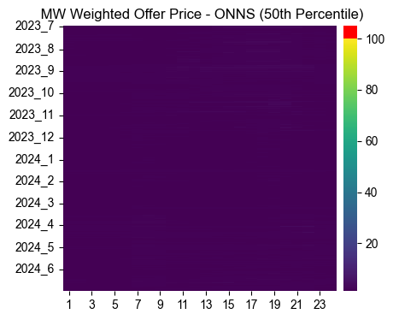
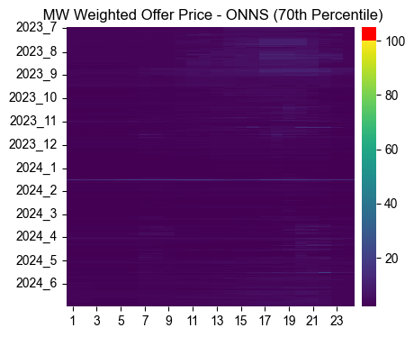
MW Weighted AS Offer- ONNS
From 7/1/2023 to 7/1/2024, for every hour, each resource’s Online NSRS offer is converted to the MW weighted offer.
For every hour, the 50th percentile and 70th percentile of the MW weighted offers are extracted to represent the Online NSRS offer price of that hour.
Two hourly heatmaps of MW weighted Online NSRS Offer price (50th and 70th percentile) to show seasonal offer patterns
*CLR’s and ESR’s excluded

Slide 12
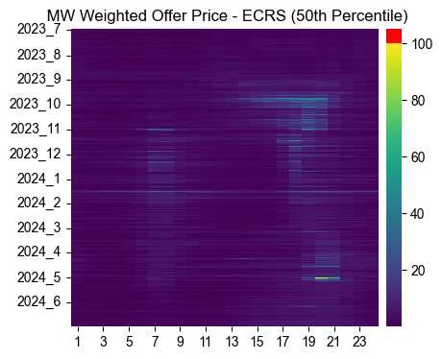
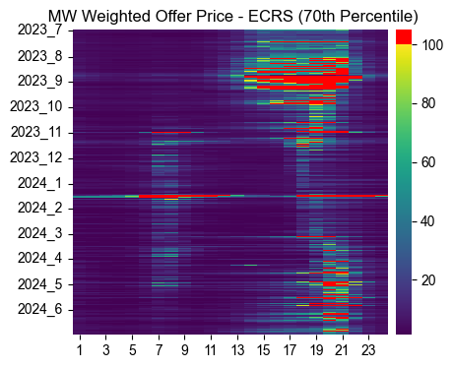
MW Weighted AS Offer- ECRS (Online)
From 7/1/2023 to 7/1/2024, for every hour, each resource’s Online ECRS offer is converted to the MW weighted offer.
For every hour, the 50th percentile and 70th percentile of the MW weighted offers are extracted to represent the Online ECRS offer price of that hour.
Two hourly heatmaps of MW weighted Online ECRS Offer price (50th and 70th percentile) to show seasonal offer patterns
*CLR’s and ESR’s excluded

Slide 13
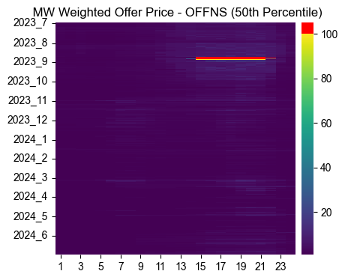
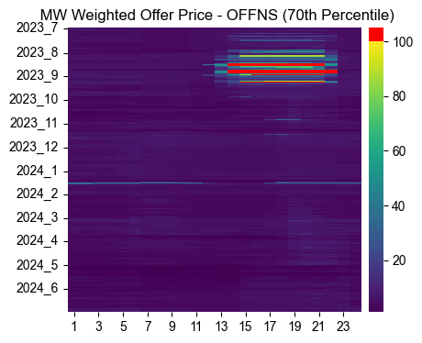
MW Weighted AS Offer- OFFNS
From 7/1/2023 to 7/1/2024, for every hour, each resource’s Offline NSRS offer is converted to the MW weighted offer.
For every hour, the 50th percentile and 70th percentile of the MW weighted offers are extracted to represent the Offline NSRS offer price of that hour.
Two hourly heatmaps of MW weighted Offline NSRS Offer price (50th and 70th percentile) to show seasonal offer patterns
*CLR’s and ESR’s excluded

Slide 14
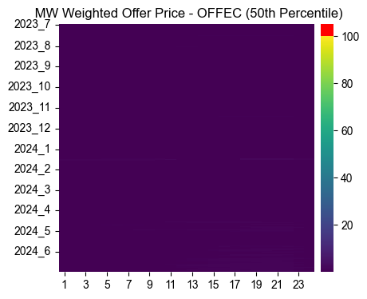

MW Weighted AS Offer- ECRS (Offline)
From 7/1/2023 to 7/1/2024, for every hour, each resource’s Offline ECRS offer is converted to the MW weighted offer.
For every hour, the 50th percentile and 70th percentile of the MW weighted offers are extracted to represent the Offline ECRS offer price of that hour.
Two hourly heatmaps of MW weighted Offline ECRS Offer price (50th and 70th percentile) to show seasonal offer patterns
*CLR’s and ESR’s excluded

Slide 15
Observations
Resources providing AS generally tend to offer at higher prices for summer peak hours. This seems to be a function of higher risk for the QSE during these hours and time of year.
For the rest of the year, the offering price across all AS type tends to be on the lower end (relatively close to 0).

Slide 16
Recommendation
As described in the presentations today, a final proxy AS offer is a function of the floor values, QSE offers for that same AS product, and QSE offers for other AS that the Resource is qualified to provide. The floors primarily come into play only when no offer is submitted by the QSE for the Resource.
Under RTC, a QSE has the ability to update Real-Time AS offers through the Operating Hour.
While there are risks (such as unknown Resource availability) that are applicable to AS Offers in the DAM, these risks are not applicable in Real-Time.
With these points in mind, ERCOT is recommending a value of $0/MW per hour for the proxy AS Offer floor parameters.

