Slide 1
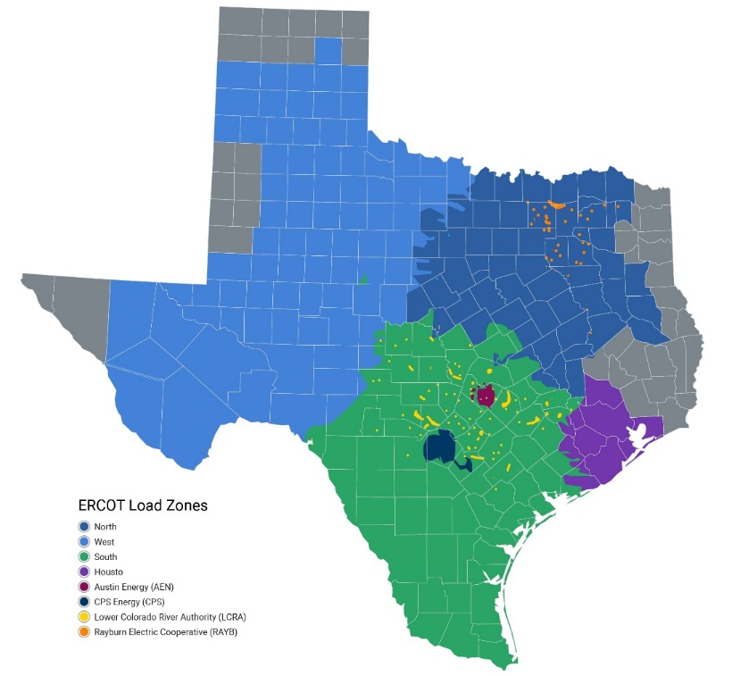
General Review
Demand Response Activities
ADER Pilot Project
  Phase 1 – use ALR framework, Participate in SCED and NSRS
  Phase 2 approved Feb 2024, expanded participation to include ECRS, modified the telemetry validation requirements
  Currently drafting phase 3 changes
    Consider allowing aggregations of blocky loads
    Other relationship changes seen as barriers to participation
  There are currently 3 ADERs participating in the wholesale electric market:
  15.0 MW for energy
  8.6 MW for Non-Spin
  8.73 MW for ECRS
  Primary technology is batteries
0.3 MW (1)
6.1 MW (1)
Energy and Non-Spin participation began in Aug. ’23, ECRS participation began in May ’24.
8 additional ADERs have ERCOT-accepted Details of the Aggregation forms in place
1.9 MW (3)
9 MW (6)

Slide 2
4CP Update
2 alternatives for a 4CP adjustment solution
An NPRR that will focus on adding either a daily report xml / csv files or ICCP telemetry data for WSL.
  Pro – market participants will have the data and can use it for a judgement call
  Pro – ERCOT will have to ensure the inputs are correctly defined so MP understand all the moving parts
  Con – This really doesn’t solve the direct challenge which is having a clear 4CP
  Con – There could be additional information requests
  Con – timing
An NPRR that will focus on removing WSL from a 4CP calculation. MP understand that ERCOT has to have a reported peak for NERC but for the purposes of calculating peak demand subtracting load sends fail signals
  Pro – The true demand will be calculated during 4CP or any monthly CP
  Pro – Historic consumers will have clear targets
  Pro – The market is already built around this
  Pro – ERCOT does not need to adjust or create new ICCP points or data
  Con – Change of the calculation

