Slide 1
CRR Transaction Limits
Samantha Findley
CRR Market Operations
WMS
September 11, 2024

Slide 2
Agenda
Pressure on the optimization continues with increases in CRRAHs and Settlement Points
Historical performance and current risk
Items to pursue in medium- and long-term
Short-term mitigation – enforce TOU limit

Slide 3
Continued increases in CRRAHs and Settlement Points
Continued increases in auction variables (# of biddable Settlement Points, Registered CRRAHs and CPs, submitted transactions) are building pressure on the optimization.
*Reduction in Settlement Points from 2020-2021 due to reclassification of some PUN RNs as non-biddable.

Slide 4
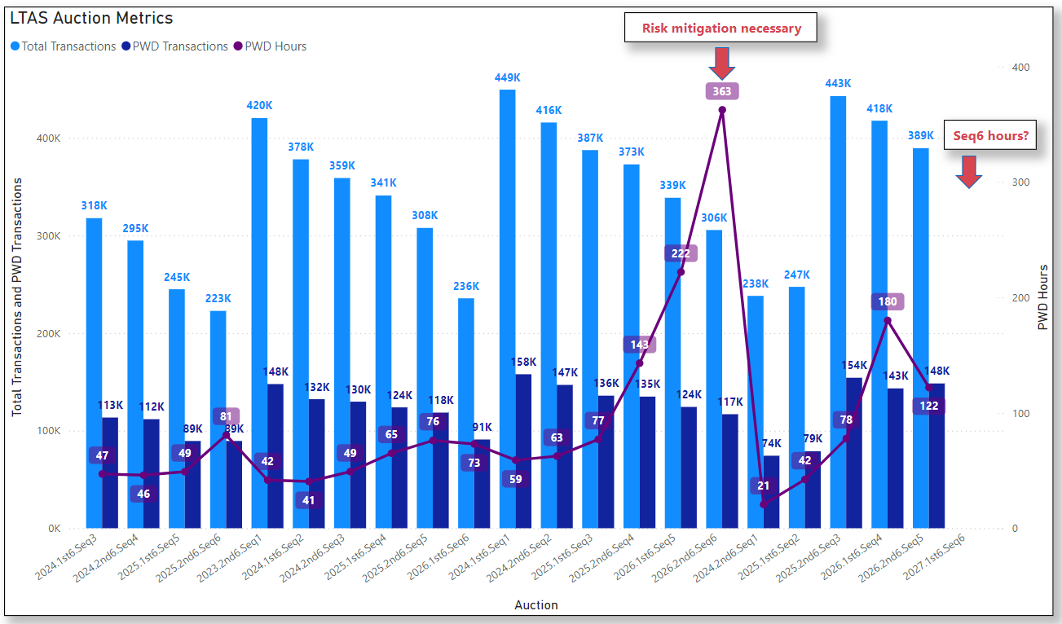
Historical performance and current risk
*2024.2nd6.Seq1 and 2025.1st6.Seq2 had reduced transactions due to transaction adjustment periods.

Slide 5
Medium- and long-term market design changes to increase liquidity and improve performance
Medium-term:
Study and set lower per-CRRAH limits
NPRR936 will move the transaction limits from CRRAH to CP
Increase minimum option bid price with TAC approval (NPRR needed, but no system change)
Long-term:
Remove multi-month bid functionality for LTAS to reduce constraints on the optimization (NPRR and system change)
Modify capacity %s for LTAS to increase capacity for lowest capacity auctions (NPRR, no system change)
Lower per-CRRAH bid limits for Seq 4-6 (TAC approval)

Slide 6
Short-term mitigation for upcoming LTAS auctions
ERCOT has observed extremely long solution times for recent Seq 4-6 auctions, especially when PWD transactions exceed certain thresholds.
LTAS with higher capacity % tend to allow more transactions than the lower capacity % Seq auctions.
Since implementation of SCR807 in December 2023, an additional per-TOU parameter can be used to further limit transactions in addition to the total auction transaction limit.
ERCOT may need to enforce a per-TOU limit (400K / 3 TOUs = 133K per TOU) for each LTAS auction that, if exceeded, will invoke a TAP to ensure the auction will solve timely.
ERCOT may need to enforce this per-TOU limit for the upcoming Seq6 that closes on 9/19, and ERCOT will sponsor an NPRR to codify the use of this TOU limit.
If either the total auction limit (400K+) or the per-TOU limit (133K+) are exceeded, a TAP will be invoked. If a TAP is invoked, an automated message will be posted on the CRR MUI Messages page. ERCOT will also send a market notice within one hour of the auction close.

Slide 7
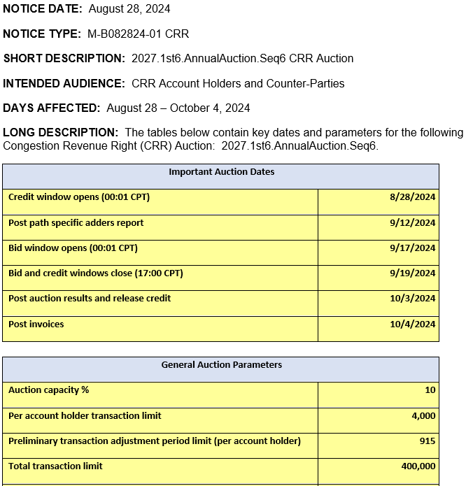
TAP per-CRRAH preliminary transaction limit
A preliminary transaction adjustment period limit is included in each auction notice, using all qualified CRRAHs as possible participants. The preliminary limit for 2027.1st6.AnnualAuction.Seq6 is 915.

Slide 8
TAP per-CRRAH bid limit calculation
Preliminary (estimated) limit calculation:
(auction transaction limit – # of grouped baseload CRRs)
# of Qualified CRR Account Holders
Example:
For upcoming 2027.1st6.AnnualAuction.Seq6: (400,000 – 720)/436 = 915
Per-CRRAH limit calculated after bid window closes:
(auction transaction limit – # of grouped baseload CRRs)
# of Participating* CRR Account Holders
Example:
2026.2nd6.AnnualAuction.Seq6 in March 2024 would have been:
(400,000 – 719)/215 = 1,857
*Participating CRRAHs either own CRRs for the auction period, or their CP has locked credit for the auction.

Slide 9
Appendix: Historical grouped baseload and Participating CRRAHs

