Slide 1
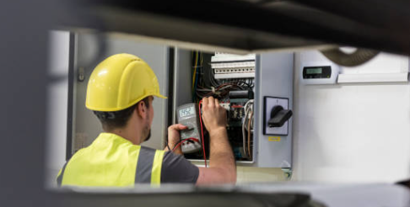
Profile Working Group

Slide 2
August 21st PWG Meeting
Reviewed BUSIDRRQ & BUSLRG Profile Counts
ERCOT monthly profile counts now include LP&L and Nueces
The remaining BUSIDRRQ are EPS Meters or are unlikely to change until the customer is no longer 4CP or a MVO is executed

Slide 3
•Reviewing Annual Validation (AV) Process Enhancement
ERCOT performing formal data analysis and review for AV enhancements
ERCOT committed to providing data analysis at the September's PWG meeting
AV enhancements goals:
•Increased TDSP efficiencies for AV processing
•Retain REP’s value to Load Profile (ex: pricing)
•Provide more accurate Load Profiles to the market
Next PWG Meeting will be 9:30am, September 24, 2024, via Webex

Slide 4
QUESTIONS

