Slide 1

TDTMS Update
RMS
September 10th, 2024

Slide 2
TDTMS
ERCOT Reporting
2025 SLO & Release Calendar – ERCOT finalizing; however, was discussed during August TDTMS that the structure will be the same as 2024 with more frequent, yet shorter duration and one longer retail release. Goal to finalize in September with RMS presentment and approval in October.
System Instances & MT Performance – All July SLAs met.
Listservs – No issues.
Robust discussion concerning aligning retail releases with other production releases; possibly to be performed during the week but that may affect intermittent activity of Find MIS, Find Transactions, and MarkeTrak applications. Additional discussion and protocol updates are needed to align; this may be held off until 2026 calendar year.

Slide 3
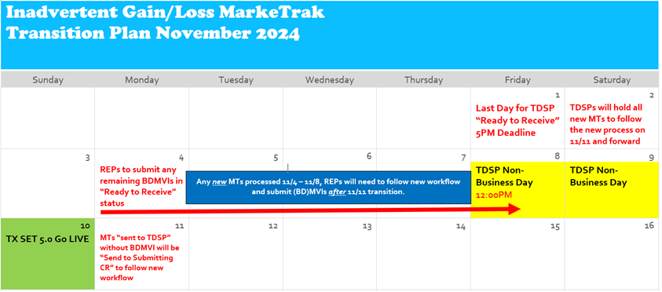
TDTMS
SCR 817
New version of Business Requirements posted to MCT ERCOT.
WSDL currently being tested with no changes identified thus far. Please send questions to ERCOT Retail Operations.
Online module updates progressing and will be reviewed via RMTTF Proposed Transition Plan - UPDATED

Slide 4
TDTMS
SCR 817 Testing & Training
SCR817 Training/Testing Dates
9/18/24 – Training, in-depth, SCR817 changes @ 9:30 AM with TDTMS scheduled at 1:00 PM
10/24/24 – Training, in-depth, SCR817 changes @ 9:30 AM with TDTMS scheduled at 1:00 PM
SCR817 Functionality is scheduled to be available in RMTE on 9/16/24 and a market notice will be sent.

Slide 5
TDTMS
MarkeTrak Subtypes Volumes Analysis
TDTMS plans to collaborate with RMTTF to incorporate anonymous MT analysis data into training for awareness and examples of where there may be process and resource inefficiencies.
REPs can examine their data to:
Reduce volumes of MarkeTraks (unnecessary resource load).
Review REP’s individual performance and measure it against anonymous peer REPs.
Opportunity to enhance REP practices and possibly market practices.
Eliminate duplicative work.
TDTMS has requested additional 2024 data to perform further MT analysis.

Slide 6
TDTMS
Next Meeting – Wednesday, August 14th
DRAFT Agenda:
ERCOT Reports
Wednesday, September 18th – 1:00 PM WebEx only
System Instances & MT Performance
Listserv
Market Notice Archives - update
SCR817 Business Requirements Discussion
User’s Guide Updates
Communicating Transition Plan updates
MarkeTrak Subtypes Volume Analysis 2024
Online module availability
RMTE Availability
SCR817 Training Feedback
Switch Holds, IAGs/IALs, Rescissions

