Slide 1
RTC+B Program
Matt Mereness
TWG
August 29, 2024

Slide 2
Outline
Program update at August Board
Current Issues for RTCBTF
Attestation Scorecard
Next Steps

Slide 3
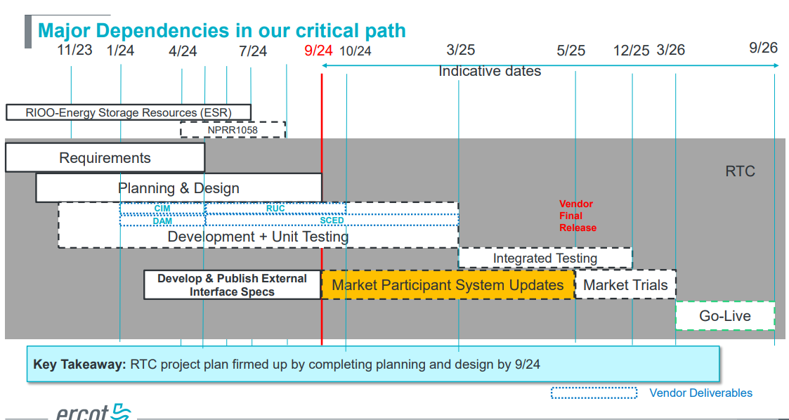
RTC+B Program Update
(excerpt from August Board T&S RTC Update)
ERCOT to publish go-live date before or during September

Slide 4
Sequence and Potential Dates for Market Trials
(dates subject to change while in Planning phase)
May 2025
June 2025
July 2025
Aug 2025
Sep 2025
Oct 2025
Nov 2025
Dec 2025
QSE Attestation
9 months before Trials
Each activity will have a public-facing Scorecard and exit Criteria
3-4 months
2 months
1 month
DRAFT
RTC QSE Submission Testing
(Submit COP, RT AS Offers,
DAM Virtual AS, Outages for ESRs)
Open-loop RTC SCED
(QSE offers, SCED non-binding award/dispatch)
Closed-loop SCED/LFC
(QSE RTC offers and telemetry to support closed-loop frequency control test 2-3 tests of 2-4 hour durations)
Transition to Go-Live
Upon completion of testing, confirmation of ERCOT and market readiness for Go-Live.
RTC QSE Telemetry Check-out (QSEs add/verify new telemetry points for UDSP, New ramp rates, ESR telemetry)
QSE Telemetry Tests
(Individual QSE to follow UDSP and support new ramp rate and ESR telemetry)
Day-Ahead Market
(Non-binding DAM using QSE offers for at least 2 tests)
Current draft of the earliest possible dates for Market Trials and Go-Live that have been shared through TWG and the RTC+B Workshops, in support of Market Participants readiness at RTCBTF.
Actual Market Trials and Go-Live milestones are to be determined and will be communicated no later than 9/30/24.
1-2 months
Updated 2024-05-22

Slide 5
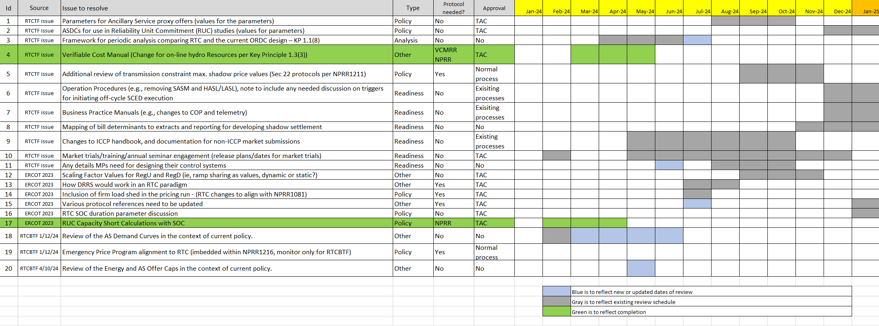
Current RTCBTF Issues List
Prior to Sept meeting, ERCOT will streamline and align to key risks with program schedule.
  Market Trials and Readiness (eg, new telemetry points and how to test in trials)
  Analysis of market outcomes (eg, price formation for certain historical days)
  Parameter values (eg, proxy offer for Ancillary Services)
  Open discussion of other risks and concerns (eg, shape of AS Demand Curves)
Re-Organize
for September

Slide 6
Reviewed at August RTCBTF
Reviewed RTC and ESR Clarifying Revision Requests if market questions
  RTC- NPRR1245
  ESR- NPRR1246, NOGRR268, PGRR118, OBDRR52
Issue 3- RTC Simulator update
  Plan to have initial study capability in mid-late September
Issue 9- Explanation of Market Submission interface changes
  Walk-through of changes in interface from business perspective
    https://www.ercot.com/calendar/08142024-RTCBTF-Meeting (agenda 5)
Issue 10- Market Readiness
  Final review of Market Trials Plan (extending reviewing into September)
  Attestation scorecard (later slide)
Issue 18- Placeholder for MPs Discussion of AS Demand Curves
  No discussion at RTCBTF, but discussion at Board
Issue 8- Mapping of bill determinants to extracts and reporting for developing shadow settlement
  Deep Dive Settlement link: Agenda 9 Materials (1-2 hours)
    https://www.ercot.com/calendar/08142024-RTCBTF-Meeting

Slide 7
Scope of RTC+B Program

Slide 8
Attestation Scorecard as of August 23, 2024
Overall 100% Complete
100 of 106 qualified QSEs with Resources completed as is
5 qualified QSEs do not currently have Resources (so Not Applicable)
1 QSE, LCRA, modified Attestation stating: “LCRA will fully support RTC+B implementation and participate in all market trials conducted in advance of RTC+B go-live. However, LCRA is unable to confirm the market trial timeline identified in ERCOT’s attestation form and will need additional information from its vendors before it can commit to being ready for market trials beginning in May 2025. Because market trials will be dependent on the successful and timely work of these vendors, LCRA is unable to attest to a date certain at this time.”

Slide 9
Next Steps
Upcoming RTCBTF is Wednesday, September 13, 2024
Issue 1- First review of Parameters for AS Proxy Offer Curves
Review RTC and ESR Clarifying Revision Requests if market questions
  RTC- NPRR1245
  ESR- NPRR1246, NOGRR268, PGRR118, OBDRR52
Issue 3- RTC Simulator update
Issue 10- Market Readiness
  Final review of Market Trials Plan (focus on Closed-Loop LFC testing details)
Issue 18- Placeholder for MPs Discussion of AS Demand Curves
  Potential discussion
Discuss approach to Training/Readiness
Questions?

