Slide 1
NDCRC – Automatic Tracing and Unit Tests
Sreenivas Badri, Nick Barbas
August 29, 2024

Slide 2
NDCRC – Automatic Tracing and Unit Tests
Project is in Execution Phase
  NDCRC release deployed into Production on August 23, 2024, to enable direct log in with QSE certificate.
  Next NDCRC release planned for production deployment on September 16, 2024, to incorporate various bug fixes and UX enhancements.
  Platform feasible improvements to the submission form and process that are requested by both ERCOT, and market users will continue in future releases as needed.
Testing Timelines Update
  Parallel Operation is cancelled to allow QSEs to continue to test the NDCRC changes through September 30, 2024, at 08:00 AM.
    Market Notice was sent out yesterday to this effect.
  QSEs to follow current process of emailing ERCOT to make real unit testing requests as usual in September.
  Go-Live on October 1, 2024, will remain unchanged, i.e. the NDCRC application will be used as the exclusive means to submit generating unit test requests beginning October 1, 2024.
  All existing generating unit test request data submitted into NDCRC will be deleted at 10:00 AM on September 30, 2024, in preparation for NDCRC go live on October 1, 2024.

Slide 3
NDCRC – Automatic Tracing and Unit Tests
Changes Implemented in 8/23 NDCRC release
  Logging in with QSE certificate rather than RE certificate is supported
  MPIM roles required for QSE access are QSE_R or QSE_W
  For any QSE that has sub QSEs, the station and unit list on the test request form will include units owned by REs that have working relationships with all your sub QSEs
  If logged in with a certificate that has the QSE_R or QSE_W role, the navigation bar will only display the “QSE Test Request” tab
  If logged in with a certificate that has the NDCRC_RE role, the navigation bar will no longer display the “QSE Test Request” tab
  Combined cycle configurations AND units both appear in the Unit Code drop down

Slide 4
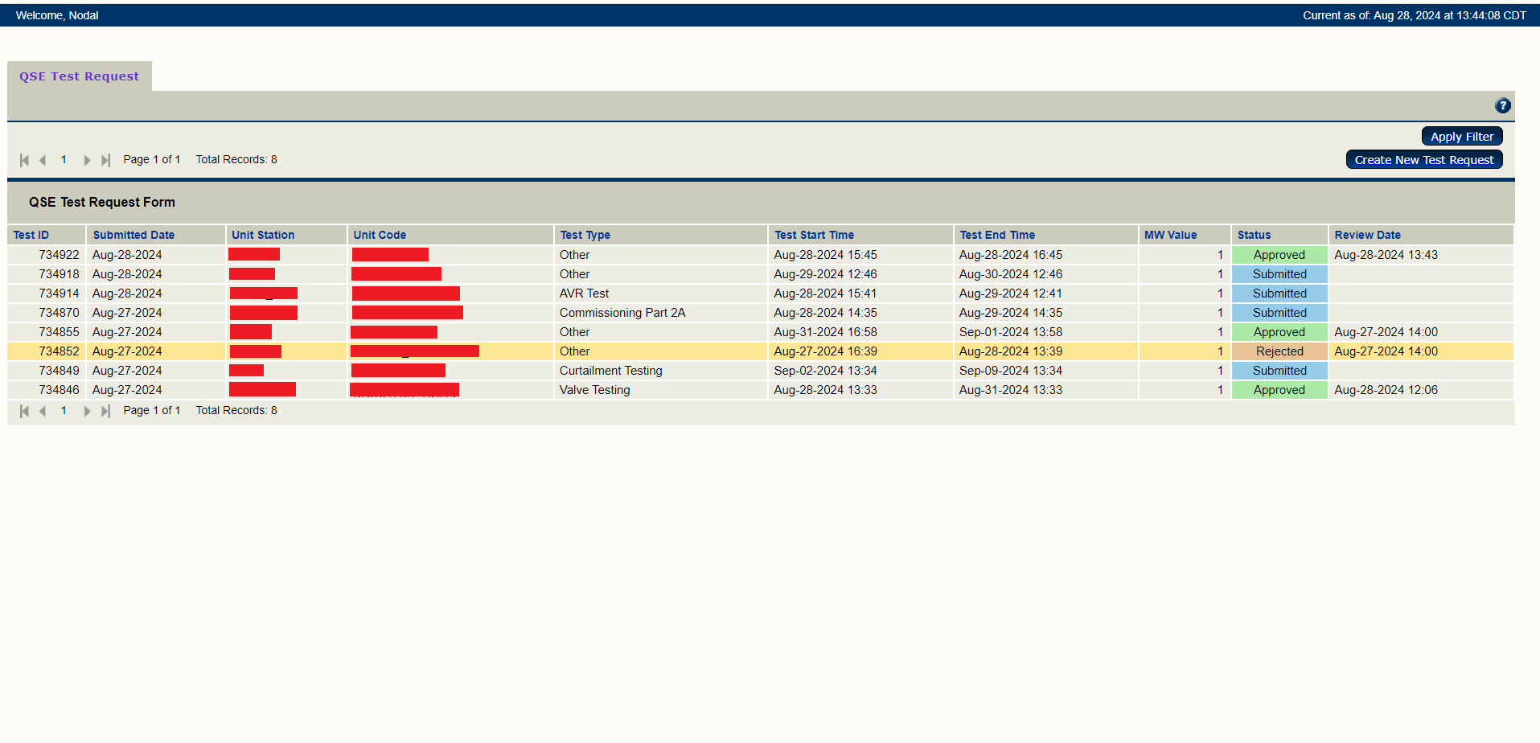
NDCRC – Automatic Tracing and Unit Tests
Dashboard change in 8/23 release

Slide 5
NDCRC – Automatic Tracing and Unit Tests
Changes in 9/16 release
  Increased length of QSE Email field
  Notification emails have added Station Name, Unit Code, Test Type, MW Value, Test Start Time, Test End Time, and Comments to email body
  Attachment filetypes for Word (doc, docx) now supported
  Seconds field for Test Start Time and Test End Time defaults to zero
  Test Start Time and Test End Times are adjustable even after a test is approved, and comments can still be made (adjustments are locked after Test End Time has passed)
  Test Start Time and Test End Time can’t be identical
  Test Type drop down list has been amended (see next slide)
  Dual attachments required for coordinated reactive tests (TO approval and CURL) and single attachment required for non-coordinated reactive tests (TO approval only)
  Filter reworked so all requests that are active between the “From Date” and “To Date” will be returned
    Test Start Time is between From Date and To Date
    Test End Time is between From Date and To Date
    Test Start Time is before From Date and Test End Time is after To Date

Slide 6
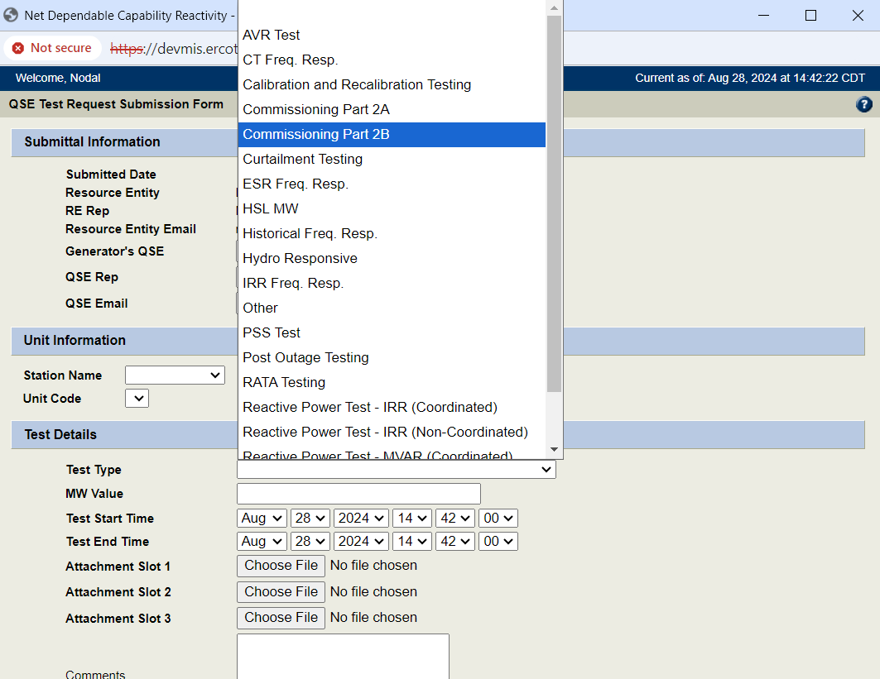
NDCRC – Automatic Tracing and Unit Tests
Form changes in 9/16 release
  Test Type full list – AVR Test, CT Freq. Resp., Calibration and Recalibration Testing, Commissioning Part 2A, Commissioning Part 2B, Curtailment Testing, ESR Freq. Resp., HSL MW, Historical Freq. Resp., Hydro Responsive, IRR Freq. Resp., Other, PSS Test, Post Outage Testing, RATA Testing, Reactive Power Test – IRR (Coordinated), Reactive Power Test – IRR (Non-Coordinated), Reactive Power Test – MVAR (Coordinated), Reactive Power Test – MVAR (Non-Coordinated), Valve Testing

Slide 7
Joint Comments on NDCRC Test Request Process
Joint Comments from Constellation, NRG, Tenaska and LCRA on NDCRC test request process and ERCOT responses are documented in the spread sheet available at https://www.ercot.com/calendar/08292024-TWG-Meeting-_-Webex

