Slide 1
ERCOT Technology Working Group (TWG)
August 29, 2024

Slide 2
ERCOT TWG
WELCOME

Slide 3
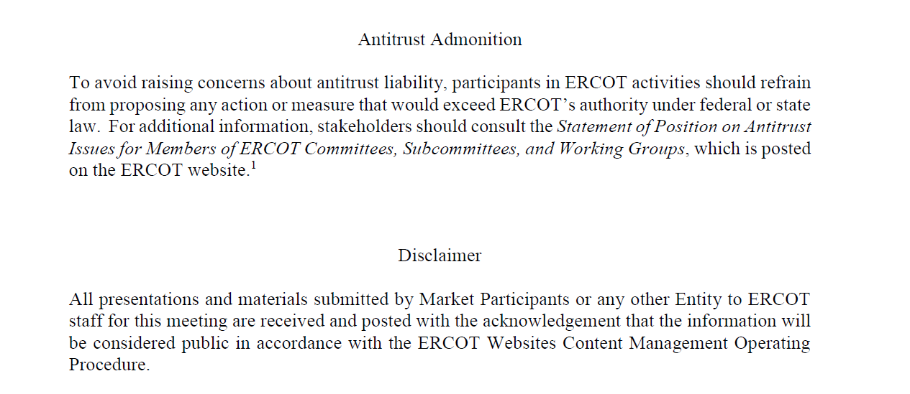
ERCOT TWG

Slide 4
ERCOT TWG Agenda
Item # | Item Description | Presenter | Start Time
1 | Antitrust admonition | Sreenivas Badri | 2:00 PM
2 | NERC EMSWG Updates | Wei Qiu | 2:05 PM
3 | Project Updates | Troy Anderson | 2:10 PM
4 | RTC+B Updates | Matt Mereness | 2:20 PM
5 | CIM16 Schema Upgrade | Joel Koepke | 2:35 PM
6 | Other Projects/Initiatives updates |  | 2:45 PM
 | Decommission of legacy MIS Report Downloads | Leo Angele
 | Secure API pilot survey results and next steps | Brian Brandaw/Balendu Mishra
 | RIOO ESR Project – Data Migration updates | Andy Adams
 | SCR799 - ERCOT Outage Study Cases in the System Operations Test Environment (SOTE) – status update | Yugendher Karedla
7 | NDCRC - Generating Unit Tests and Automatic Tracing Project update | Nick Barbas | 3:15 PM
8 | Round Table Discussion & Future Topics of Interest | Blake Holt (LCRA) | 3:45 PM
9 | Adjourn | Blake Holt (LCRA) | 4:00 PM

Slide 5
NERC EMSWG Update
NERC EMSWG Update – Wei Qiu

Slide 6
Project Updates
Project Updates – Troy Anderson

Slide 7
RTC+B Updates
RTC+B Updates – Matt Mereness

Slide 8
CIM16 Schema Upgrade
CIM16 Schema Upgrade – Joel Koepke

Slide 9
Other Projects/Initiatives Status Updates
Decommission of legacy MIS Report Downloads – Leo Angele
Secure API pilot survey results and next steps – Brian Brandaw/Balendu Mishra
RIOO ESR Project – Data Migration updates – Andy Adams
SCR799 - ERCOT Outage Study Cases in the System Operations Test Environment (SOTE) – status update – Yugendher Karedla

Slide 10
NDCRC - Generating Unit Tests and Automatic Tracing Project
NDCRC - Generating Unit Tests and Automatic Tracing Project Updates – Nick Barbas

Slide 11
ERCOT TWG – Round Table Discussion
ERCOT TWG – Round Table Discussion – Blake Holt (LCRA)
  Future Topics of Interest
  Topics and presentations from TWG members

Slide 12
ERCOT TWG
Thank You
You can reach Sreenivas at
Sreenivas.Badri@ercot.com and Blake at Blake.Holt@LCRA.ORG

