Slide 1
DSWG Meeting - August 23, 2024
ERCOT staff

Slide 2
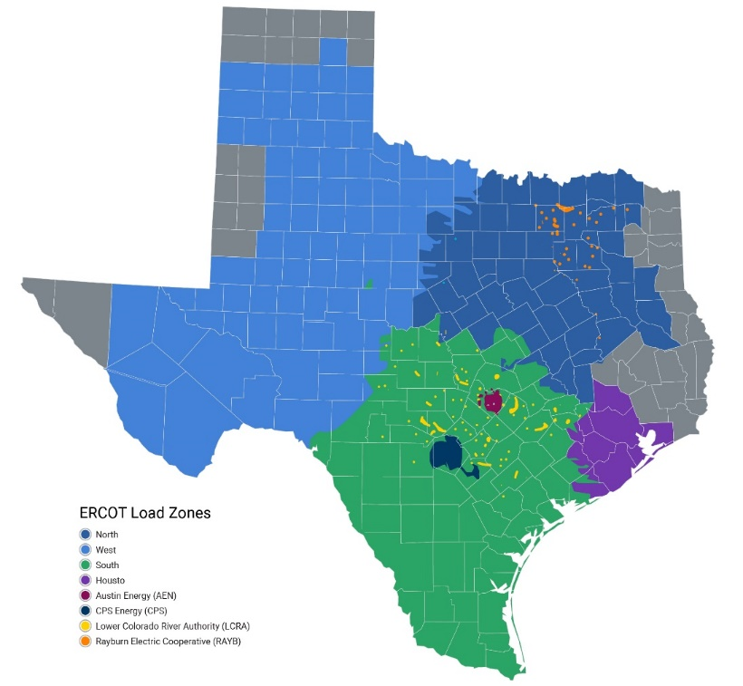
Demand Response Activities in ERCOT
ADER Pilot Project
Phase 1 – use ALR framework, Participate in SCED and NSRS
Phase 2 approved Feb 2024, expanded participation to include ECRS, modified the telemetry validation requirements
Currently drafting phase 3 changes
Consider allowing aggregations of blocky loads
Other relationship changes seen as barriers to participation
There are currently 3 ADERs participating in the wholesale electric market:
15.0 MW for energy
8.6 MW for Non-Spin
8.73 MW for ECRS
Primary technology is batteries
0.3 MW (1)
6.1 MW (1)
Energy and Non-Spin participation began in Aug. ’23, ECRS participation began in May ’24.
8 additional ADERs have ERCOT-accepted Details of the Aggregation forms in place:
1.9 MW (3)
9 MW (6)

Slide 3
Demand Response Activities in ERCOT
NPRR 1217 - Remove Verbal Dispatch Instruction (VDI) Requirement for Deployment and Recall of Load Resources and Emergency Response Service (ERS) Resources still on track for December 1, 2024 implementation.
NPRR1226 - Demand Response Monitor at the request of PRS is being reviewed by ERCOT to provide feedback by the September 2024 PRS meeting.
NPRR1238 (NOGRR265)- Voluntary Registration of Loads with Curtailable Load Capabilities is tabled for further discussion at WMWG.
NPRR1244 (NOGRR263) - Clarification of Controllable Load Resource Primary Frequency Response Responsibilities, approved by PRS 8/8/2024

Slide 4
Demand Response Activities in ERCOT
PUCT is drafting Rule language to implement Residential Smart Thermostat program in response to the recently enacted Senate Bill 1699.
RFP for Must-Run Alternative to Braunig Reliability Must-Run Agreements
RFP spans 9 seasons spanning from April 1, 2025 to March 31, 2027
Seeking of equivalent reliability benefit of the Braunig Resources (up to 859 MWs of capacity)
Proposals due September 9, 2024 (3:00 PM CPT)

Slide 5
Demand Response Activities in ERCOT
LFLTF Update (from July 5, 2024 meeting)

Slide 6
ERS
OctNov24 -an edit in the TRSOW where the number of sites in a non-weather sensitive resource was changed from 5,000 to 1,000 will be removed. The previous limit of 5,000 will stand.
3.17. QSEs may aggregate multiple Sites to constitute an ERS Resource provided that each Site in an ERS Resource aggregation meets all technical requirements described herein.
A. Non-Weather Sensitive resources will be limited to 5,000 sites per ERS Resource.
B. Aggregations for Weather Sensitive resources will be limited to 50,000 sites per ERS Resource.
For the upcoming Dec24Mar25 SCT residential aggregations will not be permitted into non-weather sensitive ERS.

Slide 7
Emergency Response Service Technical Requirements & Scope of Work
Participation by Registered Load Resources (LRs)
8.1. The following combinations are ineligible to participate in ERS and will be rejected:
For one or more sites in the ERS Load, the LR QSE is different from the ERS QSE.
The responsibility for determining if an ERS Site is represented by a QSE other than ERS QSE for purposes of participating as a Load Resources is on the ERS QSE.
If during an ERS SCT a site is determined to be represented by a QSE other than the ERS QSE the site will be deemed unavailable for ERS for all hours starting at the time the other QSE relationship was initiated in the LR registration process until the dual representation is resolved.

Slide 8
NPRR 1131 and NPRR 1058
NPRR 1131 Controllable Load Resource Participation in Non-Spin
Changes CLR participation in Non-Spin to be similar to On-Line GRs
CLR changes their Non-Spin Schedule to show as 0 MW 30-sec before the top of the hour to reflect a standing Non-Spin deployment
CLR must have a Bid-to-Buy with a bid floor of $75 per MWh
Went live in DAM on 8/22 and in real-time 8/23
OBDRR 040
Governs ORDC changes related to 1131
Removes the CLR schedules for Non-Spin and Regulation capacity calculations in alignment with 1131 as a standing deployment
OBDRR for Non-Spin Deployment Procedure
No more deployments for CLRs – dispatched by SCED as a standing deployment
Went live on 8/23 to reflect standing deployment for CLRs providing Non-Spin
NPRR 1058 Resource Offer Modernization
Allows On-Line GRs and CLRs to update offers and Bids for energy in real-time
Requires a reason for the change when updating in the Operating Hour
Also goes live on 8/23

Slide 9
Posting of Reports for Load Resource Deployments
Reports that are posted to the ERCOT MIS require a Protocol requirement.
Here are the deployment Performance reports that are currently posted.
Monthly Reports are being posted for deployments of Load Resource
Monthly Non-Spin NCLR Deployment Performance Report – Resource Specific – Certified
Monthly CLR Energy Deployment Performance Report – Resource Specific – Certified
Monthly Deployment Performance QSE Summary Report for Non-CLRs Providing RRS and ECRS – QSE – Secured
Monthly Deployment Performance Report for Resource Specific Non-CLRs Providing RRS and ECRS – Resource Specific – Certified
Note: In the past ERCOT has provided historical performance for NCLR deployments of RRS at DSWG on an ad hoc basis. Now that NCLRs are participating in other services which we expect will be deployed much more frequently ad hoc reporting moving forward may become unrealistic.

