Slide 1
ESR RFI Updates
Joel Koepke
8/21/2024

Slide 2
Topics
Overview
Dates
Additional Posting Files
Questions

Slide 3
RIOO ESR Project
This change supports the RTC+B program and precedes other downstream application updates
RIOO
RIOO
Combo Model
Single Model
The goal of the RIOO ESR project is to implement a single-model representation of Energy Storage Resources

Slide 4
Post RIOO ESR Project: Single Model in RIOO Only
After the RIOO ESR Project, RIOO will no longer represent an ESR as individual loads and generators. Downstream systems will continue to use the combo model.
ERCOT will translate single model submissions into the combo model
RIOO
Model
EMS/MMS
Outputs
Changes to both the charging and discharging sides of the ESR can be done in one submission
Downstream systems will continue to use the combo model
Q3 2024 through Q4 2025

Slide 5
Post RIOO ESR Project: Single Model in RIOO Only
After the RIOO ESR Project, RIOO will no longer represent an ESR as individual loads and generators. Downstream systems will continue to use the combo model.
ERCOT will translate single model submissions into the combo model
RIOO
Model
EMS/MMS
Outputs
Changes to both the charging and discharging sides of the ESR can be done in one submission
Downstream systems will continue to use the combo model
ERCOT will also bring key ESR information into the model to support RTC+B testing
Q3 2024 through Q4 2025

Slide 6
Parallel ESR Telemetry Prior to RTC+B Go-Live
To support testing and ensure readiness, parallel telemetry for combo-model and single-model representations of ESRs will be required prior to RTC+B go-live.
Current
EMS/MMS
Model
To support this new telemetry, QSEs will need the ESR name provided in the prepopulated Excel file (or entered into RIOO when completing the interconnection request)
UNIT1
Telemetry from QSE
CLR1
RTC+B
EMS/MMS
ESR1
Single-model telemetry, including those needed for RTC+B, will be required prior to RTC+B go-live
Q3 2024 through Q4 2025

Slide 7
Dates
6/12 – RIWG: Initial discussion of ESR conversion
7/10 – Market Notice #1
7/24 – RIWG: Review of RFI process
8/6 – ESR DocuSign envelopes sent
8/6 – Market Notice #2
8/9 – IBRWG: Review conversion and RFI process
Today – RIWG: Open discussion
9/6 – Submission due date for RFI
9/26 – Conversion scripts executed in RIOO to move to single-model
9/26 through EOY – A small subset of remaining combo models will be converted

Slide 8
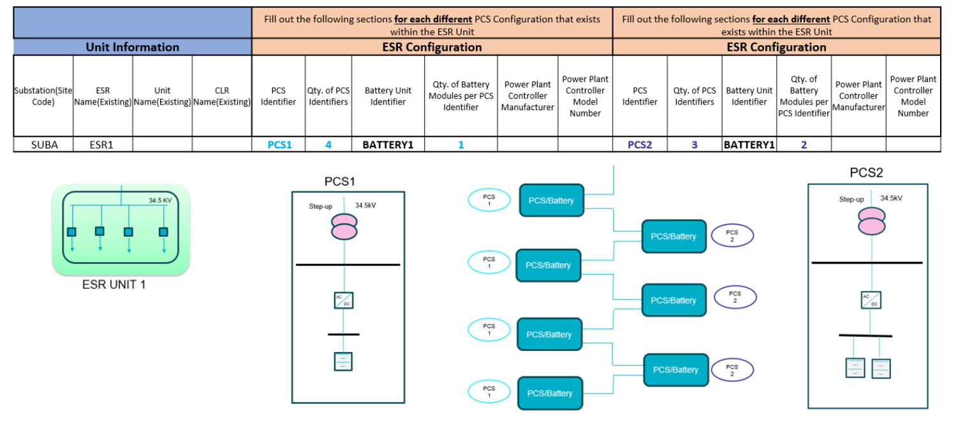
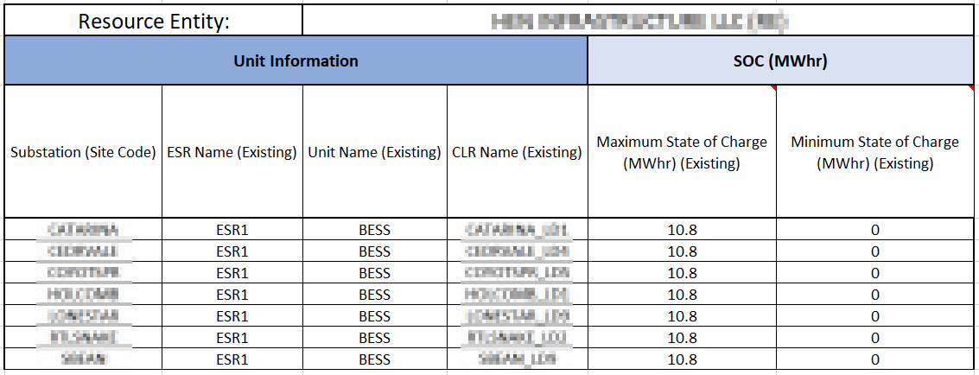
Postings
Sample from RFI diagram file
July RIWG Meeting Page
Meeting Link
Presentation summarizing efforts
(New) “ESR RFI Additional Information V1” diagram
Provides additional context to Excel file
MIS Requested Information
MIS Link
Prepopulated RFI Excel template
State of Charge Supplement
Contains SOC info previously provided to ERCOT
Note: These files will expire after 30 days
Supplemental SOC example

Slide 9
Market Notices
https://www.ercot.com/services/comm/mkt_notices/M-A071024-01
https://www.ercot.com/services/comm/mkt_notices/M-A071024-02

Slide 10
Questions?

