Slide 1
NPRR1234 – Overview and Key Concepts
Bill Blevins
Director, Grid Coordination
NDSWG
August 20, 2024

Slide 2
Agenda
Overview of Significant Changes in NPRR1234 and New Modeling Requirements
Appendix – Summary of NPRR1234 by Section

Slide 3
NPRR1234 – New Concepts & Significant Changes from NPRR1191
This NPRR implements the changed approach announced at the April 1 LFLTF. The following concepts from NPRR1191 do not appear in NPRR1234
  Registered Curtailable Loads (RCLs)
  Ramping limitations on Large Loads
  Voltage Ride Through (VRT) requirements for Large Loads
ERCOT remains concerned about the ramping and VRT issues and will explore other solutions such as procurement of additional AS and other system improvements.
Language in Section 16 requiring the registration of a load 25 MW or greater with ERCOT has been removed and replaced with a new requirement in Section 3.10.7.2 requiring identification and classification of loads 25 MW or greater in the Network Operations Model.

Slide 4
Modeling of Loads 25 MW or Greater – Additional Details
TSPs will need to identify a load point or collection of load points serving a site with a historical, requested, or expected peak Demand 25 MW or greater in the ERCOT Network Operations Model.
RE will need to identify a load point or collection of load points serving a behind the meter load (excluding aux load) with a historical, requested, or expected peak Demand 25 MW or greater in the Resource Registration Data.
Load points serving sites 25-75 MW may include additional customers <25 MW.
For each load point identified, the TSP/RE must also provide the primary end-use activity from a list of broad categories.
The goal of these requirements is to allow ERCOT to improve its load forecasts and to provide real-time visibility to system operators.

Slide 5
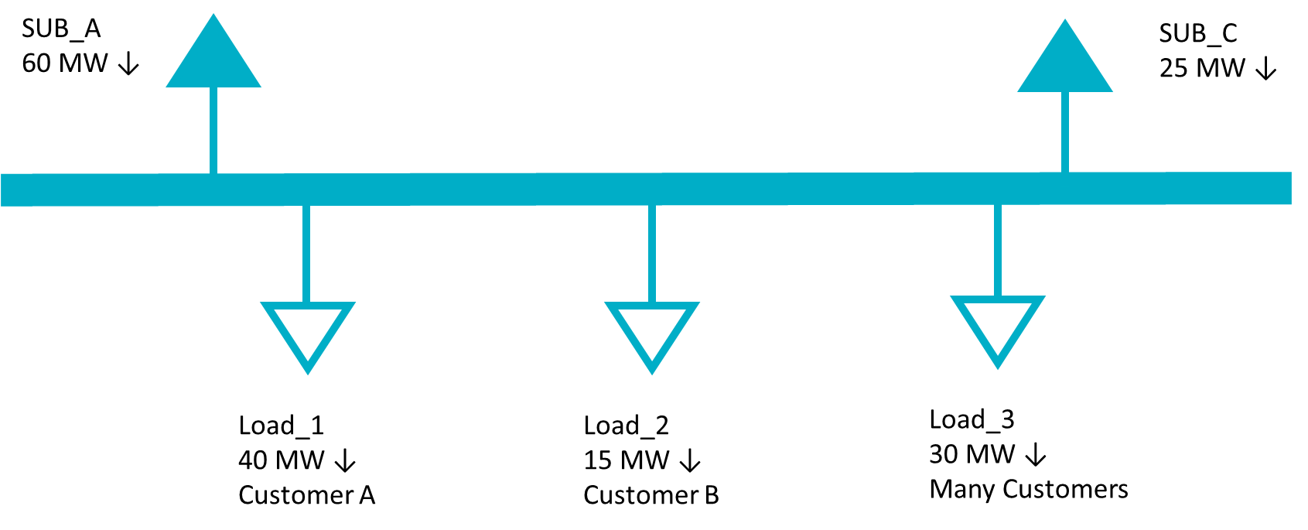
Modeling of Loads 25 MW or Greater – Conceptual Examples
Example 1
A single customer and/or site with a historical peak Demand of 25 MW or larger served from a single load point in the Network Operations Model.
In the example below, a substation serves 85 MW of customer load. Load_1 serves a single facility with a peak Demand of 40 MW and does not include any other customer load. Load_2 represents a single, smaller customer and Load_3 includes many customers across multiple sites, none of whom are 25 MW or greater individually.
TSP Actions
Identify Load_1 as a 25 MW or greater facility in the ERCOT Network Operations Model
Identify the primary end use category of Load_1 from a pre-defined list.
Load_2 does not need to be identified since it is less than 25 MW.
Load_3 does not need to be identified because it is composed of many customers and facilities.

Slide 6
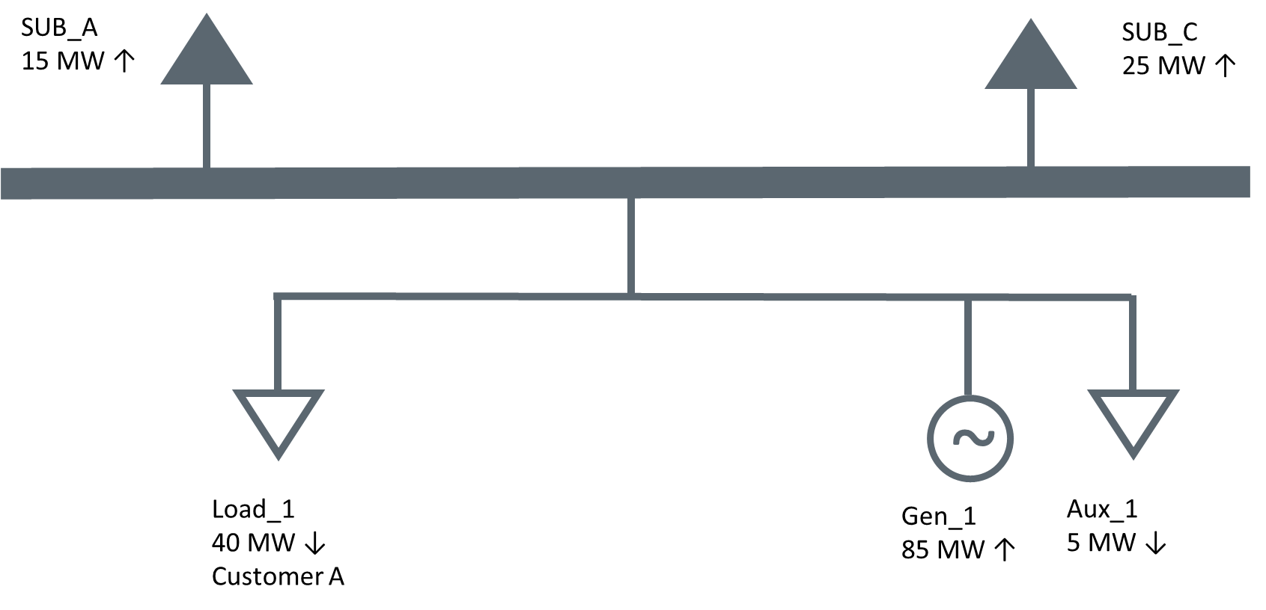
Modeling of Loads 25 MW or Greater – Conceptual Examples
Example 2
A single customer and/or site with a historical peak Demand of 25 MW or larger located with a Generation Resource served from a single load point in the Network Operations Model.
In this example, the same Load_1 from the previous example is served behind the meter of a Generation Resource. The generator also has 5 MW of Aux load.
RE Actions
Identify Load_1 as associated with a 25 MW or greater facility in its Resource Registration Data.
Identify the primary end use category of Load_1 from a pre-defined list.
The Aux load should not be identified as a 25 MW or greater facility.

Slide 7
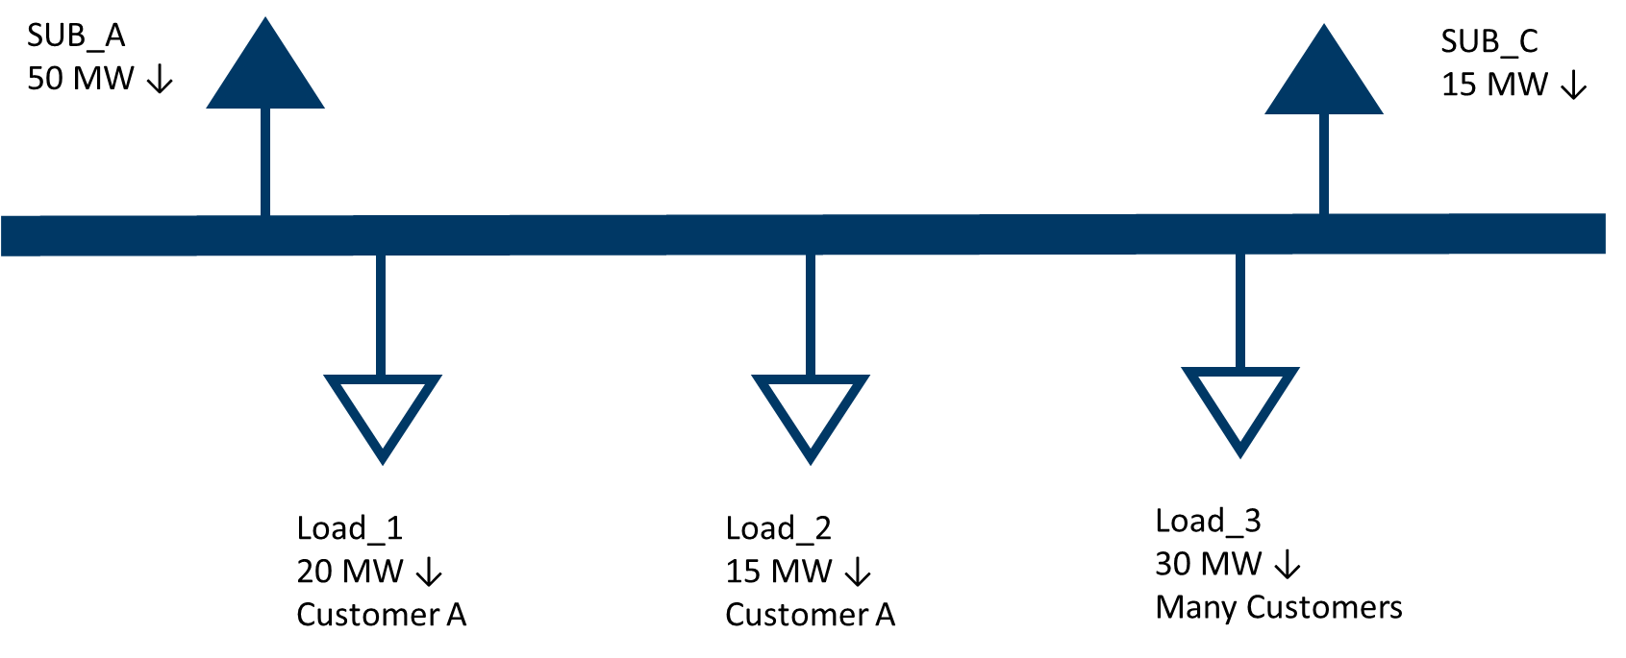
Modeling of Loads 25 MW or Greater – Conceptual Examples
Example 3
A single customer and/or site with a historical peak Demand of 25 MW or larger served from a multiple load points in the Network Operations Model.
In the example below, a substation serves 65 MW of customer load. Load_1 and Load_2 correspond to a single site with a peak Demand of 35 MW. Load_3 includes many customers across a multiple sites, none of whom are 25 MW or greater individually.
TSP Actions
Identify Load_1 AND Load_2 as associated with a 25 MW or greater site in the ERCOT Network Operations Model. Even though neither point individually exceeds 25 MW, both should be included because the correspond to a single site.
Identify the primary end use category of Load_1 and Load_2 from a pre-defined list.
Load_3 does not need to be identified because it is composed of many customers and sites.

Slide 8
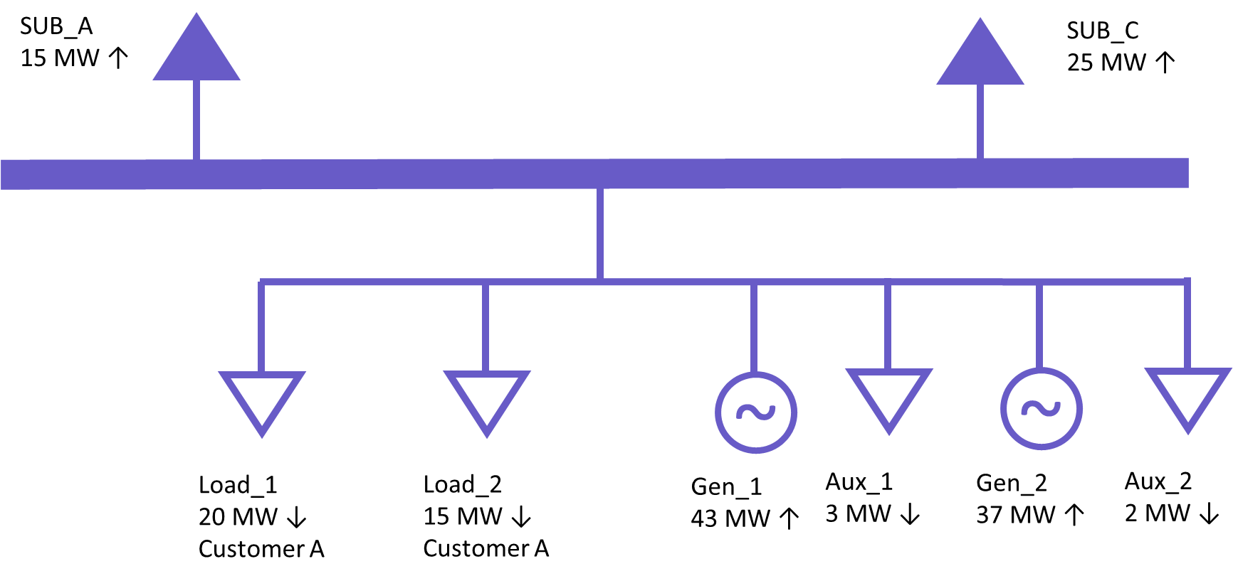
Modeling of Loads 25 MW or Greater – Conceptual Examples
Example 4
A single customer and/or site with a historical peak Demand of 25 MW or larger located with a Generation Resource served from multiple load points in the Network Operations Model.
In this example, the same Load_1 and Load_2 from the previous example are served behind the meter of a Generation Resource. The generator also has 5 MW of Aux load.
RE Actions
Identify Load_1 AND Load_2 as associated with a 25 MW or greater facility in the Resource Registration data. Even though neither point individually exceeds 25 MW, both should be included because the total load, excluding aux load, behind the POI exceeds 25 MW.
Identify the primary end use category of Load_1 and Load_2 from a pre-defined list.
The Aux loads should not be identified as part of a 25 MW or greater facility.

Slide 9
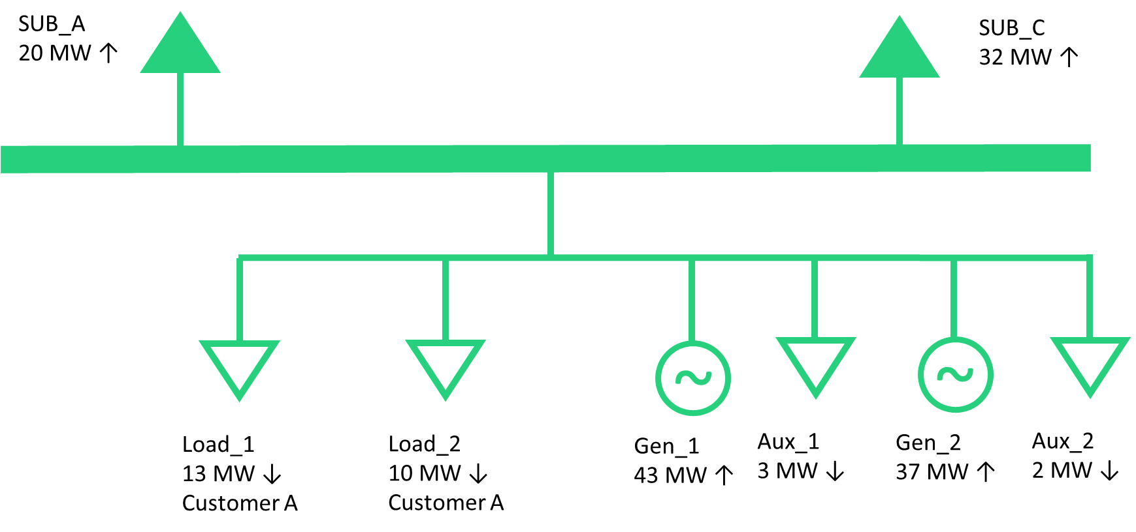
Modeling of Loads 25 MW or Greater – Conceptual Examples
Example 5
A single customer and/or site with a historical peak Demand of 22 MW located with a Generation Resource served from multiple load points in the Network Operations Model.
In this example, the same Load_1 and Load_2 from the previous example are served behind the meter of a Generation Resource. The total peak Demand of these two load points is 22 MW. The generator also has 5 MW of Aux load.
RE Actions
No loads need to be identified as associated with a 25 MW or greater facility in the Resource Registration data. Even though the total load behind the POI exceeds 25 MW, the non-aux load peak Demand is less than 25 MW.

Slide 10
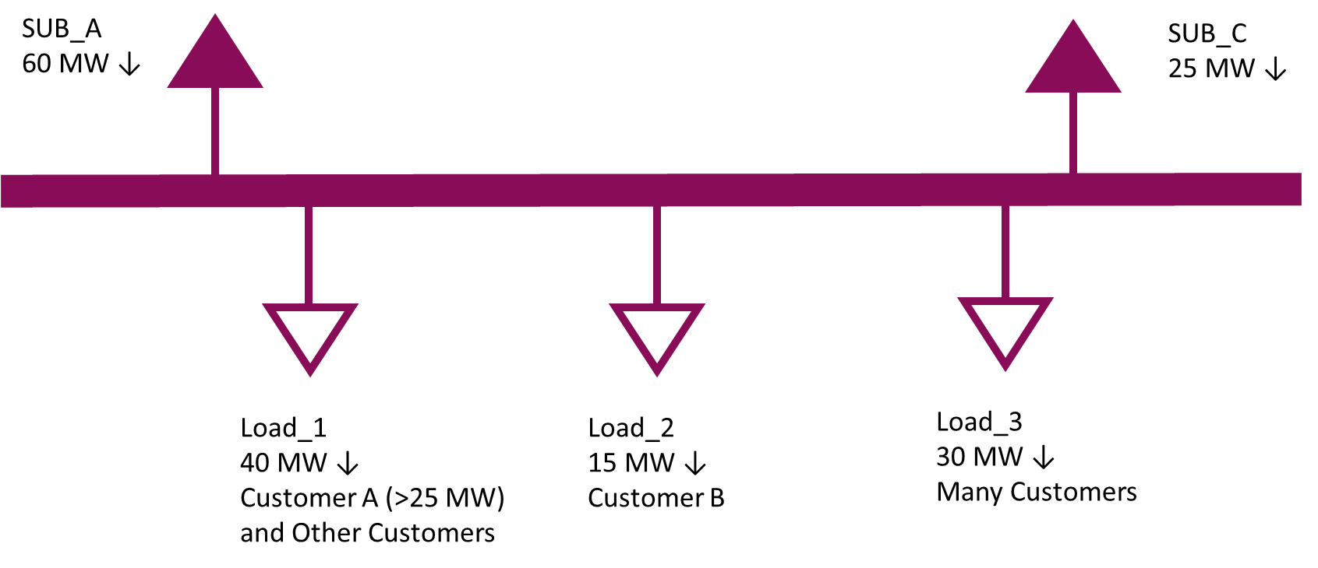
Modeling of Loads 25 MW or Greater – Conceptual Examples
Example 6
A single customer and/or site with a historical peak Demand of 25 MW or larger served from a single load point in the Network Operations Model that includes other customers.
In the example below, a substation serves 85 MW of customer load. Load_1 serves a site with a peak Demand greater than 25 MW and other, smaller customers. Load_2 represents a single, smaller customer and Load_3 includes many customers across multiple sites, none of whom are 25 MW or greater individually.
TSP Actions
Identify Load_1 as associated with a 25 MW or greater facility in the ERCOT Network Operations Model.
Identify the primary end use category of the largest customer behind Load_1 from a pre-defined list.
Load_2 does not need to be identified since it is less than 25 MW.
Load_3 does not need to be identified because it is composed of many customers and facilities.

Slide 11
Modeling of Loads 25 MW or Greater – Conceptual Examples
Example 7
A single customer and/or site with a historical peak Demand of 25 MW or larger served from multiple load points across multiple substations in the Network Operations Model.
In the example below, Load_1 at Substation X and Load_2 at Substation Y each serve a single customer. Load_2 at Substation X and Load_1 at Substation Y represent a single customer with a peak demand of 35 MW split across two transformers located at different substations and do not include any other customer load.
TSP Actions
Identify Load_2 at Substation X and Load_1 at Substation Y as associated with a 25 MW or greater facility in the ERCOT Network Operations Model.
Load_1 at Substation X does not need to be identified since it is less than 25 MW.
Load_2 at Substation Y does not need to be identified since it is less than 25 MW.
SUB A
10 MW ↓
SUB C
25 MW ↓
SUB D
20 MW ↓
SUB F
5 MW ↓
SUBSTATION X
SUBSTATION Y
Load_1
15 MW ↓
Customer A
Load_2
20 MW ↓
Customer B
Load_1
15 MW ↓
Customer B
Load_2
10 MW ↓
Customer C

Slide 12
Modeling of Loads 25 MW or Greater – Conceptual Examples
Example 8
A single customer and/or site with a historical peak Demand of 25 MW or larger served from multiple load points across multiple substations in the Network Operations Model where one load point includes multiple customers.
In the example below, Load_1 at Substation X and Load_2 at Substation Y each serve a single customer. Load_2 at Substation X serves Customer B with a peak Demand greater than 25 MW and other, smaller customers. Customer B, from Load_2 at Substation X, is also supplied power from another substation, represented by Load_1 at Substation Y, that does not include any other customer load.
TSP Actions
Identify Load_2 at Substation X and Load_1 at Substation Y as associated with a 25 MW or greater facility in the ERCOT Network Operations Model.
Load_1 at Substation X does not need to be identified since it is less than 25 MW.
Load_2 at Substation Y does not need to be identified since it is less than 25 MW.
SUB A
30 MW ↓
SUB C
25 MW ↓
SUB D
20 MW ↓
SUB F
5 MW ↓
SUBSTATION X
SUBSTATION Y
Load_1
15 MW ↓
Customer A
Load_2
40 MW ↓
Customer B (>25 MW)
and Other Customers
Load_1
15 MW ↓
Customer B
Load_2
10 MW ↓
Customer C

Slide 13
Modeling of Loads 25 MW or Greater – Conceptual Examples
Example 9
A single customer and/or site with a historical peak Demand of 25 MW or larger served from multiple load points across multiple substations in the Network Operations Model.
In the example below, Load_2 at Substation Y serves a single customer. Load_1 at Substation X, Load_2 at Substation X, and Load_1 at Substation Y represent a single customer with a peak demand of 50 MW split across three transformers located at different substations and do not include any other customer load.
TSP Actions
Identify Load_1 and Load_2 at Substation X and Load_1 at Substation Y as associated with a 25 MW or greater facility in the ERCOT Network Operations Model.
Load_2 at Substation Y does not need to be identified since it is less than 25 MW.
SUB A
10 MW ↓
SUB C
25 MW ↓
SUB D
20 MW ↓
SUB F
5 MW ↓
SUBSTATION X
SUBSTATION Y
Load_1
15 MW ↓
Customer A
Load_2
20 MW ↓
Customer A
Load_1
15 MW ↓
Customer A
Load_2
10 MW ↓
Customer C

Slide 14
Modeling of Loads 25 MW or Greater – Conceptual Examples
Example 10
A single customer and/or site with a historical peak Demand of 25 MW or larger served from multiple load points across multiple substations in the Network Operations Model where one load point includes multiple customers.
In the example below, Load_1 at Substation X and Load_2 at Substation Y each serve a single customer. Load_2 at Substation X serves Customer B with a peak Demand less than 25 MW and other, smaller customers. Customer B, from Load_2 at Substation X, is also supplied power from another substation, represented by Load_1 at Substation Y, that does not include any other customer load. Customer B has a peak demand of 25 MW or larger across Load_2 at Substation X and Load_1 at Substation Y.
TSP Actions
Identify Load_2 at Substation X and Load_1 at Substation Y as associated with a 25 MW or greater facility in the ERCOT Network Operations Model.
Load_1 at Substation X does not need to be identified since it is less than 25 MW.
Load_2 at Substation Y does not need to be identified since it is less than 25 MW.
SUB A
30 MW ↓
SUB C
25 MW ↓
SUB D
20 MW ↓
SUB F
5 MW ↓
SUBSTATION X
SUBSTATION Y
Load_1
15 MW ↓
Customer A
Load_2
40 MW ↓
Customer B (<25 MW)
and Other Customers
Load_1
15 MW ↓
Customer B
Load_2
10 MW ↓
Customer C

Slide 15
Loads 25 MW or Greater - Draft End Use Classifications
Oil and Gas Production, Processing, and Transmission
Oil and Chemical Refining
Steel Manufacturing
Cryptocurrency Mining
Data Center (non-Cryptocurrency)
Hydrogen and Electrofuel Production
Other Industrial

Slide 16
Appendix
Summary of NPRR1234 by Section

Slide 17
NPRR1234 – Changes to Section 2
Section 2.1 – Definitions
Interconnecting Large Load Entity (ILLE) – Any Entity that has submitted a request to interconnect a Large Load to the ERCOT system. Analagous to an Interconnecting Entity in the generation interconnection process
Large Load – One or more Facilities at a single site with an aggregate peak Demand greater than or equal to 75 MW behind one or more common Points of Interconnection (POIs) or Service Delivery Points
Large Load Interconnection Study (LLIS) – The set of interconnection studies done by the TSP for a Large Load connecting in 2 years or less
Other New or Modified Terms – Subsynchronous Ferroresonance (SSFR), Torque Amplification
Section 2.2 – Acronyms
Added acronyms for ILLE, LLIS, and SSFR

Slide 18
NPRR1234 – Changes to Section 3
Section 3.1.1 – Role of ERCOT
Updated “SSR” to “SSO”
Section 3.1.5.11 – Evaluation of Transmission Facilities Planned Outage or Maintenance Outage Requests
Updated “SSR” to “SSO”
Section 3.3.2 – Types of Work Requiring ERCOT Approval
Added subparagraph (e), Large Load Interconnections, to the list of modeling work that requires ERCOT approval

Slide 19
NPRR1234 – Changes to Section 3 (continued)
Section 3.10.7.2 – Modeling of Resources and Transmission Loads
Modified paragraph (7) to apply to Resource Entities and changed “Model Load” to “Load Point.”
Added new paragraphs (14), (15), and (16) to describe Transmission Service Providers’, Resource Entities’, or Interconnecting Entities’ responsibilities to identify in the Network Operations Model load points serving customer with peak Demand of 25 MW or greater.
Section 3.10.7.5 – Telemetry Requirements
Modified paragraph (4) to change “Model Load” to “Load Point.”
Section 3.10.7.5.1
Modified paragraph (4)(a) to change “Model Load” to “Load Point.”

Slide 20
NPRR1234 – Changes to Section 3 (continued)
Section 3.15 – Voltage Support
Modified paragraph (13) to specify that the addition of a 20 MW or greater Load to a Generation site constitutes a modification that requires a new reactive study.
Section 3.15.3 – Generation Resource Requirements Related to Voltage Support
Added paragraph (12), which requires a new reactive study if a Load 20 MW or more is added to a Generation site.

Slide 21
NPRR1234 – Changes to Section 3 (continued)
Section 3.22 – Subsynchronous Oscillation
Section heading changed to replace “Resonance” with “Oscillation.”
Section 3.22.1 – Subsynchronous Oscillation Vulnerability Assessment
Section heading changed to replace “Resonance” with “Oscillation.”
Changed “SSR” to “SSO” and “Subsynchronous Resonance” to “Subsynchronous Oscillation.”
Added paragraph (2) to require that the SSO vulnerability assessment includes the interactions between Generation Resources and series capacitors.
Section 3.22.1.1 – Existing Generation Resource Assessment
Changed “SSR” to “SSO” and “Subsynchronous Resonance” to “Subsynchronous Oscillation.”
Clarified screening criteria.
Section 3.22.1.2 – Generation Resource or Energy Storage Resource Interconnection Assessment
Changed “SSR” to “SSO” and “Subsynchronous Resonance” to “Subsynchronous Oscillation.”
Clarified screening criteria.

Slide 22
NPRR1234 – Changes to Section 3 (continued)
Section 3.22.1.3 – Transmission Project Assessment
Changed “SSR” to “SSO” and “Subsynchronous Resonance” to “Subsynchronous Oscillation.”
Clarified screening criteria.
In paragraph (2), added that existing Large Loads and Large Loads that have completed all planning studies must be including in an SSO vulnerability assessment for a new transmission project.
Added new paragraphs (7) and (8) to provide more details when and how mitigation should be addressed for SSO interactions between Large Loads and transmission projects.
(NEW) Section 3.22.1.4 – Large Load Interconnection Assessment
Added a new section to address SSO interactions on existing Facilities from the proposed interconnection of a new Large Load, including load modeling, mitigation, and countermeasures.

Slide 23
NPRR1234 – Changes to Section 3 (continued)
Section 3.22.1.5 – Annual SSO Review
Renumbered section after the addition of the new 3.22.1.4, Large Load Interconnection Assessment.
Changed “SSR” to “SSO” and “Subsynchronous Resonance” to “Subsynchronous Oscillation.”
Clarified screening criteria.
Added a new paragraph (1)(c) to detail the ongoing obligations of Large Loads in the annual SSO review.
Section 3.22.2 – Subsynchronous Oscillation Vulnerability Assessment Criteria
Changed “SSR” to “SSO” and “Subsynchronous Resonance” to “Subsynchronous Oscillation.”
Clarified screening criteria.

Slide 24
NPRR1234 – Changes to Section 3 (continued)
Section 3.22.3 – Subsynchronous Resonance Monitoring
Changed “SSR” to “SSO.”
Clarified screening criteria.
Added paragraph (2) to describe how Large Loads will be assessed for potential vulnerability to SSO.
Modified paragraph (4) to clarify which assessments apply to Generation Resources and those that apply to Large Loads.

Slide 25
NPRR1234 – Changes to Section 16 and ERCOT Fee Schedule
Section 16.5 – Registration of a Resource Entity
Changed “SSR” to “SSO.”
ERCOT Fee Schedule
Added a $14,000 Large Load Interconnection Study fee to the ERCOT Fee Schedule.

