Slide 1
Submitting Declarations of Weather Preparedness for New Resources during Summer or Winter
David Kezell, Director of Weatherization and Inspection
ERCOT
Resource Integration Working Group
August 21, 2024

Slide 2
Weatherization and the Commissioning Process
Resource Entities (REs) seeking Step 3 commissioning approval for a new resource* during either of the summer or winter seasons “must submit the appropriate declaration of preparedness prior to the resource commissioning date established in the ERCOT interconnection process for resources” (16 TAC §25.55(c)(3)(C)).
Suggestion – work on weatherization requirements during Step 2.
If weatherization requirements have been met for the new resource prior to the summer or winter season, an RE can declare the new unit in its Declaration of Weather Preparedness (DoWP) submitted in the Portal for its existing resources during the May 1 – Jun 1 or Nov 1 – Dec 1 windows.
If the weatherization requirements are completed “during the season” then a DoWP is submitted by opening a Weatherization Support case in the Portal.
See Step-3-Commissioning-Process-for-Submitting-Declarations-of-Weatherization-Preparedness-2024-06.pdf (ercot.com) for details.
Also see Microsoft Word - Market Participant Portal User Guide_FINAL (ercot.com) for instructions on using the portal.

Slide 3
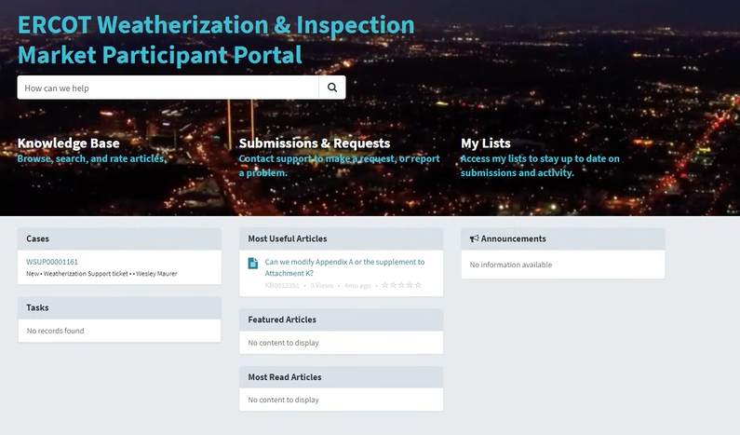
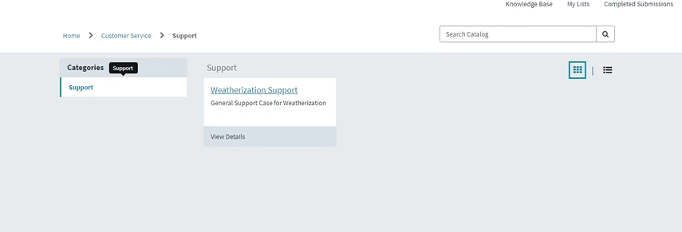
Portal Use Basics for “In Season” Submittals
Log into MIS and click on the Weatherization box to enter the Portal.
Click on “Submissions and Requests”.
Then select Weatherization Support.

Slide 4
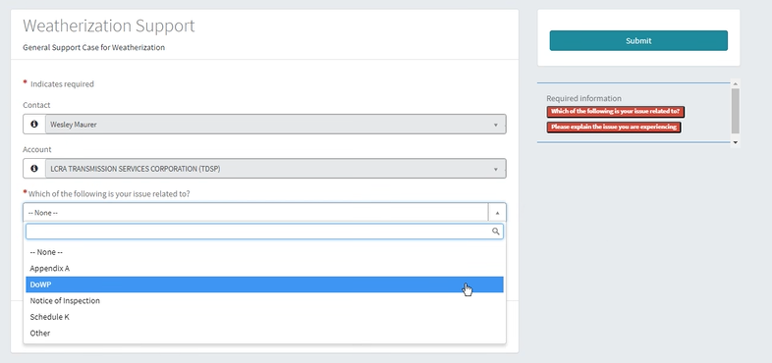
Start your Weatherization Support (WSUP) Case
Your name and resource entity name will be auto-populated in the first two cells of the form.
In the drop-down menu, select DOWP.
Your Name Will Be Here
Your Resource Entity Will Be Here

Slide 5
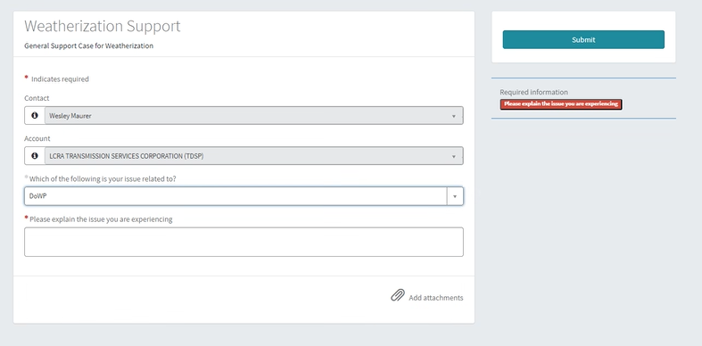
Complete your DoWP Weatherization Support (WSUP) Case
In the “Please explain the issue you are experiencing” box, describe that you are submitting Declaration of Weather Preparedness documents for a new resource soon to be fully commissioned. Please include the INR number.
Your Name Will Be Here
Your Resource Entity Will Be Here
Use the paperclip icon to add your signed, notarized declaration document, your Appendix A, and any other documents that support your declaration (for new resources primarily fueled by natural gas, an Attachment K should also be attached for summer declarations). The rule requires that the declaration “Summarizes all activities engaged in by the generation entity to complete the requirements” so please attach any plans that support such a summary. Blank templates for the declaration, Appendix A, and Attachment K documents are found in the “Templates for Declaration of Summer/Winter Weather Preparedness – GE and TSP” folders on https://www.ercot.com/gridinfo/generation/summerready and https://www.ercot.com/gridinfo/generation/winterready.

Slide 6
Submit your DoWP Weatherization Support (WSUP) Case
Press the Submit document to send in your WSUP with the DoWP documents.
Your Name Will Be Here
Your Resource Entity Will Be Here

Slide 7
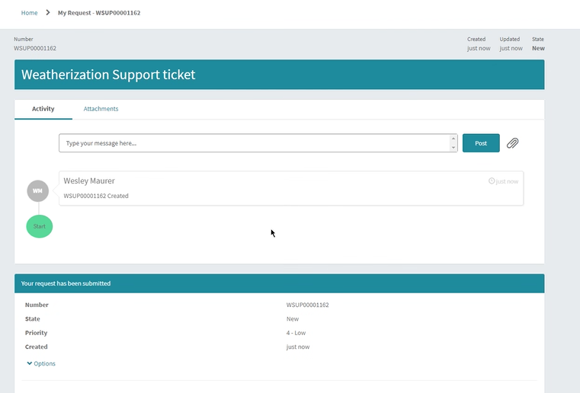
Any Further Communication Occurs in the Support Case
Your Name Will Be Here
ERCOT Weatherization Personnel will review your submittal and ask for any necessary adjustments. All subsequent correspondence will occur within the WSUP. Once the submitted documents are satisfactory, you will be notified, and the Resource Integration team will also be notified.

Slide 8
Questions?
Thank you!

