Slide 1
Large Loads Update
August 2024
ERCOT
Operations Planning
PDCWG | August 21, 2024

Slide 2
Introduction
As proposed in NPRR1234, a Large Load is “One or more Facilities at a single site with an aggregate peak Demand greater than or equal to 75 MW behind one or more common Points of Interconnection (POIs) or Service Delivery Points.”
The Large Flexible Load Task Force (LFLTF) provides Large Load Interconnection Queue Status Updates monthly.
ERCOT has conducted some analysis on Large Flexible Loads and their impact on Regulation and frequency control.

Slide 3
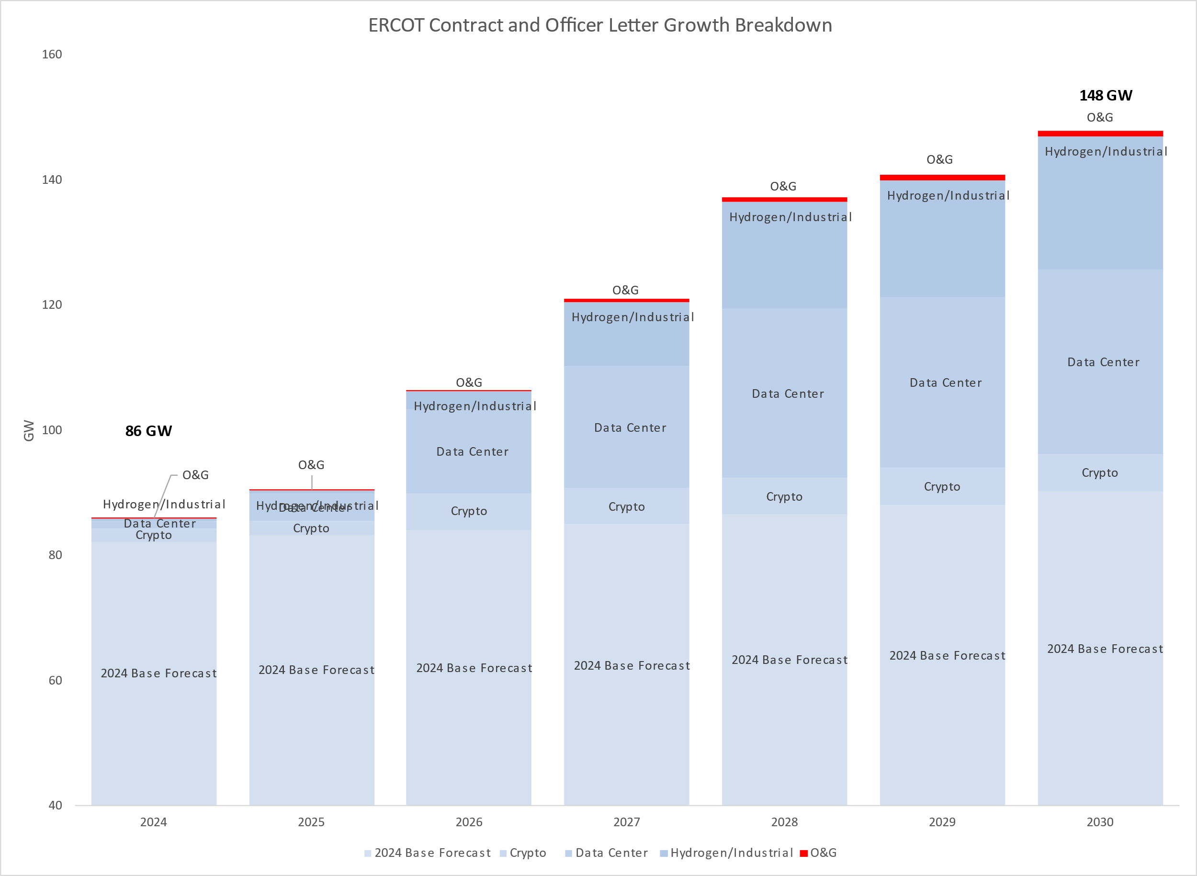
Additional Detail in Large Load Growth
Types of Large Loads being tracked:
Crypto, Oil & Gas, Industrial & Hydrogen, Data Centers.
Each of these large loads have different characteristics in consumption and ability to manage consumption.
Source: https://www.ercot.com/gridinfo/load/forecast

Slide 4
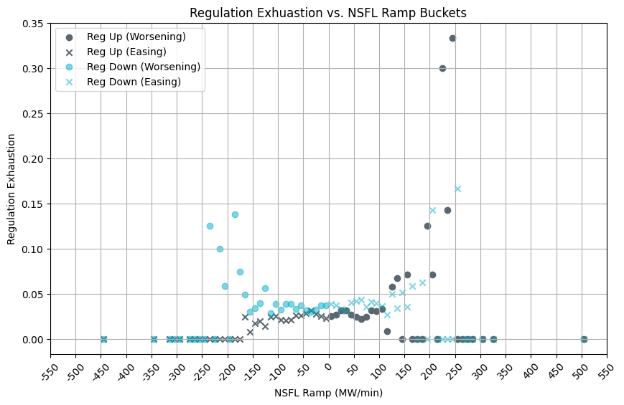
Regulation Exhaustion vs NSFL* Ramps
For 1/1/2024 to 8/1/2024, 1-min NSFL ramp values were examined in bins of 10 MWs (as tracked on x-axis) and the average rate of intervals during which regulation was exhausted (i.e. remaining regulation was less than 5 MW) was computed (as tracked on y-axis).
* NSFL represents Large Flexible Loads that are not following SCED Dispatch Instructions
Key Takeaway: Currently with the set of LFLs within the ERCOT system there is no correlation between LFL ramping and regulation exhaustion.
Notes:
For example, a point (395, 0.5) would represent that in 2024 (to date), regulation was exhausted in 50% of the time during which the ramp was between 390 and 400 MW. No dot represents there was no intervals of an NSFL ramp in the bin.
Steel Mill Load is considered NSFL on this slide.

Slide 5
Questions?
Notes:
Questions or suggestions for what PDCWG would like to see on these?

