Slide 1
EAL Change Proposals
Scenario #5B
Sanchir Dashnyam
ERCOT Market Credit Manager
ERCOT Public
August 21, 2024

Slide 2
Invoice Exposures – Definitions
Invoice exposures – New
M1 days forward invoices + 7 days look back actual invoices
M1 days could range from 10 to 21 days depending on weekends/holidays, MP activity
Invoices exclude M&N securitization invoices, CRR auction invoices, miscellaneous invoices relating to $2B distributed to market for Sec N on 6/21/22
Data is for a period covering 11/21/2021 through 4/30/2024
Excluded CARD invoices
TPEA excludes Uri invoices, PUL uplift
Excluded CARD credits from OUT
TPEA – Invoice exposures = Gap
Negative gap is when invoice exposures exceed TPEA (less than -$10,000)
Positive gap is when TPEA exceeds invoice exposures (more than $10,000)
Independent amounts posted as a result of NPRR1165 are not included in these calculations. IA’s are part of TPES.

Slide 3
Current EAL Formula vs. Scenarios #1, #1a and 1b
Current: EAL _{q} = Max [IEL during the first 40-day period only beginning on the date that the Counter-Party commences activity in ERCOT markets, RFAF * Max {RTLE during the previous lrq days}, RTLF] + DFAF * DALE + Max [RTLCNS, Max {URTA during the previous lrq days}] + OUT _{q} + ILE _{q}
OUT _{q} = OIA _{q} + UDAA _{q} + UFA _{q} + UTA _{q} + CARD*
Scenario #1: EAL t = Max [RFAF * Max { RTNLE during the previous lrt days}, FAF*RTNLF] + DFAF * DALE + Max [RTLCNS NLCD, Max {ULERTA during the previous lrq days}] + OUT (included UDAA)
NLE = Total net liability extrapolated (Last 14 days RTM Initial Statement Average + Last 14 days DAM Initial Statement Average based on RTM Initial OD)*M1. Use same RTM ODs for DAM as well
NLF = net liability forward = 1.5 * NLCD
NLCD = (7 most recent Operating days Real time estimates + 7 most recent DAM ODs day-ahead) if settled data is available use settled else estimates – no price cap
FAF = 21 future / most recent days 7 RTM Prices
ULE = unbilled liability extrapolated (Last 14 days RTM Initial Statement Average + Last 14 days DAM Initial Statement Average based on RTM Initial OD)*M2 - use same RTM ODs for DAM as well
Scenario #1a: EAL = Max [RFAF * Max { RTNLE during the previous lrt days}, FAF*RTNLF] + DFAF * DALE + Max [RTLCNS (RTLCNS + UDAA), Max {ULERTA during the previous lrq days}] + OUT
Scenario #1b EAL t = Max [RFAF * Max { RTNLE during the previous lrt days}, FAF*RTNLF] + DFAF * DALE + Max [RTLCNS NLCD, Max {ULERTA during the previous lrq days}] + OUT
OUT t = OIA + UFA + UTA + CARD* (S1a and S1b excludes UDAA)

Slide 4
Scenarios #2, #3 and #4
Scenario #2*: EAL q = Max [IEL during the first 40-day period only beginning on the date that the Counter-Party commences activity in ERCOT markets, Max{(RFAF * Max {RTLE) during the previous lrq days}, RTLF] + DFAF * DALE + Max [RTLCNS, Max {URTA during the previous lrq days}] + OUT q + ILE q
Scenario #3*: EAL q = Max [IEL during the first 40-day period only beginning on the date that the Counter-Party commences activity in ERCOT markets, RFAF * Max {RTLE during the previous lrq days}, RTLF] + DFAF * DALE + Max [RTLCNS, Max {URTA during the previous lrq days}] + OUT q + ILE q
  Two RFAF’s: CP specific RFAF and Global RFAF
  CP specific RFAF = Projected Real-Time ICE Forward Average Price / Max RTLE date Historic Real-Time Settled Average Price
  Global RFAF is calculated based on existing methodology. Global RFAF is used in MCE calculations.
Scenario #4*: Take Scenario #1a as a basis: EAL = Max [RFAF * Max { RTNLE*FAF during the previous lrt days}, FAF*RTNLF] + DFAF * DALE + Max [RTLCNS (RTLCNS + UDAA), Max {ULERTA during the previous lrq days}] + OUT
  Apply FAF against NLE, then take the Max and compare against FAF*NLF. Essentially combine Scenario #2 and Scenario #1
  Establish a floor for FAF at 1
  Increase MCE for load entities (2 days from 1 day) - FAF Revised

Slide 5
Scenario #5B – Final proposal
Scenario #5A: Take Scenario #4 as a basis: EAL = Max [RFAF * Max { RTNLE*RFAF during the previous lrq days}, FAF*RTNLF] + DFAF * DALE + Max [RTLCNS (RTLCNS + UDAA), Max {ULERTA during the previous lrq days}] + OUT*
  RFAF_{i} = 21-day future prices / 14 days RTM Prices corresponding to the 14 days in NLE_{i.} Cap RFAF at 1.5. RFAF is applied against NLE. There is a floor for RFAF at 1.00. For each RFAF, we are using the corresponding Operating Day (and not Invoice Business Day) RTM settled prices, which match the respective operating Days in the NLE.
  Apply FAF against NLF. FAF = 21-day future prices / 7 most recent days RTM Prices corresponding to the 7 days in NLF. Set a floor of 1 for FAF.
  Strip out impact of CARD invoices from both invoice exposures and TPEA
  For MCE use RFAF (No floor Or Cap) for a minimum of 2 days for load.
Scenario #5B: The same as #5 above, except the look back period for NLE and ULE changes depending on a season (except for traders):
summer months: 40 days from May 16 through Sep 15,
non summer months: 20 day lookback from Sep 16 through May 15.
Current: EAL _{q} = Max [IEL during the first 40-day period only beginning on the date that the Counter-Party commences activity in ERCOT markets, RFAF * Max {RTLE during the previous lrq days}, RTLF] + DFAF * DALE + Max [RTLCNS, Max {URTA during the previous lrq days}] + OUT _{q} + ILE _{q}
OUT _{q} = OIA _{q} + UDAA _{q} + UFA _{q} + UTA _{q} + CARD*

Slide 6
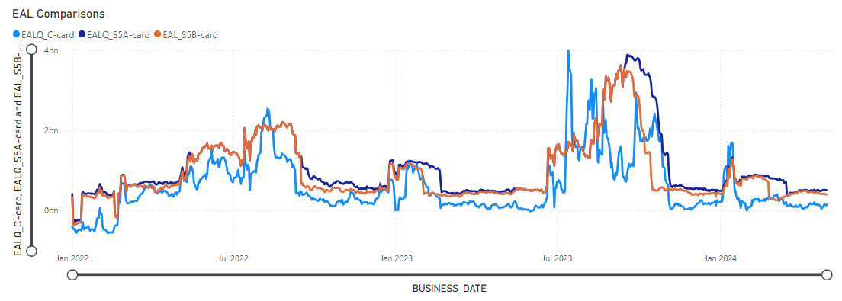
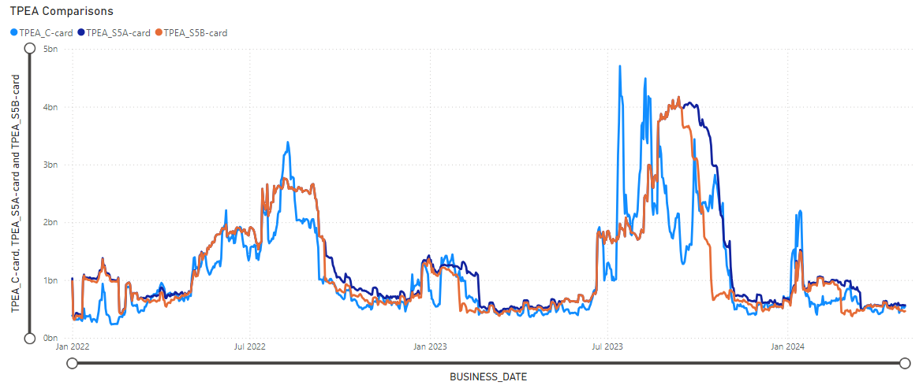
EAL and TPEA for Scenarios 5A & 5B vs. Current EAL

Slide 7
Negative and Positive Gaps for the entire period: Market

Slide 8
Negative and Positive Gaps during Elliott

Slide 9
Negative and Positive Gaps during Summer 2022

Slide 10
Negative and Positive Gaps during Summer 2023

Slide 11
Negative and Positive Gaps during Winter Storm Heather (Jan 2024)

Slide 12
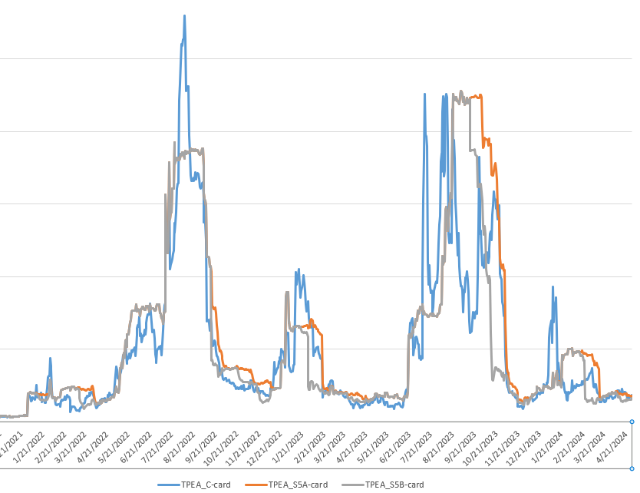
Sample CP – TPEA comparison

Slide 13
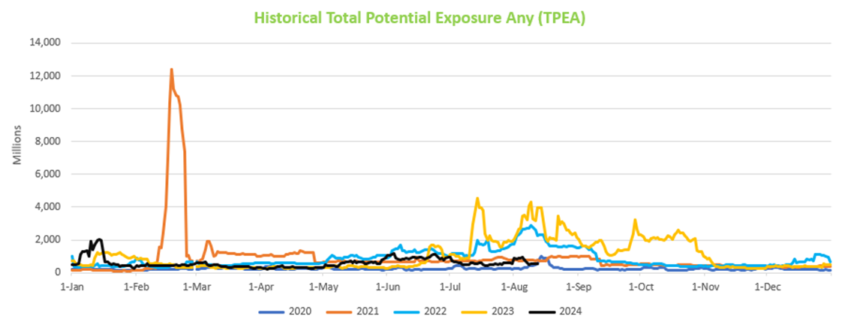
Historical TPEA comparison

Slide 14
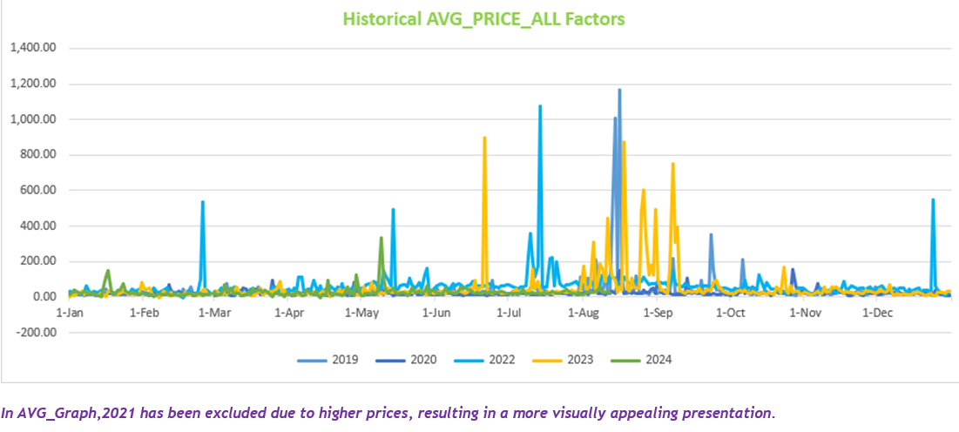
Historical average price comparison

Slide 15
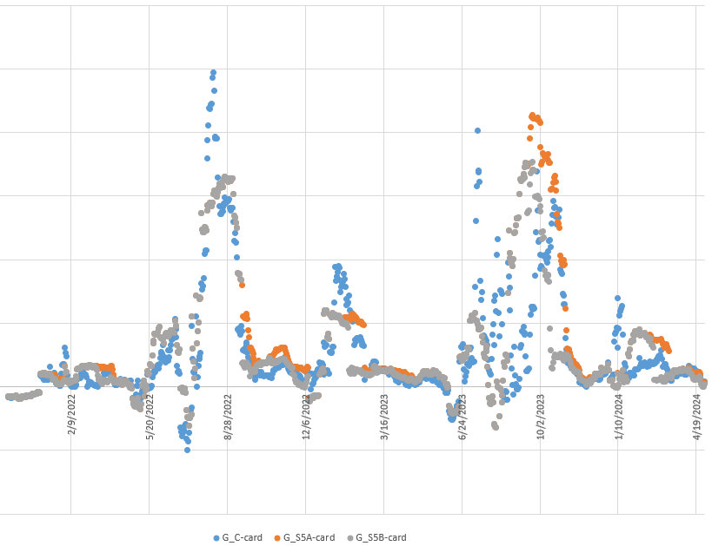
Sample CP – gap events

Slide 16

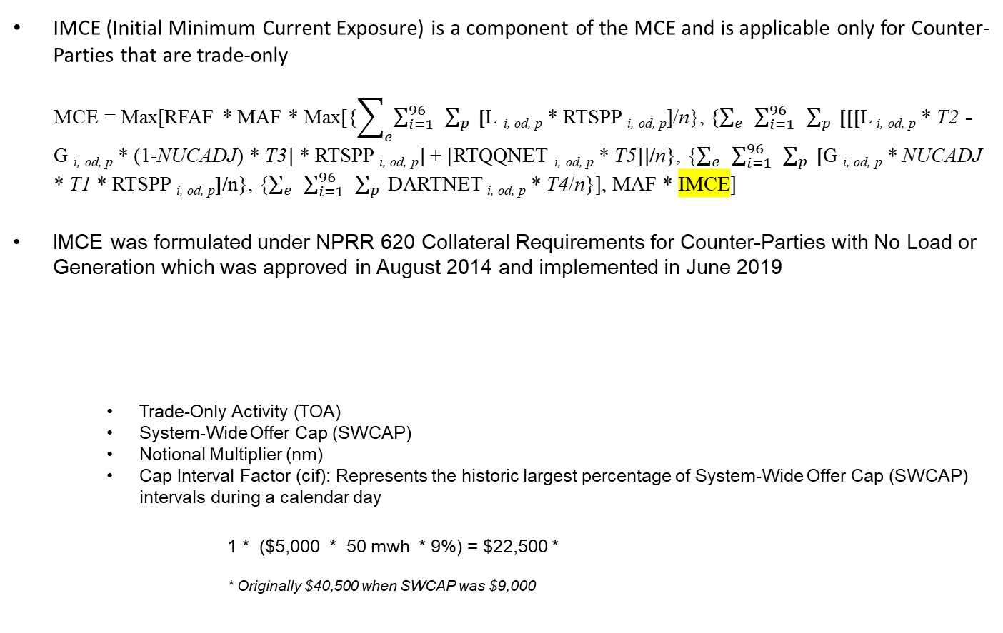
IMCE (Initial Minimum Current Exposure) – Traders only
IMCE (Initial Minimum Current Exposure) is a component of the MCE and is applicable only for Counter-Parties that are trade-only
MCE = Max[RFAF * MAF * Max[{$\sum_{e}^{ }{\sum_{i=1}^{96}{ }\sum_{p}^{ }{ }}$[L _{i, od, p} * RTSPP _{i, od, p}]/n}, {$\sum_{e}^{ }{ }\sum_{i=1}^{96}{ }\sum_{p}^{ }{ }$[[[L _{i, od, p} * T2 - G _{i, od, p} * (1-NUCADJ) * T3] * RTSPP _{i, od, p}] + [RTQQNET _{i, od, p} * T5]]/n}, {$\sum_{e}^{ }{ }\sum_{i=1}^{96}{ }\sum_{p}^{ }{ }$[G _{i, od, p} * NUCADJ * T1 * RTSPP _{i, od, p}]/n}, {$\sum_{e}^{ }{ }\sum_{i=1}^{96}{ }\sum_{p}^{ }{ }$DARTNET _{i, od, p} * T4/n}], MAF * IMCE]
IMCE was formulated under NPRR 620 Collateral Requirements for Counter-Parties with No Load or Generation which was approved in August 2014 and implemented in June 2019
Trade-Only Activity (TOA)
System-Wide Offer Cap (SWCAP)
Notional Multiplier (nm)
Cap Interval Factor (cif): Represents the historic largest percentage of System-Wide Offer Cap (SWCAP) intervals during a calendar day
1 * ($5,000 * 50 mwh * 9%) = $22,500 *
* Originally $40,500 when SWCAP was $9,000
16

Slide 17
IMCE (Initial Minimum Current Exposure) – Traders only
The original IMCE amount was an arbitrarily agreed upon amount to establish a base amount of collateral to be required from new trade-only Counter-Parties and/or if the EAL was negative
Prior to the formulation of the IMCE, the amount required was only $5,000 which was deemed too minimal and had no Protocol basis
The cif and notional multipliers were arbitrarily determined in order for the IMCE to result to the agreed upon value of $40,000
The cif was initially set to 9% (roughly 9 intervals with prices at the SWCAP or 9/96) even though in February 2011 there were 12 intervals of prices at the cap (around 12%)
We reviewed historical interval prices through the years (excluding during URI) and determined that on July 13, 2022 there were actually 14 intervals wherein prices reached the cap; this translates to a cif of 15% (14/96 or 14.58%)
Using this cif results in an IMCE of $35,000 or $12,500 more than the current IMCE
17

Slide 18
IMCE (Initial Minimum Current Exposure) – Traders only
Proposal:
Adjust the IMCE such that negative gap (during Elliot) remains at current level
Adjust the cif to 15% and the notional multiplier to 100 resulting in an IMCE of $75,000 as part of the EAL change proposal (S5a)
1 * ($5,000 * 100 mwh * 15%) = $75,000
An IMCE of $75,000 brings the negative gaps in S5a to roughly the same level as the negative gap in the current calculations
ERCOT recommends implementing the above flat increase in IMCE (for traders only) and notes the following:
EAL framework captures the historical activity and projects the future obligations based on the historical pattern.
There is an existing constraint for Traders in DAM once collateral call is issued. Also, since there is no mass transition risk, traders can be terminated on a much shorter timeframe than the others.
Trader’s activity can be highly volatile and tying MCE to the historical activity could lead to high volatility in MCE.
The proposed methodology directly addresses negative gaps when EAL is net credit since this is the root of the problem.
There is a built-in constraint in DAM in that ACL captures the bid exposures.
18

Slide 19
Conclusion: Scenario 5B
ERCOT recommends Scenario 5B as outlined above.
Scenario 5B
Reduces negative gaps by capturing DAM exposures and having a look back period for DAM, similar to treatment of RTM exposures under the current framework. Under the current framework, DAM exposures are captured in DALE, but there is no look back period.
Solves the double top or higher 2nd top problem. As it was brought up by multiple market participants, the “Double top” or “Higher 2nd top” could occur when a volatility event is followed up by another volatility event after a short period of stable/lower prices. This could lead to unreasonably high TPEA’s, which under certain circumstances could place an exceptional strain on the market.
Reduces overcollateralization and excessive volatility. As can be seen from the graphs presented above, the proposed framework will trim excessive overcollateralization and reduce overall volatility driven by RFAF*MaxRTLE function. It provides relatively more stable or less volatile measurement of exposures tracking actual invoices more closely. RFAF in the existing framework is more volatile and is applied against MaxRTLE, while the proposed Scenario S5B is applying RFAF against NLE with a floor.

