Slide 1
Indifference Payment required under RTC to avoid Incentive Incompatibility
Shams Siddiqi, Ph.D.
Hunt Energy Network (HEN)
(512) 619-3532
shams@crescentpower.net
RTCBTF Meeting
August 14, 2024

Slide 2
RTC inadvertently Eliminated Indifference Payment related to RDPA
Reliability Deployment Price Adder (RDPA) creates Settlement Point Prices (SPPs) at Resource Nodes that are inconsistent with (and higher than) SCED Dispatch LMPs – this is true for every instance of positive RDPA
For example: 4/22/22 at 15:00, System Lambda=$63.85/MWh and RDPA=$230.45/MWh
Without an Indifference Payment, there is a very strong incentive to not follow Resource Base Point (BP) based on $63.85/MWh SCED dispatch run LMP but rather chase $294.30/MWh LMP+RDPA payment by overproducing
To avoid this incentive incompatibility, currently all Resource available capacity is paid the RTRDAIAMT (RDPA-related Ancillary Service Imbalance Amount) of $230.45/MWh – which is magnitudes greater than needed to keep Resource’s indifferent and eliminate incentive to not follow their respective BPs
However, RTC eliminates RTRDAIAMT and thus creates an incentive incompatibility in following BP (the market is currently overpaying just to ensure this issue is addressed)
The following graph compares what is paid today as RTRDAIAMT and the proposed Indifference Payment based on 0.5*ΔLMP*ΔMW between pricing run and dispatch run deltas (graph values based on ΔLMP*ΔMW)

Slide 3
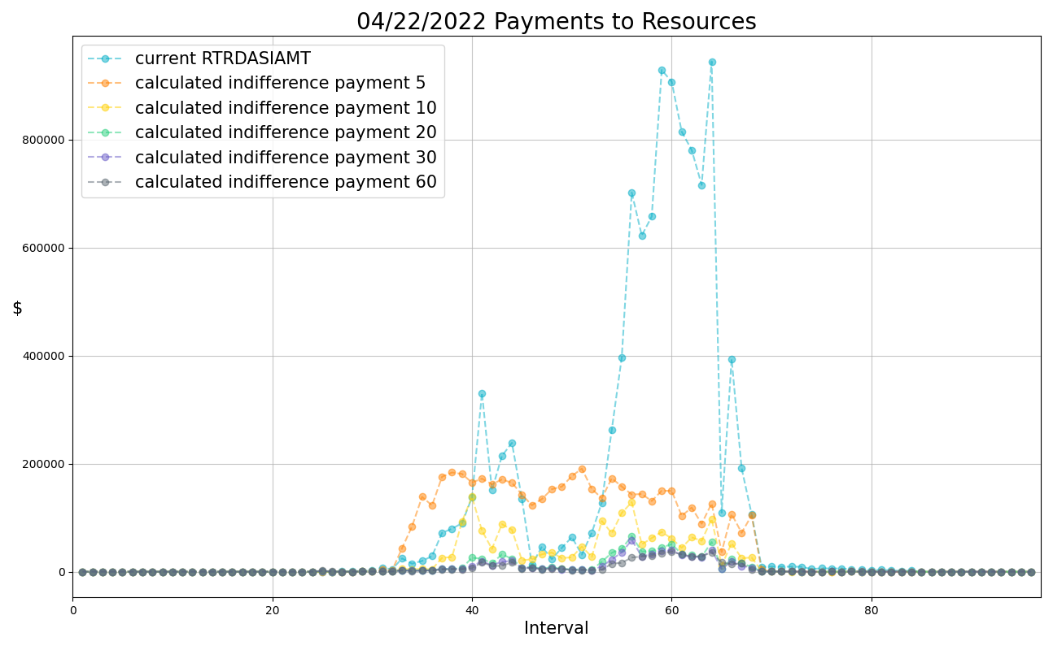
Current RDRDASIAMT v. Proposed Indifference Payment related to RDPA

Slide 4
Recommended Next Steps
Since AS (in particular Non-Spin) is likely to be awarded to almost all available capacity, a further refinement is to account to AS award differences between the SCED pricing run and dispatch run as follows (this will further reduce the Indifference Payment):
Indifference Payment=Max(0, 0.5*ΔLMP*ΔMWenergy + Σ (ΔMCPC*ΔMWas))
NPRR1214 addresses this issue by introducing an Indifference Payment under the current market (to eliminate RDPA-related RTRDASIAMT) as well as under RTC
However, recently filed ERCOT comments on NPRR1214 would defer even considering this issue till after RTC is implemented
The 4/22/22 example provided is a moderate one – if a severe scarcity event were to occur after RTC implementation but prior to fixing this lack of Indifference Payment, RDPA could be $4,000/MWh whereas System Lambda $1,000/MWh creating a huge reliability concern with Resources not following their BPs
HEN recommends either pursuing NPRR1214 to implement Indifference Payment with RTC implementation or pursuing a new Urgent NPRR to do that same.

