Slide 1
RoCoF and Phase Jump Measurement Discussion
IBRWG
Stephen Solis – Principal, System Operations Improvement
August 9th, 2024

Slide 2
Introduction
The intent of this presentation is to continue the discussion on Rate of Change of Frequency (RoCoF) and Phase Angle Jump requirements and measurement windows.
Further clarity can provide additional understanding and consistency in measuring, protections, conformity and post event analysis.

Slide 3
IEEE 2800-2022 – Rate of Change of Frequency (RoCoF)
7.3.2.3.5 Rate of change of frequency (ROCOF) ride-through (emphasis added)
“Within the mandatory operation region and continuous operation region (frequency range and corresponding cumulative duration, time), the IBR plant shall ride through and shall not trip for frequency excursions having an absolute rate of change of frequency (ROCOF) magnitude that is less than or equal to 5.0 Hz/s. As specified in 4.3, the ROCOF shall be the average rate of change of frequency over an averaging window of at least 0.1 s. Upon mutual agreement between the TS operator and the IBR operator, the IBR plant may be required to ride-through and not trip for higher ROCOF levels.”
4.3 Applicable voltages and frequency (emphasis added)
“For rate of change of frequency (ROCOF) ride-through requirements in 7.3.2.3.5, the ROCOF shall be the average rate of change of frequency over an averaging window of at least 0.1 s.”
9.2 Rate of change of frequency (ROCOF) protection (emphasis added)
This standard does not require rate of change of frequency (ROCOF) protection in an IBR plant. In cases where ROCOF protection is used to protect specific equipment within the IBR plant, it shall not impede the IBR plant from meeting the ride-through requirements of this standard inclusive of ROCOF ride-through requirements. ROCOF should be based on a change of frequency averaged over sufficient time to reject spurious frequency measurements caused by distortion and transients.
Key Takeaway: IEEE 2800-2022 defines the lowest possible averaging window and provides guidance but does not define the averaging window. This window should be defined so that protections and post event evaluation are consistent; and so that the 5.0 Hz/s requirement can be verified as sufficient for the ERCOT Interconnection.

Slide 4
IEEE P2800-2 – Rate of Change of Frequency (RoCoF)
P2800-2 Drafting team has attempted to add additional clarity in its initial draft.
The intent of the RoCoF requirement is to address switching and load rejection related frequency excursions and not fault related.
Frequency and RoCoF cannot be reliably measured during a fault and clearance.
Frequency protection is disabled in most equipment during severe voltage-dips and faults
IBRs should not trip due to any measured RoCoF during the fault disturbance and recovery period
Drafting recommends that TSP and RE agree on a method to measure frequency and calculate ROCOF during generation loss events.
Key Takeaway: IEEE 2800-2022 defines the lowest possible averaging window and provides guidance but does not define the averaging window. This window should be defined so that protections and post event evaluation are consistent; and so that the 5.0 Hz/s requirement can be verified as sufficient for the ERCOT Interconnection.
Disclaimer: This summary is based on draft language which has not been approved.

Slide 5
Additional Considerations for RoCoF
RoCoF (df/dt) protection is not required for transmission connected IBRs
Frequency protection is disabled in most equipment during severe voltage dips and for faults.
Instantaneous Frequency protection, if enabled, should utilize filtering to prevent erroneous measurements from being used AND/OR sufficient time delays.
If frequency protection is enabled, it should be set to the maximum equipment capabilities.
RoCoF protection is primary focus, however Phase Lock Loop controls should also be set to maximize the ride-through capability for frequency deviations.
Key Takeaway: IBRs should not enable RoCoF or frequency protection unless needed. If needed, should use filtering and time delays and maximize settings to equipment capabilities even if beyond requirement.

Slide 6
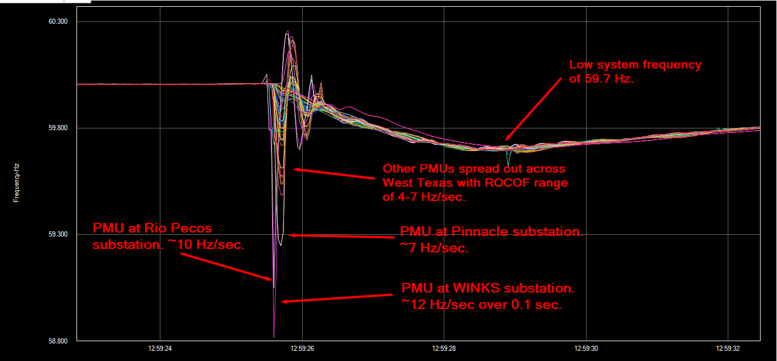
RoCoF example from Odessa 2022 event
Key Takeaway: Using a .1 second average window suggests RoCoF requirements be set higher than 5 Hz/second.

Slide 7
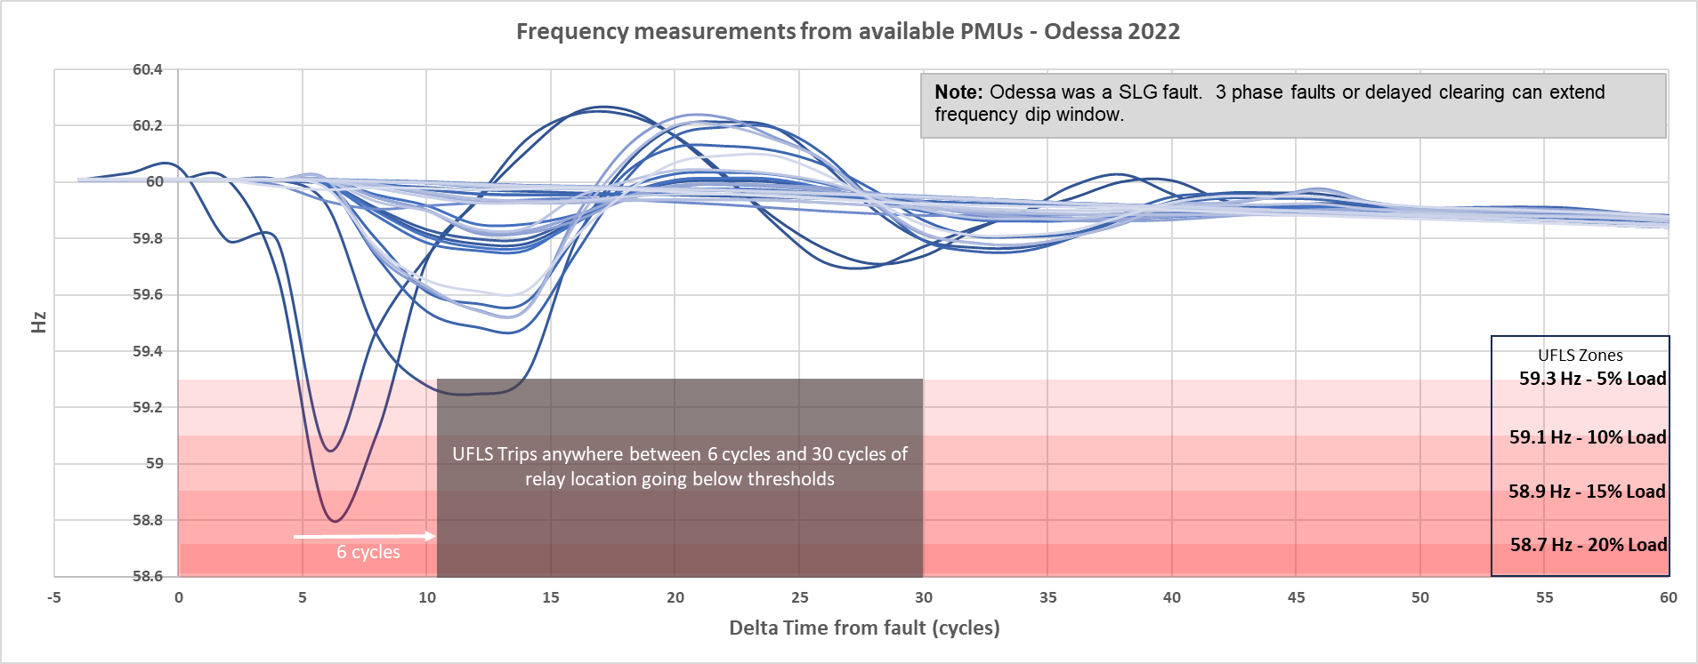
RoCoF example from Odessa 2022 event
Should .5 sec be used (30 cycles)??
Normal Clearing
Backup Clearing
Key Takeaway: Assuming normal and backup clearing times are .2 to .33 seconds (12 to 20 cycles) and giving a small amount of time (~.2 sec) to recover, would .5 seconds of an averaging window be appropriate?
Key Takeaway: Validating and properly modeling capabilities may be important to verify IBR’s ability to ride-through large load rejection and UFLS/UVLS simulations.

Slide 8
IEEE 2800-2022 – Phase Angle Jump (PAJ)
7.3.2.4 Voltage phase angle changes ride-through (emphasis added)
The IBR plant shall ride through positive-sequence phase angle changes within a sub-cycle-to-cycle time frame of the applicable voltage of less than or equal to 25 electrical degrees.116
In addition, the IBR plant shall remain in operation for any change in the phase angle of individual phases caused by occurrence and clearance of unbalanced faults, provided that the positive-sequence angle change does not exceed the forestated criterion. Active and reactive current oscillations in the post-disturbance period that are positively damped shall be acceptable in response to phase angle changes. Current blocking in the post-disturbance period shall not be permitted.
116 Typically caused by line switching (in or out), load rejection, etc., and depends on pre- and post-network flows.
Key Takeaway: IEEE 2800-2022 identifies the time window for non-fault phase angle changes to be sub cycle to cycle (i.e. within a single cycle). For unbalanced faults and the clearing of the faults, the delta measurement window is not defined. It is unclear if a window should be defined.

Slide 9
IEEE P2800-2 – Phase Angle Jump
P2800-2 Drafting team has attempted to add additional clarity in its initial draft.
The intent of the Phase Angle Jumps requirement is to address switching and load rejection related phase angle jumps and not fault related.
Phase angle change of the applicable voltages cannot be reliably measured during a fault and clearance, especially for near-by faults.
IBRs should not trip due to any measured phase angle changes during the fault disturbance and recovery period
Key Takeaway: IEEE 2800-2022 appears to identify that only sub cycle changes in phase angle beyond 25 degrees would be allowed to trip. Phase angle jumps due to a fault and its clearing, does not appear to be allowed.
Disclaimer: This summary is based on draft language which has not been approved.

Slide 10
Additional Considerations for RoCoF
Phase angle jump protection is not required for transmission connected IBRs
Instantaneous protection, if enabled, should utilize filtering to prevent erroneous measurements from being used AND/OR sufficient time delays to the extent possible.
If phase angle jump protection is enabled, it should be set to the maximum equipment capabilities.
Phase angle jump protection is primary focus, however Phase Lock Loop controls should also be set to maximize the ride-through capability for frequency deviations.
Key Takeaway: IBRs should not enable phase angle jump protection unless needed. If needed, should use filtering and time delays and maximize settings to equipment capabilities even if beyond requirement.

Slide 11
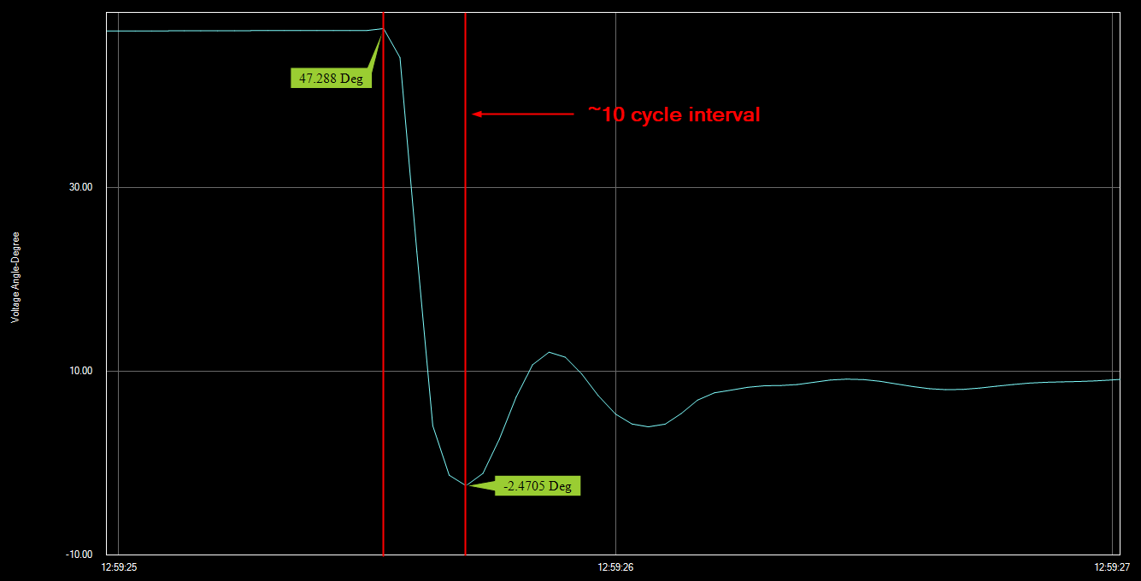
Phase Angle Jump example from Odessa 2022 event
Key Takeaway: This example shows that a 10 cycle (.167 sec) interval measurement. Extending the measurement interval would not have resulted in significant delta decrease.
Key Question: If faults and recovery normally occur within .2 to .33 seconds, is phase angle jump protection relevant after .5 seconds?

Slide 12
Questions?

