Slide 1
ERCOT IBRTF: NERC and Other Industry Updates
Julia Matevosyan
Chief Engineer
ESIG
08/09/2024

Slide 2
Forum for the Implementation of Reliability Standards for Transmission (i2X FIRST)| 7/30/24
An initiative spearheaded by the Solar Energy Technologies Office and the Wind Energy Technologies Office

Slide 3
Key Goals and Outcomes from i2X FIRST
To facilitate understanding and adoption of new and recently updated standards relevant for existing and newly interconnecting wind, solar and battery storage plants
The Forum will convene the industry stakeholders to enable practical and more harmonized implementation of these interconnection standards.
The presentation portion of the meeting will be recorded and posted, and presentation slides will be shared.
Additionally, the leadership team will produce a summary of each meeting capturing:
Recommended best practices
Challenges
Gaps that require future work
Notes:
[DOE]

Slide 4
Upcoming i2X FIRST Meetings
May 28th, 2024, 11 a.m.- 1 p.m. ET: Introduction of Evolving Standards Landscape
June 25th, 2024, 11 a.m.- 1 p.m. ET: IEEE2800 Ride Through Requirements
July 30th, 2024, 11 a.m.- 1 p.m. ET: IEEE2800 Ride Through Requirements, OEM Readiness
August 20th, 2024, 11 a.m.- 1 p.m. ET:
September 24th, 2024, 11 a.m.- 1 p.m. ET:
October 24th, 2024 hybrid, full day, during ESIG Fall Workshop, Providence, RI: Conformity Assessment
November 26th, 2024, 11 a.m.- 1 p.m. ET:
December 17th, 2024, 11 a.m.- 1 p.m. ET:
January 28th 2025, 11 a.m.- 1 p.m. ET:
February 25th 2025
March 20th, 2025 hybrid full day event during ESIG Spring Workshop, Austin, Texas
Sign up for all future i2X FIRST Meetings here: https://www.zoomgov.com/meeting/register/vJItceuorTsiErIC-HInpPbWuTUtrYQAuoM#/registration
Follow DOE i2X FIRST website: https://www.energy.gov/eere/i2x/i2x-forum-implementation-reliability-standards-transmission-first for meeting materials & recordings and for future meeting details & agendas

Slide 5
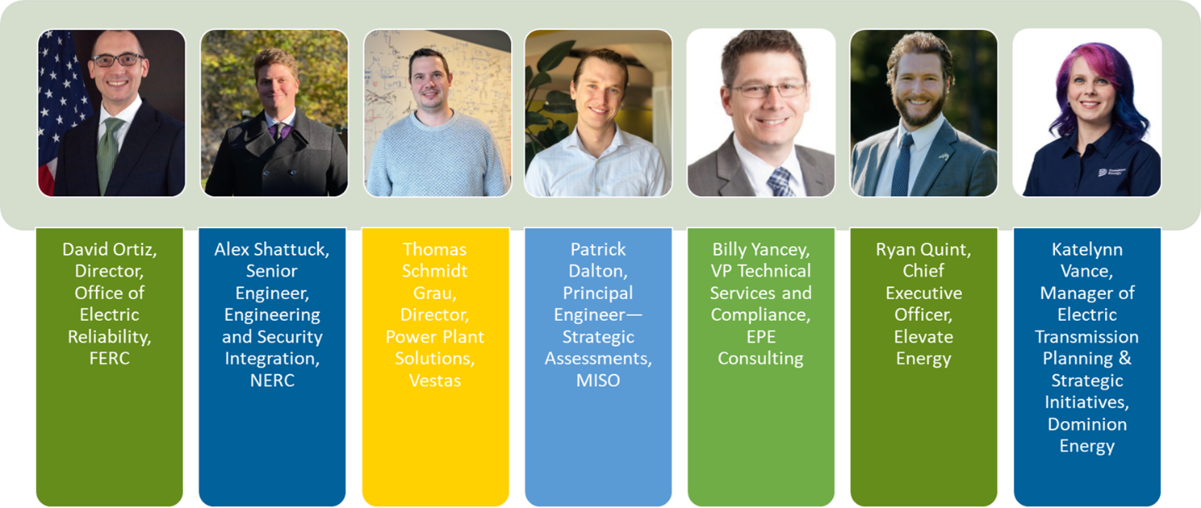
IEEE PES GM 2024 Panel on Status of IBR Standards Development and Integration Efforts
Stay Tuned: ESIG is working on a summary of the panel

Slide 6
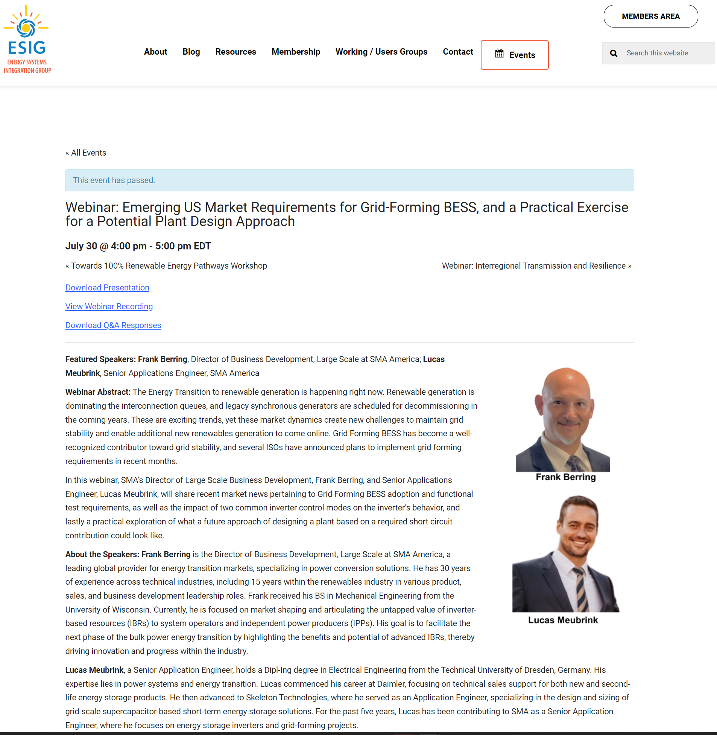
ESIG Webinar: Emerging US Market Requirements for GFM BESS, and a Practical Exercise for a Potential Plant Design Approach
Download Presentation
View Webinar Recording
Download Q&A Responses

Slide 7
Julia Matevosyan
julia@esig.energy

