Slide 1
PRC-028, 029, 030 Update
Julia Matevosyan
Chief Engineer
ESIG
06/14/2024

Slide 2
Disclaimer
This presentation contains the presenter’s interpretation of the NERC Standard Drafts, Implementation Plans and IEEE 2800-2022
Please consult original documents rather than using information from these slides

Slide 3
Background
As the Milestone 1 on NERC Work Plan in response to FERC Order 901, three standards are currently in their final ballot phase, :
PRC-028 Disturbance Monitoring and Reporting Requirements for Inverter-Based Resources, Draft 4
PRC-029 Frequency and Voltage Ride-through Requirements for Inverter-based Resources, Draft 3
PRC-030 Unexpected Inverter-Based Resource Event Mitigation. Draft 3
The ballots and non-binding poll is open through 8 p.m. Eastern, Monday, August 12, 2024.
This will be the last opportunity for NERC to ballot these projects through traditional mechanisms.
NERC Board may take requisite action during the August 2024 Board of Trustees meeting to ensure directives are met, i.e.. the requirements are completed and filed with FERC by November 4, 2024
.

Slide 4
Prior PRC-028, 029, 030 Balloting Results
Standard Draft | Ballot Quorum/Approval | Non-Binding Poll Quorum/Supportive Options
PRC-028 (Draft 3) | 79.26% / 46.77% | 76.63% / 48.15%
PRC-029 (Draft 2) | 85.39% / 35.45% | 82.47% / 29.03%
PRC-030 (Draft 2) | 81.95%/ 31.44% | 78.63%/ 24.68%

Slide 5
PRC-029 Applicability
The Elements associated with (1) Bulk Electric System (BES) IBRs; and (2) Non-BES IBRs that either have or contribute to an aggregate nameplate capacity of greater than or equal to 20 MVA, connected through a system designed primarily for delivering such capacity to a common point of connection at a voltage greater than or equal to 60 kV.

Slide 6
PRC-029 vs IEEE 2800-2022
Based on my observations:
The requirements that are discussed seem consistent with IEEE 2800-2022, except for frequency ride through requirement
Volts per hertz capability requirement is specified, while IEEE 2800-2022 has it as “frequency ride-through requirement within volts per hertz capability limits” of IBR plant equipment.

Slide 7
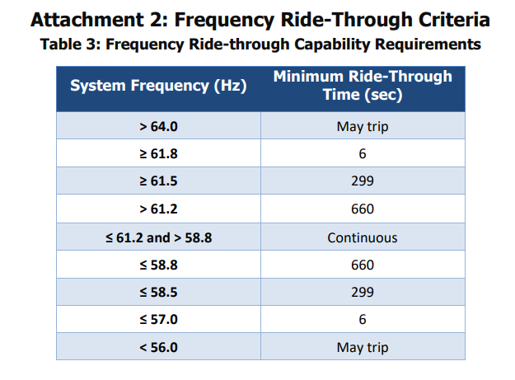
PRC-029 vs IEEE 2800-2022 Frequency Ride-Through
IEEE 2800-2022
PRC-029 Draft 3
IEEE 2800-2022, with 60 Hz nominal frequency
Frequency range (Hz) | Minimum time(s) (design criteria)
> 61.8 | May trip
61.2 < f ≤ 61.8 | 299
58.8 ≤ f ≤ 61.2 | Continuous operation
57.0 ≤ f < 58.8 | 299
< 57.0 | May trip

Slide 8
PRC-029 Implementation Plan
The standard shall become effective on the first day of the first calendar quarter that is twelve months after the FERC approval date.
Non‐BES IBRs shall not be required to comply with Requirements R1, R2, and R3 relating to the design until the later of: (1) January 1, 2027; or (2) the effective date of the standard.
Standard will apply to design portion of requirements from its effective date
IBR shall not be required to comply with the requirements relating to the operation of IBRs until the entity has established the required disturbance monitoring equipment capabilities in accordance with the implementation plan for PRC‐028‐1.

Slide 9
PRC-029 Exemptions (R4)
Each Generator Owner identifying an IBR that is in-service by the effective date of PRC-029-1, has known hardware limitations that prevent the IBR from meeting voltage ride-through criteria as detailed in Requirements R1 and R2 and requires an exemption from specific voltage Ride-through criteria shall document those limitations and provide respective documentation to PC/TO/TP/RC.
If hardware is replaced the exemption no longer applies
The exemption process is for existing IBRs only for voltage ride-through requirements (R1, R2)
IBRs connected after the standard becomes effective have no exemptions, no provisions for “safe harbor” equipment.
Frequency ride through requirements, RoCoF, phase jump, V/Hz requirements apply to all IBRs existing and new.

Slide 10
NERC Glossary IBR Defintion
NERC Glossary IBR Definition out for ballot as well open through 8 p.m. Eastern, Tuesday, August 12, 2024. https://www.nerc.com/pa/Stand/Pages/Project-2020_06-Verifications-of-Models-and-Data-for-Generators.aspx
All PRC standards above are leaning on this IBR Definition

Slide 11
Julia Matevosyan
julia@esig.energy

