Slide 1
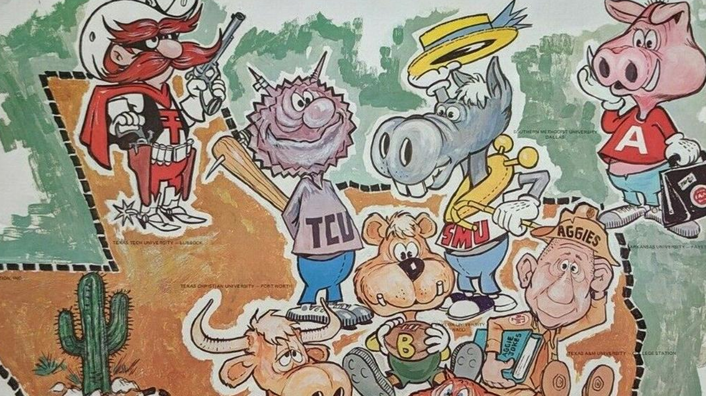
TEXAS SET UPDATE
RMS: August 6, 2024

Slide 2
UPDATEs & Voting Items
TEXAS SET 5.0 Market Orientation - June 25th
Flight 0924: TEXAS SET 5.0
2025 Flight Schedule (Possible Vote)
Change Control Call (Vote)
TXSETCC 851: Update the gray box in the 814_04 for the SHF (Switch Hold Indicator) to reflect the SHF Reject Code is not valid when the LIN07 or LIN09 = MVO
NPRR1237: Retail Market Qualification Testing Requirements

Slide 3
August
August 13, 2024 @ 9:30
Joint MCT/TEXAS SET
WebEx Only

