Slide 1
RTC+B Settlement Overview
Magie Shanks
ERCOT
RTCBTF Meeting
8/14/2024

Slide 2
Settlement Overview
This presentation covers a high-level overview of the Settlement changes under Real-Time Co-optimization and Single Model ESR.
List of NPRRs included in RTC+B Project:
  NPRR1007-1013 – RTC
  NPRR1014 – Single Model ESR
  NPRR1029 – Only Sections 25.5.2, 25.5.5, 25.5.6 for Market Suspension for ESRs
  NPRR963 – Sections 6.6.5.5, 6.6.5.5.1, 6.6.5.6; NPRR1014 was written on top of the NPRR963 grey boxes for Set Point Deviation for ESRs – will need to keep as baseline for NPRR1014 implementation
  NPRR1054 – Removes Oklaunion Exemption; Cleans up any remaining code and billing determinants in the Settlement System
  NPRR1172 – Only Section 5.7.2 for RUC Clawback Settlement Clean up
  NPRR1000 – Eliminate DSR
  NPRR1236 – RUC State of Charge
  NPRR1245 & 1246 – Clean-up NPRRs for RTC and ESR

Slide 3
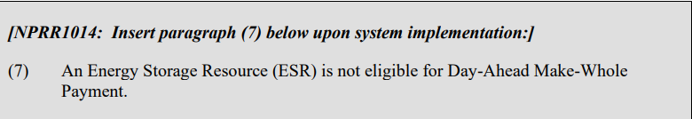
Day-Ahead Make-Whole Payment
Description of Change: Excludes ESRs from receiving DAMW payments
Protocol Section 4.6.2.3 and 4.6.2.3.1

Slide 4
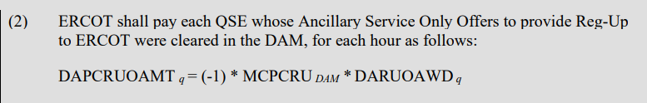
Day-Ahead Ancillary Service Payment (new)
Description of Change: Adding Ancillary Service Only Offers in DAM; new charge type on DAM Settlement Statement
Protocol Section 4.6.4.1, Payments for Ancillary Services Procured in the DAM
Settlement below is for Reg-Up. Same Settlement changes for each AS type.

Slide 5
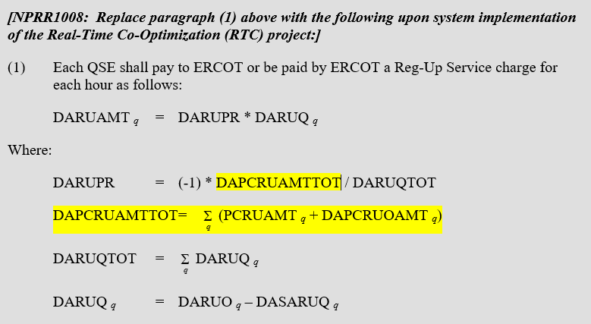
Day-Ahead Ancillary Service Charge
Description of Change: Adding Ancillary Service Only Offers in DAM; new charge type on DAM Settlement Statement
Protocol Section 4.6.4.2, Charges for Ancillary Services Procured in the DAM
Settlement below is for Reg-Up. Same Settlement changes for each AS type.

Slide 6
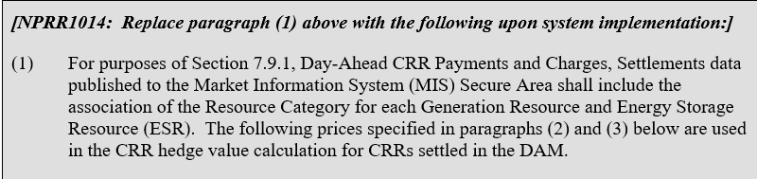

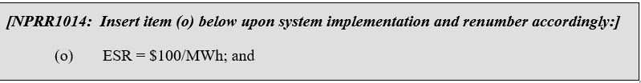
Day-Ahead Congestion Revenue Rights
Description of Change: For minimum and maximum prices used for the source and sink settlement points, adding a new category for “ESR”
Protocol Section 7.9.1.3, Minimum and Maximum Resource Prices
Minimum Price (MINRESPR):
Maximum Price (MAXRESPR):

Slide 7
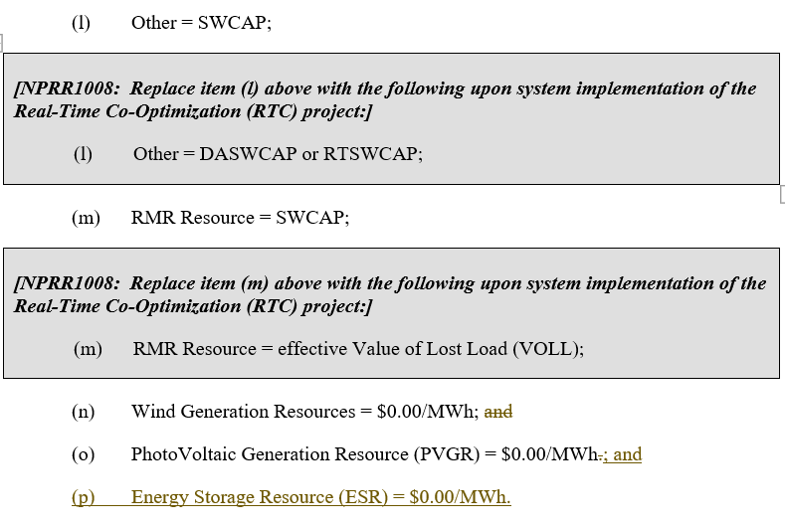
Energy Offer Curve Cost Caps
Description of Change:
  Changing the value of the cost categories “Other” and “RMR Resource”; Adding a new category for “Energy Storage Resource”
  Values are utilized in the calculations of Day-Ahead Average Incremental Energy Cost (DAAIEC) and Real-Time Energy Offer Curve Cost Cap (RTEOCOST)
  DAAIEC is utilized in DAM Make-Whole Payments; ESRs are excluded from DAAIEC
  RTEOCOST is utilized in RUC Make-Whole Payments, HDLO Payments, and VSS Payments
Protocol Section 4.4.9.3.3, Energy Offer Curve Cost Caps

Slide 8
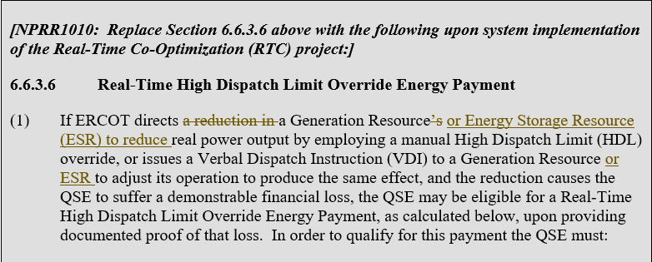
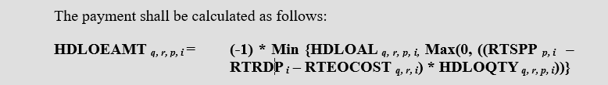
Real-Time HDLO Energy Payment
Description of Change:
  Remove Real-Time Reserve Price for On-Line Reserves (RTRSVPOR) from calculation
  Clarify that an ESR will qualify for HDLO payment if they were directed to reduce power
Protocol Section 6.6.3.6, Real-Time High Dispatch Limit Override Energy Payment

Slide 9
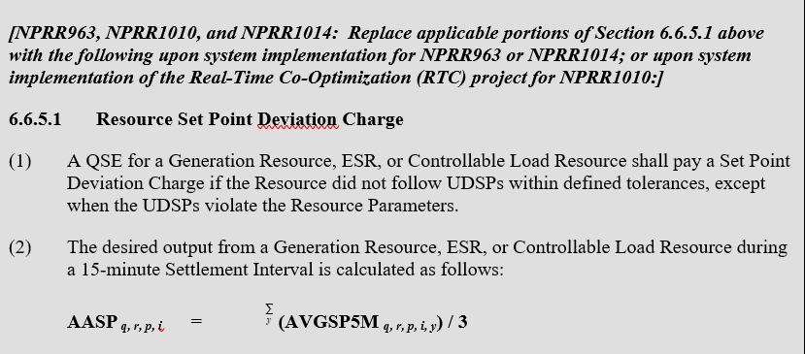
Set-Point Deviation
Description of Change:
  Renames charge from Base-Point Deviation to Set-Point Deviation; will also rename charge type on RTM Settlement Statement
  Renames AABP to AASP for all SPD calculations
  Utilizes UDSP instead of BP + Regulation for AASP calculation
  Adds a new SPD calculation for ESRs based on evaluation for over and under performance
  Tolerance threshold set at 3% or 3MW
  Removes exemption for Dynamically Scheduled Resources (NPRR1000)
Protocol Section 6.6.5, Set Point Deviation Charge

Slide 10
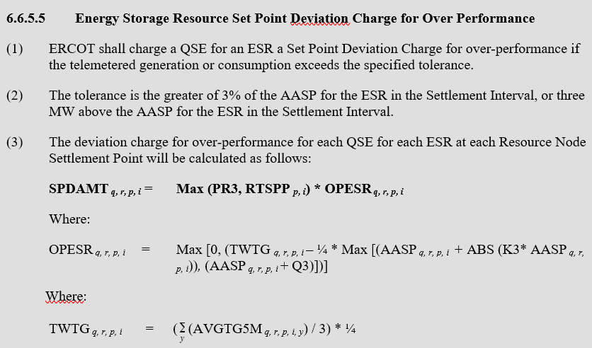
Set-Point Deviation (cont.)
Protocol Section 6.6.5.5, Energy Storage Resource Set Point Deviation Charge for Over Performance (excludes any language related to DC-Coupled from NPRR1014; grey box edited below to show final blacklined language from NPRR1246)

Slide 11
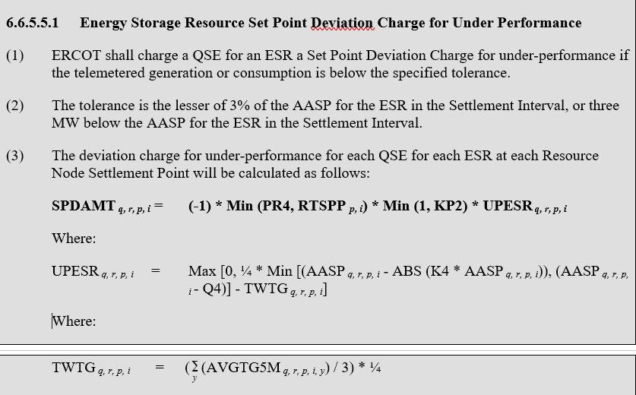
Set-Point Deviation (cont.)
Protocol Section 6.6.5.5.1, Energy Storage Resource Set Point Deviation Charge for Under Performance (excludes any language related to DC-Coupled from NPRR1014 ; grey box edited below to show final blacklined language from NPRR1246)

Slide 12
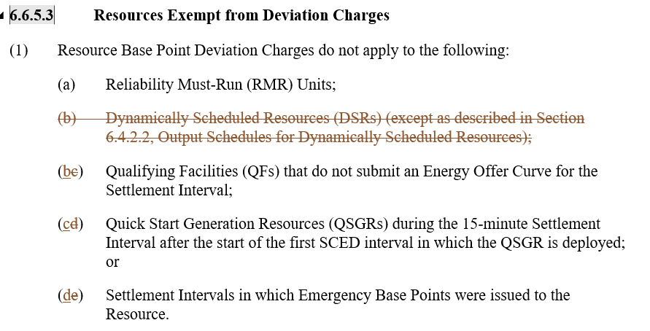
Set-Point Deviation (cont.)
Protocol Section 6.6.5.3, Resources Exempt from Deviation Charges (changes from NPRR1000)

Slide 13
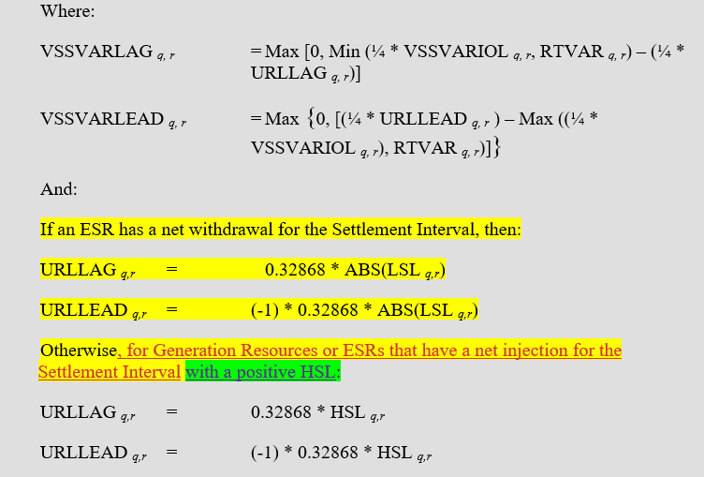
Voltage Support Service VAr Payment
Description of Change:
  Updates VSSVARAMT payment to include ESRs
  New URLLAG and URLLEAD intermediate calculations for ESRs
Protocol Section 6.6.7.1(1) and (2), Voltage Support Service Payments
Note: After further review, an additional change to NPRR1246 will be proposed to not compensate an ESR in the instance where an ESR is discharging but showing a negative HSL in their COP.

Slide 14
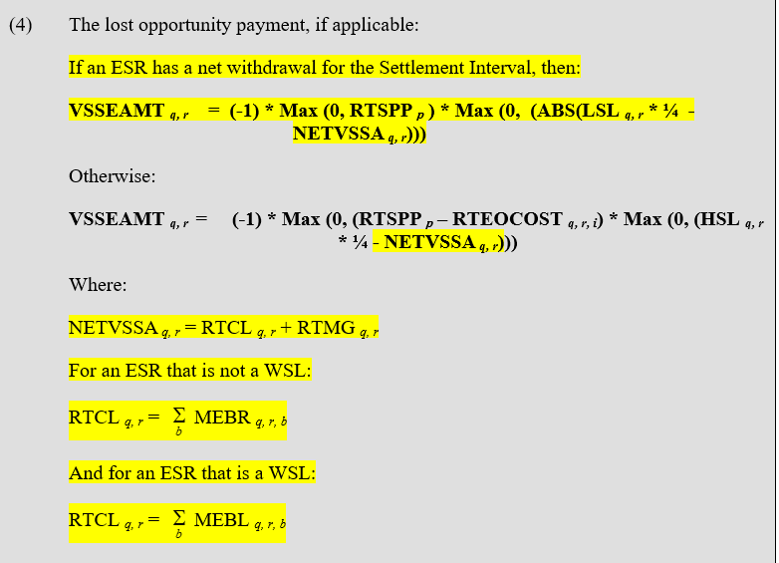
Voltage Support Service Lost Opportunity Payment
Description of Change:
  Updates VSSEAMT payment to include consideration of ESRs
  New NETVSSA and RTCL intermediate calculations for ESRs
Protocol Section 6.6.7.1(4), Voltage Support Service Payments

Slide 15
Emergency Operations Payment
Description of Change:
  Updates EMREAMT payment to include consideration of ESRs
  Adds a new EMREAMT calculation that will consider RTM AS revenues in addition to RTM energy revenues when calculating an emergency payment
  Energy Offer Curve or Energy Bid/Offer Curve used in the calculation of the Emergency Base Point Price (EBPPR) will be the curve that was submitted and approved immediately prior to the emergency event, excludes price correction events
  MOC used for ESRs will be set to the highest RTSPP at the Resource’s Settlement Point for the Operating Day
Protocol Section 6.6.9, Emergency Operations Settlement; 6.6.9.1, Payment for Emergency Operations Settlement
To determine which calculation the Resource will be evaluated under, we will have a new flag, EMGSETLFLAG, that will indicate a value of 1 or 2:
  If the Resource will be analyzed for payment under paragraphs (1) Real EBP, (2) Cap Test or (8) CFC Mode of 6.6.9, the EMGSETLFLAG will be set to 1 and settled under paragraph (1) of Section 6.6.9.1.
  For all other scenarios, the EMGSETLFLAG will be set to 2 and settled under paragraph (2) of Section 6.6.9.1.

Slide 16
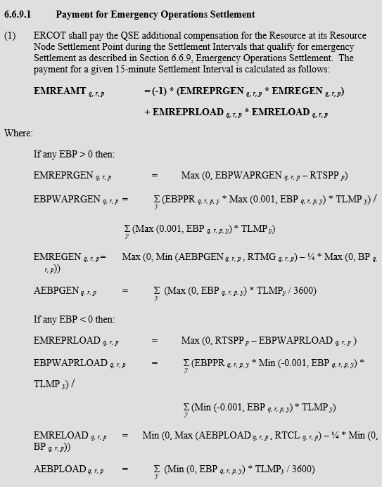
Emergency Operations Payment (cont.)
Protocol Section 6.6.9.1 (1), Payment for Emergency Operations Settlement
Same structure as current emergency payment is today, it has just been adjusted to account for the charging side of an ESR.

Slide 17
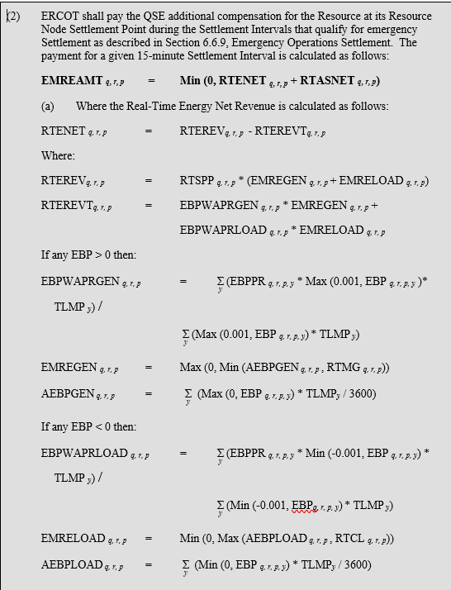
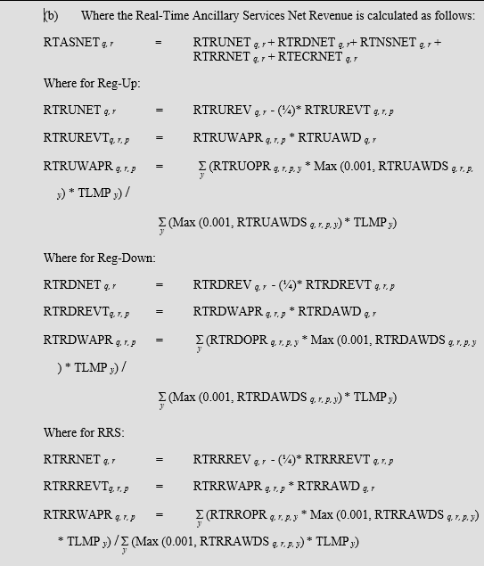
Emergency Operations Payment (cont.)
Protocol Section 6.6.9.1 (2), Payment for Emergency Operations Settlement
Considers Energy and AS Revenues in the Emergency settlement calculation

Slide 18
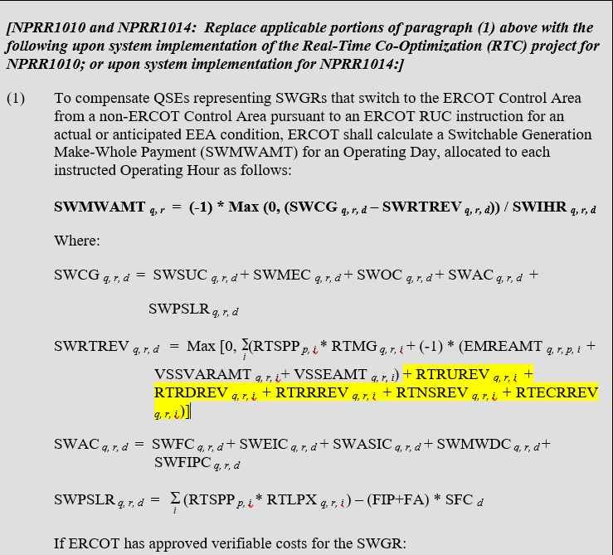
Switchable Generation Make-Whole Payment
Description of Change: Updates the calculation of Switchable RT revenues to include RT AS Revenues
Protocol Section 6.6.12.1, Switchable Generation Make-Whole Payment

Slide 19
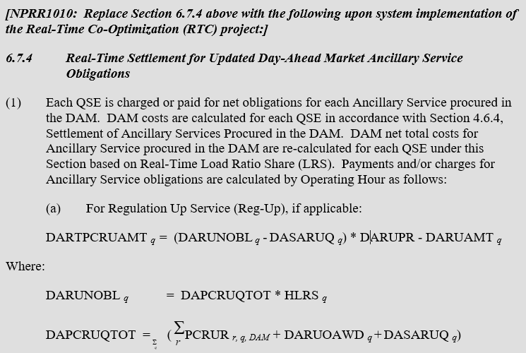
Real-Time Settlement for updated DAM AS Obligations (new)
Description of Change: AS Obligations assigned in DAM will be recalculated based on the QSE’s updated Hourly Load Ratio Share (HLRS); new charge type on RTM Settlement Statement
Protocol Section 6.7.4, Real-Time Settlement for Updated Day-Ahead Market Ancillary Service Obligations
Settlement below is for Reg-Up. Same Settlement changes for each AS type.

Slide 20
Real-Time Ancillary Service Settlement (new)
Description of Change:
  New payment or charge based on calculated AS Imbalance quantities
  New charge for AS Only Offers purchased in DAM
  New charge for AS Trade Overages
  New load allocated settlement for the total AS payments and charges
  New charge types on RTM Settlement Statement – 1 for each bullet above for each AS Type; total of 20 new charge types
Protocol Section 6.7.5, Real-Time Ancillary Service Charges and Payments (includes all subsections) and 6.7.6, Real-Time Ancillary Service Revenue Neutrality Allocation
Settlement on following slide is for Reg-Up. Same Settlement changes for each AS type.

Slide 21
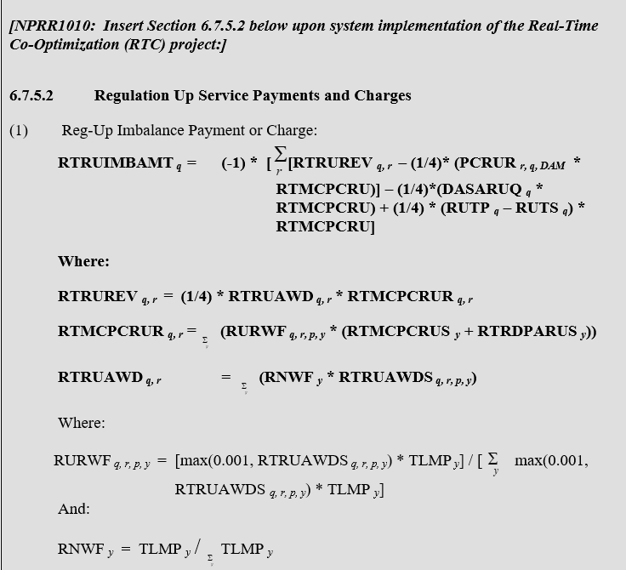

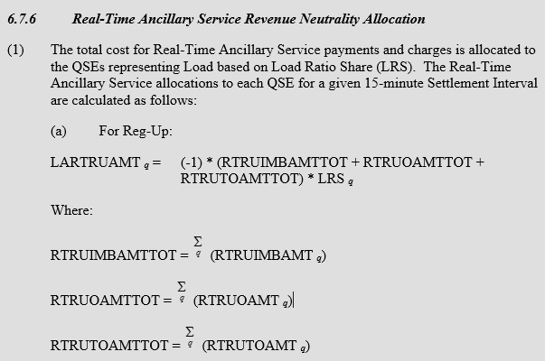

Real-Time Ancillary Service Settlement (cont.)

Slide 22
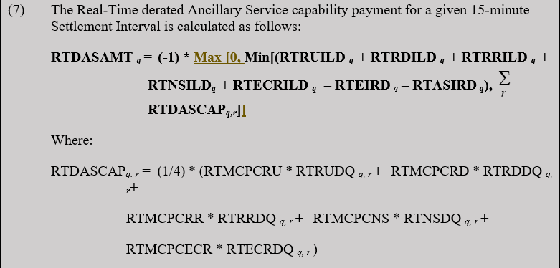
Real-Time Derated AS Capability Payment (new)
Description of Change:
  If ERCOT manually reduces the amount of AS that may be awarded to a Resource in RTM and causes a reduction in payment to the QSE under the RT AS Imbalance Settlement, the QSE may file a dispute under this section
  New charge type on RTM Settlement Statement
Protocol Section 6.7.5.7, Real-Time Derated Ancillary Service Capability Payment

Slide 23
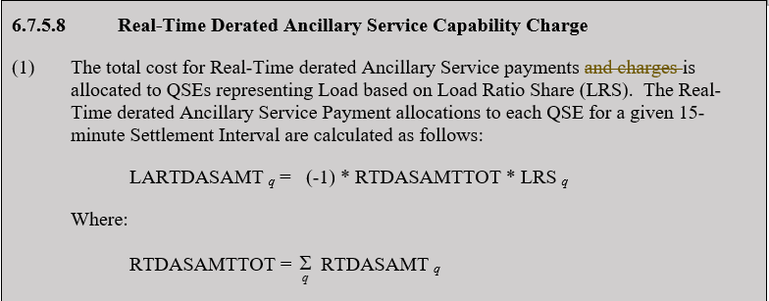
Real-Time Derated AS Capability Charge (new)
Description of Change:
  Total Cost for RT Derated payments will be allocated on LRS basis
  New charge type on RTM Settlement Statement
Protocol Section 6.7.5.8, Real-Time Derated Ancillary Service Capability Charge

Slide 24
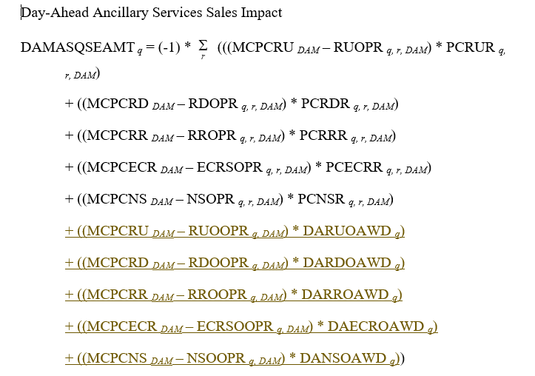
Settlement for MP Impacted by Omissions or Manual Actions to Resolve DAM
Description of Change: Included AS Only offers into the consideration of the AS impact for this dispute-based Settlement
Protocol Section 9.14.10, Settlement for Market Participants Impacted by Omitted Procedures or Manual Actions to Resolve the DAM
Note: This section will require additional changes as described in the prior agenda item.

Slide 25
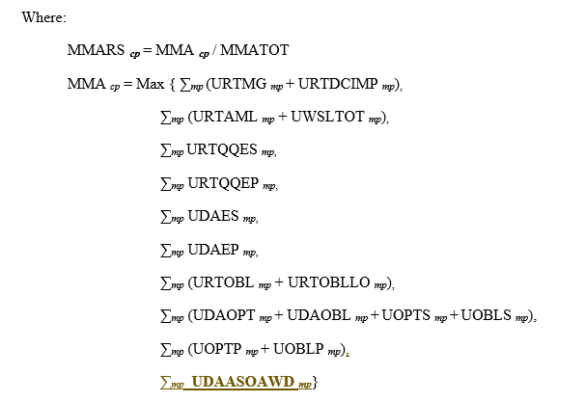
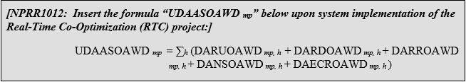
Default Uplift Invoices
Description of Change: Includes AS Only Offers into the consideration of the Counter-Party’s Maximum Market Activity (MMA)
Protocol Section 9.19.1, Default Uplift Invoices

Slide 26
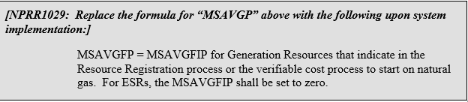
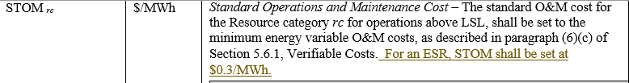
Market Suspension Payment
Description of Change:
  Updated to include consideration of ESRs for Market Suspension Payments
  In the calculation of Market Suspension Operation Costs (MSOC), assigned the values of the variables MSAVGFP to $0/MWh and STOM to $0.30/MWh for ESRs.
Protocol Section 25.5.2, Market Suspension Make-Whole Payment

Slide 27
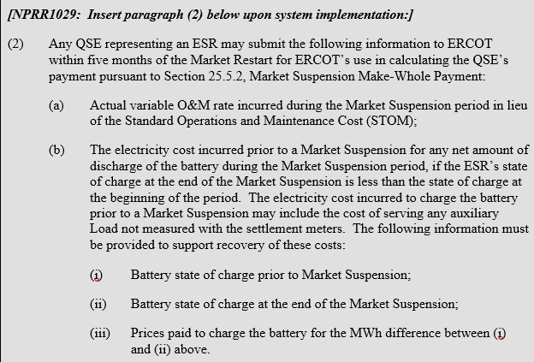
Market Suspension Payment (cont.)
Description of Change:
  ESRs can submit additional information to ERCOT to utilize an actual O&M rate instead of the standard STOM value in the calculation of the ESR’s costs
  ESRs can recoup charging costs incurred prior to the Market Suspension period (included in the billing determinant: Market Suspension Operating Costs Adjustment (MSOCADJ))
Protocol Section 25.5.6, Market Suspension Data Submissions

Slide 28
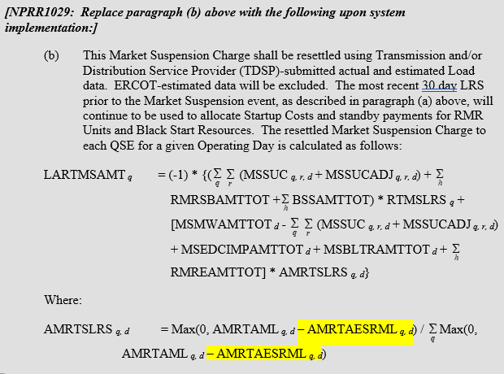
Market Suspension Charge
Description of Change: Updated the LRS allocation used in the resettlement to remove any ESR load from being assessed a portion of the Market Suspension Charges
Protocol Section 25.5.5, Market Suspension Charge Allocation

Slide 29
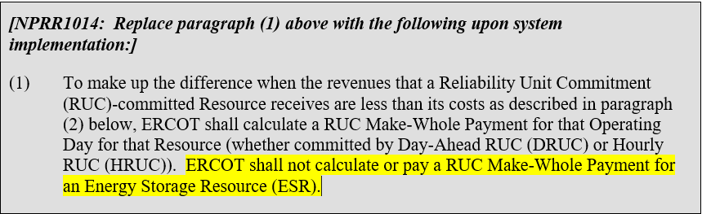
RUC Make-Whole Payments
Description of Change:
  Excludes ESRs from receiving RUCMW payments
  Includes RT AS revenues in the calculation of Revenue Less Costs Above LSL During RUC Committed Hours (RUCEXRR96) and Revenue Less Cost During QSE-Clawback Interval (RUCEXRQC) used to offset the RUC Guarantee
Protocol Section 5.7.1, RUC Make-Whole Payment; 5.7.1.3, Revenue Less Cost Above LSL During RUC-Committed Hours; and 5.7.1.4, Revenue Less Cost During QSE Clawback Intervals

Slide 30
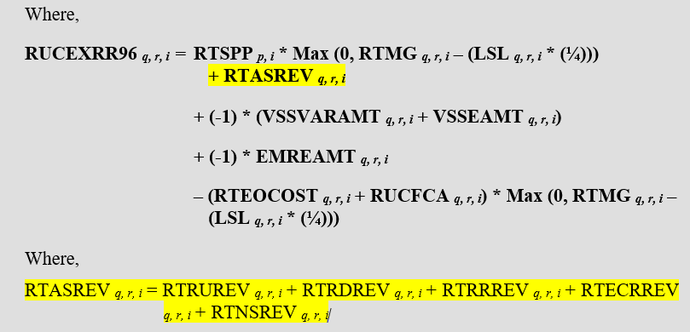
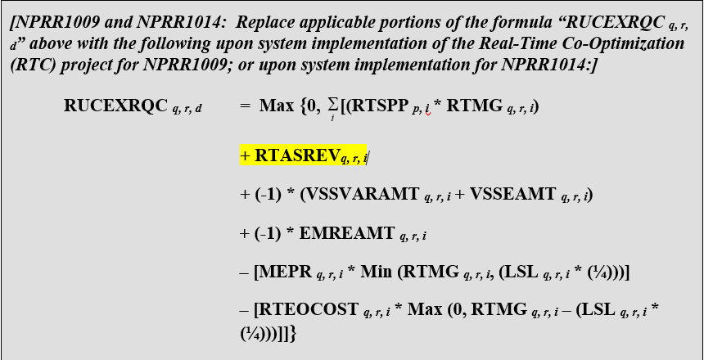
RUC Make-Whole Payments (cont.)

Slide 31
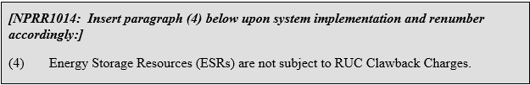
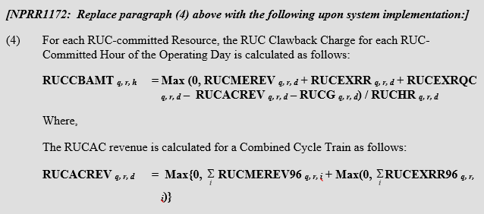
RUC Clawback Charges
Description of Change:
  Excludes ESRs from RUC Clawback Charges
  Cleans up the RUC Clawback Charge (RUCCBAMT) calculation as approved in NPRR1172
Protocol Section 5.7.2 RUC Clawback Charge

Slide 32
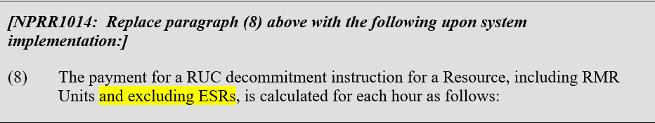
RUC Decommitment Payment
Description of Change:
  Excludes ESRs from RUC Clawback Charges
Protocol Section 5.7.3, Payment When ERCOT Decommits a QSE-Committed Resource

Slide 33
RUC Capacity Short
Description of Change:
  Updated to include consideration of ESR’s into the QSE’s capacity calculation
  New calculation to determine a QSE’s Ancillary Service Shortfall
  The overall shortfall calculation updated to take the maximum of the QSE’s overall shortfall or their Ancillary Service Shortfall
  To view all changes to this section for the RTC project, please refer to NPRR1236
Protocol Section 5.7.4.1.1, Capacity Shortfall Ratio Share
Calculations on following slide only show the equations at the RUC Snapshot. Similar equations have also been included for the end of Adjustment Period.

Slide 34
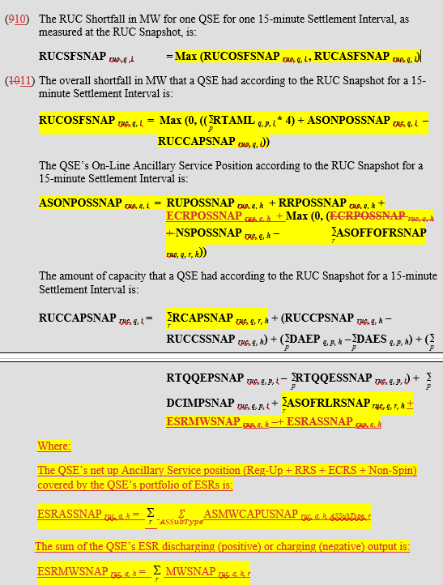
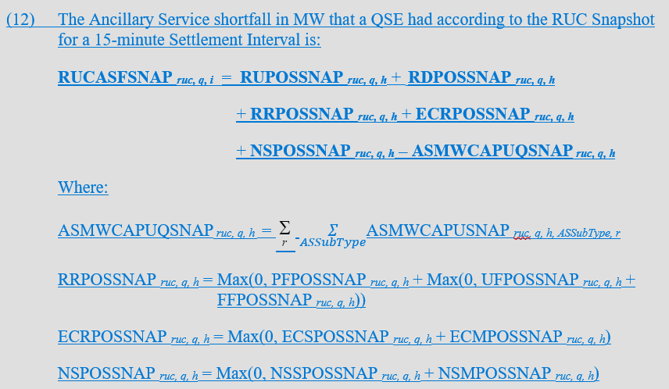
RUC Capacity Short (cont.)

Slide 35
Settlement Sections Removed
6.7.1, Payments for Ancillary Service Capacity Sold in a Supplemental Ancillary Services Market (SASM) or Reconfiguration Supplemental Ancillary Services Market (RSASM)
6.7.2, Payments for Ancillary Service Capacity Assigned in Real-Time Operations
6.7.2.1, Charges for Infeasible Ancillary Service Capacity Due to Transmission
6.7.3, Charges for a Failure to Provide Ancillary Service
6.7.4, Adjustments to Cost Allocations for Ancillary Services Procurement
6.7.5, Real-Time Ancillary Service Imbalance Payment or Charge
6.7.6, Real-Time Ancillary Service Imbalance Revenue Neutrality Allocation
6.7.7, Adjustments to Net Cost Allocations for Real-Time Ancillary Services

Slide 36
Settlement Charge Types Removed
Total of 34 Charge Types removed:
RUFQAMTQSETOT
RDFQAMTQSETOT
RRFQAMTQSETOT
NSFQAMTQSETOT
ECRFQAMTQSETOT
RUINFQAMT
RDINFQAMT
RRINFQAMT
NSINFQAMT
ECRINFQAMT
RTRUAMT
RTRDAMT
RTRRAMT
RTNSAMT
RTECRAMT
RTPCRUAMTQSETOT
RTPCRDAMTQSETOT
RTPCRRAMTQSETOT
RTPCNSAMTQSETOT
RTPCECRAMTQSETOT
RTAURUAMTQSETOT
RTAURRAMTQSETOT
RTAUECRAMTQSETOT
NETARTRUAMT
NETARTRRAMT
NETARTECRAMT
RTASIAMT
RTRDASIAMT
RTRUCRSVAMT
RTRDRUCRSVAMT
LAASIRNAMT
LARDASIRNAMT
BDAMTQSETOT (renamed)
LABPDAMT (renamed)

Slide 37
Settlement Charge Types Added
Total of 34 Charge Types added:
DAPCRUOAMT
DAPCRDOAMT
DAPCRROAMT
DAPCNSOAMT
DAPCECROAMT
DARTPCRUAMT
DARTPCRDAMT
DARTPCRRAMT
DARTPCNSAMT
DARTPCECRAMT
RTDASAMT
LARTDASAMT
RTRUIMBAMT
RTRDIMBAMT
RTRRIMBAMT
RTNSIMBAMT
RTECRIMBAMT
RTRUOAMT
RTRDOAMT
RTRROAMT
RTNSOAMT
RTECROAMT
RTRUTOAMT
RTRDTOAMT
RTRRTOAMT
RTNSTOAMT
RTECRTOAMT
LARTRUAMT
LARTRDAMT
LARTRRAMT
LARTNSAMT
LARTECRAMT
SPDAMTQSETOT (renamed)
LASPDAMT (renamed)

Slide 38
Settlement Statements, Invoices & Extracts
No changes to the structure of Settlement Statements, Invoices and Extracts
New charges and billing determinants will flow onto existing Statements and Extracts

Slide 39
Questions?

Slide 40
Appendix
RTC Key Principles
RTC Key Documents
BESTF Key Documents

