Slide 1
Settlement of Omitted Procedures or Actions to Resolve DAM in RTC
Magie Shanks
RTCBTF
August 14, 2024

Slide 2
Background
While reviewing the changes proposed in NPRR1245, Additional Clarifying Revisions to Real-Time Co-Optimization, we discovered additional changes required to Section 9.14.10, Settlement for Market Participants Impacted by Omitted Procedures or Manual Actions to Resolve the DAM.
The current approved language and edits proposed in NPRR1245 do not take into consideration the Real-Time Market Clearing Price (RTMCPC) into the equations.
The existing and currently proposed language assumes the DAM awards for Ancillary Services are physical and ignore the fact that Ancillary Services will be awarded in Real-Time.
The edits proposed in this presentation are in alignment with how the calculations worked for energy offers.
ERCOT will submit these changes as comments to NPRR1245 for consideration at the September PRS.

Slide 3
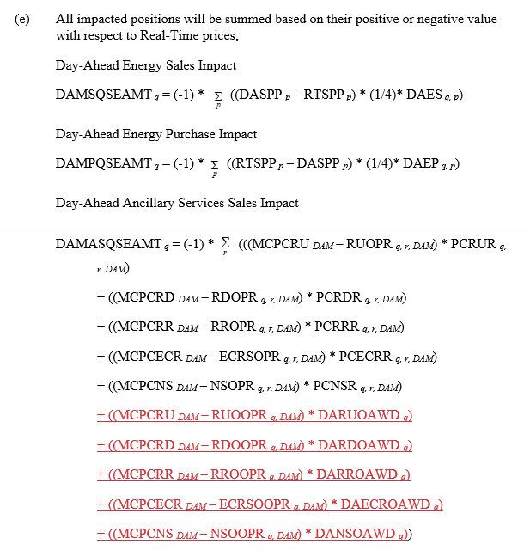
Current Protocol Language in NPRR1245
Current equations takes the difference of the DAM Clearing price and the submitted Ancillary Service Offer Price, multiplied by the quantity of what would have been awarded in the DAM.
In RTC, DAM AS Awards and Ancillary Only Awards will be charged the RTMCPC in Real-Time. This consideration is missing from the Settlement below.

Slide 4
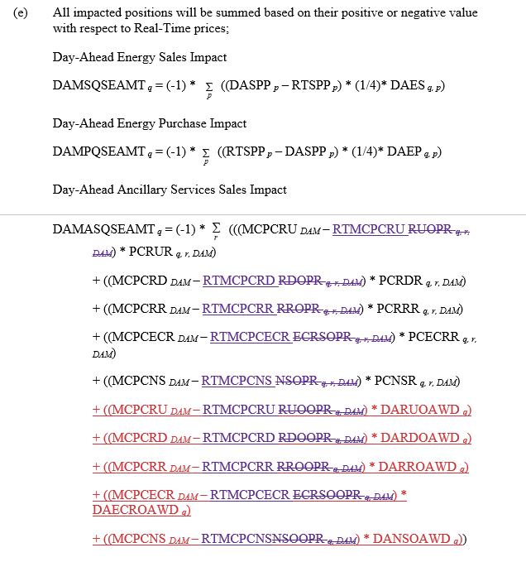
Proposed Protocol Language
Proposal is to replace the Ancillary Service Offer Price with the RTMCPC for the associated AS Type to capture the price difference between the DAM and RTM MCPC.

