Slide 1
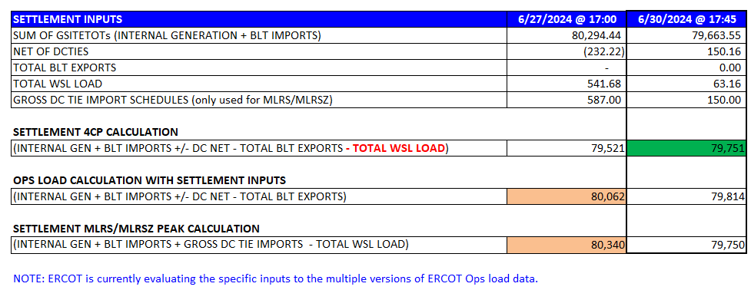
DSWG REVIEW
DSWG meeting occurred on June 21
The group would like WMS to endorse NPRR 1226 – Demand Response Monitor
We covered one major topic
ERCOT reviewed the June 4CP explanation
Highlights are Net DC Tie information and WSL Load
9.17.1 Billing Determinant Data Elements
(3) Coincidental MW peak is defined as the highest monthly Settlement Interval 15-minute MW peak for the entire ERCOT Transmission Grid as calculated per the following formula: The sum of all net energy produced by Generation Resources + Settlement Only Generators (SOGs) + Block Load Transfers (BLTs) from ERCOT to another Control Area that have been registered for Settlement purposes + actual Direct Current Tie (DC Tie) imports - BLTs to ERCOT from another Control Area that are not reflected in a Non-Opt-In Entity’s (NOIE’s) Load - actual DC Tie exports - Wholesale Storage Load (WSL).

Slide 2
4CP Continued
Take away was DSWG participants wanted more transparency into variables that are included in 4CP like WSL. ERCOT was evaluating inputs.
- WSL after the month ends
- Following the TAC meeting ERCOT issued the below notice.
DAYS AFFECTED: August 1, 2024
LONG DESCRIPTION: As discussed at the ERCOT TAC meeting on July 31, 2024, under agenda item 14, 4-CP Update, Market Participants should recognize that the Real-Time operational Load includes Wholesale Storage Load (WSL) while it is excluded from the Settlement 4-CP peak determination calculation pursuant to Protocol Section 9.17.1. ERCOT uses the four 4-CP peak intervals to determine DSP level average 4-CP load ratio shares which are used by the PUCT in the allocation of Transmission Cost of Service for the ERCOT Region.
Market Participants wanting to monitor potential 4-CP peak dates/times in near Real-Time may want to incorporate the ESR Charging Component of the Energy Storage Resource dashboard (which is equivalent to WSL) into their current monitoring process to align their data more closely with the Settlement 4-CP peak determination calculation.
Market participants I have discussed this item with still can’t back into actuals using ESR charging. There is a concern that if loads lose true transparency into the actual CPs that participation will decline. The adjustments will continue to grow with the increases in ESR deployment.
Participants would like us to review the inputs and find a solution for real time visibility.

