Slide 1
IMM State of the Market – ERCOT 2023
Jeff McDonald, Ph.D.
VP, ERCOT IMM Director
Wholesale Market Subcommittee Meeting
August 7, 2024

Slide 2
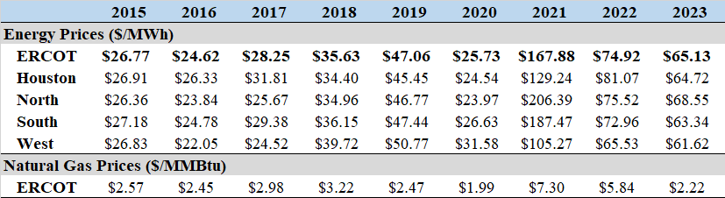
2023 Energy Prices
Average real-time prices fell 13% from 2022
Real-time energy value for 2023 was $30 billion.
Primary Price Movers: lower natural gas prices (-60%), adverse effects of the ECRS implementation prohibited further price decrease.
Tighter range of prices across zones, as seen prior to 2022.

Slide 3
ECRS Impact on Price in 2023
ECRS implementation created considerable excess cost in 2023
Doubled real-time energy price for June - December
Estimated excess cost was over $12b
Price Impact of ECRS

Slide 4
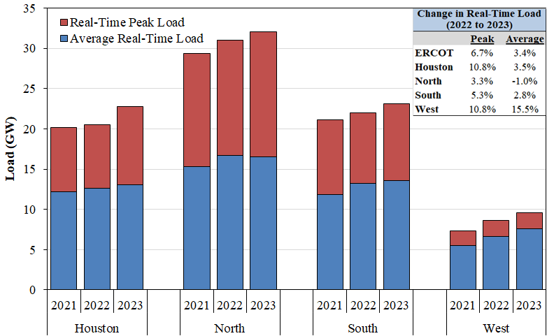
Load Trends
Total ERCOT load increased in 2023
Average load in ERCOT grew 3.4% from 2022
Record peak demand of 85.7 GW on August 10, 2023
Annual Load Statistics by Zone

Slide 5
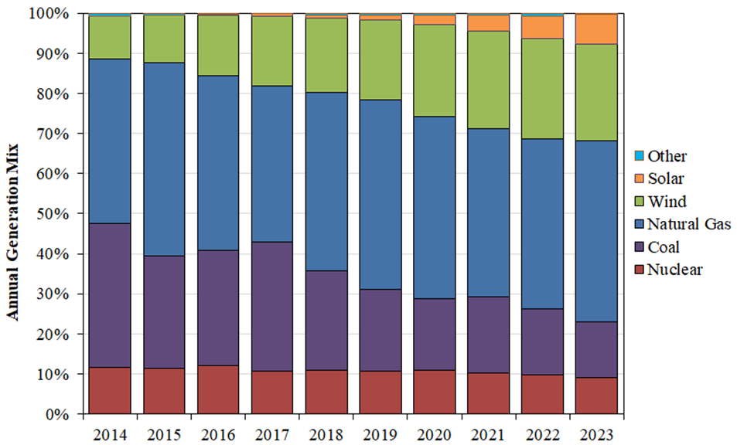
Supply Changes
Approximately 10,500 MW of new generation resources came online in 2023
  1,800 MW of wind
  5,800 MW of solar
  1,900 MW of energy storage resources
  970 MW of natural gas resources
The generation share from wind was 24.3% of the annual generation in 2023
  Solar contributed 7.3%
  Coal down from 16.6% in 2022 to 13.9% in 2023
Annual Generation Mix

Slide 6
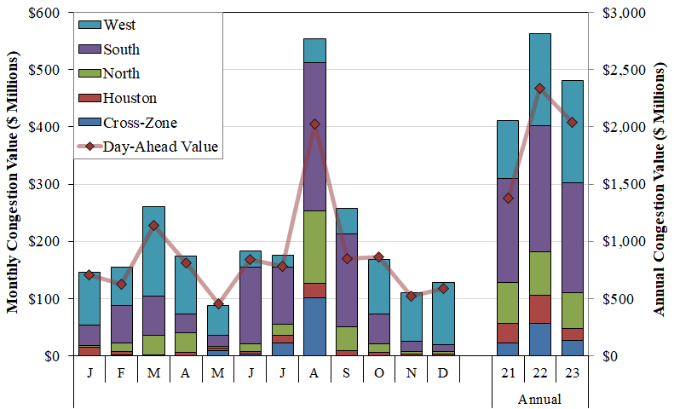
Transmission Congestion
Real-time congestion costs were down 15%, to $2.4B
Lower natural gas price contributed to decrease.
West zone high cost from high renewable output and growth of oil and gas loads.
Transmission upgrades relieved congestion cost in Houston area.
Congestion Cost by Zone

Slide 7
Net Revenues
Gross revenues minus production costs were well above the estimated cost of new entry for a CT in all zones
The effect of ECRS pushed net revenues from in the range of CONE to well above.
Combustion Turbine Net Revenues

Slide 8
Recommendations
4 new recommendations
Continue to prioritize implementation of RTC and single model for energy storage resources
Notes:
Are both RTC and single model for ESR in progress?

Slide 9
Conclusion
Full 2023 State of the Market Report can be found [add link]

