Slide 1
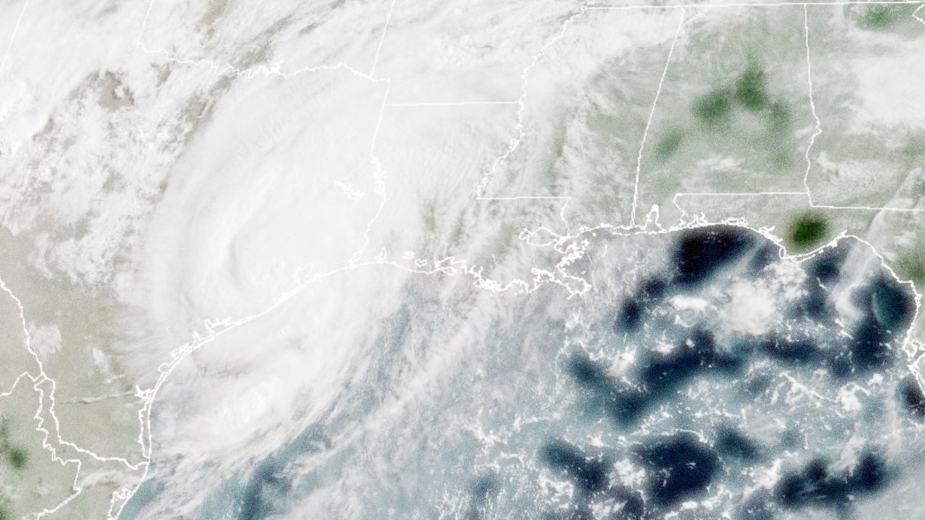
TNMP Update on Hurricane Beryl
Impacts Communications
Service Orders
Meter Data Restoration
By Rob Bevill

Slide 2
TNMP serves 275,000 homes and businesses
52% are in the Gulf Coast Region

Slide 3
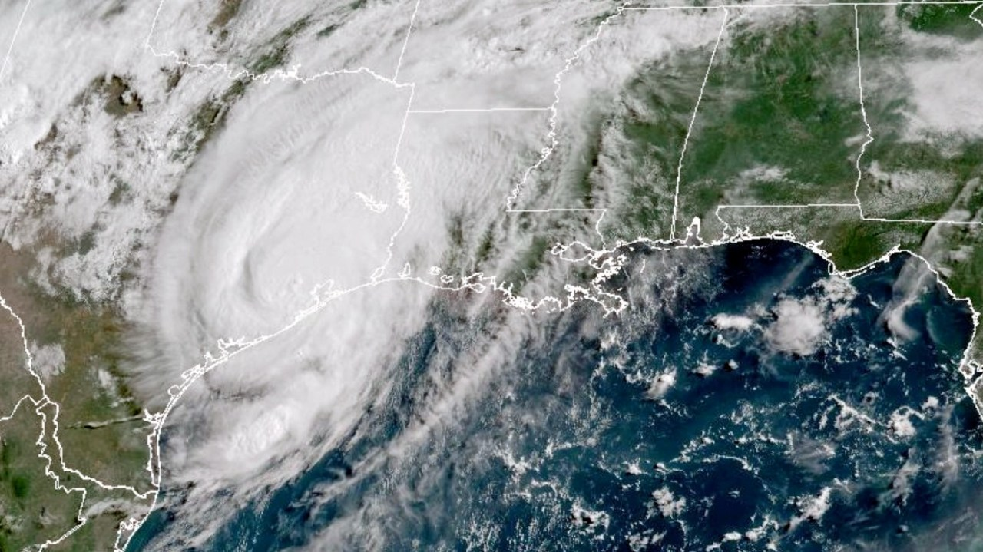
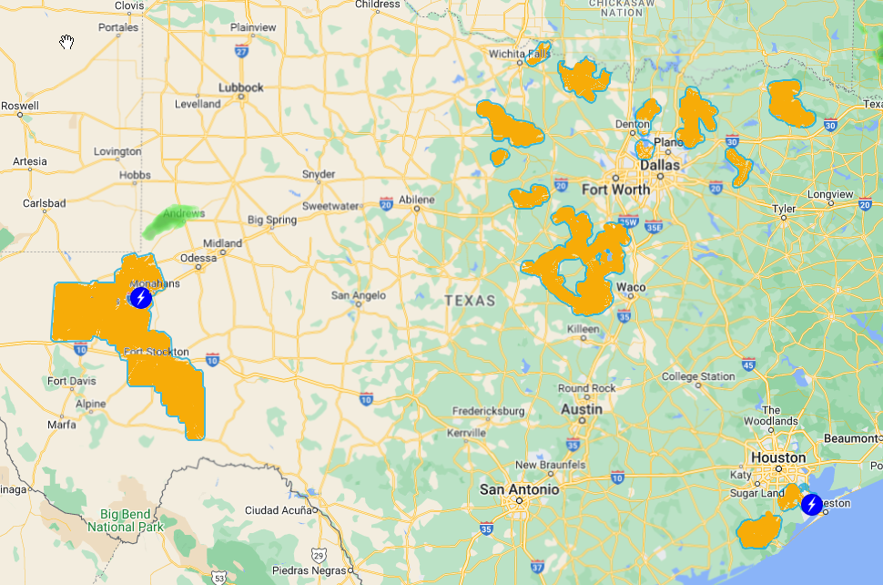
TNMP
service territories

Slide 4
Direct Hit. Beryl knocked out
power to 80% of our Gulf Coast customers

Slide 5
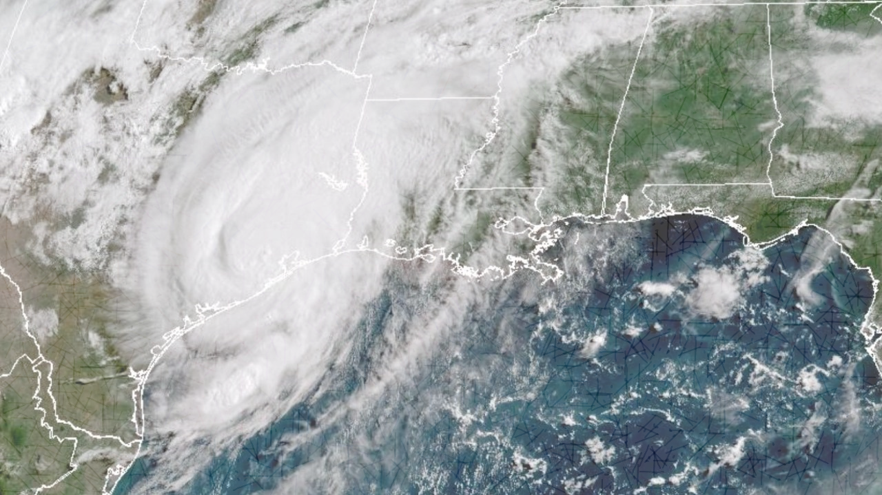
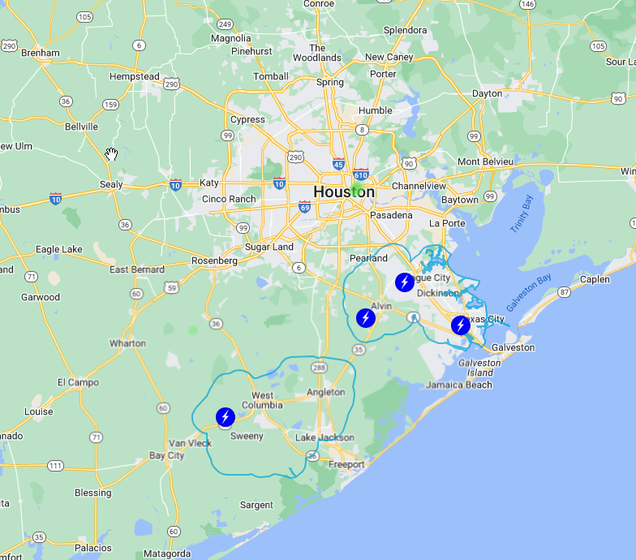
116,000 Outages
Brazoria County
Brazoria
West Columbia
Angleton
Galveston County
Alvin
Dickinson
League City
Texas City
No Industrial Outages

Slide 6
After the Storm
Beryl Impact Summary
116,000 customers lost power
8 transmission circuits locked out
60 distribution circuits damaged
Immediate Restoration Activity (by Tues)
500 linemen, 250 vegetation crew
8 transmission circuits restored
45 distribution circuits restored
50% restored within 24 hours
Crews Added after Tuesday
860 linemen, 760 veg management & 44 damage assessors
Total internal + external crew: 1880
Before the Storm
Over the weekend, TNMP deployed additional linemen and vegetation management personnel and staged them strategically throughout the service territory in advance of the storm.
These crews included internal resources from other parts of the state as well as contractor crews.
Crews began damage assessments by 11am Monday morning.
All Pending DNP Orders were rejected on Sunday

Slide 7
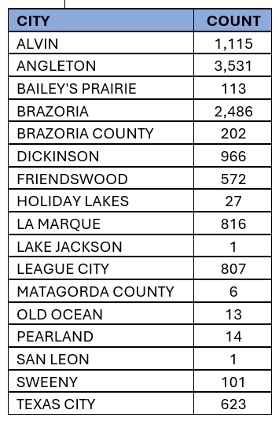
Market & Public Communications
Notice #1: Tuesday 7/9 - 116k outages
Notice #2: Thursday 7/11 – 29k outages - 75% Restored
Outage map showed 52k outages
AMS meter data indicated 29k outages
Lag traced to cellular network outages
Increased from 250 to 420 tree trimmers
Outage tracker & market notices updated to use AMS data
Notice #3: Saturday 7/13
12k outages. AMS counts by city provided.
Notice #4: Sun. 7/14. 8.5k outages.
AMS level data provided.
Notice #5: Mon 7/15. 5k outages.
AMS-level data provided.
Notice #6: Tues. 7/16. 3.2k outages.
Notice #7: Wed. 7/17. < 1k outages.
Notice #8: Thur. 7/18 – Restoration complete.
AMS Meters Not Communicating

Slide 8
Market & Public Communications
Social Media and Website Were Updated Throughout Storm Recovery
Email address created for customers without cell service: Hurricane@tnmp.com
Service Orders
All orders that could not be automatically completed by AMS were dispatched to the field and either completed or unexecuted due to safety.
Usage & Billing
LSE files for Tuesday 8/9 were delayed by one day.
Transactions and LSE files were populated with estimated data when actual data was not available.
Non-com meters were estimated with zeros.

Slide 9
Questions?

