Slide 1
TDTMS Update
RMS
August 6th, 2024

Slide 2
TDTMS
ERCOT Reporting
2025 SLO & Release Calendar – ERCOT finalizing, should be available in August to introduce at RMS and discuss at August TDTMS meeting.
Market Notice Archives – All market notices that failed to archive due to character limit exceeded in the subject title have been posted. ERCOT continues to work on a solution.
System Instances & MT Performance – Q1 SLOs were not met, yet Q2 achieved targets. Will MT performance be impacted by TXSET v5.0 changes to MarkeTrak? Performance is not expected to be impacted as revisions are code related.

Slide 3
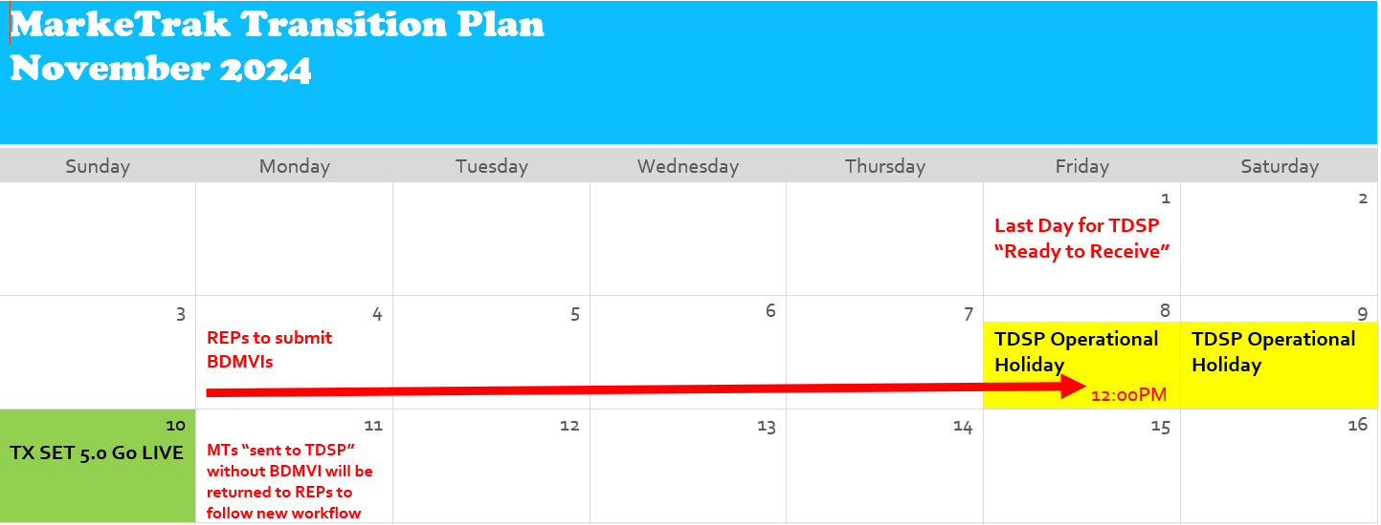
TDTMS
SCR 817
User’s Guide revisions have been integrated. TDTMS will continue to accept comments/edits.
All testing continues to go well.
Proposed Transition Plan

Slide 4
TDTMS
SCR 817 Testing & Training
Proposed SCR817 Testing Dates
9/18/24 – Opening scheduled TDTMS meeting @ 9:30 AM
Should align with RMTE Availability for MT testing of new functionality
10/24/24 – Opening scheduled TDTMS meeting @ 9:30 AM
Goal is conduct closer to GO LIVE of 11/8/24
SCR817 Functionality is scheduled to be available in RMTE on 9/16/24.

Slide 5
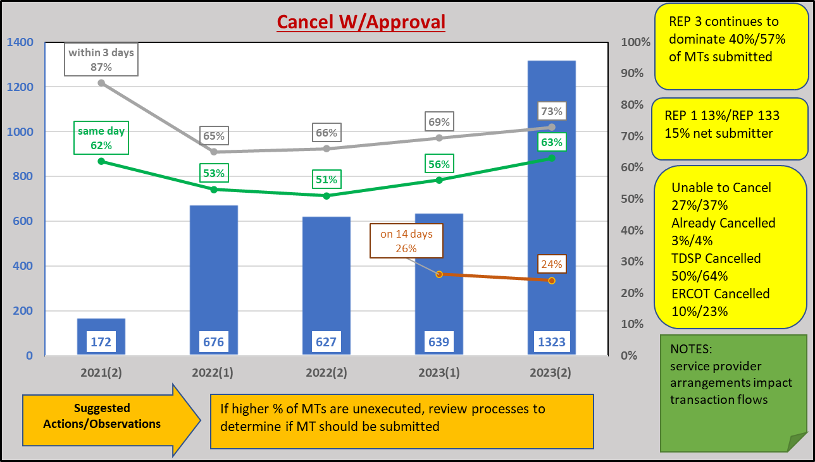
TDTMS
MarkeTrak Subtypes Volumes Analysis
Reviewed the MT data from 2023 for key higher volumes subtypes.

Slide 6
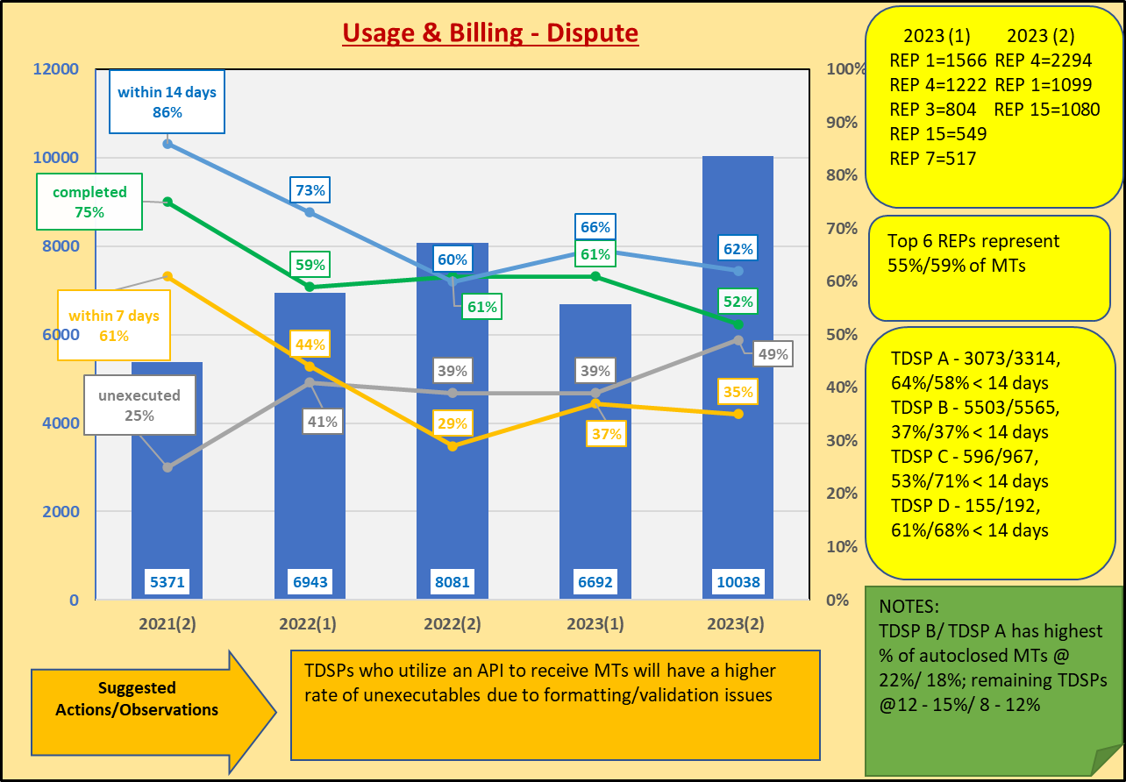
TDTMS
MarkeTrak Subtypes Volumes Analysis

Slide 7
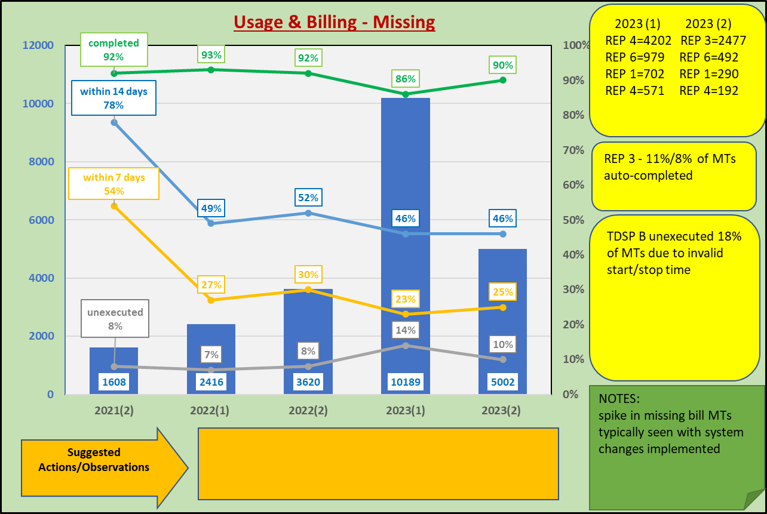
TDTMS
MarkeTrak Subtypes Volumes Analysis

Slide 8
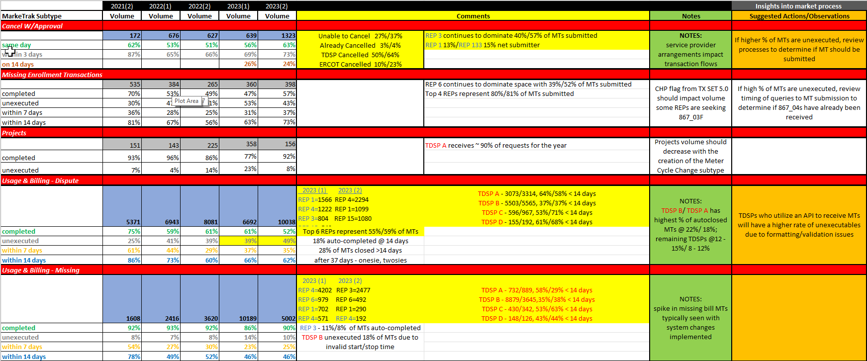
TDTMS
MarkeTrak Subtypes Volumes Analysis

Slide 9
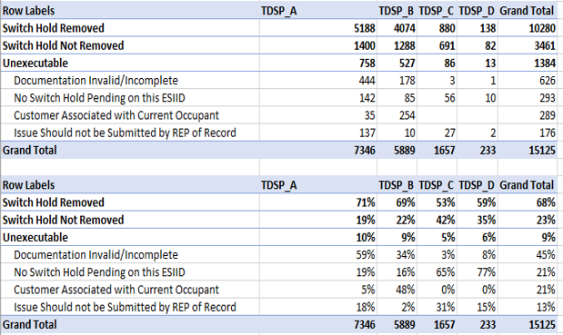
TDTMS
MarkeTrak Subtypes Volumes Analysis
TD
TDSPs utilize varying practices on processing Switch Hold Removal requests.
TDSPs A and B are more likely to review and unexecute prior to forwarding to other REP, where TDSPs C and D will ‘not remove switch hold’.

Slide 10
TDTMS
Next Meeting – Wednesday, August 14th
DRAFT Agenda:
ERCOT Reports
Wednesday, August 14th- 9:30 AM WebEx only
System Instances & MT Performance
Listserv
Market Notice Archives
SCR817 Business Requirements Discussion
User’s Guide Updates
Communicating Transition Plan updates
MarkeTrak Subtypes Volume Analysis 2023 – results
On line module availability
RMTE Availability
Detailed SCR817 Training Dates
Switch Holds, IAGs/IALs, Rescissions

