Slide 1
Settlement Stability
2024 Q2 Update to WMS
Settlements Group
ERCOT
8/07/2024

Slide 2
8.2(2)(c)(i) Track number of price changes
Reporting Period: 2024 Q2
Operating Day | # of Corrected Prices |  |  |  |  |  | # of Intervals Affected |  |  |  |  |  | Market Notice
 | DASPP | MCPC | RTSPP | RTRMPR | ORDC Adders | RTESOGPR | DASPP | MCPC | RTSPP | RTRMPR | ORDC Adders | RTESOGPR
01/10/2024 | 20,620 | 18 | – | – | – | – | 24 | 10 | – | – | – | – | M-B042424-01 M-B042424-02
01/15/2024 | 20,666 | 49 | 22,566 | 23,510 | – | 5,842 | 24 | 21 | 26 | 26 | – | 26 | M-B042424-01 M-B042424-02 M-B042424-05
01/17/2024 | 20,947 | 60 | 23,070 | 23,993 | – | 6,014 | 24 | 20 | 26 | 26 | – | 26 | M-B042424-01 M-B042424-02 M-B042424-03 M-B042424-05
01/18/2024 | 20,141 | 26 | – | – | – | – | 24 | 11 | – | – | – | – | M-B042424-01 M-B042424-03
01/19/2024 | 20,826 | 5 | 17,562 | 18,262 | 4,593 | – | 24 | 4 | 20 | 20 | – | 20 | M-B042424-01 M-B042424-03 M-B042424-05
01/20/2024 | 12,973 | 11 | – | – | – | – | 24 | 7 | – | – | – | – | M-B042424-01 M-B042424-04
01/23/2024 | 16,670 | 30 | – | – | – | – | 24 | 14 | – | – | – | – | M-B042424-01 M-B042424-04
01/25/2024 | 20,176 | 21 | – | – | – | – | 24 | 14 | – | – | – | – | M-B042424-01 M-B042424-04
02/28/2024 | – | – | 3,163 | 3,319 | – | 843 | – | – | 4 | 4 | – | 4 | M-B042424-01 M-B042424-06
Notes:
The price changes reported on this slide display the price corrections that have been done after the Settlement Statement has posted for the Operating Day.
A CRRBA Resettlement was issued due to DAM Resettlements for various Operating Days from 01/10/2024 to 01/25/2024. Please refer to Market Notice M-B042424-07 for more information.

Slide 3
8.2(2)(c)(iv) Track number of resettlements due to non-price errors
Reporting Period: 2024 Q2
Operating Day(s) Resettled | Reason for Resettlement | Affected Charge Types | Market Notice Number
11/02/2022 11/05/2022 11/06/2022 11/07/2022 | Return of Settlement Funds (RSF) | LARTRNAMT, RTEIAMT, LAASIRNAMT, RTASIAMT, LARDASIRNAMT, RTRDASIAMT, BPDAMT, LABPDAMT | M-A040924-01 M-A040924-02

Slide 4
8.2(2)(c)(ii) Track number and types of disputes submitted
8.2(2)(c)(iii) Compliance with timeliness of response to disputes
YEAR | 2024 |  | 100% of dispute resolutions were timely.
CALENDAR QUARTER REPORTED | Q1 - Q2
Disputed Charge Sub-Type | Submitted | Resolved | Denied | Granted | Granted with Exceptions
Ancillary Services-RT | 4 | 7 | 7 | 0 | 0
Emergency Operations | 2 | 3 | 1 | 2 | 0
Energy-RTM | 10 | 11 | 10 | 1 | 0
Firm Fuel Supply Service | 4 | 3 | 0 | 3 | 0
Base Pt Deviation | 15 | 12 | 10 | 0 | 2
Reliability Unit Commitment | 2 | 2 | 0 | 2 | 0
TOTAL | 37 | 38 | 28 | 8 | 2
Submitted but not resolved disputes may be:
Not started
Open
Rejected
Withdrawn

Slide 5
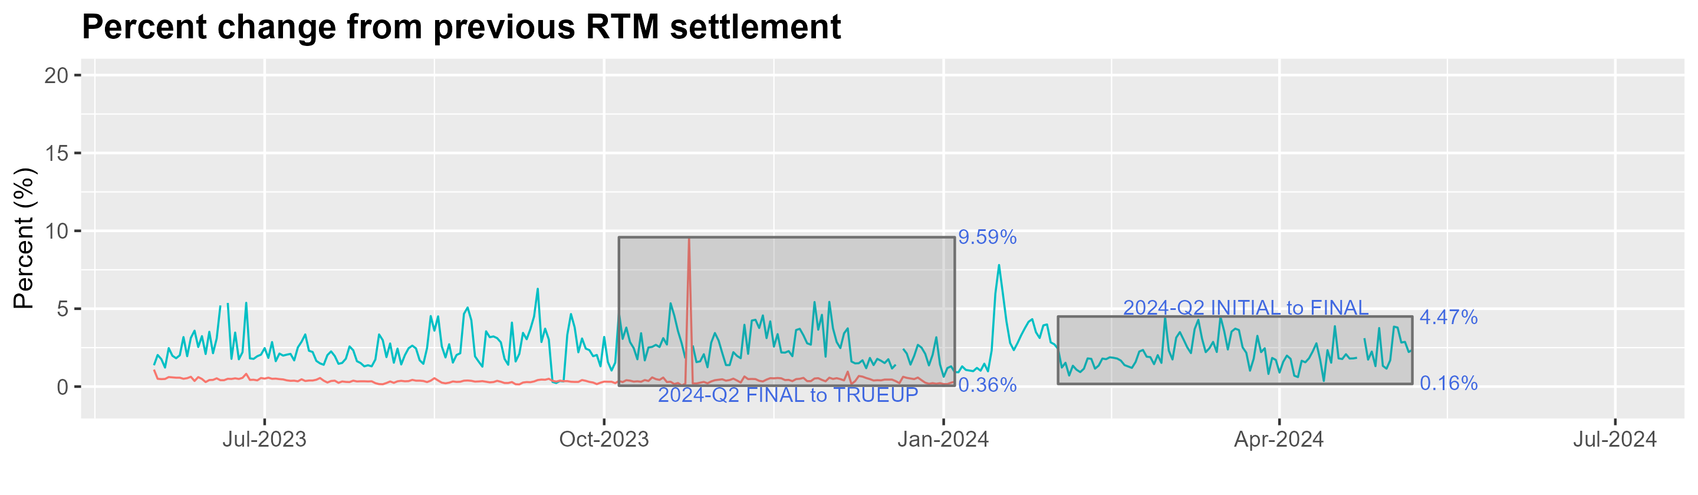
8.2(2)(c)(v) Other Settlement metrics
NOTE: ERS Final settlement OD data is not represented in graph.
The ERS True-Up Settlement for OD 10/24/2023 was the cause of the significant percentage change between the Final and True-Up. For additional information, refer to Market Notice W-A042224-01.
Average percent change
 | 2011 | 2012 | 2013 | 2014 | 2015 | 2016 | 2017 | 2018 | 2019 | 2020 | 2021 | 2022 | 2023 | 2024
FINAL | 3.49 | 2.56 | 2.83 | 3.18 | 2.99 | 2.57 | 3.01 | 2.93 | 2.66 | 3.09 | 3.53 | 3.36 | 2.9 | 5.95
TRUEUP | 0.41 | 0.39 | 0.33 | 0.31 | 0.25 | 0.28 | 0.27 | 0.26 | 0.2 | 0.26 | 0.46 | 0.99 | 0.93 | 0.22

Slide 6
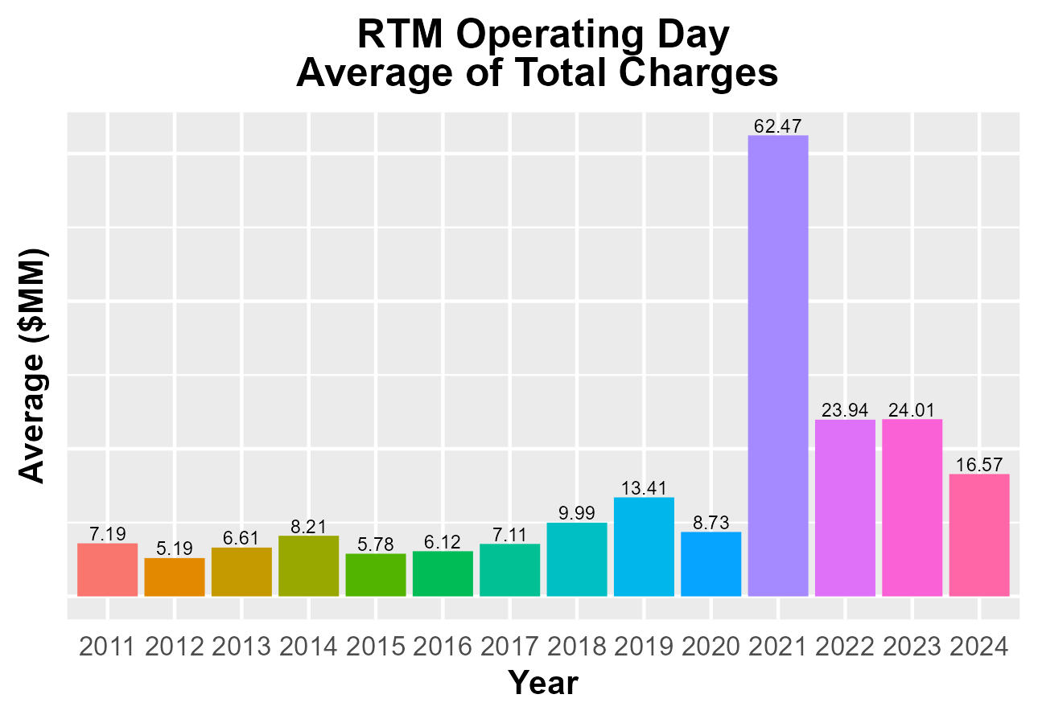
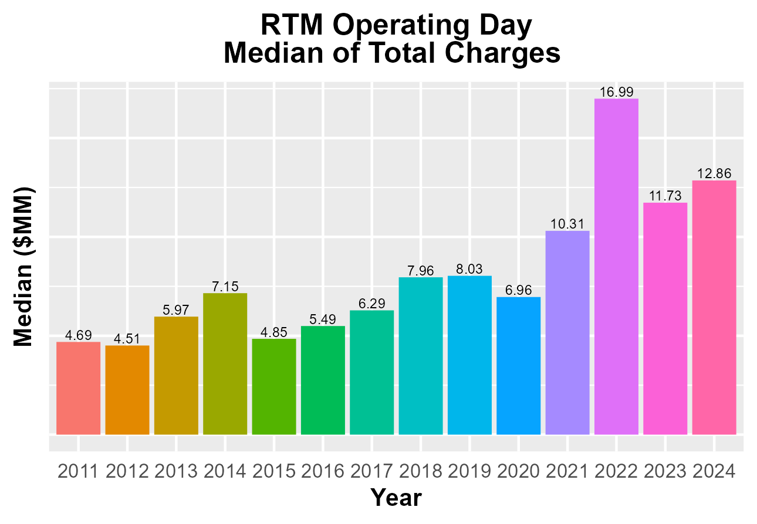
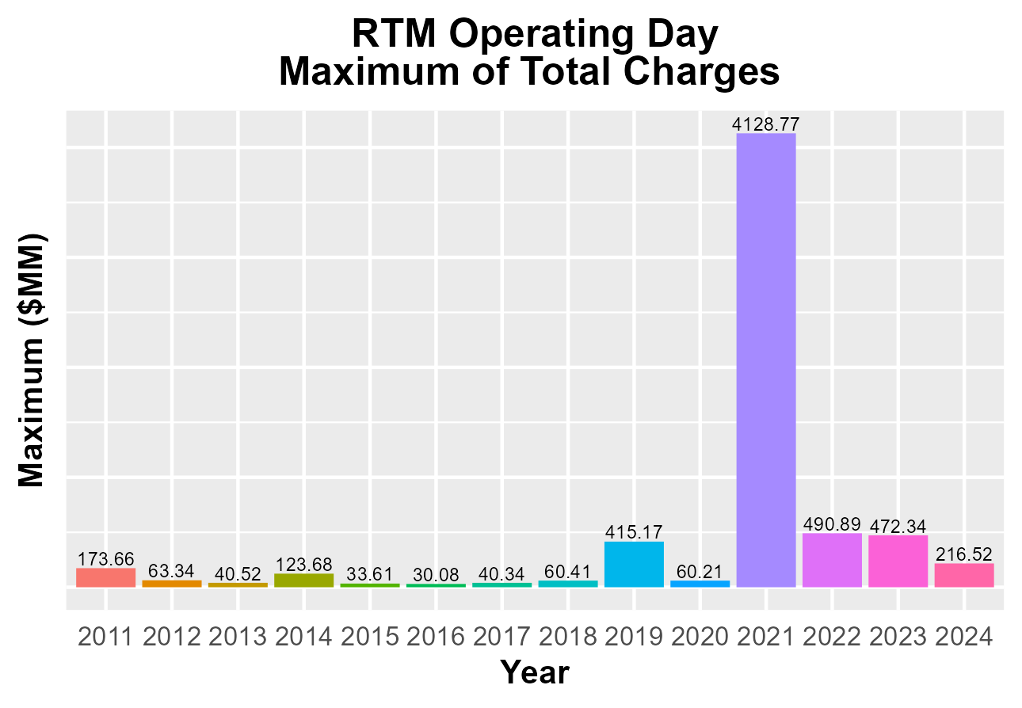
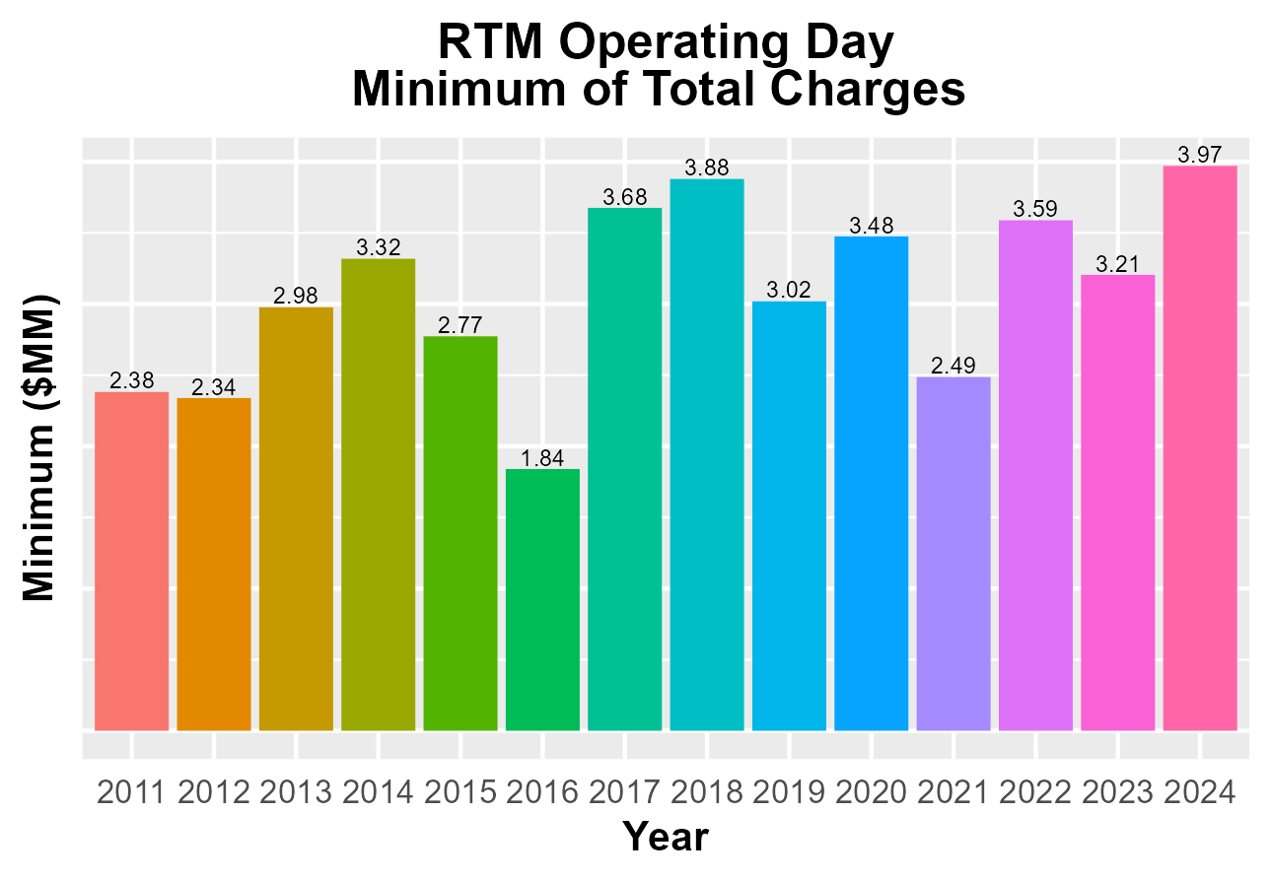
8.2(2)(c)(v) Other Settlement metrics

Slide 7
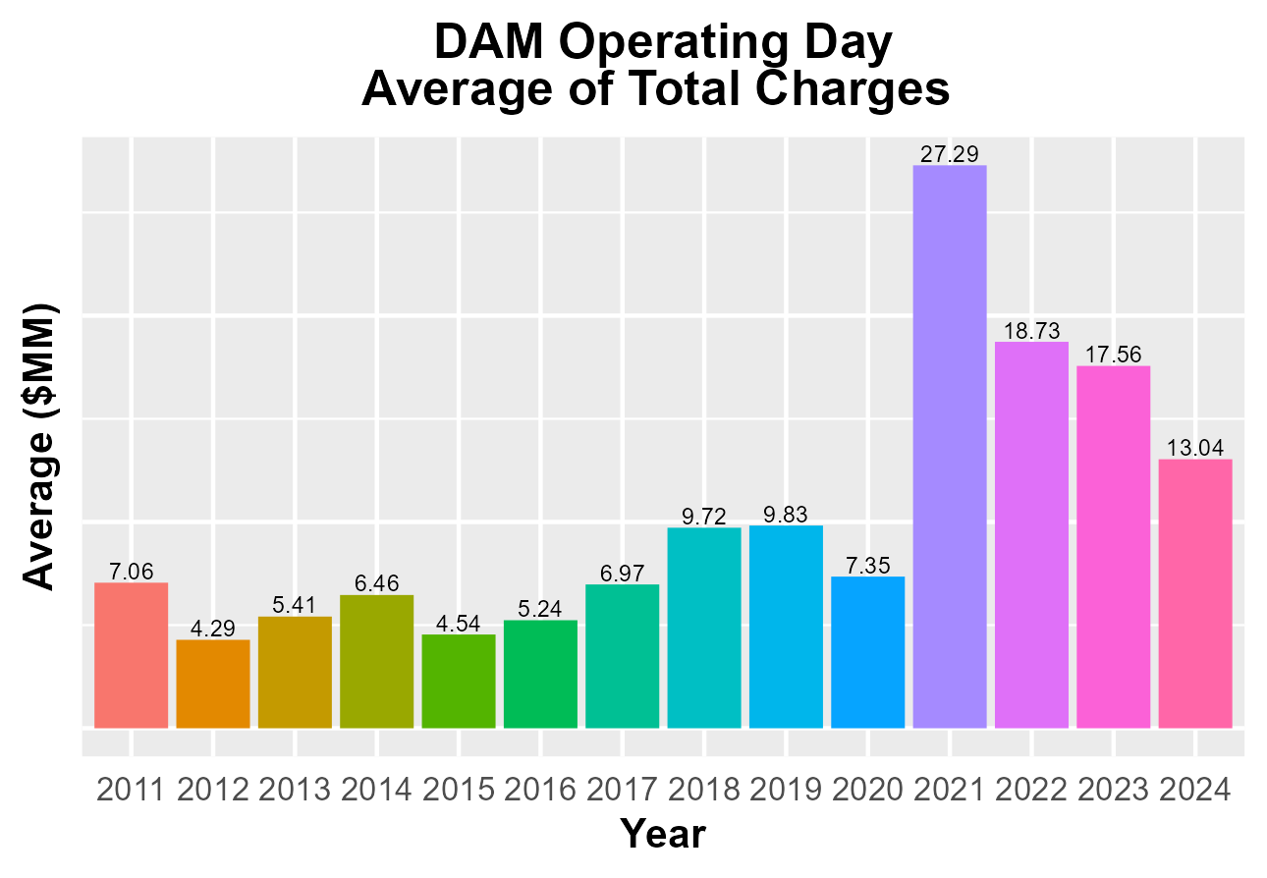
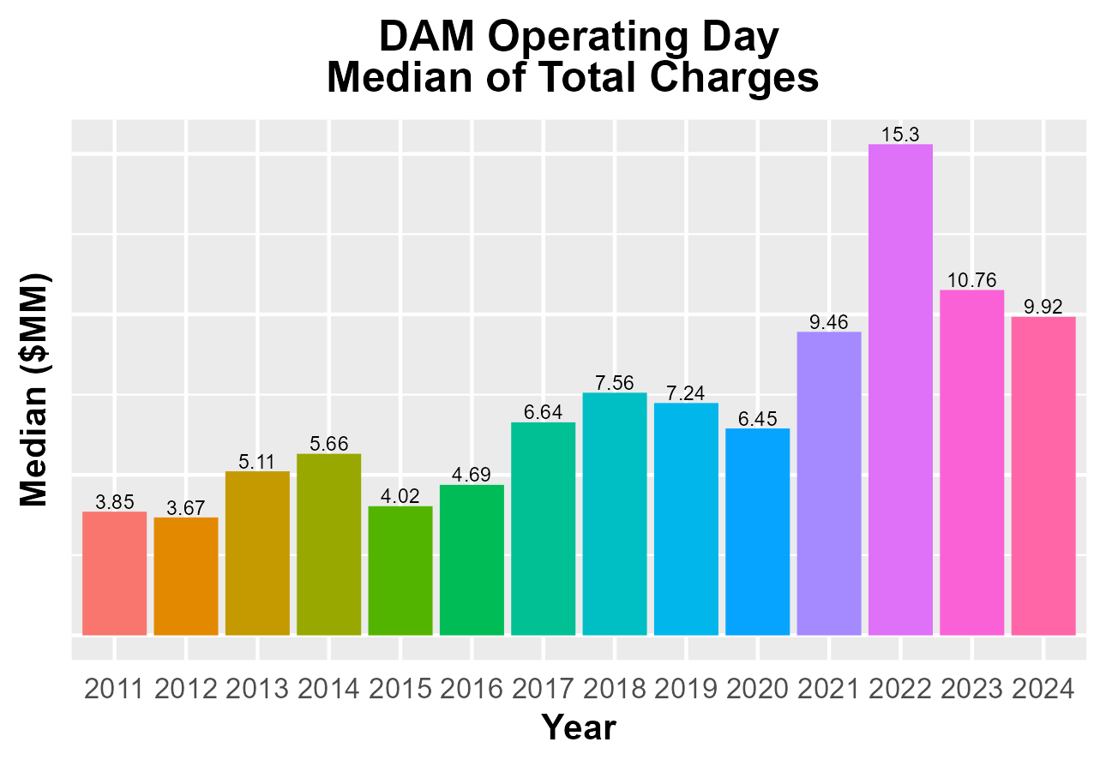
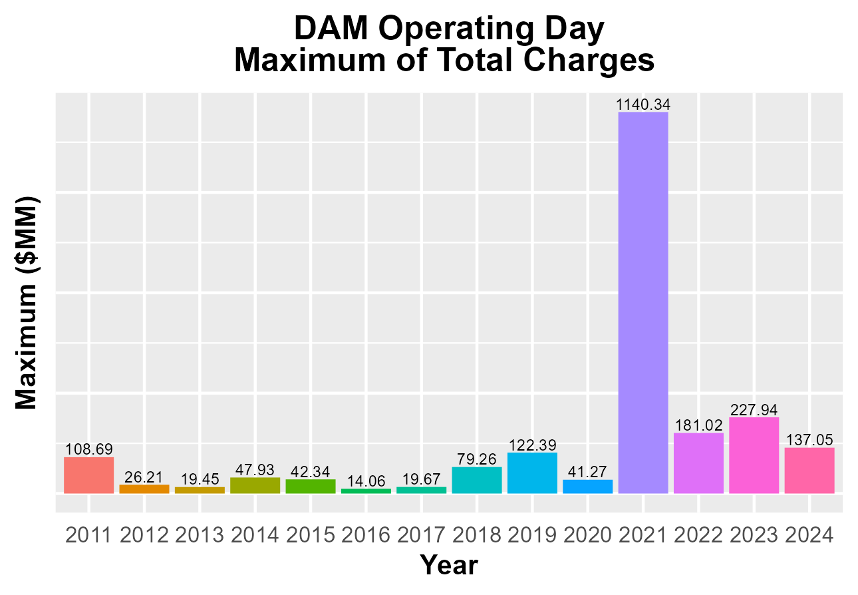
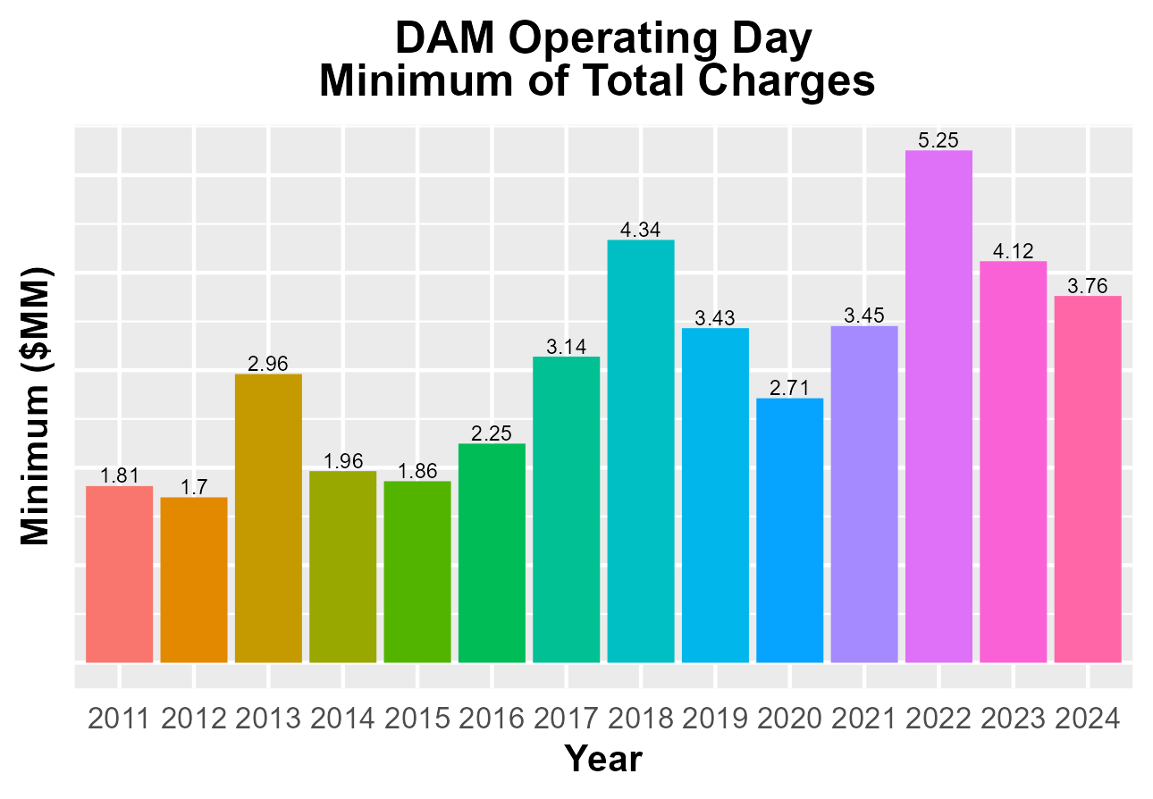
8.2(2)(c)(v) Other Settlement metrics

Slide 8
8.2(2)(c)(vi) Availability of ESIID consumption data

Slide 9
8.2(2)(c)(vi) Availability of ESIID consumption data

Slide 10
8.2(2)(g) Net Allocation to Load - Totals and $/MWh
NET ALLOCATION TO LOAD ($M)
 | Jun 2023 | Jul 2023 | Aug 2023 | Sep 2023 | Oct 2023 | Nov 2023 | Dec 2023 | Jan 2024 | Feb 2024 | Mar 2024 | Apr 2024 | May 2024 | Jun 2024
Ancillary Service Settlement | 273.7 | 120.9 | 808.5 | 154.9 | 62.2 | 44.8 | 16.9 | 94.1 | 10.5 | 27.5 | 39.4 | 146.4 | 30.1
Balancing Account Payout to Load | -35.2 | -37.9 | -83.0 | -30.3 | -14.1 | -13.0 | -19.9 | -40.3 | -12.1 | -21.0 | -5.7 | -19.0 | -29.9
Base Point Deviation Payments | -0.7 | -0.7 | -1.1 | -0.6 | -0.6 | -0.5 | -0.5 | -0.6 | -0.4 | -0.9 | -1.5 | -0.7 | -0.6
Black Start Service Settlement | 0.5 | 0.6 | 0.6 | 0.5 | 0.6 | 0.5 | 0.6 | 0.7 | 0.6 | 0.7 | 0.6 | 0.7 | 0.6
Block Load Transfer Settlement | 0.0 | 0.0 | 0.0 | 0.0 | 0.0 | 0.0 | 0.0 | 0.0 | 0.0 | 0.0 | 0.0 | 0.0 | 0.0
Emergency Energy Charges | 0.3 | 0.6 | 1.3 | 0.6 | 0.8 | 0.4 | 0.2 | 8.1 | 0.7 | 0.1 | 0.2 | 0.2 | 0.1
ERCOT Admin Fee Settlement | 23.7 | 26.4 | 27.9 | 23.9 | 19.7 | 17.5 | 18.5 | 24.2 | 19.4 | 20.4 | 21.2 | 25.3 | 28.1
ERO Pass-Through Fee⁵ | 2.1 | 2.1 | 2.1 | 2.1 | 2.1 | 2.1 | 2.1 | 2.3 | 2.3 | 2.3 | 2.3 | 2.3 | 2.3
ERS Settlement¹ | 6.3 | 6.3 | 6.3 | 6.3 | 2.6 | 2.6 | 8.8 | 8.8 | 8.8 | 8.8 | 0.0 | 0.0 | 0.0
Firm Fuel Service Settlement | 0.0 | 0.0 | 0.0 | 0.0 | 0.0 | 3.5 | 7.3 | 7.4 | 7.1 | 3.6 | 0.0 | 0.0 | 0.0
High Dispatch Limit Override | 0.0 | 0.0 | 0.1 | 0.2 | 0.0 | 0.0 | 0.0 | 0.0 | 0.0 | 0.0 | 0.0 | 0.0 | 0.0
Non-Zonal Auction Distribution | -49.0 | -27.4 | -28.4 | -37.8 | -56.6 | -51.0 | -44.2 | -37.3 | -31.9 | -53.4 | -61.4 | -57.7 | -46.5
ORDC Settlement | 0.0 | 0.3 | -10.0 | -3.0 | 0.2 | 0.3 | 0.0 | 1.3 | 0.2 | 1.4 | 1.6 | -0.7 | 0.2
Revenue Neutrality Total | 2.9 | 5.9 | 1.9 | -2.6 | 7.6 | 7.9 | 16.0 | 10.7 | 8.0 | 20.5 | 13.0 | 25.7 | 7.9
RMR Settlement | 0.0 | 0.0 | 0.0 | 0.0 | 0.0 | 0.0 | 0.0 | 0.0 | 0.0 | 0.0 | 0.0 | 0.0 | 0.0
RUC Settlement | -0.1 | -0.2 | -0.4 | -1.0 | -0.2 | 0.0 | 0.0 | -0.1 | -0.1 | -0.5 | -2.1 | -2.1 | 0.0
Voltage Services Settlement | 0.0 | 0.0 | 0.0 | 0.0 | 0.0 | 0.0 | 0.0 | 0.0 | 0.0 | 0.0 | 0.0 | 0.0 | 0.0
Zonal Auction Distribution² | -78.3 | -90.2 | -90.6 | -77.7 | -82.9 | -76.1 | -80.2 | -89.1 | -91.9 | -97.8 | -93.0 | -100.5 | -103.4
Total Allocation to Load | 146.2 | 6.7 | 635.2 | 35.5 | -58.6 | -61.0 | -74.4 | -9.8 | -78.8 | -88.3 | -85.4 | 19.9 | -111.1
Adjusted Metered Load (TWh) | 42.8 | 47.5 | 50.3 | 43.1 | 35.5 | 31.5 | 33.4 | 38.4 | 30.8 | 32.3 | 33.6 | 40.1 | 44.6
$/MWh³ | 3.4 | 0.1 | 12.6 | 0.8 | -1.7 | -1.9 | -2.2 | -0.3 | -2.6 | -2.7 | -2.5 | 0.5 | -2.5
Note: The Net Allocation to Load amounts provided in this presentation are for informational purposes only and cannot be relied upon for accurate measurements or forecasts of individual QSE charges and payments.
¹The total ERS charges have been evenly allocated across the contract period.
²Zonal Auction Distribution by 2003 Congestion Management Zone, shown below.
³The $/MWh value as calculated per PR 8.2 (2) g
⁴The $/MWh value by 2003 Congestion Management Zone, as calculated per PR 8.2(2) g
⁵Allocated to load from two years prior per the Electric Reliability Organization Fee Assessment and Collection Guide

Slide 11
8.2(2)(g) Net Allocation to Load - Totals and $/MWh
ZONAL AUCTION DISTRIBUTION PER CONGESTION MANAGEMENT ZONE ($M)
 | Jun 2023 | Jul 2023 | Aug 2023 | Sep 2023 | Oct 2023 | Nov 2023 | Dec 2023 | Jan 2024 | Feb 2024 | Mar 2024 | Apr 2024 | May 2024 | Jun 2024
HOUSTON | -8.6 | -11.4 | -11.9 | -11.9 | -10.8 | -10.2 | -8.7 | -8.4 | -8.0 | -8.7 | -8.5 | -11.0 | -13.1
NORTH | -13.7 | -21.7 | -22.6 | -17.4 | -14.7 | -14.4 | -15.2 | -18.0 | -17.8 | -14.0 | -15.7 | -17.3 | -21.0
SOUTH | -30.6 | -33.7 | -32.2 | -26.6 | -29.8 | -26.2 | -26.7 | -32.5 | -30.2 | -33.0 | -30.2 | -33.2 | -35.9
WEST | -25.4 | -23.4 | -23.9 | -21.8 | -27.6 | -25.4 | -29.6 | -30.2 | -36.0 | -42.1 | -38.6 | -39.1 | -33.3
TOTAL | -78.3 | -90.2 | -90.6 | -77.7 | -82.9 | -76.1 | -80.2 | -89.1 | -91.9 | -97.8 | -93.0 | -100.5 | -103.4
REAL-TIME ADJUSTED METERED LOAD BY CONGESTION MANAGEMENT ZONE (TWh)
 | Jun 2023 | Jul 2023 | Aug 2023 | Sep 2023 | Oct 2023 | Nov 2023 | Dec 2023 | Jan 2024 | Feb 2024 | Mar 2024 | Apr 2024 | May 2024 | Jun 2024
HOUSTON | 11.4 | 12.3 | 13.1 | 11.3 | 9.3 | 7.9 | 8.1 | 8.6 | 7.4 | 8.0 | 8.5 | 10.3 | 11.6
NORTH | 14.0 | 16.2 | 17.6 | 13.9 | 10.9 | 9.9 | 10.7 | 13.6 | 9.8 | 9.8 | 10.1 | 12.2 | 14.3
SOUTH | 11.7 | 12.8 | 13.3 | 11.9 | 9.6 | 8.1 | 8.5 | 9.9 | 7.9 | 8.5 | 9.1 | 11.2 | 12.0
WEST | 5.7 | 6.2 | 6.2 | 5.9 | 5.7 | 5.6 | 6.0 | 6.2 | 5.7 | 6.0 | 6.0 | 6.4 | 6.6
TOTAL | 42.8 | 47.5 | 50.3 | 43.1 | 35.5 | 31.5 | 33.4 | 38.4 | 30.8 | 32.3 | 33.6 | 40.1 | 44.6
ZONAL AUCTION REVENUE PER CONGESTION MANAGEMENT ZONE ($/MWh)
 | Jun 2023 | Jul 2023 | Aug 2023 | Sep 2023 | Oct 2023 | Nov 2023 | Dec 2023 | Jan 2024 | Feb 2024 | Mar 2024 | Apr 2024 | May 2024 | Jun 2024
HOUSTON | -0.8 | -0.9 | -0.9 | -1.1 | -1.2 | -1.3 | -1.1 | -1.0 | -1.1 | -1.1 | -1.0 | -1.1 | -1.1
NORTH | -1.0 | -1.3 | -1.3 | -1.3 | -1.3 | -1.5 | -1.4 | -1.3 | -1.8 | -1.4 | -1.6 | -1.4 | -1.5
SOUTH | -2.6 | -2.6 | -2.4 | -2.2 | -3.1 | -3.2 | -3.1 | -3.3 | -3.8 | -3.9 | -3.3 | -3.0 | -3.0
WEST | -4.5 | -3.8 | -3.9 | -3.7 | -4.8 | -4.5 | -4.9 | -4.9 | -6.3 | -7.0 | -6.4 | -6.1 | -5.0
TOTAL | -1.8 | -1.9 | -1.8 | -1.8 | -2.3 | -2.4 | -2.4 | -2.3 | -3.0 | -3.0 | -2.8 | -2.5 | -2.3
NET ALLOCATION TO LOAD PER CONGESTION MANAGEMENT ZONE ($/MWh)⁴
 | Jun 2023 | Jul 2023 | Aug 2023 | Sep 2023 | Oct 2023 | Nov 2023 | Dec 2023 | Jan 2024 | Feb 2024 | Mar 2024 | Apr 2024 | May 2024 | Jun 2024
HOUSTON | 4.4 | 1.0 | 13.5 | 1.6 | -0.7 | -1.1 | -1.4 | 0.8 | -0.9 | -1.4 | -1.2 | 1.3 | -1.4
NORTH | 4.2 | 0.6 | 13.1 | 1.4 | -0.8 | -1.3 | -1.7 | 0.5 | -1.6 | -1.7 | -1.8 | 1.0 | -1.8
SOUTH | 2.6 | -0.7 | 12.0 | 0.5 | -2.6 | -3.0 | -3.4 | -1.5 | -3.6 | -4.2 | -3.5 | -0.6 | -3.3
WEST | 0.7 | -1.9 | 10.5 | -1.0 | -4.3 | -4.3 | -5.2 | -3.1 | -6.1 | -7.3 | -6.6 | -3.7 | -5.3
TOTAL | 3.4 | 0.1 | 12.6 | 0.8 | -1.7 | -1.9 | -2.2 | -0.3 | -2.6 | -2.7 | -2.5 | 0.5 | -2.5

Slide 12
26.2 Securitization Default Charge
27.3 Securitization Uplift Charge
Subchapter M Invoice Month | Reference Month (RTM_FINAL data) | Monthly Uplift ($) (TSDCMA) | SDCMMATOT (MWh)
Jun-23 | Mar-23 | 1,553,571 | 214,898,428
Jul-23 | Apr-23 | 1,553,571 | 211,504,571
Aug-23 | May-23 | 1,553,571 | 222,251,153
Sep-23 | Jun-23 | 1,553,571 | 222,744,356
Oct-23 | Jul-23 | 1,553,571 | 231,642,261
Nov-23 | Aug-23 | 1,897,324 | 236,369,349
Dec-23 | Sep-23 | 1,897,324 | 243,257,169
Jan-24 | Oct-23 | 1,897,324 | 226,729,946
Feb-24 | Nov-23 | 1,897,324 | 221,661,975
Mar-24 | Dec-23 | 1,897,324 | 238,659,437
Apr-24 | Jan-24 | 1,897,324 | 239,846,950
May-24 | Feb-24 | 1,926,208 | 223,533,999
Jun-24 | Mar-24 | 1,926,208 | 239,187,399
Subchapter N¹ Invoice Month | Monthly Uplift ($) (MTSUCDA) | Non-Optout RTAML (MWh) | $/MWh
Jun-23 | 12,385,027 | 24,609,925 | 0.50
Jul-23 | 12,385,027 | 28,472,757 | 0.43
Aug-23 | 11,907,317 | 30,533,073 | 0.39
Sep-23 | 11,139,103 | 24,750,494 | 0.45
Oct-23 | 12,291,424 | 21,746,907 | 0.57
Nov-23 | 11,504,250 | 17,583,304 | 0.65
Dec-23 | 11,120,775 | 17,189,564 | 0.65
Jan-24 | 12,654,675 | 23,047,361 | 0.55
Feb-24 | 11,366,927 | 17,177,461 | 0.66
Mar-24 | 11,366,927 | 16,823,907 | 0.68
Apr-24 | 12,542,816 | 19,400,910 | 0.65
May-24 | 11,838,559 | 22,312,031 | 0.53
Jun-24 | 10,692,892 | 23,036,285 | 0.46
¹The data provided is grouped by the month the amount was invoiced.

