Slide 1
RCWG
WMS update 8.07.2024

Slide 2
RCWG 7.23.2024
Discussion continued on VCMRR041
VCMRR041 – Emission Index Prices in VC
Eliminates index price subscription
Replaces annual price index with fixed prices (NO_{X}=$3/short ton, SO₂ =$2/short ton)
Annual index pricing has remained stagnant for last 5 years
Fixed prices would remain until new EPA requirements go into effect OR ERCOT determines that a competitive market for NO_{X} /SO₂ exists OR until TAC directs otherwise

Slide 3
RCWG 7.23.2024
Luminant presented draft NPRR and VCMRR (has since been filed)
Luminant would like to retain index price subscription to enable ERCOT to quickly react to rapidly changing emission rules.
NPRR1242- Creates an “Emission Costs Subscription” ERCOT fee that allocates the index subscription fee to REs with Generation Resources on a MW capacity ratio share.
VCMRR042- Allows for seasonal index pricing May – Sep and annual index pricing Oct - Apr

Slide 4
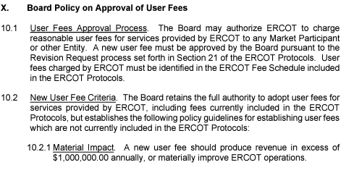
RCWG 7.23.2024
ERCOT stated that per Board Policies a new user fee must produce $1M in annual revenue (NPRR1242 most likely would not)
RCWG requested ERCOT legal’s opinion at the 8.07 WMS meeting.
ERCOT stated that WMS should either approve or reject VCMRR041 at the 8.07 meeting.

Slide 5
No RCWG in August

