Slide 1
Unregistered Distributed Generation Report:
2024 Q2 Update
Resource Adequacy
8/7/2024

Slide 2
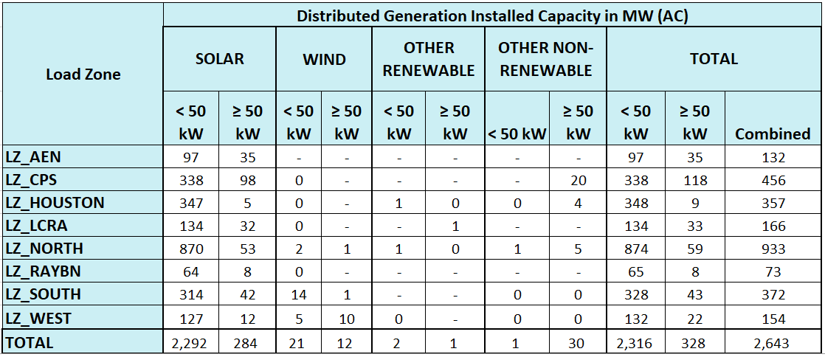
2024 Q2 Unregistered Distributed Generation Report
DG Battery Energy Storage (26.02 MW Competitive, 41.43 MW NOIEs, 67.45 MW Total)
Totals may not match the sum of their columns/rows due to rounding
Notes:
DG battery energy storage was excluded for the first time (26.02 MW Competitive, 41.43 MW NOIEs, 67.45 MW Total)
Competitive and NOIE breakdown:
Competitive: 1,502 MW
NOIE: 1,141 MW
For the quarterly report, NOIE capacity below 50 kW only includes information from NOIEs that have more than two MW of aggregate capacity from those sites.

Slide 3
DG Storage Reporting Change
DG updates before 2024-Q2
  DG Battery Energy Storage systems were not required reporting based on Protocol Sections 3.2.5.1, 3.2.5.2 , 3.2.5.3
  However, we have started seeing voluntary submissions of these systems reflected in the “Other Renewable” and “Other Non-renewable” categories.
2024-Q2 and onwards
  To provide better transparency on Battery Energy Storage systems these resources were excluded from the DG reporting table and summarized as a footnote in Slide 2.
MW Impact of Change
  26.02 MW Competitive
  41.43 MW NOIE
  67.45 MW Total

Slide 4
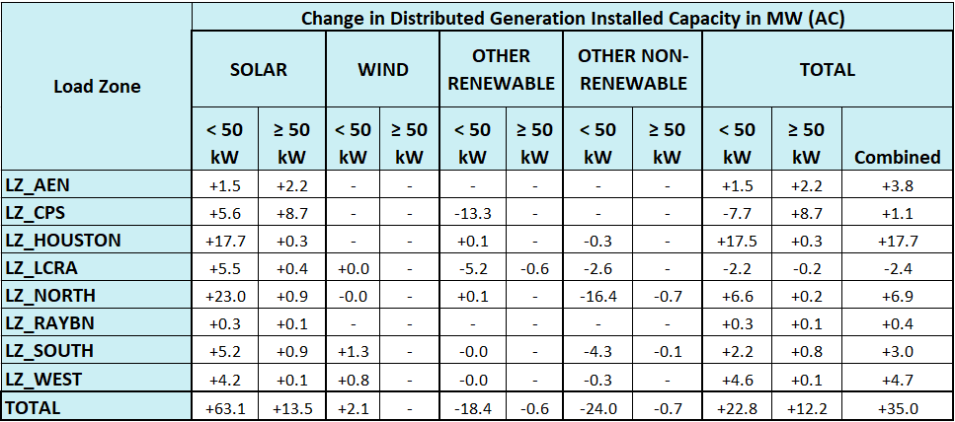
2024 Q1 → 2024 Q2 Change
Totals may not match the sum of their columns/rows due to rounding

Slide 5
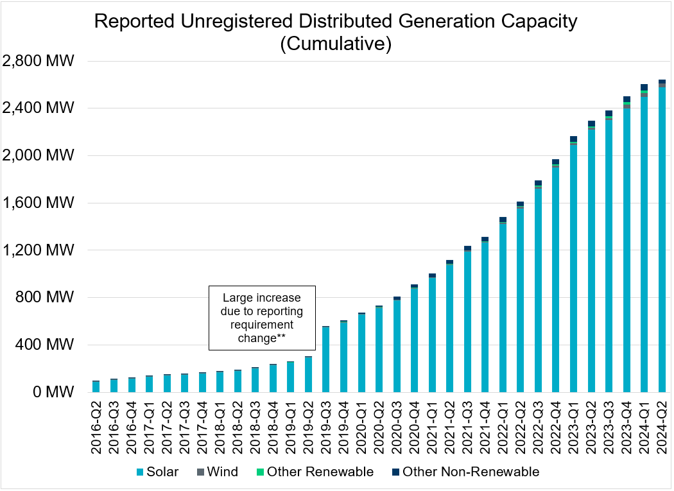
Unregistered DG Growth: 2016-Q2* to 2024-Q2
* 2016-Q2 was the first report published after implementation of report changes per NPRR794/COPMGR044
** 2019-Q3 was the first report published after implementation of report changes per NPRR891
2024-Q2 was the first report published excluding Battery Energy Storage systems.

