Slide 1
PDCWG Report to ROS
Chair: Kevin Bunch, EDF Trading North America
Vice Chair: Chad Mulholland, NRG
ROS
August 1st, 2024

Slide 2
Report Overview & Notes
Report Overview
  Meeting Minutes
    2025 AS Methodology Review
    NOGRR 263 – Clarification of Controllable Load Resource Primary Frequency Response Responsibilities
    NOGRR 264 – Related to NPRR1235, Dispatchable Reliability Reserve Service as a Stand-Alone Ancillary Service
    NPRR 1235 – Dispatchable Reliability Service as a Stand-Alone Ancillary Service
    ERCOT Frequency Control Metrics and Regulation Reports
    TRE Report
    ICCP Tags for IRR Curtailments Discussion
    Analysis of Disturbances
  BAL-001-TRE-2 FMEs and IMFR
    1 FME in the month of June
  Frequency Control Report

Slide 3
Frequency Measurable Events Performance

Slide 4
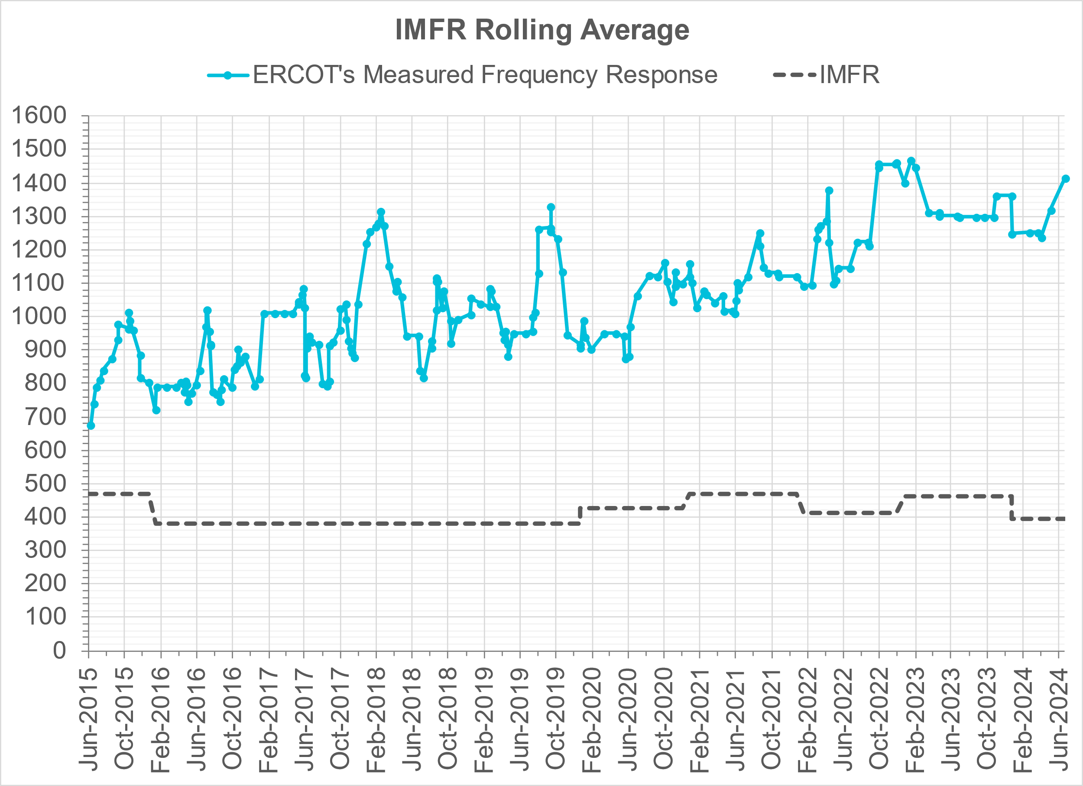
Interconnection Minimum Frequency Response (IMFR) Performance
IMFR Performance currently
1431.00 MW/0.1HZ
Frequency Response Obligation (FRO): 395 MW/0.1 Hz

Slide 5
Questions?

Slide 6
Frequency Control Report
February 2024

Slide 7
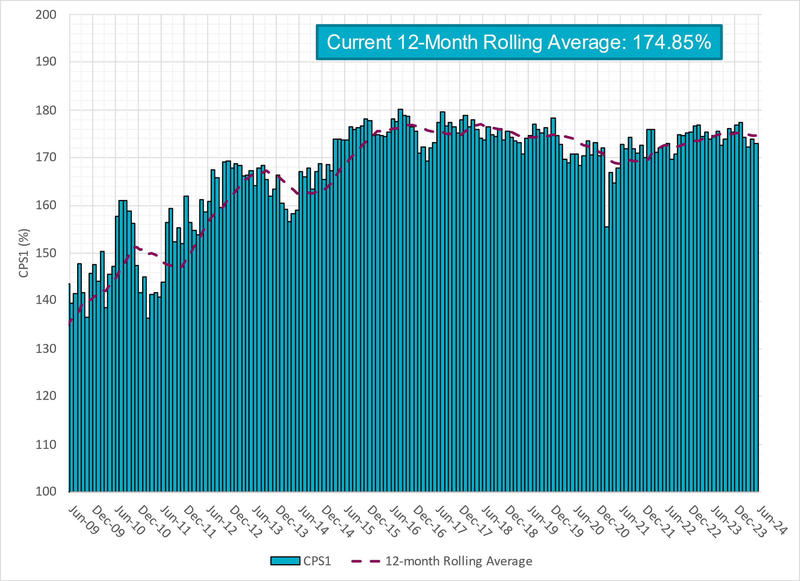
CPS1 Performance

Slide 8
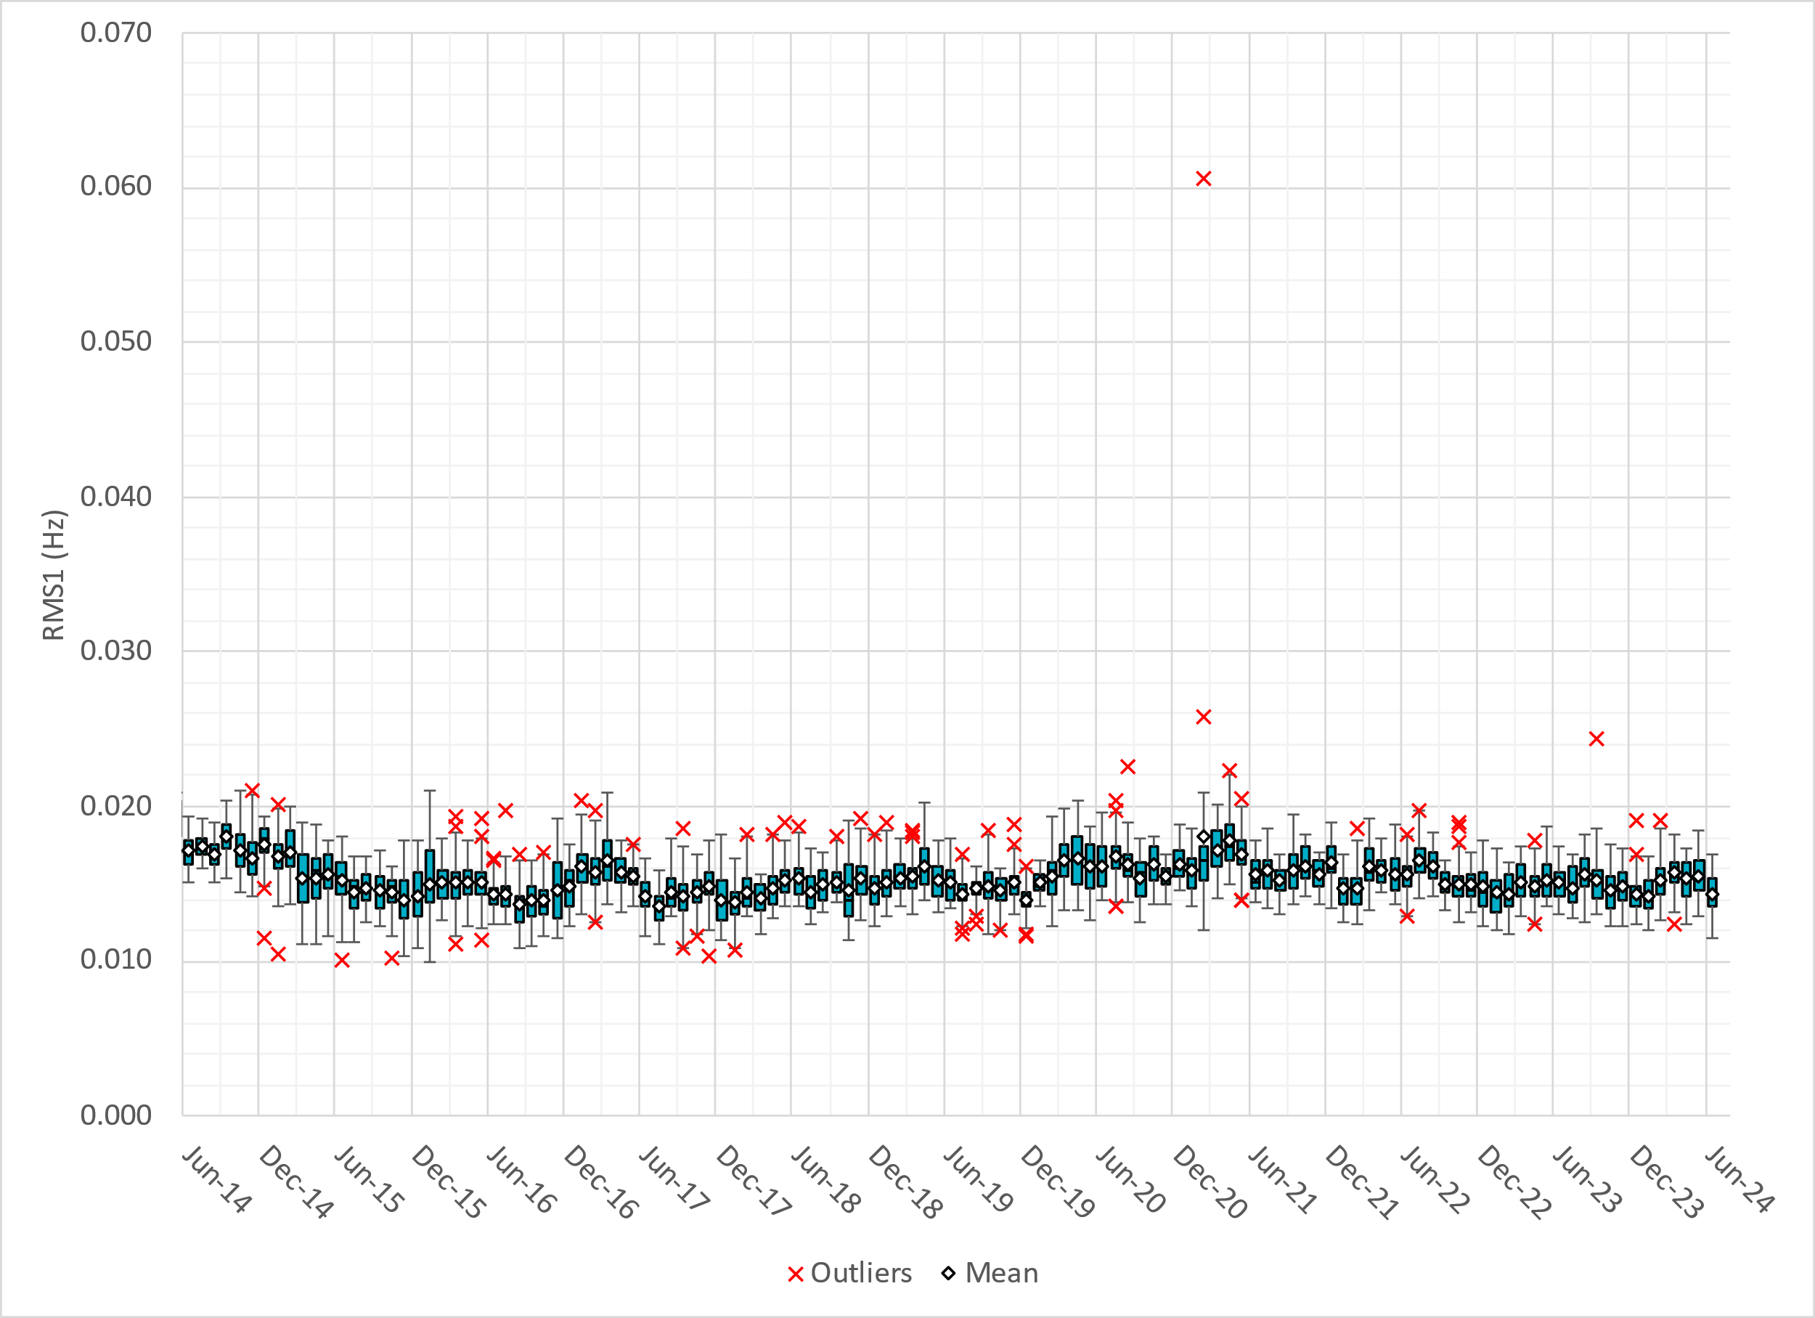
RMS1 Performance of ERCOT Frequency
Notes:
14.28 mHz on avg for June 2024

Slide 9
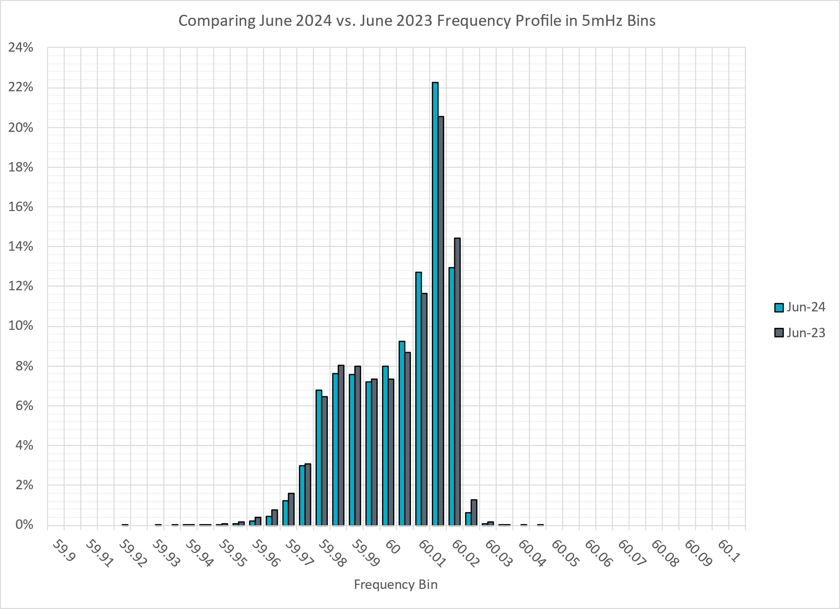
Frequency Profile Analysis

Slide 10
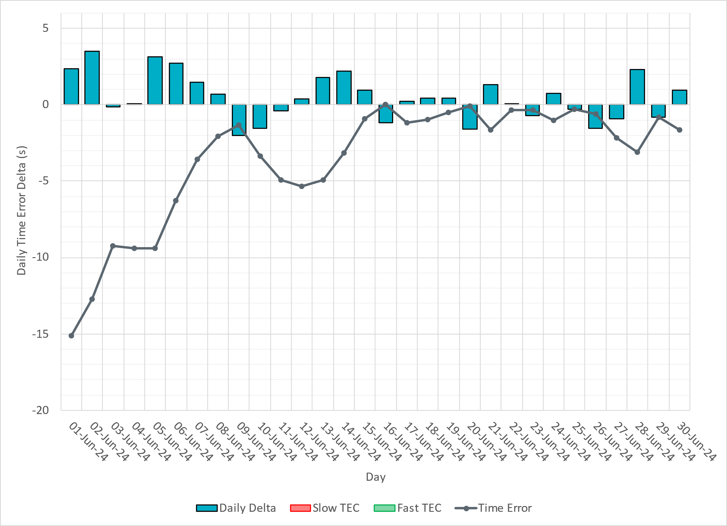
Time Error Corrections
Notes:
Time error toward the beginning of the month was due to abnormal loading conditions and weather patterns which contributed to forecasted errors. ERCOT increased the ACE integral feedback to adjust time error.

Slide 11
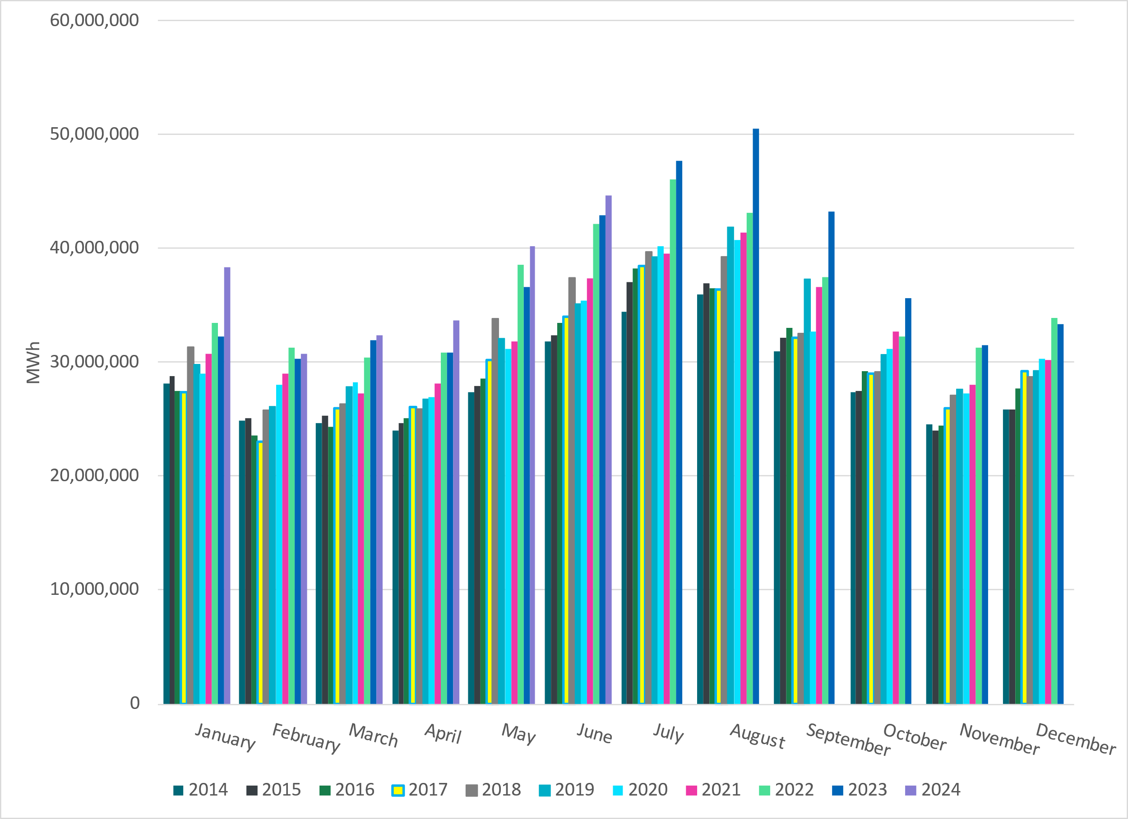
ERCOT Total Energy
Notes:
44,675,848 MWh

Slide 12
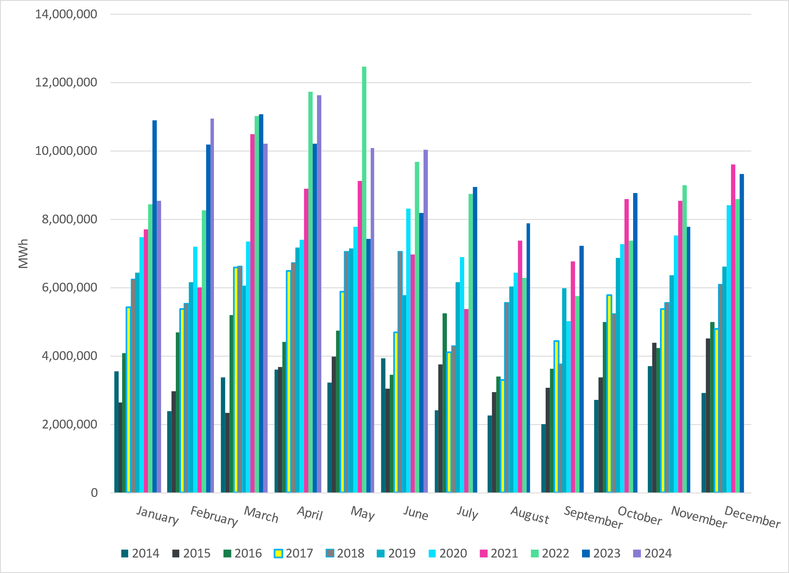
ERCOT Total Energy from Wind Generation
Notes:
10,029,421 MWH

Slide 13
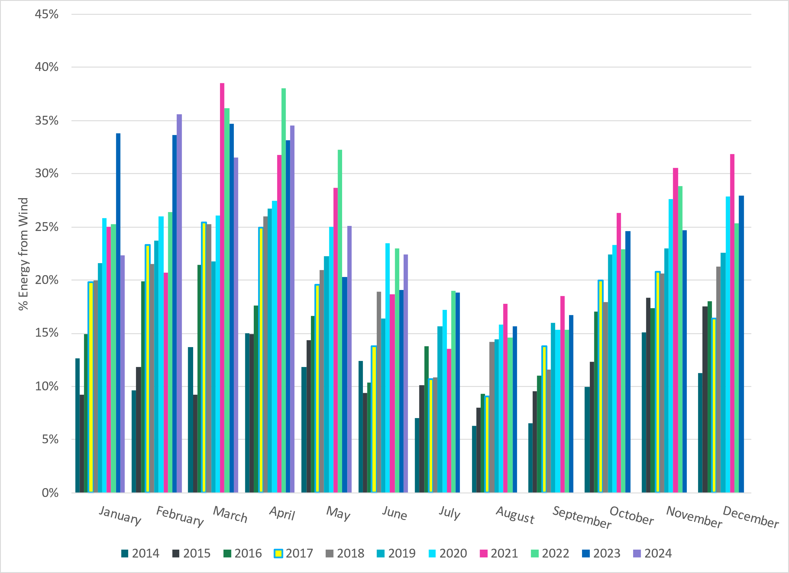
ERCOT % Energy from Wind Generation
Notes:
22.45% of total energy was provided by wind generation

Slide 14
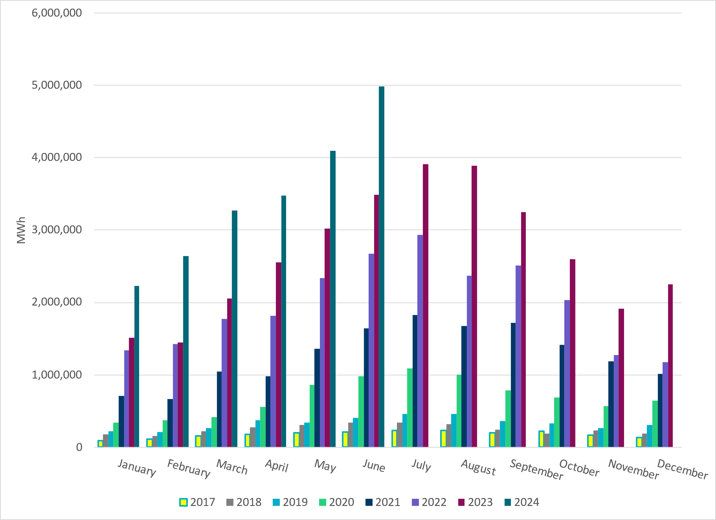
ERCOT Total Energy from Solar Generation
Notes:
4,979,491 MWh

Slide 15
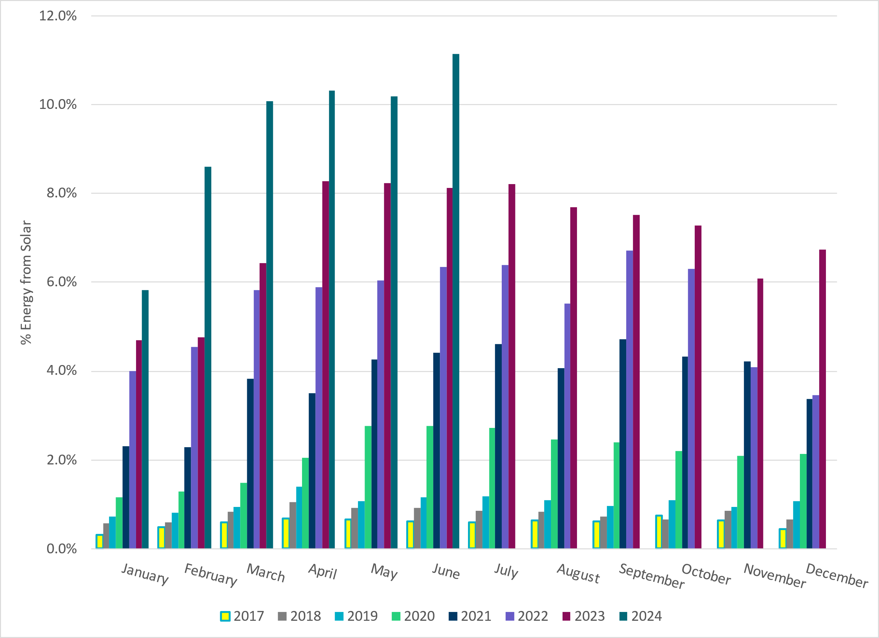
ERCOT % Energy from Solar Generation
Notes:
11.15% of total energy was provided by solar generation

Slide 16
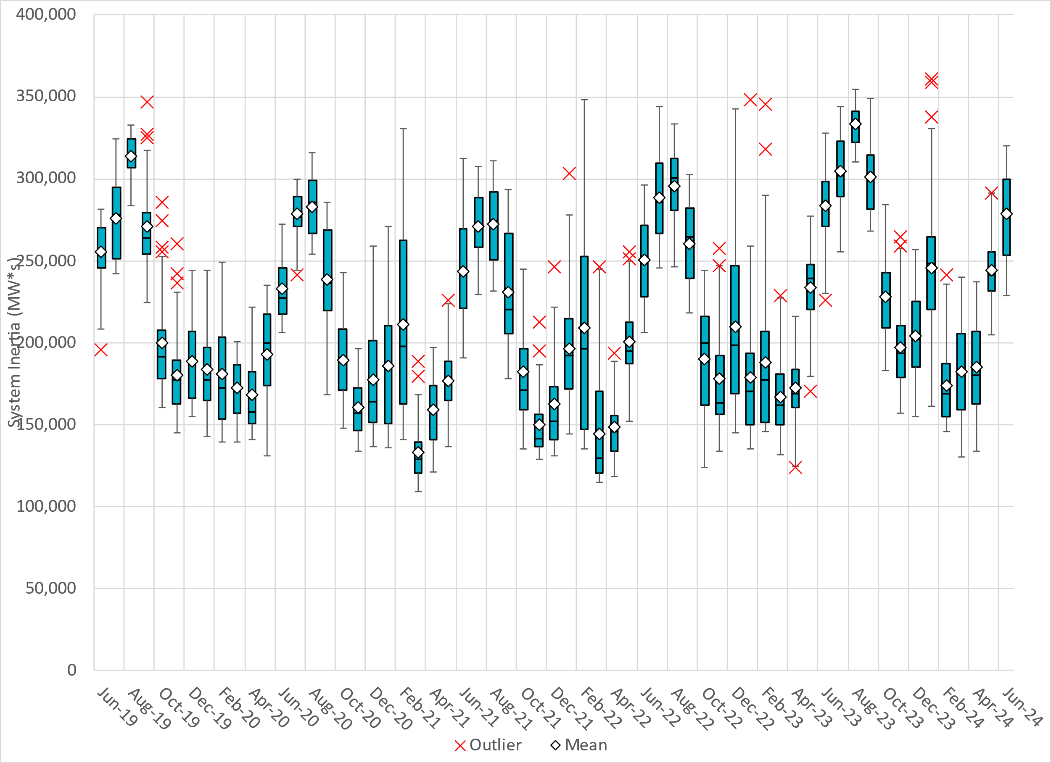
ERCOT Daily Minimum System Inertia
Notes:
Minimum Inertia in June 2024 = 228,743 MW*s on June 18th
Historical Overall Minimum was 109,029 MW*s on 3/22/2021
June Data:
Mean: 278,647 MW*s
Max: 320,334 MW*s on June 27th
Min: 228,743 MW*s on June 18th

Slide 17
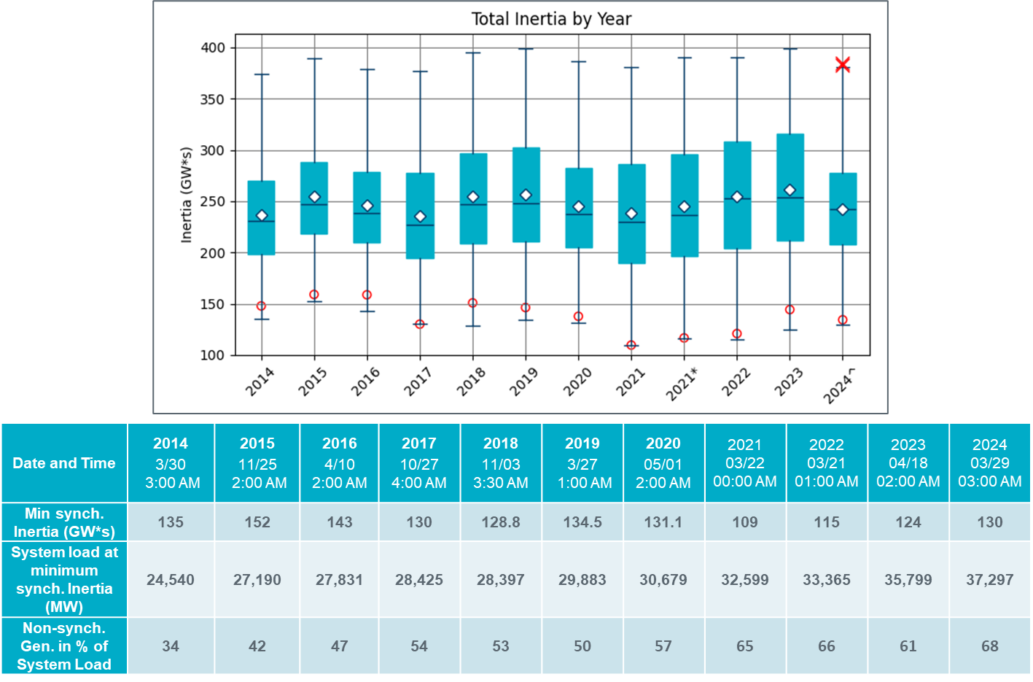
ERCOT Inertia Trend
Notes:
Summary of ERCOT intertia for the previous 10 years. Lowest inertia this year was on March 29th.
For each box, the central mark (red line) is the median, the edges of the box (in blue) are the 25th and 75th percentiles, the whiskers correspond to +/- 2.7 sigma (i.e., represent 99.3% coverage, assuming the data are normally distributed. The corresponding lowest inertia in each year is given in the table.
The circle on each boxplot is showing inertia during time when highest portion of load was served by wind/solar generation in that year.

