Slide 1
Credit Finance Sub Group Update to the Technical Advisory Committee
Brenden Sager, Austin Energy, Chair
Loretto Martin, NRG, Vice Chair
31 July 2023

Slide 2
General Update
  July 24 CFSG meeting
  Voting matters
    Operational NPRR’s without credit impacts
  Discussion items
    EAL Change Proposals from DC Energy and ERCOT
    NPRR1205, Revisions to Credit Qualification Requirements of Banks and Insurance Companies
    For awareness, brief mention of PCM proposal and next steps
  Regular credit exposure updates

Slide 3
NPRR1205, Revisions to Credit Qualification Requirements of Banks and Insurance Companies
NPRR1205 introduces the following changes as it relates to LC issuing banks:
Establish minimum rating threshold of A-/A3 rating from all available rating agencies (instead of at least one)
Use the “lower of” rule to different ratings within the same rating agency and amongst rating agencies
Define the bank ratings as follows (if available): Long term issuer rating, long term senior unsecured or Long Term Counterparty Risk Assessment (for Moody’s).
Require US Branch/office to have an acceptable rating on its own by at least one of the rating agencies. Use US Branch rating as the issuing bank rating, if the ratings are available.

Slide 4
NPRR1205, Revisions to Credit Qualification Requirements of Banks and Insurance Companies
Approved by PUC in July 2024
Letter of Credit limits doubled by rating tranche
There will be six banks as of November will not meet updated requirements
ERCOT Credit will be sending out market notices in September
Up to seven market CP’s affected
Question from Beverly Loew on whether changes were too stringent relative to standards of the derivatives industry
Members noted these terms are market standard in negotiated ISDA’s and other bilateral energy trading contracts

Slide 5
NPRR1205, Revisions to Credit Qualification Requirements of Banks and Insurance Companies

Slide 6
Estimate Aggregate Liability / Collateral req’t
  Current:
    EAL q = Max [IEL during the first 40-day period only beginning on the date that the Counter-Party commences activity in ERCOT markets,
    RFAF * Max {RTLE during the previous lrq days}, RTLF] +
    DFAF * DALE +
    Max [RTLCNS, Max {URTA during the previous lrq days}] + OUT q + ILE q
  Weighted ratio of forward North Hub prices over Settlement prices
    That is, higher forwards over lower settlements results in a FAF > 1.0
  Simplified formula: RFAF x Max 40-day RT invoice history
  RT/DA invoices not netted and there are separate RFAF and DFAF
    RFAF more prominent in EAL calculation, applied to max value of Real Time daily history (lookback)

Slide 7
DC Energy Proposal on Estimate Aggregate Liability changes for ERCOT credit postings
DC Energy is concerned that substantially larger “double top” spikes than have been shown in the backtests can be reasonably expected to occur
The sequence of events driving such an outcome are an extreme volatility event (e.g., heat wave or cold snap) followed by a period of normalcy and then even just the forecast of a second extreme volatility event that drives futures (ICE) prices up in anticipation
This could result in EAL requirements for the market that are many multiples above what has been modeled (and importantly, well above what is needed)
We propose including a hypothetical stress test in ERCOT EAL backtests that include two winter storms over a short period
Example: running the EAL calculations as if February 2021 (Uri) was followed by January 2024

Slide 8
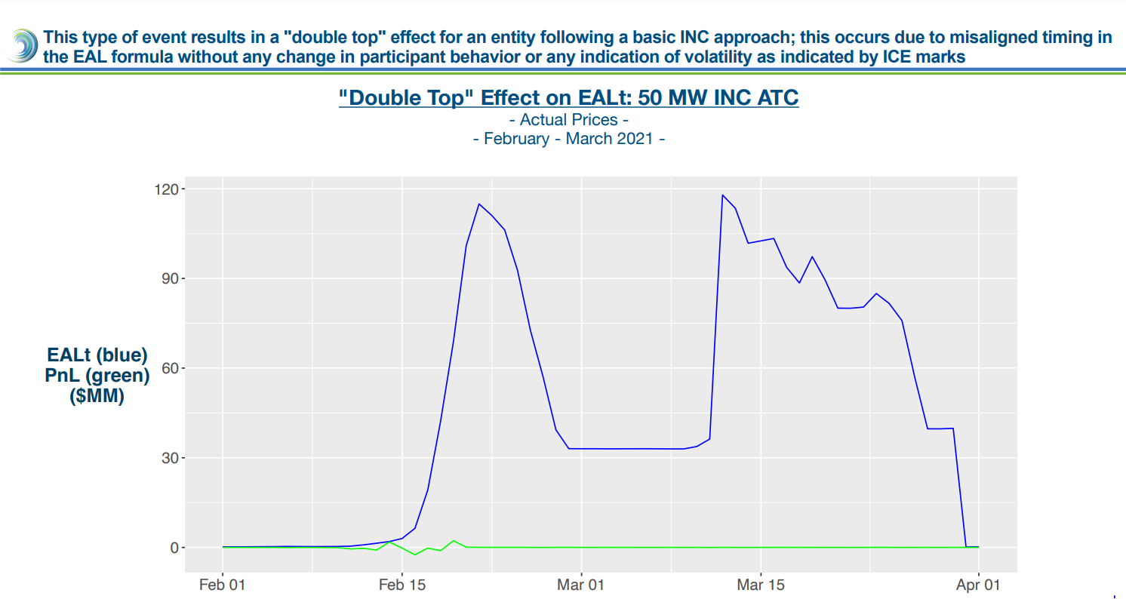

Slide 9
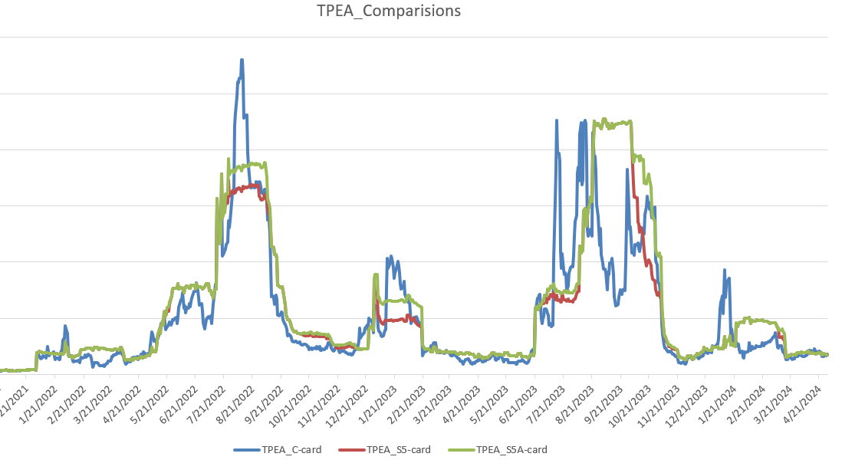
Sample CP – TPEA comparison
S5a resolves the “double top” issue discussed in prior meetings.
It provides more stable or less volatile measurement of exposures tracking actual invoice exposures more closely. RFAF in the existing framework is more volatile and is applied against MaxRTLE while S5a is applying FAF against NLE with a cap and a floor.
Overall, S5a provides slightly higher coverage relative to the existing methodology.
One of the main advantages of S5a is capturing DAM exposures and having a look back period (Scenarios #4 and #5 are further refinements of Scenario #1).

Slide 10
Negative and Positive Gaps: Market
S5a significantly decreases the negative gap events while increasing positive gaps. However, it is noted that the extent of the increase in positive gap $s and occurrences is not as much as in S4.

Slide 11
FAF Data Summary
min | 0.01 | 2/7/2018
max | 10.61 | 4/9/2024
N | 2254
FAF | obs > | N-tile | Wgt Avg > FAF level
2 | 117 | 0.90 | 4.215
2.5 | 45 | 0.95 | 5.425
3.25 | 11 | 0.97 | 5.819
5.25 | 4 | 0.99 | 8.119

Slide 12
PCM Next Steps
Stakeholders provided feedback over the last 2 months, which concluded in a PUCT public workshop last Thursday (after CFSG).
Now ERCOT is working with E3 to draft the white paper with the evaluation of the different potential design decisions, which should inform what PUCT Commissioners and Staff decide on in terms of the PCM design that will be utilized for the cost-benefit analysis that ERCOT and the IMM have until the end of the year to perform.
  From David Delgado at E3 Consultants

Slide 13
NPRR’s Reviewed
NPRR1221, Related to NOGRR262, Provisions for Operator-Controlled Manual Load Shed.
NPRR1231, FFSS Program Communication Improvements and Additional Clarifications.
NPRR1233, Modification of Weatherization Inspection Fees on the ERCOT Fee Schedule.
NPRR1236, RTC+B Modifications to RUC Capacity Short Calculations.
NPRR1219, Methodology Revisions and New Definitions for the Report on Capacity, Demand and Reserves in the ERCOT Region (CDR).
NPRR1217, Remove VDI Requirement for Deployment and Recall of Load Resources and ERS Resources.
NPRR1224, ECRS Manual Deployment Triggers.
NPRR1227, Related to RMGRR181, Alignment of Defined Term Usage and Resolution of Inconsistencies.

Slide 14
Monthly Highlights May 2024 - June 2024
Market-wide average Total Potential Exposure (TPE) increased from $1.82 billion in May 2024 to $2.18 billion in June 2024.
TPE increased due to higher forward adjustment factors
Discretionary Collateral is defined as Secured Collateral in excess of TPE,CRR Locked ACL and DAM Exposure
Average Discretionary Collateral increased from $3.88 billion in May 2024 to $4.23 billion in June 2024
No unusual collateral call activity

Slide 15
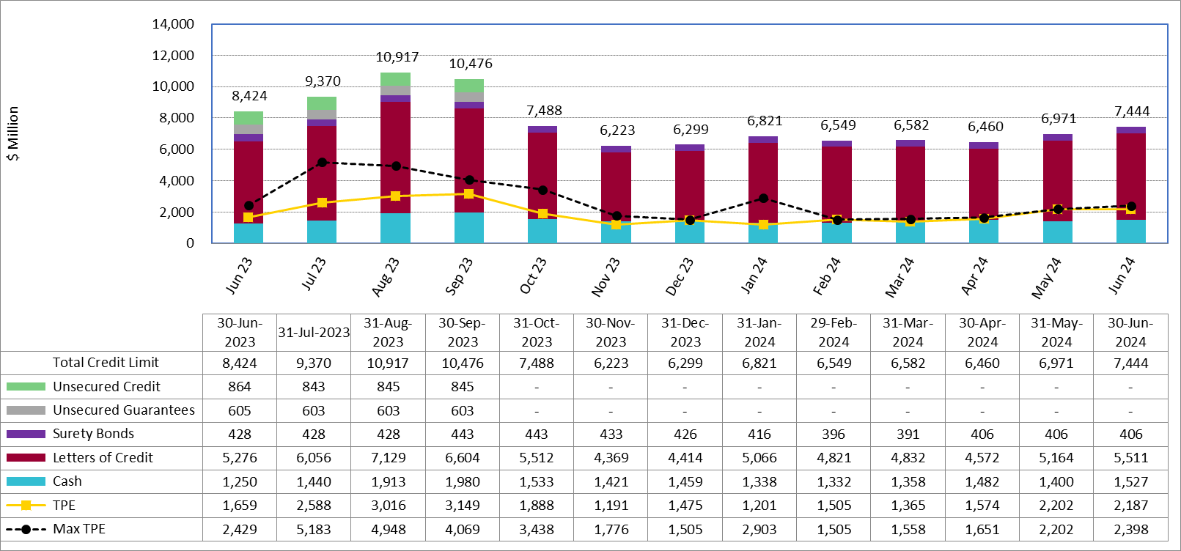
Available Credit by Type Compared to Total Potential Exposure (TPE) YTD June 2024

Slide 16
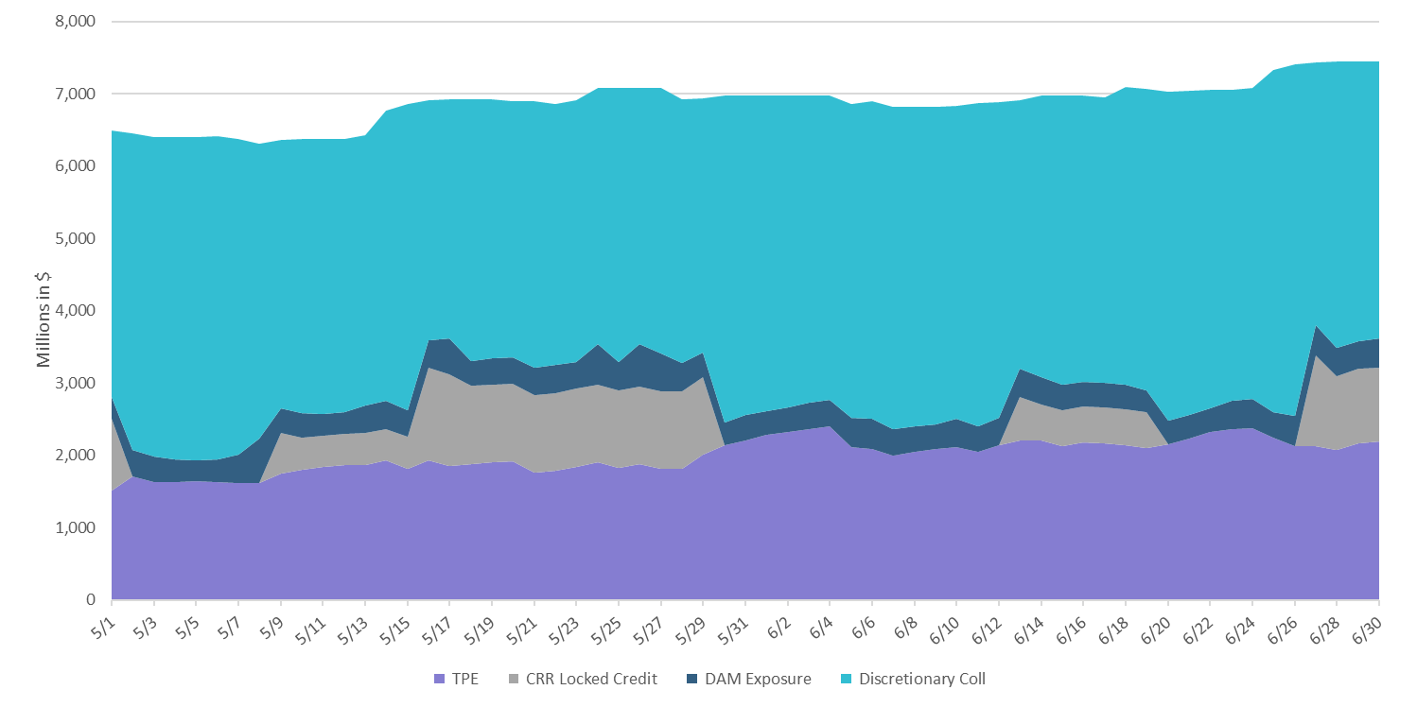
Discretionary Collateral May-June 2024

Slide 17

Questions?

