Slide 1
NPRR1058 Resource Offer Modernization
July 25, 2024

Slide 2
NPRR1058 – Resource Offer Modernization
Objectives
  Allow all Resources to update their offers in Real-Time to reflect their current costs.
    For any Operating Hour, a QSE
      may submit or change Energy Offer Curve for a Resource
      may submit or change RTM Energy Bid
    The QSE can provide a freeform reason (to address IMM’s comments included in its 12/21/2020 comments) if EOC submitted after the end of the Adjustment Period
    For the percentages FIP and FOP within an EOC, submissions and updates must be received by ERCOT in the Adjustment Period
  Changes will be in
    XSD
      posted on the ERCOT XSDs page, and
      Posted on the Developer Portal at https://github.com/ercot/api-specs/tree/ews_nprr_1058_updates/ews)
    Market Manager UI
    Backward compatible
Project is in Execution Phase
  Testing in progress
  Go live – August 22, 2024
MOTE Testing Expectations
  Changes will be available in MOTE for MPs testing – planned for 08/02/2024
  Perform submission of Energy Offer Curve and RTM Energy Bid up to Real Time
    Market Manager UI
    API

Slide 3
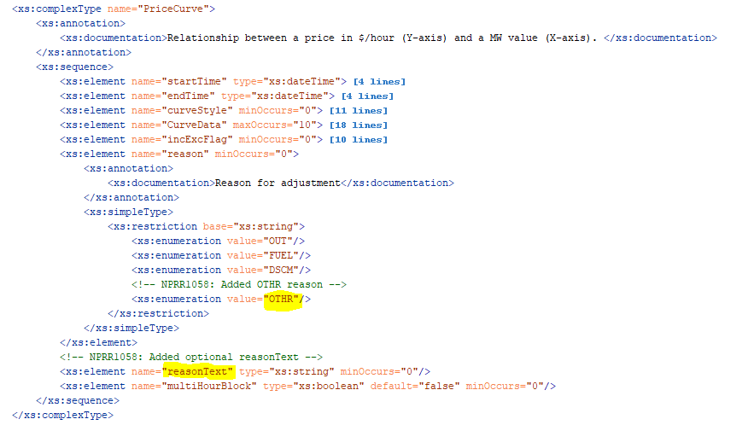
NPRR1058 – Resource Offer Modernization
XSD Changes

Slide 4
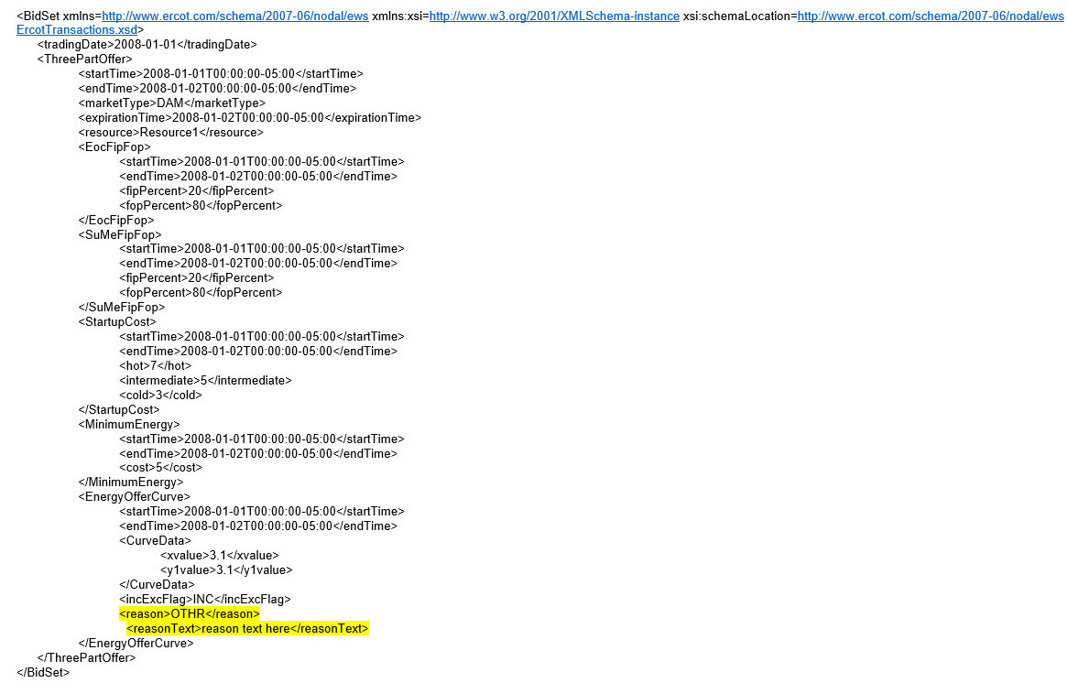
NPRR1058 – Resource Offer Modernization
XSD Changes – A Sample

Slide 5
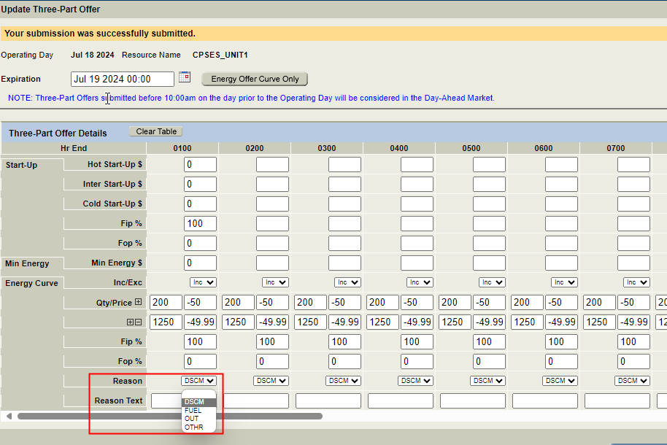
NPRR1058 – Resource Offer Modernization
MMS UI Changes

Slide 6
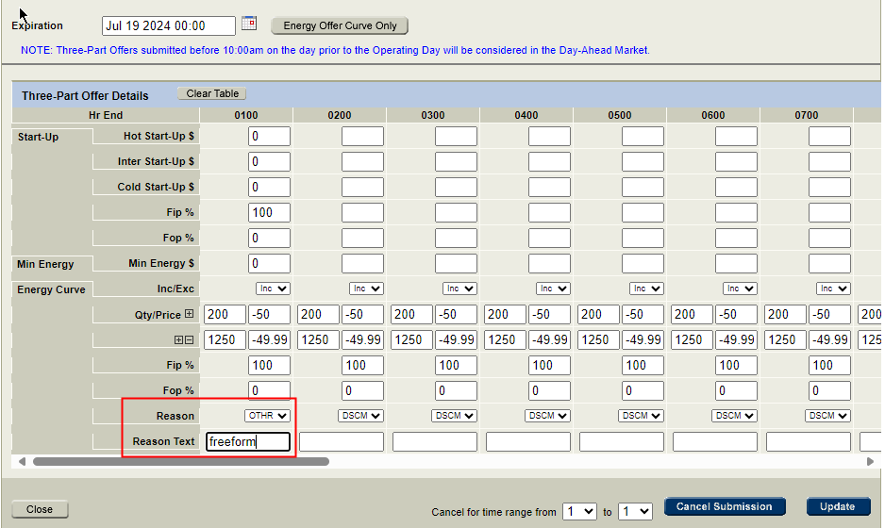
NPRR1058 – Resource Offer Modernization
MMS UI Changes

