Slide 1
NDCRC – Automatic Tracing and Unit Tests
Sreenivas Badri/Nick Barbas
July 25, 2024

Slide 2
NDCRC – Automatic Tracing and Unit Tests
Project is in execution phase
Soft launch in production set for July 25, 2024
Email format request is still supported while market acclimates to using the web form
Looking at implementing platform feasible improvements to the submission form and process that are requested by both ERCOT and market users in the interim

Slide 3
NDCRC – Automatic Tracing and Unit Tests
Transition Plan
07/25/2024 - NDCRC changes will be deployed into Production. This is a soft launch to help QSEs get acclimatized with NDCRC display changes and start planning for testing.
08/01/2024 - 08/31/2024 - QSEs Testing window. QSEs can submit test requests into NDCRC. At the end of the testing phase, test data requests will be deleted from NDCRC system.
During this testing phase, QSEs are expected to utilize respective RE digital certificates to submit the unit test.
ERCOT is developing a plan to allow QSEs directly access NDCRC new displays built for this effort without needing to use RE certificates. Tentative roll out date of this change is R8 release (08/22/2024).
09/01/2024 - 09/30/2024 - Window of parallel Operation of current email process and new NDCRC process. QSEs are requested to submit unit test requests using either current email process or NDCRC UI. Control Room will be approving Unit test requests during this window based on whichever process is used by QSEs for parallel operation. This will alleviate the burden on QSEs having to submit requests through both current and new process.
10/01/2024 - Cutover to use NDCRC exclusively.

Slide 4
NDCRC – Automatic Tracing and Unit Tests
Changes to NDCRC UI since last demo
Only combined cycle configurations shown in drop down, not individual units
MW value field is freeform text entry to support need to provide approximations
Coordinated versions of reactive test are now supported and don’t need to be treated as special case
Form provides 3 attachment slots
Request can be cancelled by submitter, even after approval, if it’s no longer needed
All parties receive email notifications for submission and approval/rejection events by default

Slide 5
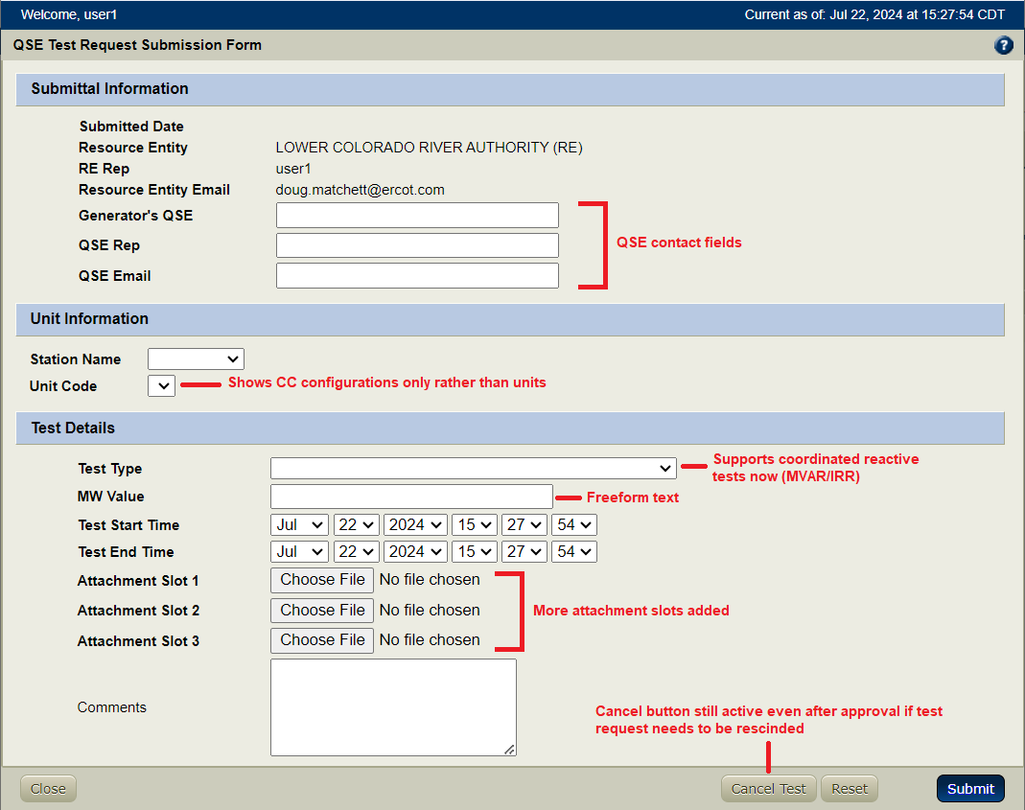
NDCRC – Automatic Tracing and Unit Tests
Form changes in first release

Slide 6
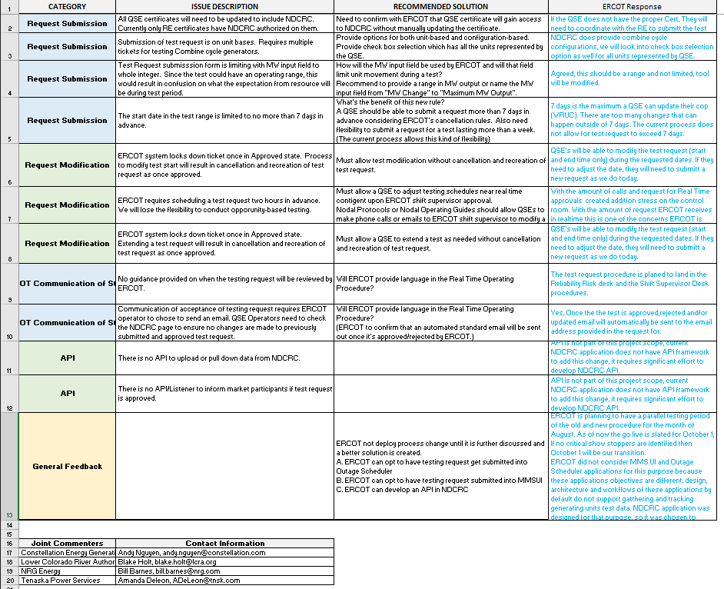
NDCRC – Automatic Tracing and Unit Tests - Comments/Feedback from QSEs

