Slide 1
ERCOT Technology Working Group (TWG)
July 25, 2024

Slide 2
ERCOT TWG
WELCOME

Slide 3
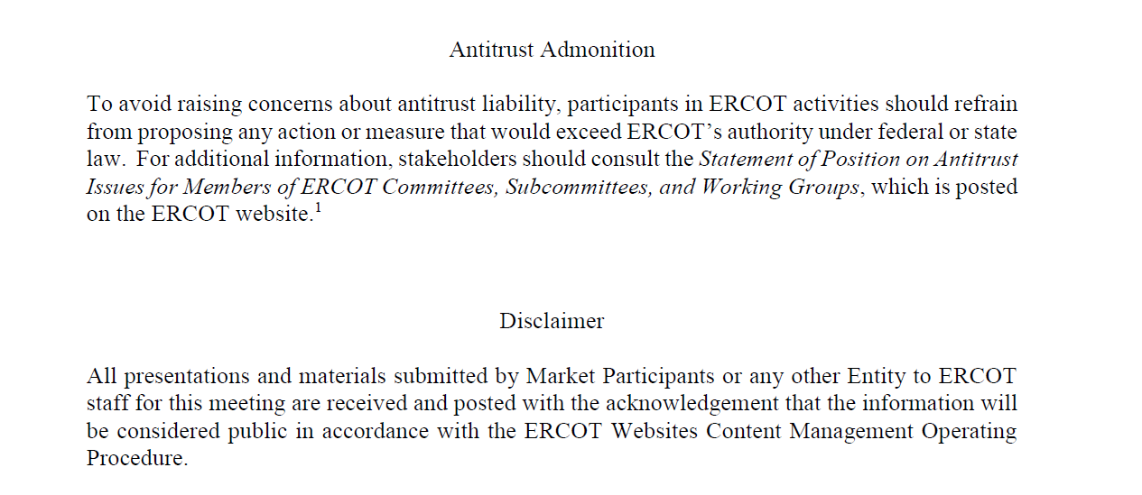
ERCOT TWG

Slide 4
ERCOT TWG Agenda
Item # | Item Description | Presenter | Start Time
1 | Antitrust admonition | Blake Holt (LCRA) | 2:00 PM
2 | Project Updates | Troy Anderson | 2:05 PM
3 | RTC+B Updates | Matt Mereness | 2:10 PM
4 | NPRR1058 Project Update | Katherine Li | 2:20 PM
5 | Other Projects/Initiatives updates |  | 2:30 PM
 | RIOO ESR Project Update | Andy Adams
 | Secure API Pilot Update | Brian Brandaw
 | Data Access Portal and public API Demo | Omar Soberanis/Ajay Mannepalli
6 | NDCRC - Generating Unit Tests and Automatic Tracing Project update | Sreenivas Badri/Nick Barbas | 3:10 PM
7 | Generating Units Testing Submission in other Markets | Constellation | 3:30 PM
8 | Round Table Discussion & Future Topics of Interest | Blake Holt (LCRA) | 3:45 PM
9 | Adjourn | Blake Holt (LCRA) | 4:00 PM

Slide 5
Project Updates
Project Updates – Troy Anderson

Slide 6
RTC+B Updates
RTC+B Updates – Matt Mereness

Slide 7
NPRR1058 Project Update
NPRR1058 Project Update – Katherine Li

Slide 8
Other Projects/Initiatives Status Updates
RIOO ESR Project Update – Andy Adams
Secure API Pilot Update – Brian Brandaw
Data Access Portal and public API Demo –
Omar Soberanis/Ajay Mannepalli

Slide 9
NDCRC - Generating Unit Tests and Automatic Tracing Project
NDCRC - Generating Unit Tests and Automatic Tracing Project Updates – Sreenivas Badri/Nick Barbas

Slide 10
Generating Units Test Submissions in other Markets
Generating Units Test Submissions in other Markets – Constellation

Slide 11
ERCOT TWG – Round Table Discussion
ERCOT TWG – Round Table Discussion – Blake Holt (LCRA)
  Future Topics of Interest
  Topics and presentations from TWG members

Slide 12
ERCOT TWG
Thank You
You can reach Sreenivas at
Sreenivas.Badri@ercot.com and Blake at Blake.Holt@LCRA.ORG

